Slide 1
Europe and the World: New Encounters, 1500–1800
Chapter 14

Slide 2
Focus Questions
​Why did Europeans begin to embark on voyages of discovery and expansion at the end of the fifteenth century?
​How did Portugal and Spain acquire their overseas empires, and how did their empires differ?
​How did the arrival of the Dutch, British, and French on the world scene in the seventeenth and eighteenth centuries affect Africa, Southeast Asia, India, China, and Japan? What were the main features of the African slave trade, and what effects did it have on Africa?
​How did European expansion affect both the conquered and the conquerors?
​What was mercantilism, and what was its relationship to colonial empires?

Slide 3
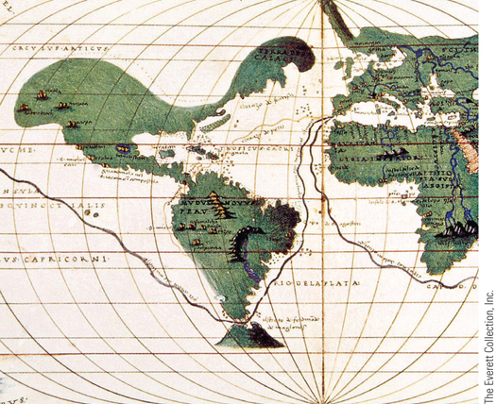
A 1536 Mercator projection map showing the route of Ferdinand Magellan’s first circumnavigation of the world
p399
Notes:
A 1536 Mercator projection map showing the route of Ferdinand Magellan’s
first circumnavigation of the world

Slide 4
On the Brink of a New World
The Motives for Expansion
Fantastic lands
The Travels of John Mandeville (14th century)
Economic motives
Access to the East
The Polos (Marco Polo’s Travels)
Religious Zeal
The Means for Expansion
Maps
Ptolemy’s Geography (1477, available in print)
Ships and sailing
Navigational aids and enhanced knowledge
Could build ships to sail against the wind
Compass and astrolabe
Knowledge of wind patterns

Slide 5
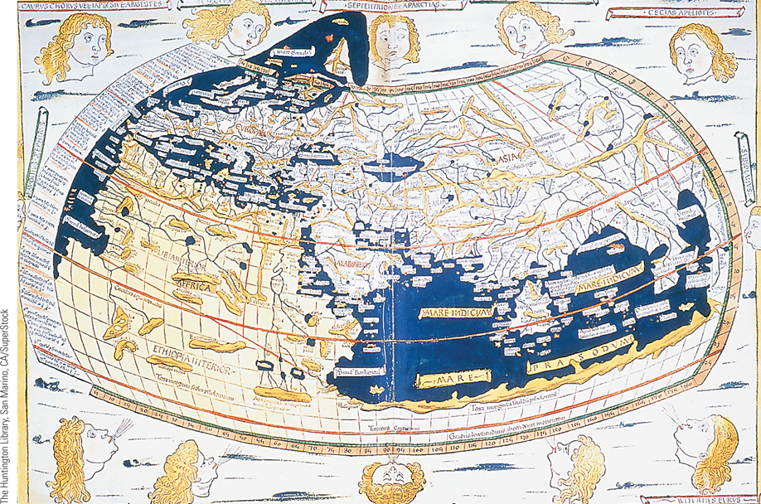
Ptolemy’s World Map
Contained in the Latin translation of Ptolemy’s Geography was this world map,
which did not become available to Europeans until the late 1400s.
p402
Notes:
Ptolemy’s World Map. Contained in the Latin translation of Ptolemy’s Geography was this world map,
which did not become available to Europeans until the late 1400s. Scholars quickly accepted it as the most
accurate map of its time. The twelve ‘‘wind faces,’’ meant to show wind currents around the earth, were a
fifteenth-century addition to the ancient map.

Slide 6
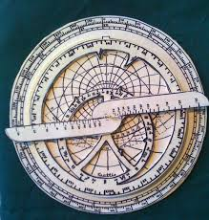
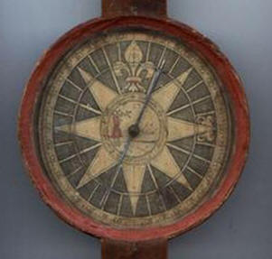
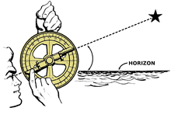

Slide 7
New Horizons: The Portuguese and Spanish Empires
The Development of a Portuguese Maritime Empire
Prince Henry the Navigator (1394 – 1460)
The Portuguese in India
Bartholomeu Dias and Vasco da Gama
Viceroys
Alfonso d’Albuquerque (c. 1462 – 1515)
Slaughter of the Arabs of Malacca
Commercial – military bases
In search of spices
Reasons for Portuguese Success
Guns and seamanship

Slide 8
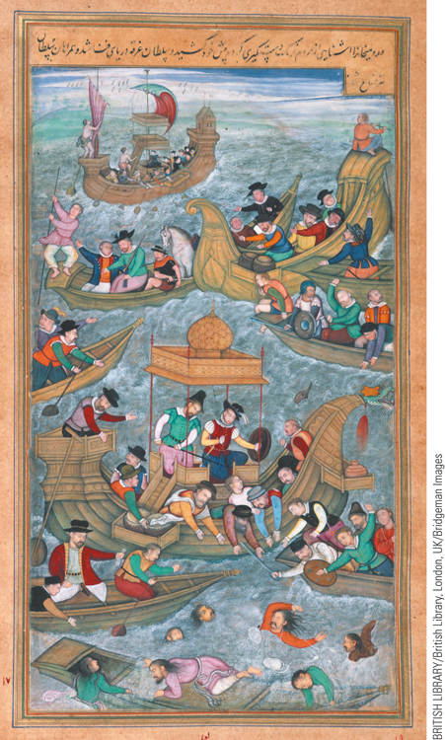
Portuguese in India
The Portuguese continued their exploration of India after gaining control of Goa in 1509 by moving northwards into the territory of Gujarat.
p403
Notes:
Portuguese in India. (p.403)
The Portuguese continued their exploration of India after gaining control of Goa in 1509 by moving northwards into the territory of Gujarat. This painting by a Mughal artist portrays the killing of Bahadur Shah, leader of the Gujarat sultanate, by a Portuguese convoy in 1537 after Bahadur Shah had formed an alliance with the Portuguese in an attempt to regain control of his sultanate after it was conquered by the Mughals.

Slide 9
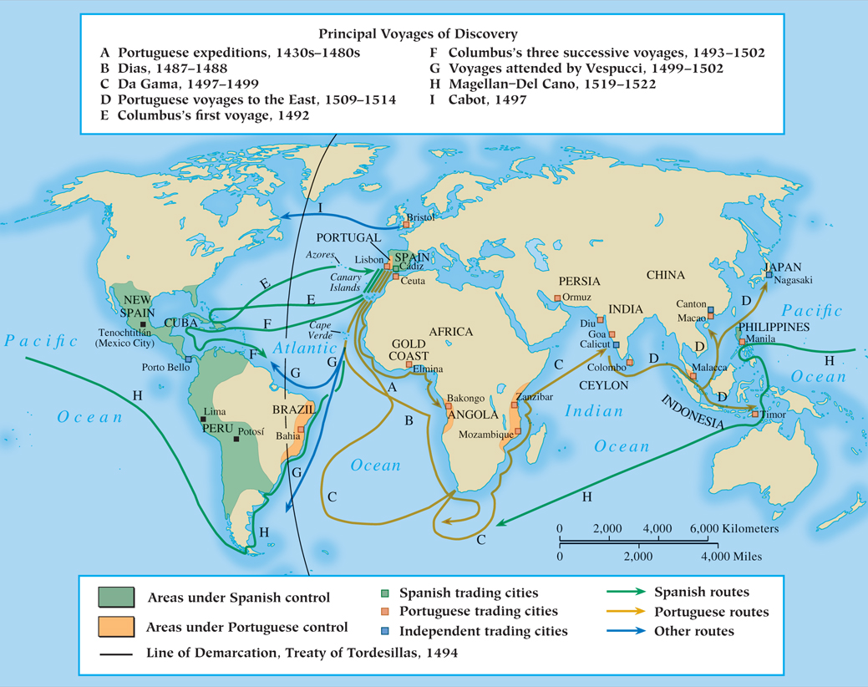
MAP 14.1 Discoveries and Possessions in the Fifteenth and Sixteenth Centuries
Map 14.1 p404
Notes:
MAP 14.1 Discoveries and Possessions in the Fifteenth and Sixteenth Centuries. Desire for
wealth was the main motivation of the early explorers, though spreading Christianity was also an
important factor. Portugal under Prince Henry the Navigator initiated the first voyages in the early
fifteenth century; Spain’s explorations began at the century’s end.

Slide 10
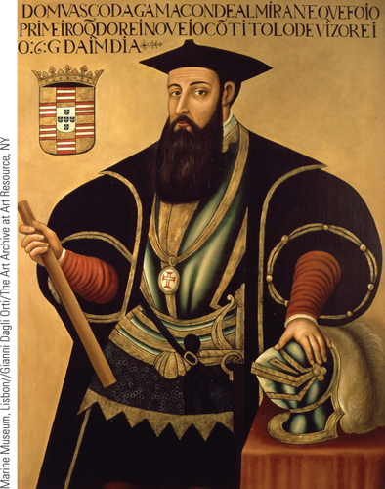
Spices and World Trade (Slide 1 of 3)
Vasco da Gama’s success in locating a route to the East by sailing around Africa shifted much of the control over the spice trade into Portuguese hands. The illustration shows a portrait of da Gama from ca. 1600.
p405
Notes:
Spices and World Trade

Slide 11
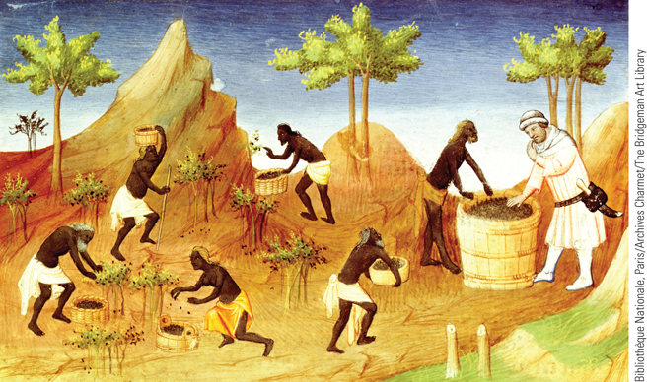
Spices and World Trade (Slide 2 of 3)
The illustration is from a fifteenth-century French manuscript shows pepper being harvested in Malabar, in southwestern India.
p405
Notes:
Spices and World Trade

Slide 12
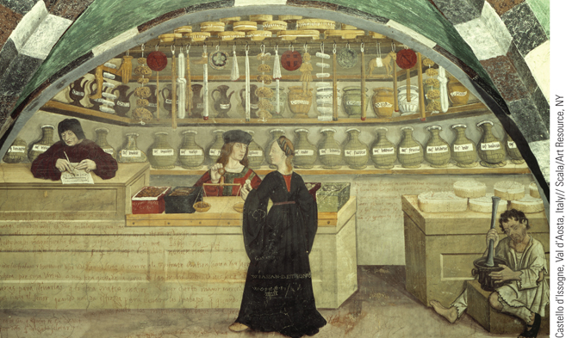
Spices and World Trade (Slide 3 of 3)
The Venetians had played a dominant role in the spice trade via Constantinople, as is evident in the Venetian fresco shown.
p405
Notes:
Spices and World Trade

Slide 13
Voyages to the New World
The Voyages of Christopher Columbus (1451 – 1506)
Spanish financing to sail west to reach Asia
Reached the Bahamas (Oct. 12, 1492)
Additional voyages (1493, 1498, and 1502)
New Voyages
John Cabot- New England
Pedro Cabral- South America
Amerigo Vespucci- American geography
Vasco Nunez de Balboa- Panama, Pacific Ocean
Ferdinand Magellan (1480 – 1521)
Circumnavigation (died in the Philippines)
Treaty of Tordesillas (1494)- Pope Alexander VI, then Julius II divides non-European world between Spain and Portugal.

Slide 14
The Treaty of Tordesillas (1494)
*Not strictly enforced

Slide 15
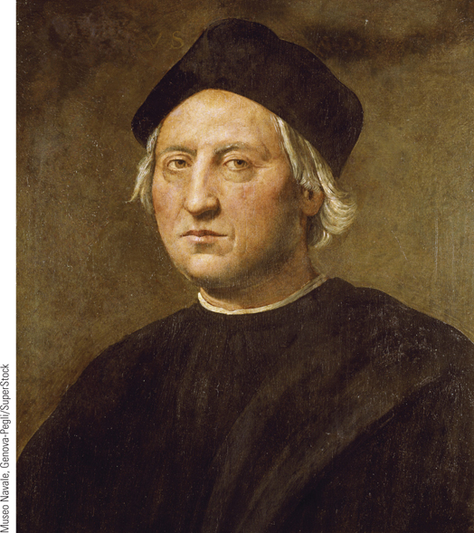
Christopher Columbus
Columbus was an Italian explorer who
worked for the queen of Spain.
p406
Notes:
Christopher Columbus. Columbus was an Italian explorer who
worked for the queen of Spain. He has become a symbol for two
entirely different perspectives. To some, he was a great and heroic
explorer who discovered the New World; to others, especially in Latin
America, he was responsible for beginning a process of invasion that led
to the destruction of an entire way of life. Because Columbus was never
painted during his lifetime, the numerous portraits of him are more
fanciful than accurate. The portrait shown here was probably done by
the Italian painter Ridolfo Ghirlandaio.

Slide 16
CHRONOLOGY The Portuguese and Spanish Empires in the Sixteenth Century
Event | Dates
Bartholomeu Dias sails around the tip of Africa | 1488
The voyages of Columbus | 1492–1502
Treaty of Tordesillas | 1494
Vasco da Gama lands at Calicut in India | 1498
Portuguese seize Malacca | 1511
Landing of Portuguese ships in southern China | 1514
Magellan’s voyage around the world | 1519–1522
Spanish conquest of Mexico | 1519–1522
Pizarro’s conquest of the Inca | 1530–1535
p406
Notes:
CHRONOLOGY The Portuguese and Spanish Empires
in the Sixteenth Century

Slide 17
The Spanish Empire in the New World
The Role of the Conquistadors
Motivated by “God, Glory and Gold”
Early Civilizations in Mesoamerica
The Maya
Yucatan Peninsula
Sophisticated calendar
Accomplished artists
The Aztecs
Tenochtitlán
By 1500, 80,000-200,000 inhabitants
Outstanding warriors
Loose political organization

Slide 18
The Spanish Empire in the New World
Spanish Conquest of the Aztec Empire
Hernan Cortés (1485 – 1547)
Moctezuma (Montezuma)
The Inca
The leadership and conquests of Pachakuti
Administration, buildings, and roads
Spanish Conquest of the Inca Empire
Francisco Pizarro (c. 1475 – 1541)
The devastations of smallpox and Spanish weapons

Slide 19
The Spanish Empire in the New World
Administration of the Spanish Empire
Recreated urban cities of Spain
Santo Domingo (1501) first Spanish city.
Encomienda and impact:
A formal grant from Spain of the right to the labor of a specific number of Natives.
It was supposed to mimic European slavery, but was really just slavery and brutality.
The mit’a system in Peru (Inca empire)- mandatory public service from all men for public works projects.
But the Spanish adopted it for their purposes- mining.
Abuses were horrible, and “debt slavery” meant they never went home.

Slide 20
The Spanish Empire in the New World
Viceroys and audiencias
Spanish governors, representatives of the Spanish Crown in America, aided by their advisory groups.
The church
Building of missions, schools, cathedrals, hospitals
Converting Natives to Catholicism
The Spanish Inquisition
Disease in the New World
Sweeping epidemics of Old World disease
High mortality rates and labor shortages
Led to mass importing of African slaves to work plantations.

Slide 21
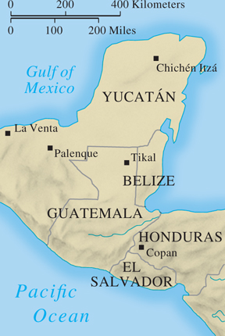
The Maya
p408
Notes:
The Maya

Slide 22
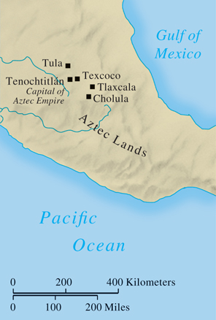
The Aztecs
p408
Notes:
The Aztecs

Slide 23
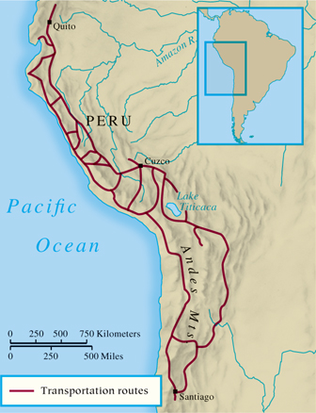
The Inca
p408
Notes:
The Inca

Slide 24
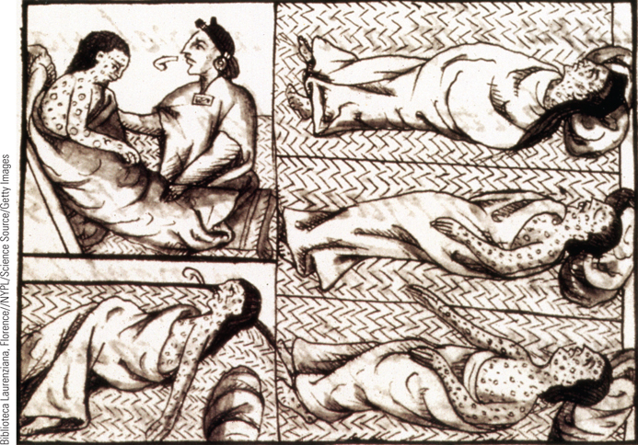
Aztec Victims of Smallpox
The indigenous populations of the New World had no immunities to the diseases of the Old World, such as smallpox. By 1520, smallpox had spread
throughout the Caribbean and Mesoamerica.
p412
Notes:
Aztec Victims of Smallpox. The indigenous populations of the New World had no
immunities to the diseases of the Old World, such as smallpox. By 1520, smallpox had spread
throughout the Caribbean and Mesoamerica. This sixteenth-century drawing by a Franciscan friar
portrays Native Americans afflicted with smallpox. The pustules that often covered the body are
clearly depicted. The figure at the lower right twists in agony, reflecting the immense pain
experienced by those who contracted the disease.

Slide 25
New Rivals on the World Stage
Africa: the Slave Trade
Origins of the slave trade
Cane sugar, plantations, and slavery
Growth of the slave trade
Triangular trade
Up to 10,000,000 African slaves taken to the Americas between the sixteenth and nineteenth centuries
High death rate during the Middle Passage
Conduct of the slave trade
Prisoners of war from Africa
Depopulation of African kingdoms as slave raiders moved farther inland.
Role of African middle men

Slide 26
Africa: The Slave Trade
Effects of slave trade
Overall 10 million people were stolen from Africa.
Limited criticism of slavery- some religious/intellectual groups denounced it.
Increased warfare and violence in Africa
Economic effect on Africa: cheap goods imported from Europe led to death of African industry → poverty.

Slide 27
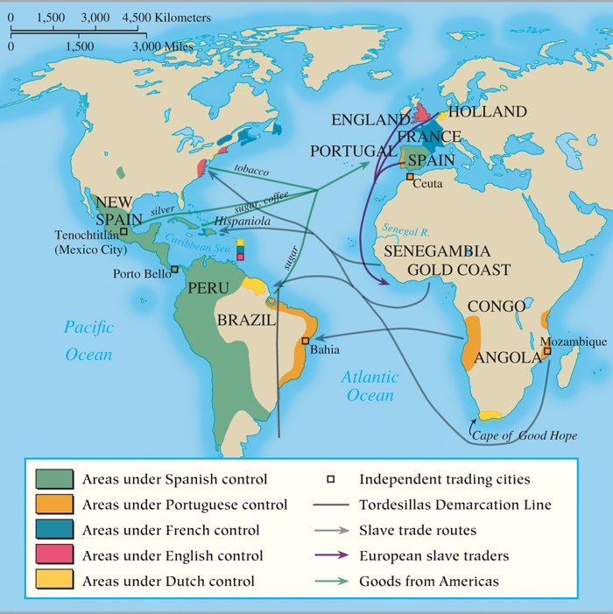
MAP 14.2 Triangular Trade Route in the Atlantic Economy
Map 14.2 p413
Notes:
MAP 14.2 Triangular Trade Route in the
Atlantic Economy. As the trade in slaves
grew, it became part of the triangular trade
route that characterized the Atlantic
economy, involving the exchange of goods
and slaves between the western coast of
Europe, the slave depots on the African
coast, and the ports of North and South
America.

Slide 28
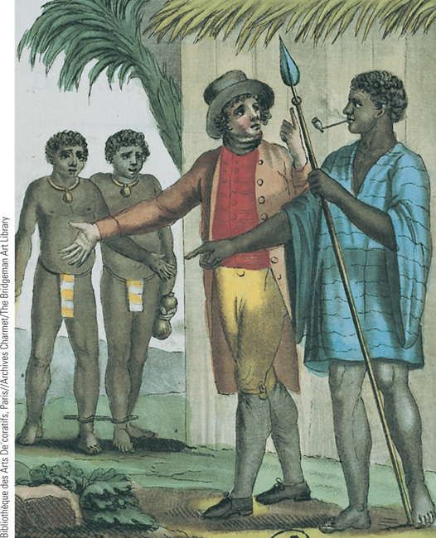
The Sale of Slaves
In the eighteenth century, the slave trade was a highly profitable commercial enterprise. This painting shows a Western slave merchant negotiating with a local African leader over slaves at Gore´e, Senegal, in West Africa.
p415
Notes:
The Sale of Slaves. In the eighteenth century, the slave trade was a
highly profitable commercial enterprise. This painting shows a Western
slave merchant negotiating with a local African leader over slaves at
Gore´e, Senegal, in West Africa in the late eighteenth century.

Slide 29
The West in Southeast Asia
European and Native Rivals
Portugal
The limits of empire
Spain
The importance of the Philippines
The Dutch and the English gain ground
Dutch consolidation of economic, political, and military control.
The Spice Islands: Moluccas, Ceylon (Sri Lanka), Java Island (Jakarta), Sumatra.
The strength of mainland kingdoms in Burma (Myanmar), Thailand, and Vietnam
Goods not as profitable as the Spice Islands

Slide 30
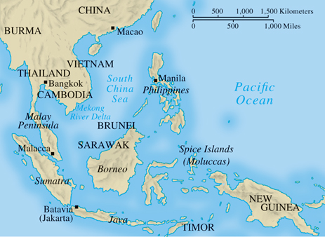
Southeast Asia, c. 1700
p416
Notes:
Southeast Asia, c. 1700

Slide 31
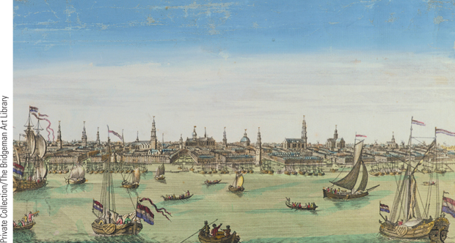
Europe in Asia
As Europeans began to move into parts of Asia, they reproduced many of the physical surroundings of their homeland in the port cities they built there.
p416
Notes:
Europe in Asia. As Europeans began to move into parts of
Asia, they reproduced many of the physical surroundings of
their homeland in the port cities they built there. The scene is from a sixteenth-century engraving of
Amsterdam. This Dutch city had become the financial and
commercial capital of Europe. It was also the chief port for
the ships of the Dutch East India Company, which brought
the spices of the East to Europe.

Slide 32
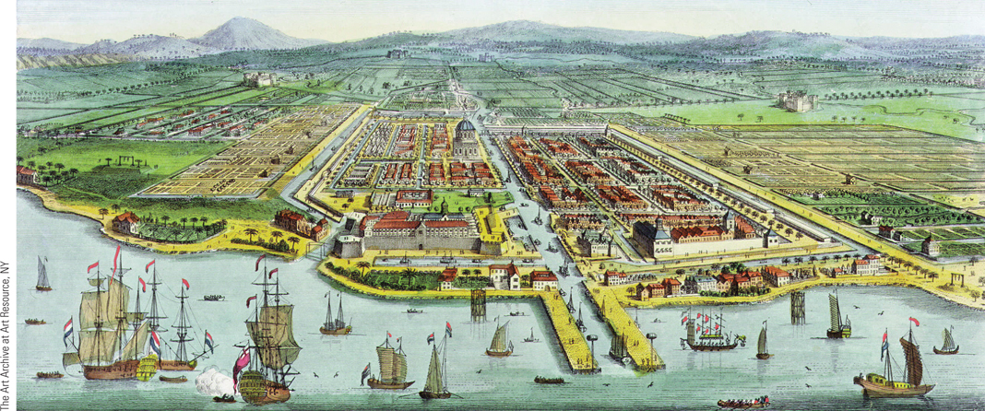
Europe in Asia
This is a seventeenth-century view of Batavia, which the Dutch built as their headquarters on the northern coast of Java in 1619.
p416
Notes:
Europe in Asia. As Europeans began to move into parts of
Asia, they reproduced many of the physical surroundings of
their homeland in the port cities they built there. Pictured is a
seventeenth-century view of Batavia, which the Dutch built
as their headquarters on the northern coast of Java in 1619.

Slide 33
The French and British in India
The Mughal Empire
Babur (1483–1530)
Akbar (1556–1605)
Collapsed by mid-17th century; power vacuum
The Impact of the Western Powers
The decline of Portugal’s dominance
The increasing presence of the English
Dutch and French competition
Sir Robert Clive and the expansion of the East India Company (The Seven Years War)
The “Black Hole of Calcutta”
Battle of Plassey (1757)
Forced withdrawal of the French
India was “colonized” by a corporation, not a country.

Slide 34
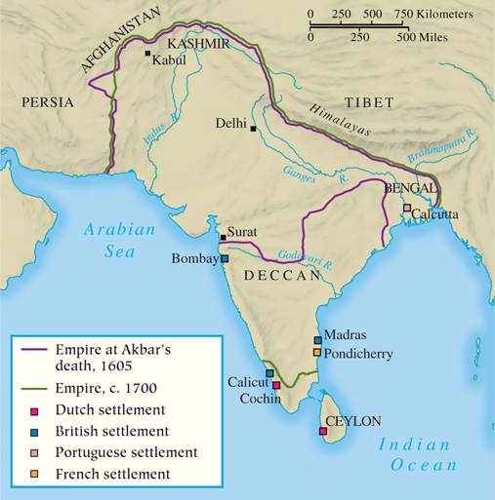
The Mughal Empire
p418
Notes:
The Mughal Empire

Slide 35
China & Japan
China
The Ming and Qing dynasties
Dynastic shift (1644) and the greatness of Manchu China
Western inroads
Imperial decline and European pressures
Qing attempts to control trade
The English had one trade port at Canton, but tried to harshly limit the foreigners it allowed in.
English frustration with China will lead to coercion- via Opium (more on that later)
Japan
Shogun Tokugawa Ieyasu (1543 – 1616)
Opening to the West
Initial traders and missionaries welcomed
Reactions against Westerners
Expulsion of missionaries and merchants

Slide 36
China & Japan
Japan
Shogun Tokugawa Ieyasu (1543 – 1616)
Feudal Japan was a military state: limited wealth, prestige of the samurai.
Opening to the West
Initial traders and missionaries welcomed
Reactions against Westerners
Jesuit Portuguese missionaries were highly influential
Expulsion of missionaries and merchants
The Dutch were allowed one port- and they did not bring missionaries.

Slide 37
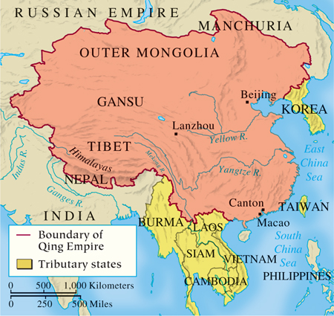
The Qing Empire
p419
Notes:
The Qing Empire

Slide 38
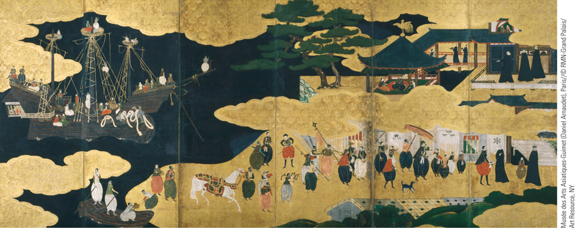
The Portuguese Arriving at Nagasaki
Portuguese traders landed accidentally in Japan in 1543. In a few years, they arrived regularly, taking part in a regional trade network involving Japan, China, and Southeast Asia.
p421
Notes:
The Portuguese Arriving at Nagasaki. Portuguese traders landed accidentally in Japan in 1543. In a
few years, they arrived regularly, taking part in a regional trade network involving Japan, China, and
Southeast Asia. In these panels, done in black lacquer and gold leaf, we see a late-sixteenth-century
Japanese interpretation of the first Portuguese landing at Nagasaki.

Slide 39
The Americas
The West Indies
The British and French “sugar factories”
Brazil: sugar plantations
British North America
The Dutch and the New Netherlands (New York)
Henry Hudson
The English
Jamestown (1607)- The Virginia Company
Religious freedom and economic interests
Control of the eastern seaboard
The thirteen colonies and their roles
Balance of trade was designed to benefit England.

Slide 40
The Americas
French North America
St. Lawrence River Valley and Quebec
By 1663- property of the French king, run as a trading area.
Furs, leather, fish, timber
Not as well-populated by the French- they are too busy fighting in Europe.
Rivalries with Britain in Canada and Latin America

Slide 41
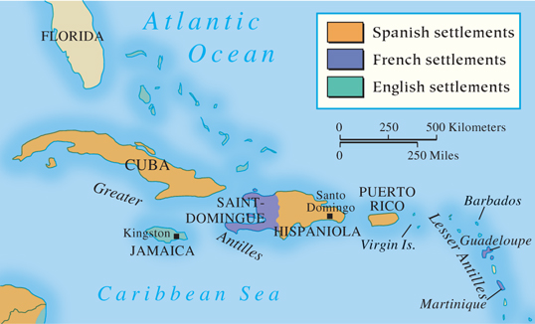
The West Indies
p421
Notes:
The West Indies

Slide 42
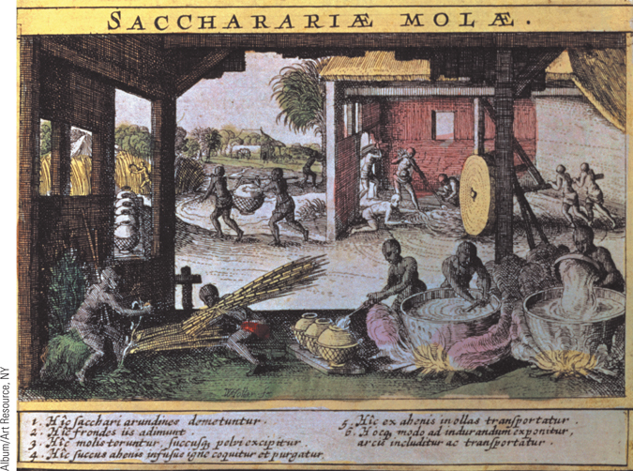
A Sugar Mill in the West Indies
Cane sugar was one of the most valuable products produced in the West Indies. By 1700, sugar was replacing honey as a sweetener for increasing numbers of Europeans.
p422
Notes:
A Sugar Mill in the West Indies. (p.422)
Cane sugar was one of the most valuable products produced in the West Indies. By 1700, sugar was replacing honey as a sweetener for increasing numbers of Europeans. This seventeenth-century French illustration shows the operation of a sugar mill in the French West Indies.

Slide 43
CHRONOLOGY New Rivals on the World Stage
Event | Dates
Portuguese traders land in Japan | 1543
British East India Company formed | 1600
Dutch East India Company formed | 1602
English settlement at Jamestown | 1607
Champlain establishes settlement at Quebec | 1608
Dutch fort established at Batavia | 1619
Dutch seize Malacca from the Portuguese | 1641
English seize New Netherland | 1664
English establish trading post at Canton | 1699
Battle of Plassey | 1757
French cede Canada to British | 1763
British mission to China | 1793
p422
Notes:
CHRONOLOGY New Rivals on the World Stage

Slide 44
The Impact of European Expansion
The Conquered
Diverse effects
Devastating effects to local populations in America and Africa
Less impact in Asia
Creation of a multiracial society in Latin America
Ecology: livestock and crops
Catholic Missionaries
Conversion of native populations
Hospitals, orphanages, and schools
The Jesuits in Asia
Conversions in China
Japan

Slide 45
The Impact of European Expansion
The Conquerors
Opportunities for men and women
Economic effects
Gold, silver, and a price revolution
Plants and animals: the Columbian Exchange
Impact on European lifestyle
Chocolate, coffee, and tea
Deepening European rivalries
New views of the world
Gerardus Mercator (1512 – 1594) and his map
Psychological impact

Slide 46
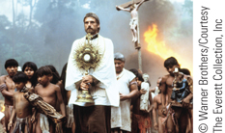
Film & History: The Mission
The Jesuit missionary Father Gabriel (Jeremy Irons) with the Guaraní Indians of Paraguay before their slaughter by Portuguese troops.
p424
Notes:
The Jesuit missionary Father Gabriel (Jeremy Irons) with the Guaraní Indians of
Paraguay before their slaughter by Portuguese troops.

Slide 47
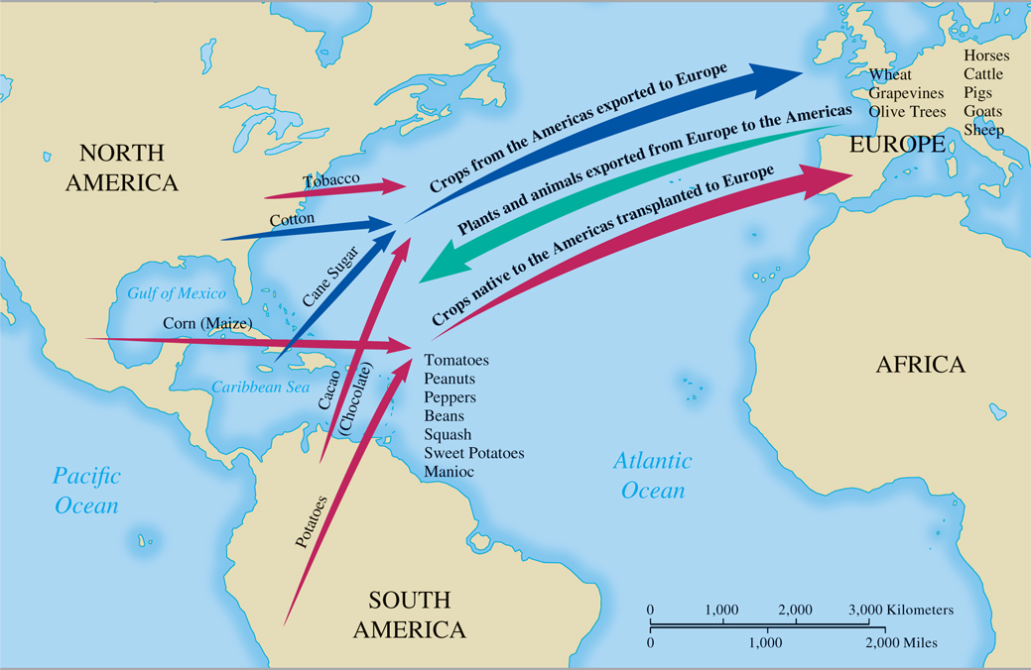
MAP 14.3 The Columbian Exchange
Map 14.3 p426
Notes:
MAP 14.3 The Columbian Exchange. In addition to their diseases, which killed vast numbers of
indigenous inhabitants of the Americas, Europeans transplanted many of their crops and domestic
animals to the New World. Europeans also imported plants from the New World that improved food
production and nutrition in Europe.

Slide 48
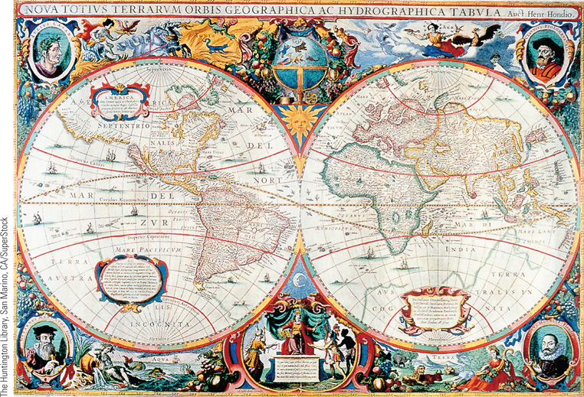
A Seventeenth-Century World Map
This beautiful world map was prepared in 1630 by Henricus Hondius.
p427
Notes:
A Seventeenth-Century World
Map. This beautiful world map was
prepared in 1630 by Henricus Hondius.
The four portraits are of Caesar, the
Roman statesman; Ptolemy, the secondcentury
astronomer; Mercator, the
Flemish cartographer whose map
projection Hondius followed; and
Hondius himself. By comparing this
map with the map created by Ptolemy
on p. 406, one can see how much
Europeans had learned about the shape
of the world by the seventeenth century.

Slide 49
Toward a World Economy
Economic Conditions in the Sixteenth Century
The causes and consequences of inflation
The Growth of Commercial Capitalism
Joint-stock trading companies
New economic institutions
The Bank of Amsterdam (1609)
Amsterdam Bourse (Exchange)
Continuing dependence on agriculture

Slide 50
Toward a World Economy
Mercantilism
Chief beliefs and practices
Total volume of trade unchangeable
There is a certain set amount of wealth in the world, and states must compete for it.
A “zero-sum” game
Importance of bullion and favorable balance of trade
Government control of economy
Overseas Trade and Colonies: Movement toward Globalization
The value of transoceanic trade
Intra-European trade
Trade patterns interlocked Europe, Africa, the East, and the Americas

Slide 51
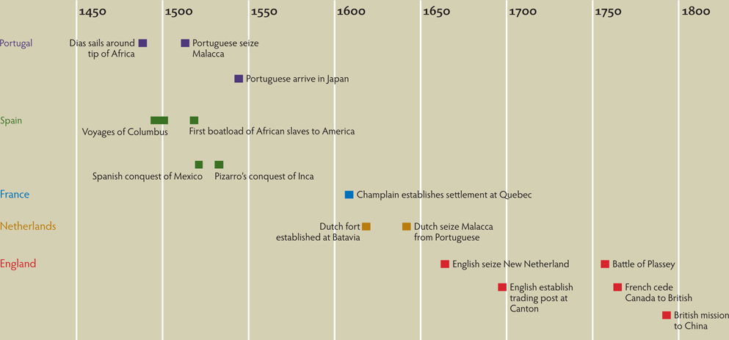
Chapter Timeline
p429

Slide 52
Discussion Questions
Why were the Western European nations so well positioned for overseas exploration?
How were the Spanish able to defeat the Aztecs?
What social and economic forces drove the slave trade?
How were the British able to achieve such a dominant position in Asia?
What impact did European colonization have on the colonized?
What economic changes occurred in Europe as a result of mercantilism and capitalism?

