Slide 1
Reaction, Revolution, and Romanticism,
1815–1850
Chapter 21

Slide 2
Focus Questions
​What were the goals of the Congress of Vienna and the Concert of Europe, and how successful were they in achieving those goals?
​What were the main tenets of conservatism, liberalism, nationalism, and utopian socialism, and what role did each ideology play in Europe in the first half of the nineteenth century?
​What forces for change were present in France, Great Britain, Belgium, Poland, and Italy between 1830 and 1848, and how did each nation respond? What were the causes of the revolutions of 1848, and why did the revolutions fail?
​How did European states respond to the increase in crime in the late eighteenth and early nineteenth centuries?
​What were the characteristics of Romanticism, and how were they reflected in literature, art, and music?

Slide 3
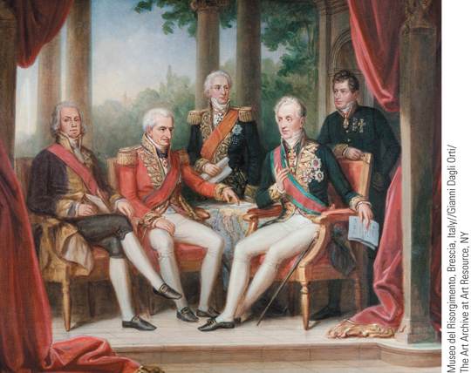
A gathering of statesmen at the Congress of Vienna
p620
Notes:
A gathering of statesmen at the Congress of Vienna

Slide 4
The Conservative Order
The Peace Settlement
  Congress of Vienna: Sep. 1814 - June 1815
    Prince Klemens von Metternich (1773 – 1859)
  The principle of legitimacy
    Restoring hereditary monarchs to thrones
    Variations in the restoration of traditional powers
    Bourbon kings returned to France and Spain
    But no king was restored to Poland- why??
    Some Italian states had kings restored, but northern provinces given to Austria

Slide 5
The Conservative Order
A new balance of power:
  Defensive barriers against France
    German states of Prussia, Westphalia, Saxony, and Rhine river were combined into one big state.
    Germanic Confederation is created to replace Napoleon’s Confederation of the Rhine.
    The Dutch Republic and Belgium (Austrian Netherlands) were combined into one large state: The Netherlands. Run by Dutch Protestant King (Orange)
    But Belgium is Catholic and speaks Flemish & French.
    **During this time, Napoleon escaped from Elba and was defeated at Waterloo.**
    French were punished for “enthusiastic” response- borders shrunk and military occupation for 5 years.

Slide 6
The Conservative Order
The Ideology of Conservatism
  Influences: Edmund Burke, Reflections on the Revolution of France (1790)
    Obedience to political and religious authorities
    Rejection of revolution and liberal demands influenced largely by mob violence of French Revolution.
    “Society is a contract… not only between those who are living, but between those who are living, whose who are dead, and those who are yet to be born.”
      No generation has the “right” to destroy this partnership.
      Sudden change and overthrow is bad.
      Some change is good, but must be gradual.

Slide 7
The Conservative Order
Beliefs of conservatives:
  Obedience to political authority
  Organized religion is necessary for order
  Against revolutionary upheaval
  Against constitutional gov, demands for civil rights, and nationalistic aspirations.
  The “community” is more important than the individual
  Society must be ordered and organized.
  Traditions are important.
Landowning aristocracy, monarchs, bureaucracies, church (both Protestant and Catholic)

Slide 8
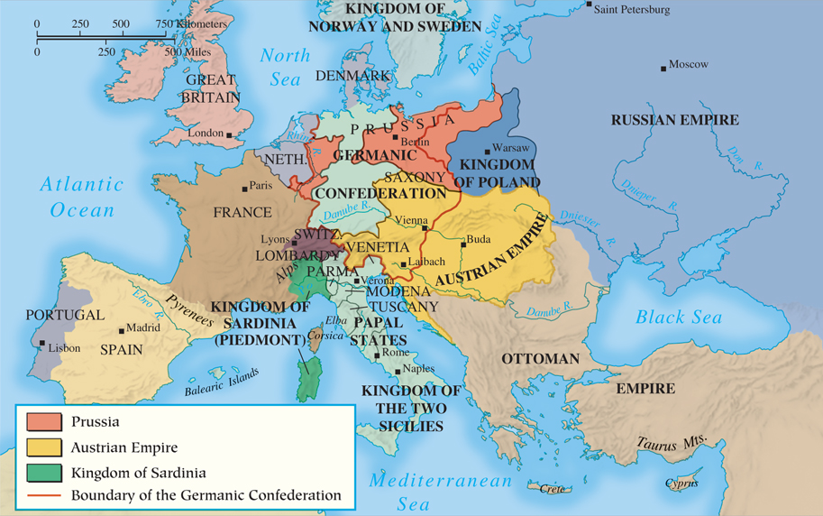
MAP 21.1 Europe After the Congress of Vienna, 1815
Map 21.1 p622
Notes:
MAP 21.1 Europe After the Congress of Vienna, 1815. The Congress of Vienna imposed order on
Europe based on the principles of monarchical government and a balance of power. Monarchs were
restored in France, Spain, and other states recently under Napoleon’s control, and much territory
changed hands, often at the expense of the smaller, weaker states.

Slide 9
Conservative Domination: the Concert of Europe
  More Congresses: the Quadruple Alliance
  Created to conserve the status quo and “police Europe” to prevent revolution.
    Metternich: “When France sneezes, Europe catches cold.”
  1818 Treaty of Aix-La-Chapelle: “Pretty Little Congress”- France is added to the Alliance.
  1820 Treaty of Troppau: deal with revolts in Spain and Italy.
The Principle of Intervention
  Allied intervention against revolution in any state.
  Britain did not join- did not like the precedent it set.
  Breakdown of the Concert of Europe.

Slide 10
Conservative Dominance
The Revolt of Latin America: Independence
  Simón Bolívar (1783 – 1830) and José de San Martín (1778 – 1850): Creole (Bourgeois) elites.
  Inspired by Enlightenment ideas and revolution
  Alliance powers wanted to send troops to crush the revolts, but Britain did not want them to- they wanted free access to trade with Latin America
  USA: Monroe Doctrine
  Political independence did not mean economic independence:
    Britain replaced Spain and Portugal as British investors moved in.
    Old patterns re-established: the bourgeois (creole) elite become the ruling class
    Raw materials exported to US and Europe while finished goods were imported.
    Destroyed industrialization and ensured economic dominance of Latin America.

Slide 11
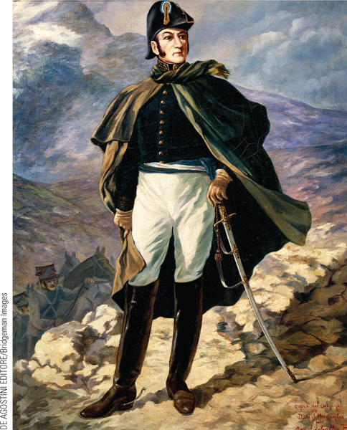
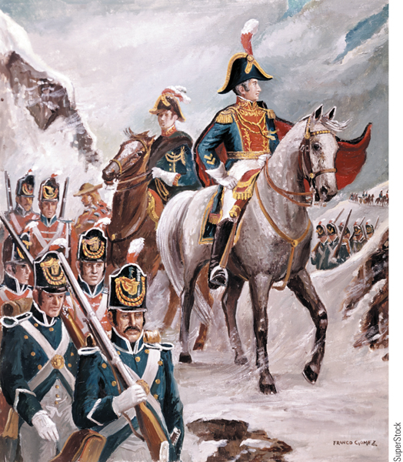
The Liberators of South America
José de San Martín of Argentina and Simón Bolívar are hailed as the leaders of the Latin American independence movement.
p624
Notes:
The Liberators of South America. p.624 (New image of San Martin)
José de San Martín of Argentina and Simón Bolívar are hailed as the leaders of the Latin American independence movement. In the painting on the left, San Martín is portrayed in the Andes mountains. His forces liberated Argentina, Chile, and Peru from Spanish authority. The painting on the right shows Bolívar leading his troops across the Andes in 1823 to fight in Peru. This depiction of impeccably uniformed troops moving in perfect formation through the snow of the Andes, by the Chilean artist Franco Gomez, is, of course, highly unrealistic.

Slide 12
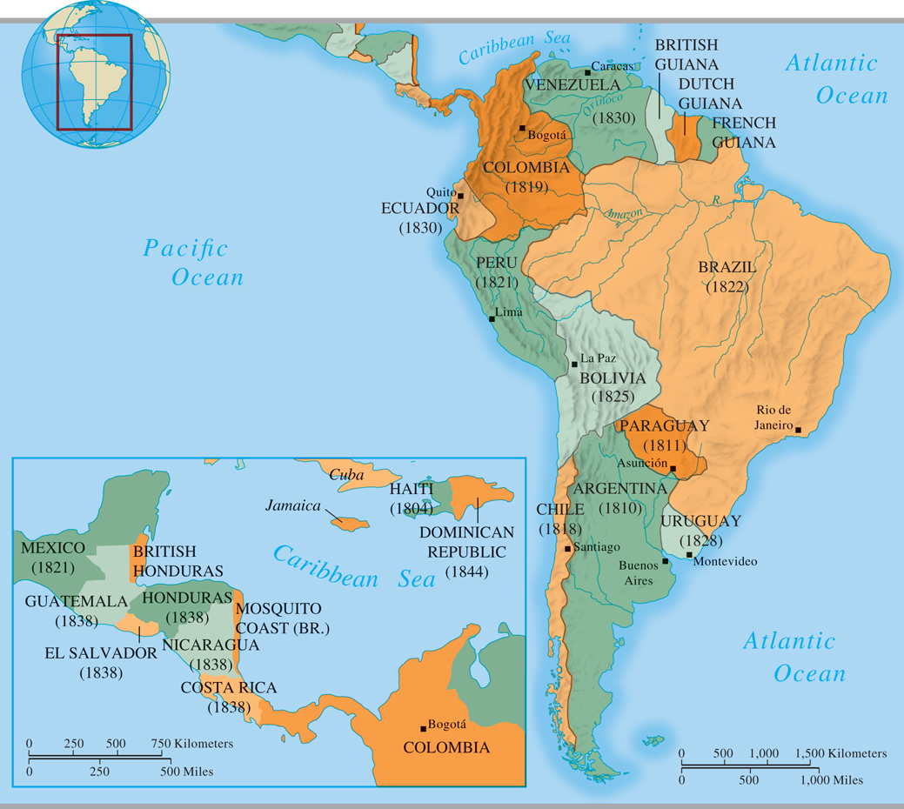
MAP 21.2 Latin America in the First Half of the Nineteenth Century
Map 21.2 p626
Notes:
MAP 21.2 Latin America in the First Half of the Nineteenth Century. Latin American colonies
took advantage of Spain’s weakness during the Napoleonic wars to fight for independence,
beginning with Argentina in 1810 and spreading throughout the region over the next decade with
the help of leaders like Simo´ n Bolı´var and Jose´ de San Martı´n. The dates in parentheses show
the years in which the countries received formal recognition.

Slide 13
Conservative Dominance
The Greek Revolt (1821-1830)
    Lesson: intervention could also support revolution.
1821: Greeks revolt against Ottoman Turks
Revival of Greek nationalism
1827: British and French fleet went to Greece to defeat the Ottoman armada.
Russia declares war on Ottomans; invades its provinces Moldavia and Wallachia (Romania).
Ottoman Empire agrees to allow Britain, France, and Russia to decide Greece’s future:
  Independent kingdom with a German as King
  Otto I- of House Wittelsbach. 17-year old Catholic.
    Successful because Great Powers supported it- conservative domination is still in tact.

Slide 14
CHRONOLOGY Conservative Domination: The Concert of Europe
Event | Dates
Congress of Vienna | 1814–1815
Congress of Aix-la-Chapelle | 1818
Revolutions win independence for Latin America | 1819–1824
Congress of Troppau | 1820
Congress of Laibach | 1821
Crushing of revolt in southern Italy | 1821
Greek revolt against the Ottoman Empire | 1821
Congress of Verona | 1822
Crushing of revolt in Spain | 1823
Monroe Doctrine | 1823
Treaty of Adrianople | 1829
Independence of Greece | 1830
p627
Notes:
CHRONOLOGY Conservative Domination:
The Concert of Europe

Slide 15
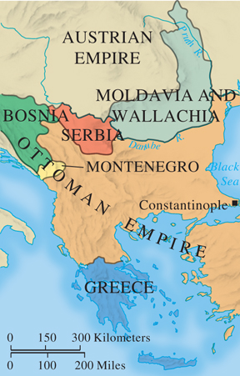
The Balkans by 1830
p627
Notes:
The Balkans by 1830

Slide 16
Conservative Domination:
The European States
Great Britain: Rule of the Tories
  Landowning classes dominate Parliament
    Tory and Whig factions, with Tories in the ascendancy
    1815- Corn Laws passed by the Tories; very unpopular
    1819- Peterloo Massacre- St Peters Fields
    Protest of 60,000; 11 dead
    Tory gov become more restrictive: censorship, prohibit large meetings, etc.
  Parliament had more power than the king, but conservative dominance was in tact.

Slide 17
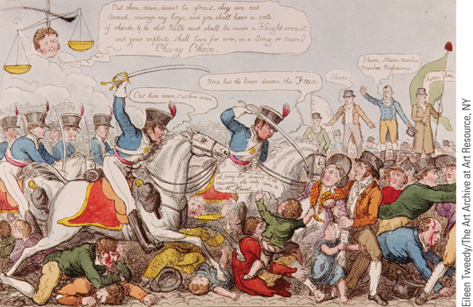
Peterloo Massacre
This colored etching depicts the massacre on August 16, 1819, in St. Peter’s Field in Manchester.
p627
Notes:
Peterloo Massacre (p.627)
This colored etching depicts the massacre on August 16, 1819, in St. Peter’s Field in Manchester. The gathering was organized by the Manchester Patriotic Union Society, a group that had called for parliamentary reforms and the end of the Corn Laws. Over 60,000 people had gathered in the field. Soldiers forced their way toward the speakers by cutting their way through the crowds with their sabers, killing eleven and wounding many women and children.

Slide 18
Conservative Domination:
The European States
Restoration in France
  The return of the Bourbons: Louis XVIII
    Was “too moderate” for France!
  Unresolved tensions: grudging moderation, ultraroyalist opposition
  Dies 1824: his brother Charles X takes throne
    He was an ultraroyalist, anti-constitution
    After public outcry, he was forced to accept ministerial responsibility, but later tried to dissolve the legislature.

Slide 19
Conservative Domination:
The European States
Intervention in the Italian States and Spain
  Reactionary governments in Italy established by Austrians.
    Nationalistic aspirations (the Carbonari and other nationalist secret societies)
    “Italy is only a geographical expression.” - Metternich
  Bourbons restorations in Spain
    King Ferdinand III adopts liberaal constitution, but later dissolves the parliament (Cortes) and rips constitution.
    Revolt of wealthy army officers, merchants, intellectuals.
    Revolt is crushed French troops. Ferdinand wins.

Slide 20
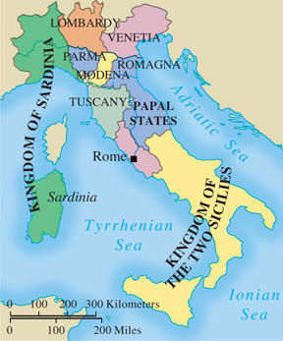
Italy, 1815
p628
Notes:
Italy, 1815

Slide 21
Conservative Domination:
The European States
Repression in Central Europe
  The German Confederation
    Metternich was “Chief Minister and Police of Europe”- especially here. *Spies everywhere*
    Austria and Prussia were the biggest states, but the Confederation was weak (to Metternich’s advantage).
    Prussian leadership: reforms after Napoleon, but little interest in German unity
  Forces of nationalism and the Burschenschaften
  University students: Honor, Liberty, Fatherland
    After assassination of conservative author, Metternich enacted the Karlsbad Decrees- 1819

Slide 22
Repression- Central Europe
The multinational Austrian Empire
  Nationalism threatened to tear it apart:
    Czechs, Slovaks, Hungarians, Germans, Slovenes, Romanians, Poles, Serbians, Italians
    Each wanted their own state.
    Only the Habsburgs, the Church, and the army held them together as an empire.
Russia: Autocracy of the Tsars
  Alexander I (1801 – 1825): from reform to reaction
    Was actually “enlightened”, though he refused to abolish serfdom.
    After Napoleon, he became reactionary and strict.
    Dies in 1825; brother Nicholas I takes power.

Slide 23
Repression- Central Europe
Nicholas I is immediately met with the Decembrist Revolt- December 1825
  Northern Union group (of upper class officers) believed rightful czar to be his brother Constantine
He went from conservative to reactionary conservative:
  Strengthened secret police (the Okrana)
  “Policeman of Europe”- fear of revolution at home and abroad
    Did not hesitate to use his troops anywhere to crush any revolt.

Slide 24
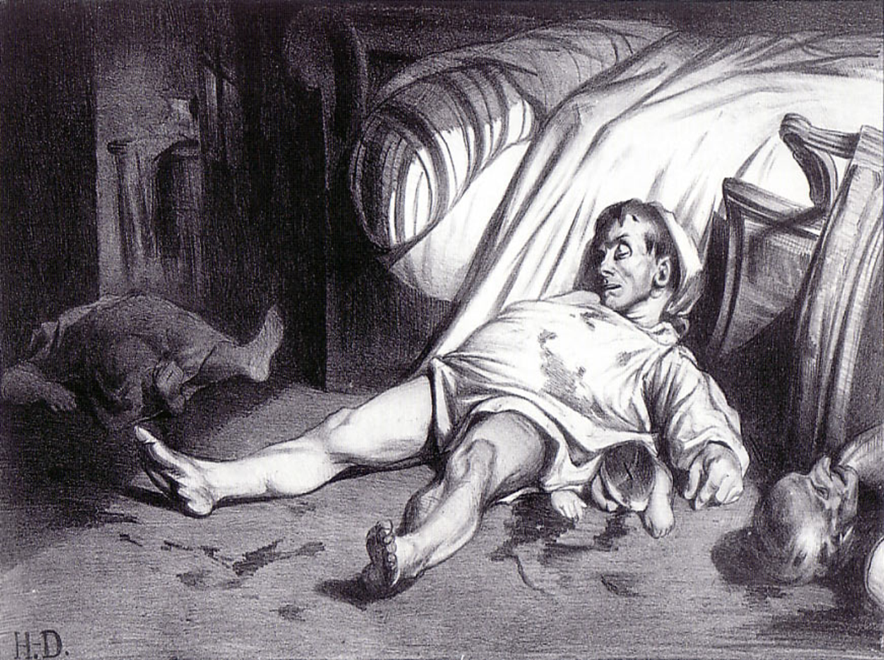

Slide 25
Ideologies of Change
Liberalism
  Economic liberalism (Classical Economics)
    The concept of laissez-faire
      Thomas Malthus (1766 – 1834) and the case against government intervention
      David Ricardo (1772 – 1823): “iron law of wages”
  Political liberalism
    Common belief: guarantee of civil liberties for all
      Constitutional government
      Free speech and press
      Religious toleration/Separate church and state
      Equality before the law (civic equality)
      Limited suffrage (NOT POLITICAL equality)
    John Stuart Mill: On Liberty; On the Subjection of Women

Slide 26
Ideologies of Change
Nationalism
  The idea of the nation as a force for change
    Features: common institutions, traditions, language, and customs; alliance with liberalism
    Became popular with the French Revolution
    Belief that each nationality should have its own state.
    Especially divided people, like Germans and Italians, or subject peoples, like Hungarians in Austria.
    Would upset the political order of things:
      A unified Italy and Germany would upset balance of power
      Empires like Austria would break up.
    Conservatives and liberals were allies in early 1800s
    Liberals believed liberty could only be achieved when people ruled themselves in their own nations.

Slide 27
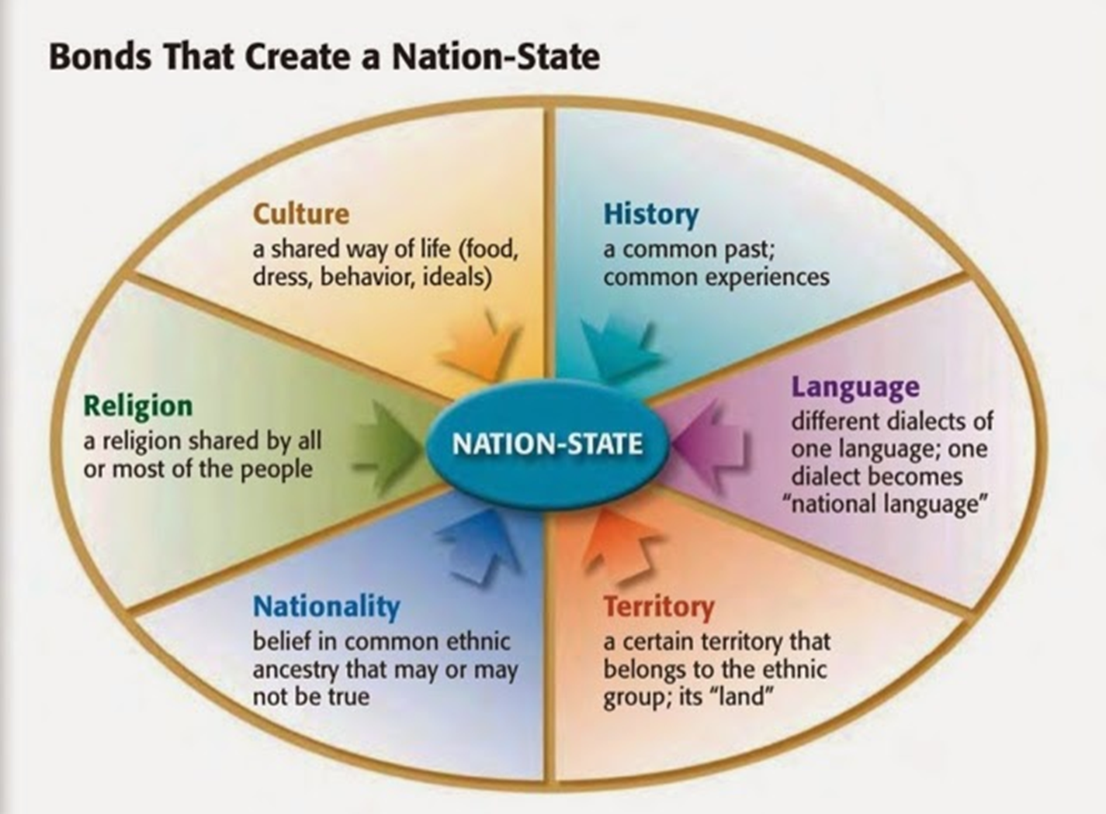

Slide 28
Nationalism Movements
Unification – Combining of politically different, but culturally similar lands.
  Like Germany and Italy
Separation – Cultural groups break away from an empire or country.
  Like Hungary and Serbia
State-building – Culturally distinct groups form into a new state by accepting a single culture.
  Like the United States or Iraq

Slide 29
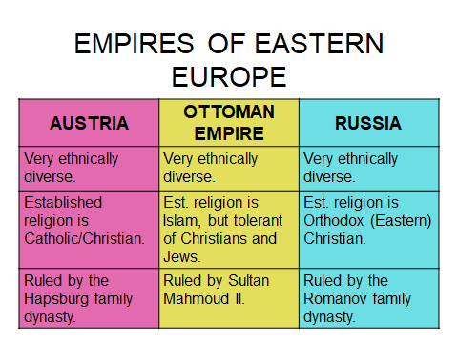

Slide 30
Ideologies of Change
Early Socialism
  Focus on social equality, human cooperation, and utopian aspirations
  Charles Fourier (1772 – 1838)
  Robert Owen (1771 – 1858)
    Success and failure: New Lanark, Scotland, and New Harmony, Indiana
  Louis Blanc (1813 – 1882)
    Denunciation of competition, promotion of workshops
  Female supporters
  Flora Tristan (1803 – 1844)

Slide 31
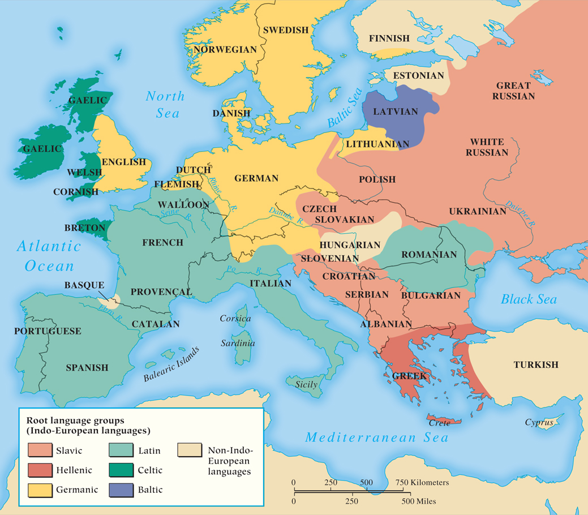
MAP 21.3 The Distribution of Languages in Nineteenth-Century Europe
Map 21.3 p633
Notes:
MAP 21.3 The Distribution of Languages in Nineteenth-Century Europe. Numerous languages
were spoken in Europe. People who used the same language often had a shared history and culture,
which laid the seeds for growing nationalism in the nineteenth century. Such nationalism eventually
led to unification for Germany and Italy but spelled trouble for the polyglot Habsburg empire.

Slide 32
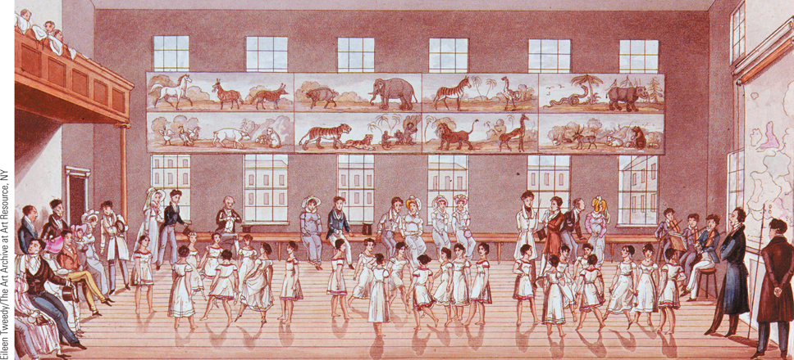
Children at New Lanark
Robert Owen created an early experiment in utopian socialism by establishing
a model industrial community at New Lanark, Scotland.
p634
Notes:
Children at New Lanark. Robert Owen created an early experiment in utopian socialism by establishing
a model industrial community at New Lanark, Scotland. In this illustration, the children of factory workers
are shown dancing the quadrille.

Slide 33
Revolution and Reform (1830-1850)
Another French Revolution
  Charles X (1824 – 1830): the July Ordinances
    Revolt by liberals
  Louis-Philippe (1830 – 1848), “bourgeois monarch”
    Constitutional changes favor the upper bourgeoisie
      The Party of Movement (Adolphe Thiers)
      Party of Resistance (François Guizot)
      Rise of industrial working class
Revolutionary Outbursts in Belgium, Poland, and Italy
  Success for the Belgians; repression in Poland and Italy

Slide 34
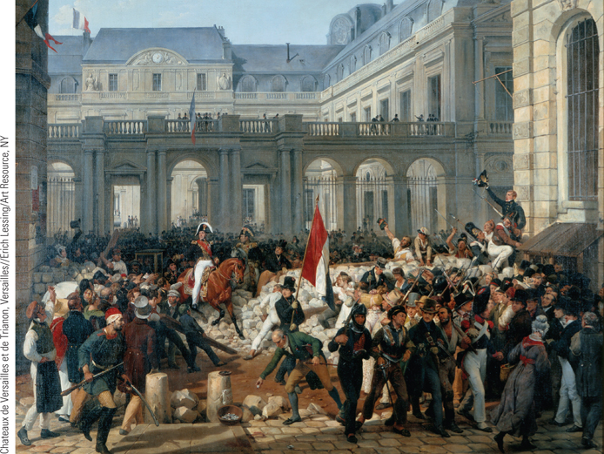
The Revolution of 1830
In 1830, the forces of change began to undo the conservative
domination of Europe.
p635
Notes:
The Revolution of 1830. In 1830, the forces
of change began to undo the conservative
domination of Europe. In France, the
reactionary Charles X was overthrown and
replaced by the constitutional monarch Louis-
Philippe, a liberal and former revolutionary
soldier. In this painting by Gustave Wappers,
Louis-Philippe is seen riding to the Hoˆtel de
Ville, the city hall, preceded by a man holding
the French revolutionary tricolor flag, which
had not been seen in France since 1815.

Slide 35
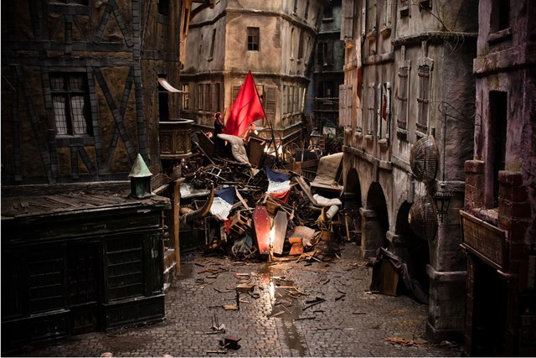

Slide 36
Revolution and Reform (1830-1850)
Reform in Great Britain
  The Whigs Come to Power, 1830
    Concessions considered superior to revolution
  The Reform Act of 1832
    Recognition of industrial change
      Eliminating rotten boroughs, enfranchising new towns and cities plus reapportionment
    Gave franchise to the upper middle class
  New reform legislation
    Laws halting industrial abuses
    Economic liberalism put into law
      The Poor Law of 1834
      The repeal of the Corn Laws

Slide 37
Revolutions of 1848
“The Springtime of the Peoples”
How revolutionary are they?
What is accomplished?
How does it end?
Does history repeat itself in 2012’s Arab Spring?? How will the Middle East resolve its conflicts? (What can 1848 teach us?)

Slide 38
The Revolutions of 1848
Yet Another French Revolution
  Causes: depression, unemployment, scandals, corruption, and failure to initiate reform
  Middle class felt disenfranchised
  The “February Days”: “To the Barricades!”
    Abdication of Louis-Philippe: February 24
    Provisional government established made of moderate and radical republicans- even the socialist Louis Blanc.
    Elections to be by universal manhood suffrage
    National workshops for the unemployed- supposed to be cooperative factories run by workers.
    Unskilled jobs. Strained government $$$.

Slide 39
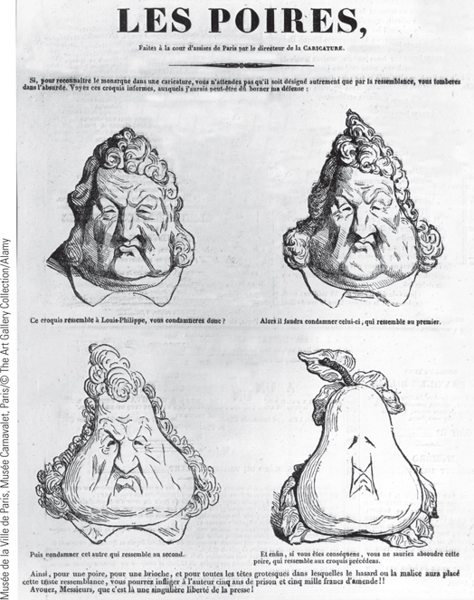
Political Cartoons: Attacks on the King (Slide 1 of 2)
Caricatures of Louis-Philippe often portrayed him with a pear-shaped head, both because there was a resemblance and because the French word for
pear—poire (PWAHr)—had the slang meaning of simpleton or fool.
p639
Notes:
Political Cartoons: Attacks on the King

Slide 40
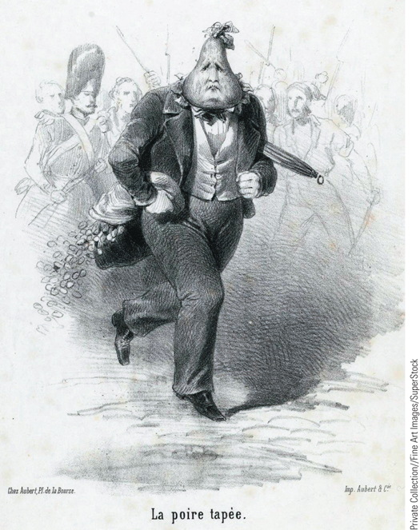
Political Cartoons: Attacks on the King (Slide 2 of 2)
Louis-Philippe is shown with a pear-shaped head, running away from an angry crowd while carrying a bag of money.
p639
Notes:
Political Cartoons: Attacks on the King

Slide 41
The Revolutions of 1848
France (Again)
Growing split between moderate and liberal republicans
  Workshops had to close.
“June Days”: Barricades up again in Paris
  Thousands killed after 4 days of fighting
    400,000 deported to Algeria.
  Government troops crush revolt
  Second Republic established- 1848
    Charles Louis Napoleon Bonaparte, elected December
    4 years later, he crowned himself emperor and declared the Second Empire.

Slide 42
The Revolutions of 1848
Something to remember…
  In February, the poor and middle class were working TOGETHER to overthrow Louis Philippe.
    The Provisional Government was made of bourgeoisie.
  By June of the same year, the bourgeoisie ran the government, and were now seen as the enemies of the working class.
  1848 is the year the bourgeoisie become the ruling class.
    Was this what 1789 was trying to achieve?

Slide 43
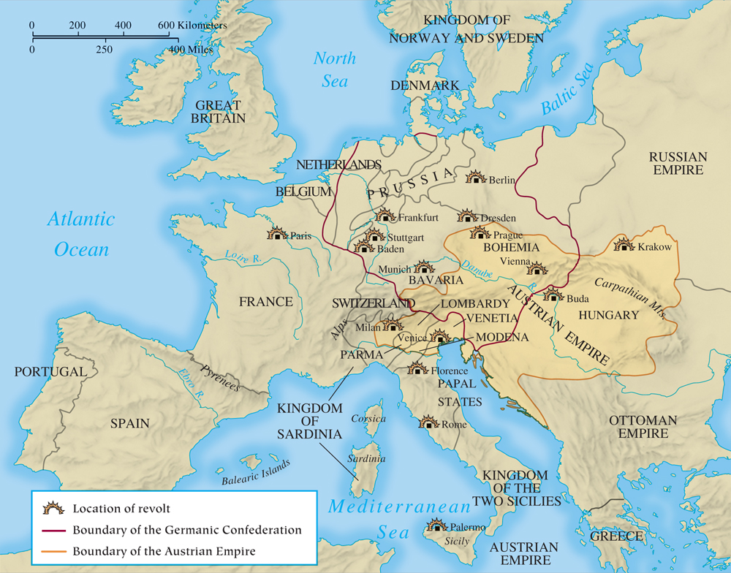
MAP 21.4 The Revolutions of 1848–1849
Map 21.4 p638
Notes:
MAP 21.4 The Revolutions of 1848–1849. Beginning in Paris, revolutionary fervor fueled by
liberalism and nationalism spread to the east and the south. After initial successes, the revolutionaries
failed to maintain unity: propertied classes feared the working masses, and nationalists such as the
Hungarians could not agree that all national groups deserved self-determination. The old order
rallied its troops and prevailed.

Slide 44
The Revolutions of 1848
Revolution in the German States
  French revolts led to promises of reform: free press, constitution, jury trials, etc.
  King of Prussia Frederick William IV (1840 – 1861)
    Promises reforms like no censorship, constitution, etc
    Frankfurt Assembly: Deputies elected via universal male suffrage.
      Educated middle class, intellectual, NATIONALIST
      Wanted a united Germany
      Debate over Grossdeutsch and Kleindeutsch
      Assembly offers Frederick the crown of a united Germany, but he refuses because it comes from “the gutter”.
      Failed liberalism: They could not united Germany

Slide 45
Revolutions of 1848
Upheavals in the Austrian Empire- March 1848
  Louis Kossuth and Hungarian liberalism
    Hungarians want commonwealth status- keep Habsburg monarch, but have their own state.
    Subsequent urban demonstrations in Austrian lands lead to Metternich’s dismissal- Buda, Prague, Vienna
      Metternich actually flees Austria- in disguise!
      Bourgeois revolutionaries draw up constitution
      Hungary is given its own legislature, army, budget, and control over its own foreign policy- with allegiance to the Habsburgs.
      In Bohemia, the Czechs want the same thing- causing a conflict.

Slide 46
Revolutions of 1848
Restoring firm control
  Francis Joseph I (1848 – 1916)
    Takes advantage of rift and fuels middle class fear of violent revolt from the working class.
  Imperial restoration and failed revolutions
  Russia swoops in and helps to crush the revolt- Austrian empire is back as it was.

Slide 47
The Revolutions of 1848 (Slide 3 of 3)
Revolts in the Italian States
  Families of Napoleonic Italy and 1830 revolution now part of new Italian leadership:
  Risorgimento and Giuseppe Mazzini (1805 – 1872)- young nationalist
    Young Italy, 1831
      Goal: a united Italy
    Cristina Belgioioso (1808 – 1871)
  1848 Rebellions began in Sicily spread north
    Rulers (kings of Italy) promised reforms
    Venetia and Lombardy in the north rebel against Austria
    The success of counterrevolutionary forces- Austria again crushes the revolts.

Slide 48
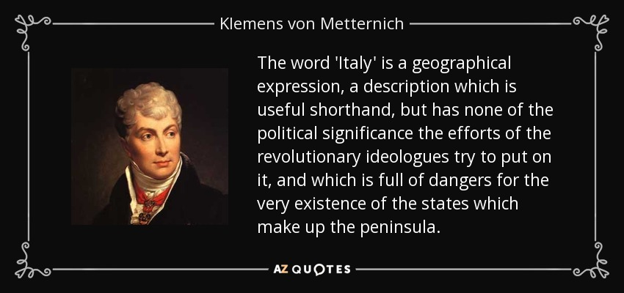

Slide 49
The Failures of 1848
“Failed liberalism”
How did popular revolts, with liberal constitutions and governments, fail so quickly?
1- Disunity: revolutionaries are united when revolution starts, but then become divided (moderates vs radicals, working class vs. middle class)
  Middle class is afraid of working class revolt, so they run back to the old ruling class for the sake of order- often ends in the old regime being re-established.
2- Nationalists want self-government, but division occurs as minorities fight each other.

Slide 50
The Maturing of the United States
Liberalism and Nationalism in the U.S.
  American Constitution defended both major forces
  Divisions over the power of the federal government
    Alexander Hamilton (1757 – 1804), Federalist
    Thomas Jefferson (1743 – 1826), Republican
  Effects of the War of 1812
  Growth of the Supreme Court
    John Marshall (1755 – 1835)
  Andrew Jackson (1767 – 1845) and mass democracy- the enfranchisement of the common man

Slide 51
CHRONOLOGY Reform, Reaction, and Revolution: The European States,
1815–1850: Great Britain
Event | Dates
Peterloo Massacre | 1819
Reform Act | 1832
Poor Law | 1834
Repeal of Corn Laws | 1846
p642
Notes:
CHRONOLOGY Reform, Reaction, and Revolution:
The European States, 1815–1850

Slide 52
CHRONOLOGY Reform, Reaction, and Revolution: The European States,
1815–1850: France
Event/Leader | Dates
Louis XVIII | 1814–1824
Charles X | 1824–1830
July Revolution | 1830
Louis-Philippe | 1830–1848
Abdication of Louis-Philippe; formation of provisional government | 1848 (February 22–24)
June Days: workers’ revolt in Paris | 1848 (June)
Establishment of Second Republic | 1848 (November)
Election of Louis Napoleon as French president | 1848 (December)

Slide 53
CHRONOLOGY Reform, Reaction, and Revolution: The European States,
1815–1850: Low Countries
Event | Dates
Union of Netherlands and Belgium | 1815
Belgian independence | 1830

Slide 54
CHRONOLOGY Reform, Reaction, and Revolution: The European States,
1815–1850: German States
Event | Dates
Frederick William III of Prussia | 1797–1840
Germanic Confederation established | 1815
Karlsbad Decrees | 1819
Frederick William IV of Prussia | 1840–1861
Revolution in Germany | 1848
Frankfurt Assembly | 1848–1849

Slide 55
CHRONOLOGY Reform, Reaction, and Revolution: The European States,
1815–1850: Austrian Empire
Event | Dates
Emperor Ferdinand I | 1835–1848
Revolt in Austrian Empire; Metternich dismissed | 1848 (March)
Austrian forces under General Windischgrätz crush Czech rebels | 1848 (June)
Viennese rebels crushed | 1848 (October)
Francis Joseph I | 1848–1916
Defeat of Hungarians with help of Russian troops | 1849

Slide 56
CHRONOLOGY Reform, Reaction, and Revolution: The European States,
1815–1850: Italian States
Event | Dates
Revolts in southern Italy and Sardinia crushed | 1821
King Charles Albert of Piedmont | 1831–1849
Revolutions in Italy | 1848
Charles Albert attacks Austrians | 1848
Austrians reestablish control in Lombardy and Venetia | 1849

Slide 57
CHRONOLOGY Reform, Reaction, and Revolution: The European States,
1815–1850: Russia
Event | Dates
Tsar Alexander I | 1801–1825
Decembrist Revolt | 1825
Tsar Nicholas I | 1825–1855
Polish uprising | 1830
Suppression of Polish revolt | 1831

Slide 58
The Emergence of an Ordered Society
New Police Forces
  French police
    The duties of the Parisian serjents
  British bobbies
    Growing professionalism
  Spread of police systems
    The military nature of the Schutzmannschaft
  Other approaches to the crime problem
    Reforms concerning poverty and morality
Prison Reform
  New emphasis on rehabilitation

Slide 59
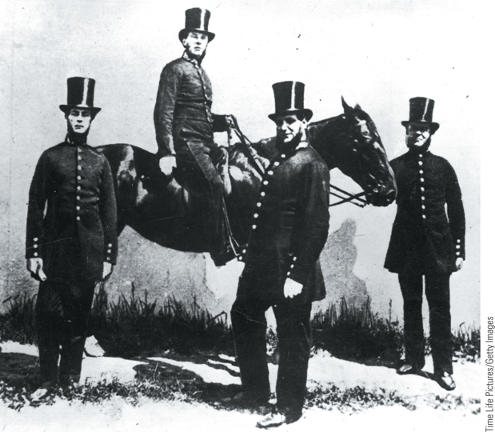
The London Police
One response to the revolutionary upheavals of the late eighteenth and early nineteenth centuries was the development of civilian police forces that would be responsible for protecting property, arresting criminals, and maintaining domestic order.
p643
Notes:
The London Police. One response to the revolutionary upheavals of the late
eighteenth and early nineteenth centuries was the development of civilian police
forces that would be responsible for protecting property, arresting criminals, and
maintaining domestic order. This early photograph shows a group of London
policemen, who came to be known as bobbies after Sir Robert Peel, the man
responsible for introducing the legislation that initiated the London police force.

Slide 60
Culture in an Age of Reaction and Revolution: The Mood of Romanticism
The Characteristics of Romanticism
  Emphases: emotion, sentiment, inner feelings
    Johann Wolfgang von Goethe (1749 – 1832), The Sorrows of the Young Werther
  Individualism
  Interest in the past
    Fairy tales
      The Grimm Brothers and Hans Christian Andersen
    Walter Scott (1771 – 1832)
    Gothic literature
      Edgar Allan Poe (1808 – 1849)
      Mary Wallstonecraft Shelley (1797 – 1851)

Slide 61
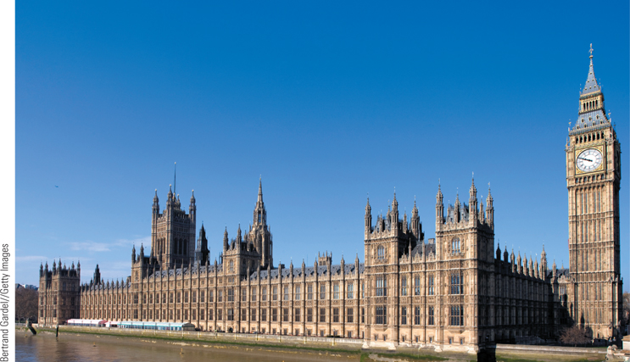
Neo-Gothic Revival: British Houses of Parliament
The Romantic movement of the first half of the nineteenth century led, among other things, to a revival of medieval Gothic architecture that
left European cities bedecked with neo-Gothic buildings.
p646
Notes:
Neo-Gothic Revival: British Houses of Parliament. The Romantic movement of the first half
of the nineteenth century led, among other things, to a revival of medieval Gothic architecture that
left European cities bedecked with neo-Gothic buildings. After the Houses of Parliament in London
burned down in 1834, they were replaced with new buildings of neo-Gothic design, as seen in this
photograph.

Slide 62
The Mood of Romanticism (Slide 1 of 2)
Romantic Poets
  Poetry as an Expression of the Soul
    Percy Bysshe Shelley (1792 – 1822)
      Prometheus Unbound
    Lord Byron (1788 – 1824)
      Childe Harold’s Pilgrimage
  Love of Nature
    William Wordsworth (1770 – 1850)
      The mysterious force of nature
    Pantheism
  Critique of Science

Slide 63
The Mood of Romanticism (Slide 2 of 2)
Romanticism in Art
  Casper David Friedrich (1774 – 1840)
  Joseph Malford William Turner (1775 – 1851)
  Eugène Delacroix (1798 – 1863)
Romanticism in Music
  Ludwig van Beethoven (1770 – 1827)
  Frenchman Hector Berlioz (1803 – 1869)
The Revival of Religion in the Age of Romanticism
  Catholicism
  Protestantism

Slide 64
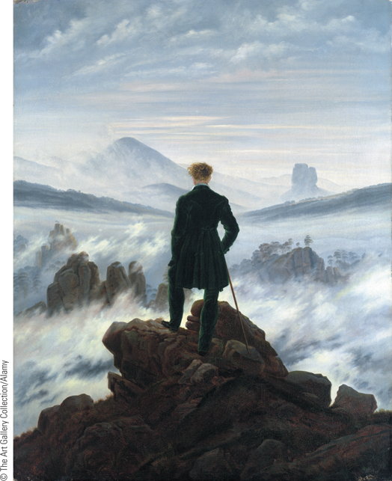
Caspar David Friedrich, The Wanderer Above the Sea of Fog
The German artist Caspar David Friedrich sought to express in painting
his own mystical view of nature. ‘‘The divine is everywhere,’’ he once
wrote, ‘‘even in a grain of sand.’’ In this painting, a solitary wanderer is
shown from the back gazing at mountains covered in fog.
p647
Notes:
Caspar David Friedrich, The Wanderer Above the Sea of Fog.
The German artist Caspar David Friedrich sought to express in painting
his own mystical view of nature. ‘‘The divine is everywhere,’’ he once
wrote, ‘‘even in a grain of sand.’’ In this painting, a solitary wanderer is
shown from the back gazing at mountains covered in fog. Overwhelmed
by the all-pervasive presence of nature, the figure expresses the human
longing for infinity.

Slide 65
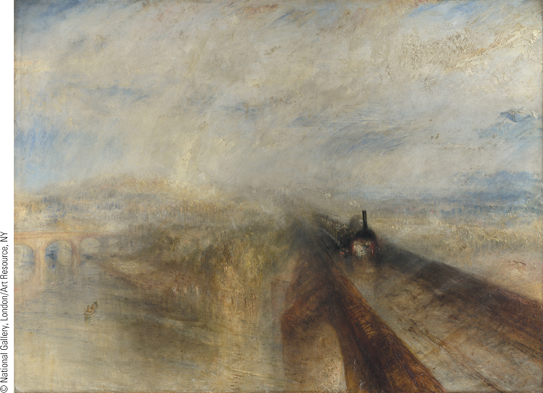
J. M. W. Turner, Rain, Steam, and Speed—The Great Western Railway
Although Turner began his artistic career by painting accurate representations of the natural world, he increasingly sought to create an atmosphere through the skillful use of light and color.
p647
Notes:
J. M. W. Turner, Rain, Steam, and
Speed—The Great Western Railway.
Although Turner began his artistic career by
painting accurate representations of the natural
world, he increasingly sought to create an
atmosphere through the skillful use of light and
color. In this painting, Turner eliminates specific
details and uses general fields of color to convey
the impression of a locomotive rushing toward
the viewer.

Slide 66
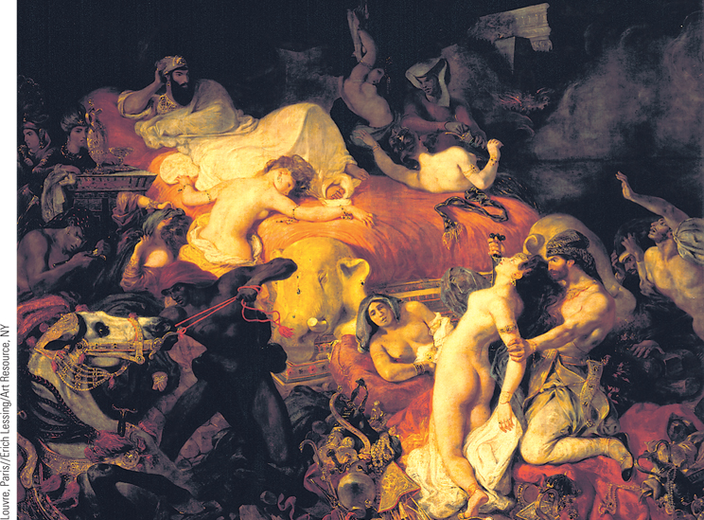
Eugene Delacroix, The Death of Sardanapalus
Delacroix’s Death of Sardanapalus was based on Lord Byron’s
verse account of the dramatic last moments of the decadent Assyrian king.
p648
Notes:
Eugene Delacroix, The Death of
Sardanapalus. Delacroix’s Death of
Sardanapalus was based on Lord Byron’s
verse account of the dramatic last
moments of the decadent Assyrian king.
Besieged by enemy troops and with little
hope of survival, Sardanapalus orders
that his harem women and prized horses
go to their death with him. At the right,
a guard stabs one of the women as the
king looks on.

Slide 67
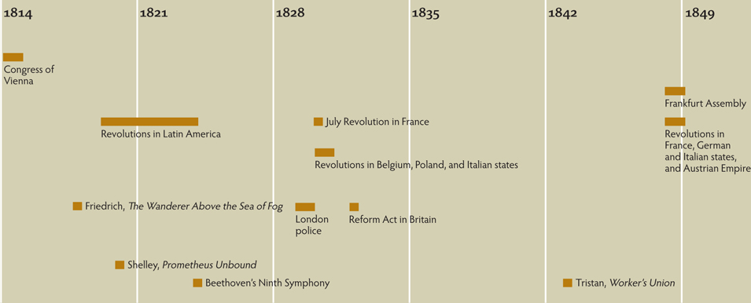
Chapter Timeline
p650

Slide 68
Discussion Questions
How did the revolts in Latin America affect the trading patterns with Europe?
How was the Greek revolt against the Ottoman Empire transformed into a noble cause?
How did Russia’s actions affect the cause of Greek independence?
How did John Marshall increase the power of the United States Supreme Court?
How did the Romantics view society and the social conventions of the day?

