Slide 1
An Age of Nationalism and Realism, 1850–1871
Chapter 22

Slide 2
Focus Questions
​What were the characteristics of Napoleon III’s government, and how did his foreign policy contribute to the unification of Italy and Germany?
​What actions did Cavour and Bismarck take to bring about unification in Italy and Germany, respectively, and what role did war play in their efforts?
​What efforts for reform occurred in the Austrian Empire, Russia, and Great Britain between 1850 and 1870, and how successful were they in alleviating each nation’s problems?
​What were the main ideas of Karl Marx?
​How did the belief that the world should be viewed realistically manifest itself in science, art, and literature in the second half of the nineteenth century?

Slide 3
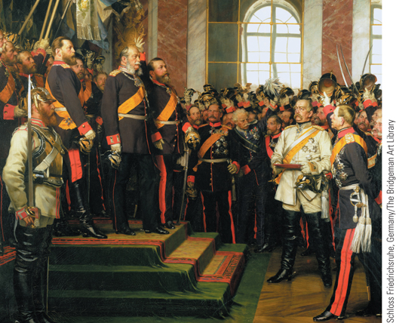
Proclamation of the German Empire in the Hall of Mirrors in the palace of Versailles
p653
Notes:
Proclamation of the German Empire in the Hall of Mirrors in the palace of
Versailles

Slide 4
The France of Napoleon III
A “Modern Dictator”: Comparisons?
A new conservative leader- realizes liberal and nationalist forces can actually boost his power.
Is not taken seriously at first- but has a name- Bonaparte- synonymous with stability, greatness, and power.
Clever and patient, he won the hearts of the public.
1852-1860: Authoritarian Empire
1860-1872: Liberal Empire

Slide 5
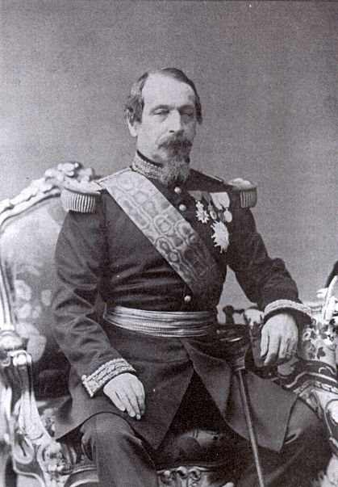
Napoleon III

Slide 6
The France of Napoleon III
Louis Napoleon: Toward the Second Empire
Winning the support of the French people
Seizure of government: Dec 1, 1851
200 died in the resistance
26,000 arrested
10,000 exiled to Algeria
Restores universal male suffrage and asks that the empire be restored
Wins in a majority vote
Assumed title Napoleon III on December 2, 1852- known as French “Caesarism”
The Second Napoleonic Empire
The realities of authoritarian government
Early domestic policies
Government resources and economic expansion
Reconstruction of Paris
Liberalization of the regime

Slide 7
The France of Napoleon III
The Second Napoleonic Empire
The realities of authoritarian government
Control of military, police, civil service, etc
Censored the press
Early domestic policies: First 5 years
Government resources and economic expansion
A time of worldwide prosperity (industrial revolution)
Reconstruction of Paris:
Railroads, canals, factories, transportation
Wide boulevards, big buildings, round plazas, gaslights, sewage and water system
To reduce tensions: free hospitals and medicine for the working class.

Slide 8
The Champs-Elysées Paris

Slide 9
The France of Napoleon III
Liberalization of the Regime: 1860 →
A response to mounting opposition
Legalized unions, gave them right to strike
Liberalized political process
Failed foreign policy and wars would be his downfall.

Slide 10
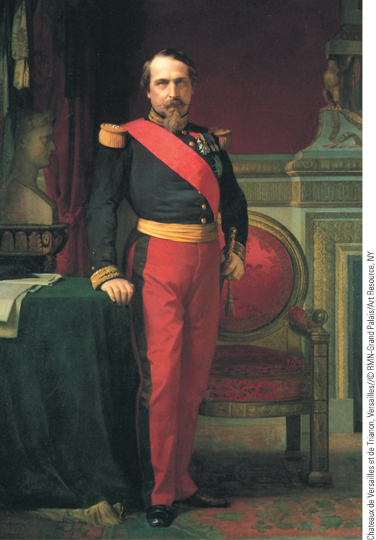
Emperor Napoleon III
On December 2, 1852, Louis Napoleon took the title of Napoleon III and then proceeded to create an authoritarian monarchy.
p654
Notes:
Emperor Napoleon III. On December 2, 1852, Louis Napoleon took
the title of Napoleon III and then proceeded to create an authoritarian
monarchy. As opposition to his policies intensified in the 1860s,
Napoleon III began to liberalize his government. A disastrous military
defeat at the hands of Prussia in 1870–1871, however, brought the
collapse of his regime.

Slide 11
The France of Napoleon III
Foreign Policy: the Mexican Adventure- 1864
The execution of Maximilian of Austria- 1867
A major blunder for Napoleon III (and this is after the Crimean War!)
Are you wondering about the Monroe Doctrine???
Foreign policy: The Crimean War
Napoleon wants to make France powerful in Europe again, and sees his chance.
The Ottoman Empire
Disintegration of Ottoman authority and lands: Ottoman Empire had once controlled Eastern Europe: Croatia, Hungary, Transylvania, Slovenia, the Crimea, Greece, Serbia.
Russia took Moldavia, Wallachia, Eastern Black Sea Coast, and the Dardanelles (very valuable sea route).
Russia had connections to Christians in the Ottoman Empire

Slide 12
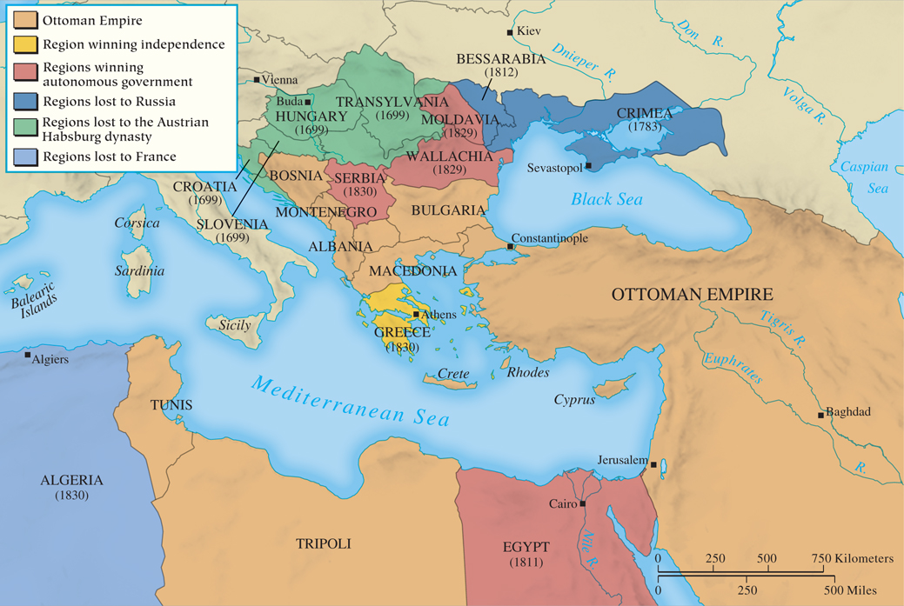
MAP 22.1 Decline of the Ottoman Empire
Map 22.1 p657
Notes:
MAP 22.1 Decline of the Ottoman Empire. The decline in Ottoman fortunes began in 1699 with
major losses to the Austrian Empire. The slide accelerated in the nineteenth century with nationalist
revolts in the European provinces and defeat in the Crimean War. Being on the losing side in World
War I would complete its destruction.

Slide 13
The Crimean War 1854-1856
Russia’s growing power threatened European states.
Ottoman refusal of religious privileges for Russia sparks invasion and war
European political considerations; Britain and France enter the war against Russia
WHY?
Concern over balance of power
British fear Russia will profit from Ottoman decline
Napoleon III felt insulted (nationalism)
Austria remains neutral- Russia was shocked and disappointed
Exposes Austria’s weakness

Slide 14
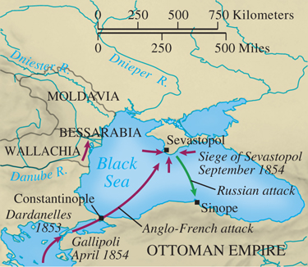
The Crimean War
p657
Notes:
The Crimean War

Slide 15
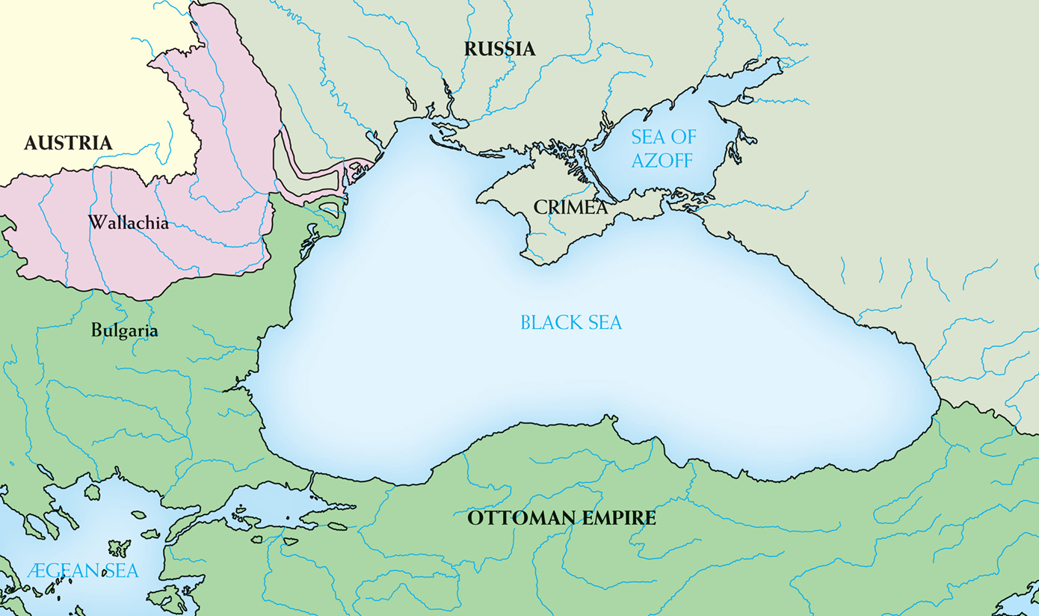

Slide 16
The Crimean War
Battle of Balaklava- horrific 2 year siege
Ultimately Britain and France won
Huge British loss (Charge of the Light Brigade)
Tsar Nicholas I died; Alex II takes over and sues for peace.
Treaty of Paris, March 1856: Russia gives up territory and accepts Black Sea neutrality.
First “newspaper” war: telegraphs and journalists
Florence Nightingale (1820–1910): The Lady of the Lamp; Pioneer of modern nursing
Influenced nurses of the U.S. Civil War

Slide 17
The Crimean War
Consequences:
Destruction of the Concert of Europe
Made Russia and Austria enemies
Exposed Russia’s weakness: did not have an advanced military- still used “serf armies”
Isolated and alienated Austria (what would Metternich say?)

Slide 18
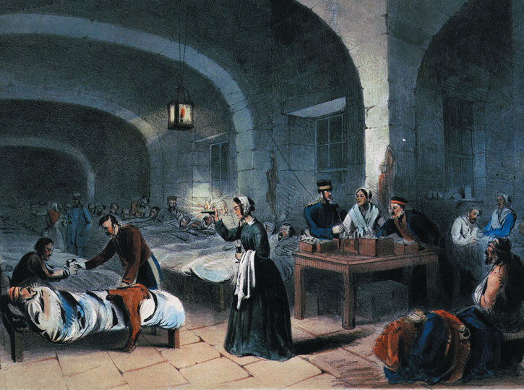
Florence Nightingale (Slide 1 of 2)
Florence Nightingale is shown caring for wounded British soldiers in the military hospital at Scutari during the Crimean War.
p658
Notes:
Florence Nightingale. Florence Nightingale is shown caring for wounded British soldiers in the military
hospital at Scutari during the Crimean War. After a British journalist, W. H. Russell, issued a scathing
denunciation of the quality of medical care afforded to wounded British soldiers, the British government
allowed Nightingale to take a group of nurses to the Crimea front. Through her efforts in the Crimean War,
Nightingale helped make nursing an admirable profession for middle-class women.

Slide 19
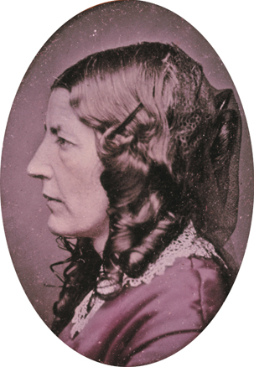
Florence Nightingale (Slide 2 of 2)
Above is a photograph of Nightingale.
p658
Notes:
Florence Nightingale. Florence Nightingale is shown caring for wounded British soldiers in the military
hospital at Scutari during the Crimean War. After a British journalist, W. H. Russell, issued a scathing
denunciation of the quality of medical care afforded to wounded British soldiers, the British government
allowed Nightingale to take a group of nurses to the Crimea front. Through her efforts in the Crimean War,
Nightingale helped make nursing an admirable profession for middle-class women. Above is a
photograph of Nightingale.

Slide 20
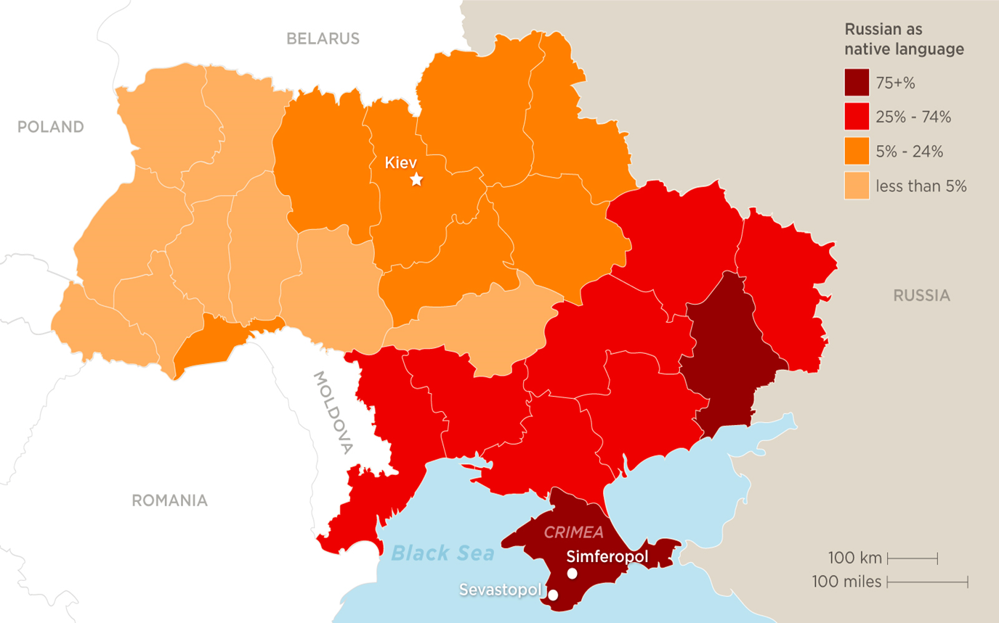

Slide 21
What is Realpolitik?
Failures of 1848 for liberals showed that strong idealism is not enough to accomplish revolutionary goals.
“Age of Realism” replaces Romanticism.
Realpolitik: the accomplishing of one’s political goals via practical (Machiavellian) rather than idealist (Romantic) means.
Political era after 1850: nationalist goals achieved step-by-step in a Machiavellian fashion.

Slide 22
National Unification: Italy and Germany
The Unification of Italy
Austria had been ruling power of Italy, but 1848 brought nationalist efforts for unity.
Northern kingdom of Piedmont- ruled by House of Savoy
Victor Emmanuel II (1849 – 1878) of Piedmont
The leadership of Count Camillo di Cavour (1810 – 1861) as Prime Minister of Piedmont
A noble, but somewhat liberal minded (wants unity)
Wealthy industrialist
Clever politician
Practical needs of unification: economic prosperity, an army, French aid, and war against Austria
Needs Napoleon III’s help to take on Austria

Slide 23
Count Camilo Cavour

Slide 24
Italian Unification
Cavour and Napoleon III strike a deal:
France would get Nice and Savoy, and Napoleon’s cousin would get central Italy and marriage to King’s daughter; Cavour gets northern Italy.
This would give France control of Italy
Cavour provokes a war with Austria.
French victory over Austria at first, but then…
Napoleon III suddenly withdraws when Prussia sides with Austria
Piedmont go Lombardy, but Austria kept Venetia
The unification of northern states under Piedmont
Nationalism spreads though Italy- especially in the south.

Slide 25
Italian Unification
The efforts of Giuseppe Garibaldi (1807 – 1882)
Had supported Giuseppe Mazzini, nationalist leader of Young Italy.
A “true Italian patriot”- wanted unity for Italy.
Raises army of 1,000 Red Shirts (volunteers)
Takes Kingdom of Two Sicilies in 1860
Enters Naples, appears to be on a winning streak
Cavour re-enters the battle: he wants unity, but not a republic. He fears Garibaldi’s March on Rome will invite French intervention.
He confronts Garibaldi in Naples, and Garibaldi is faced with a choice: unity under a monarchy, or civil war for the sake of a republic.
Kingdom of Italy proclaimed, March 17, 1861
Annexation of Venetia (1866) and Rome (1870)

Slide 26
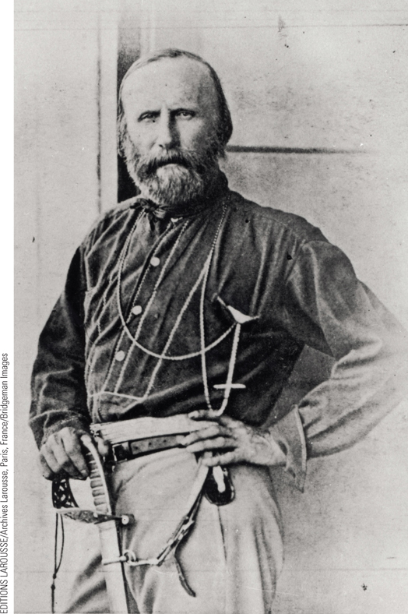
Garibaldi
The Italian nationalists’ dream of a united Italian state finally became a reality by 1870. An important figure in the cause of unification was Giuseppe Garibaldi, a determined Italian patriot.
p660
Notes:
Garibaldi. (p.660)
The Italian nationalists’ dream of a united Italian state finally became a reality by 1870. An important figure in the cause of unification was Giuseppe Garibaldi, a determined Italian patriot. Garibaldi is shown here in an 1860 photograph taken by the French photographer Gustave Le Gray.

Slide 27
Italian Unification
Garibaldi gives in to Cavour and retires.
Kingdom of Italy proclaimed, March 17, 1861
Piedmont as the central authority, with conservative monarchy of Victor Emmanuel II.
Annexation of Venetia (1866) and Rome (1870) during the Prussian Wars.
September 20, 1870: the Kingdom of Italy is complete, with Rome as its capital city.

Slide 29
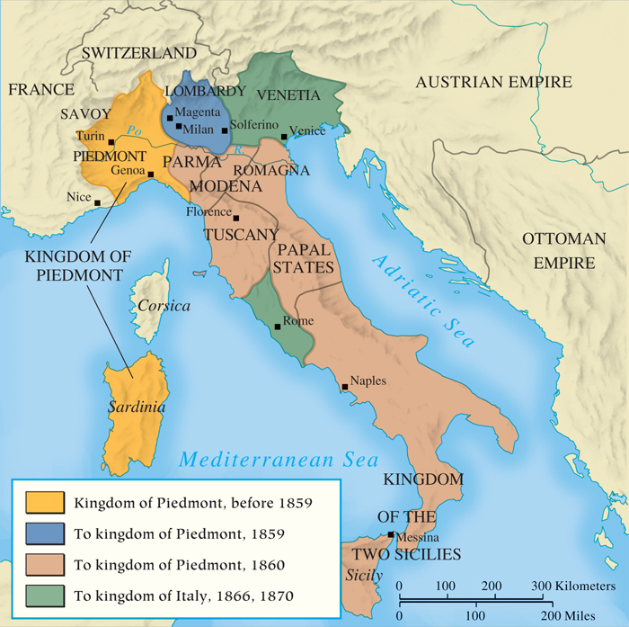
MAP 22.2 The Unification of Italy
Map 22.2 p659
Notes:
MAP 22.2 The Unification of Italy.
Piedmont under the able guidance of
Count Camillo di Cavour provided the
nucleus for Italian unification. Alliances
with France and Prussia, combined with
the military actions of republican
nationalists like Giuseppe Garibaldi, led
to complete unification in 1870.

Slide 30
CHRONOLOGY The Unification of Italy
Event/Leader | Dates
Victor Emmanuel II | 1849–1878
Count Cavour becomes prime minister of Piedmont | 1852
Agreement with Napoleon III | 1858
Austrian War | 1859
Plebiscites in the northern Italian states | 1860
Garibaldi’s invasion of the kingdom of the Two Sicilies | 1860
Kingdom of Italy is proclaimed | 1861
Italy’s annexation of Venetia | 1866
Italy’s annexation of Rome | 1870
p660
Notes:
CHRONOLOGY The Unification of Italy

Slide 31
National Unification: Italy and Germany
The Unification of Germany
The growth of Prussian power
The Zollverein- did not include Austria.
Wilhelm I (1861 – 1888) and the question of reform:
Prussia had a constitution and 2-house legislature
Mostly controlled by rising middle class liberals and industrialists
Wilhelm I wants to increase army size and compulsory service
Middle class liberals didn’t want that; feared it would make the people loyal to the king, not the nation.
Legislature rejects his military budget, and he appoints Bismarck as his Prime Minister.

Slide 32
German Unification
Otto von Bismarck (1815 – 1898)
Prussian Junker
Experienced politician and diplomat
Opportunism and Realpolitik
Never had a plan for unity- just saw opportunities for war and knew how to isolate his opponents.
Never got into a war he didn’t know he could win. He actually disliked war but used it to his advantage.
Ignored the legislature and did whatever he wanted.
The Danish War (1864)
Conflict over Schleswig and Holstein leads to Austrian isolation
Provoked Denmark into a war and used German nationalism to gain public support.
Found opportunity to cause trouble with Austria next.

Slide 33
German Unification
Austro-Prussian War (1866)
First he ensured Russian neutrality in case of war with Austria (easy after the Crimean War!)
Next he ensured French neutrality by offering land on the Rhineland.
Ensured Italian neutrality by promising Venetia.
Finally he provoked war with Austria by occupying Holstein.
Austrian defeat at Königgrätz, July 3, 1866
Creation of the North German Confederation
Annexed Scheleswig, Holstein, Hesse-Cassel, and Hanover.
Combining nationalism and conservative authoritarian power to overcome liberalism
Austria is excluded from German affairs
Even liberals were impressed

Slide 34
North German Confederation
New Constitution:
Each state kept its local government, but the King of Prussia was the head of state.
Chancellor Bismarck works for the king
Parliament: 2 houses
Bundesrat: Upper house- federal council
Reichstag: Lower house- elected by universal make suffrage.
Like Napoleon III, he believes most peasants and artisans are conservatives at heart and can be easily swayed by nationalism and patriotic romanticism.

Slide 35
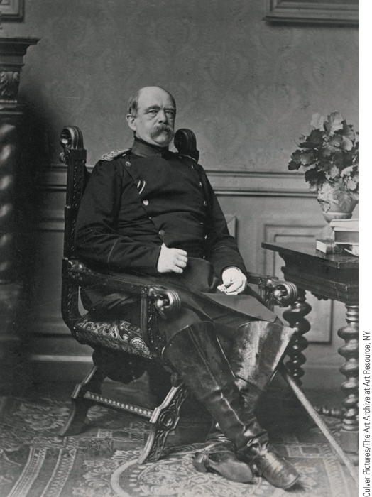
Otto von Bismarck
Otto von Bismarck played a major role in leading Prussia to achieve the unification of the German states into a new German Empire, proclaimed on January 18, 1871.
p662
Notes:
Otto von Bismarck. Otto von Bismarck played a major role in leading
Prussia to achieve the unification of the German states into a new
German Empire, proclaimed on January 18, 1871. Bismarck then became
chancellor of the new Germany. This photograph of Bismarck was taken
in 1874, when he was at the height of his power and prestige.

Slide 36
The Unification of Germany
Franco-Prussian War (1870-1871)
Causes
The threat of a strong Prussia to France
The domestic problems of Napoleon III
Dispute over the throne of Spain:
Queen Isabella II is overthrown, and the crown is offered to Leopold Hohenzollern, relative of Wilhelm I
France was not pleased at idea of being surrounded by German monarchs
Wilhelm forces his cousin to withdraw candidacy
France then asks for an apology and a promise from Wilhelm to never allow Leopold to be a candidate again!
Bismarck gets the telegram with the request from France, and send his own edited version, insulting France.
Provokes France into a war- it’s a trap.

Slide 37
German Unification
Course of the war
South German states pitch in to help
Battle of Sedan, September 2, 1870:
An entire French army is captured- including Napoleon III himself!
Kept as a prisoner, then exiled to Britain and died.
Siege of Paris; lasted 4 months, and capitulates January 28, 1871

Slide 38
The Unification of Germany
Aftermath of Franco-Prussian War
Southern German states join Northern German Confederation
Wilhelm I proclaimed Kaiser of Second German Empire in the Hall of Mirrors in Louis XIV’s palace at Versailles- on the throne, with Bismarck at his side.
New German state=triumph of authoritarian, militaristic values over liberal, constitutional sentiments
Strongest power on the Continent
French humiliated and yearned for revenge
New European balance of power (forever changed)

Slide 39
Can you spot Bismarck?

Slide 40
How important is this?
Many historians say the unification of Germany is the most important political development of the 19th century.
Refute or support this statement using evidence.

Slide 41
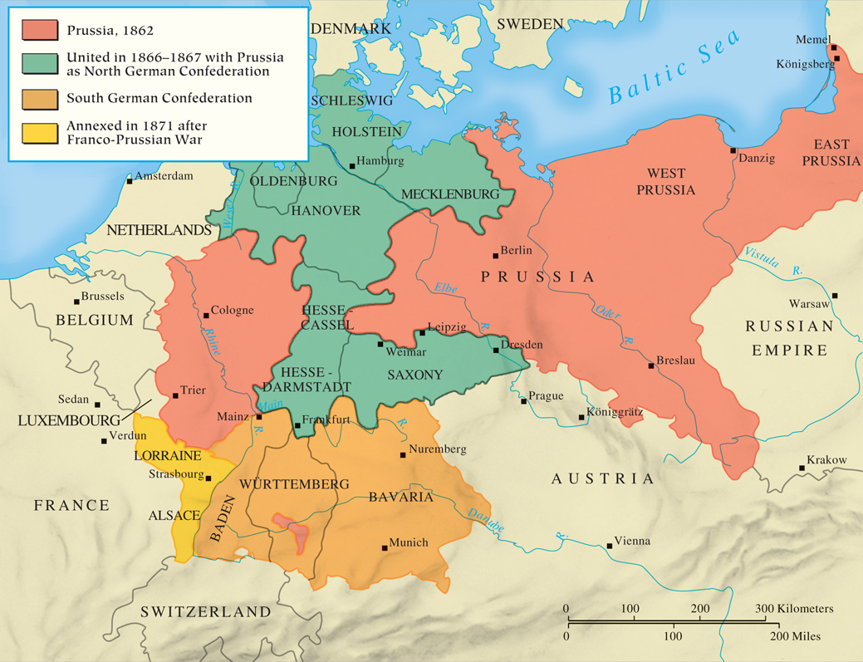
MAP 22.3 The Unification of Germany
Map 22.3 p663
Notes:
MAP 22.3 The Unification of Germany. Count Otto von Bismarck, the Prussian prime minister,
skillfully combined domestic policies with wars with Denmark, Austria, and France to achieve the
creation of the German Empire in 1871.

Slide 42
CHRONOLOGY The Unification of Germany
Event/Leader | Dates
King William I of Prussia | 1861–1888
Bismarck becomes minister-president of Prussia | 1862
Danish War | 1864
Austro-Prussian War | 1866
Battle of Königgrätz | 1866 (July 3)
Franco-Prussian War | 1870–1871
Battle of Sedan | 1870 (September 2)
Fall of Paris | 1871 (January 28)
German Empire proclaimed | 1871 (January 18)
p664
Notes:
CHRONOLOGY The Unification of Germany

Slide 43
Nation Building and Reform: The National State in Midcentury
The Austrian Empire: Toward a Dual Monarchy
Emancipation of serfs (September, 1848)
Alexander von Bach (1813-1893) and centralized autocracy
Emperor Francis Joseph (1848-1916)
Ausgleich of 1867
Creation of the Dual Monarchy of Austria-Hungary
Separate political machinery; common army, foreign policy, and finances
Dissatisfaction of other minorities

Slide 44
Nation Building and Reform: The National State in Midcentury
Imperial Russia
Tsar Alexander II (1855 – 1881)
Abolition of serfdom (March 3, 1861)
Other reforms
Zemstvos (1864)
Legal reforms (1864)
Populism
Alexander Herzen (1812-1870): The Bell
1881: People’s Will assassinate Alexander II
Alexander III (1881-1894): Turns against reform

Slide 45
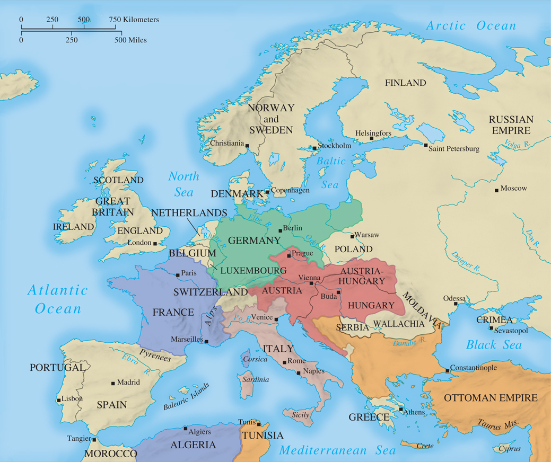
MAP 22.4 Europe in 1871
Map 22.4 p665
Notes:
MAP 22.4 Europe in 1871. By 1871, most of the small states of Europe had been absorbed into
larger ones, leaving the major powers uncomfortably rubbing shoulders with one another. Meanwhile,
the power equation was shifting: the German Empire increased in power while Austria-Hungary and
the Ottoman Empire declined.

Slide 46
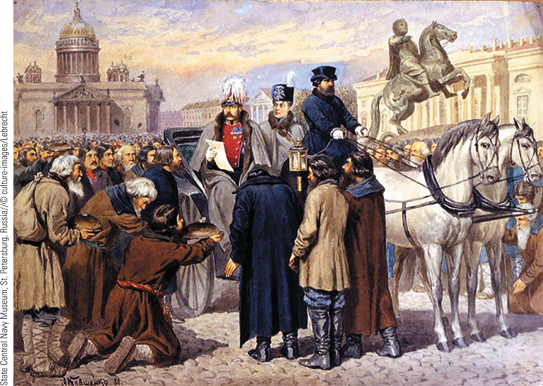
Emancipation of the Serfs
On March 3, 1861, Tsar Alexander II issued an edict emancipating the Russia serfs.
p666
Notes:
Emancipation of the Serfs. On March 3,
1861, Tsar Alexander II issued an edict
emancipating the Russia serfs. This
watercolor by Alexei Kivshenko shows
the tsar proclaiming the emancipation.

Slide 47
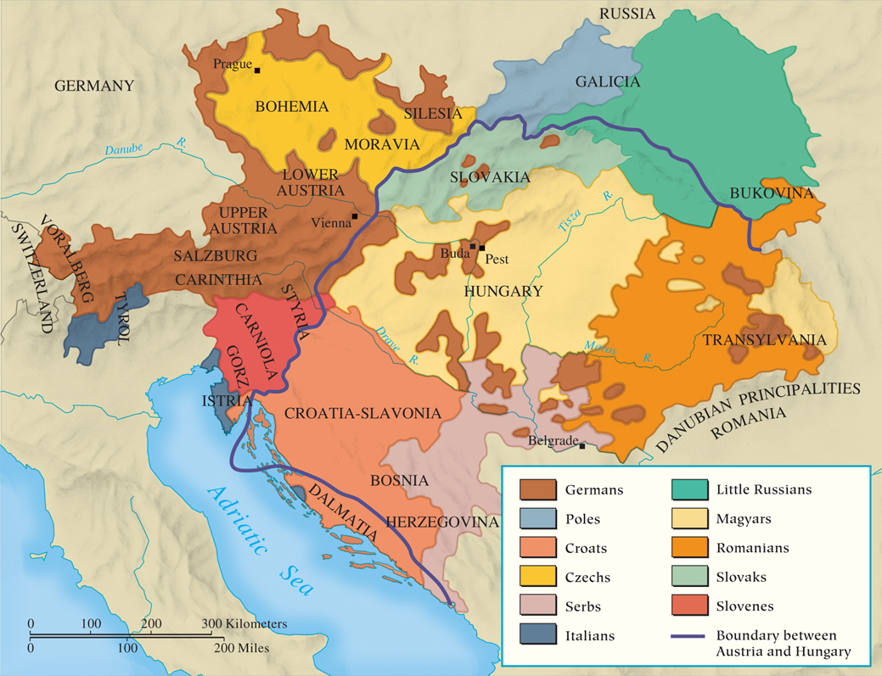
MAP 22.5 Ethnic Groups in the Dual Monarchy, 1867
Map 22.5 p667
Notes:
MAP 22.5 Ethnic Groups in the Dual Monarchy, 1867. Nationalism continued to be a problem in
the Austrian Empire after the suppression of the 1848–1849 revolutions. Military defeats led Emperor
Francis Joseph to create the Dual Monarchy, giving Hungary power over its domestic affairs. The
demands of other ethnic minorities went largely unmet, however.

Slide 48
Nation Building and Reform: The National State in Midcentury
Great Britain: The Victorian Age
The maintenance of peace and stability
Social and political reforms plus prosperity
Queen Victoria (1837 – 1901) as exemplar
Benjamin Disraeli (1804 – 1881) and the Reform Act of 1867
Doubled electorate and altered party politics
The liberal policies of William Gladstone (1809 – 1898)
Elimination of voting and military abuses, institution of fair competition for civil service, and education reform

Slide 49
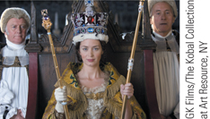
Film & History: The Young Victoria (2009)
The coronation of Victoria (Emily Blunt) as the queen of England.
p669
Notes:
The coronation of Victoria (Emily Blunt) as the queen of England.

Slide 50
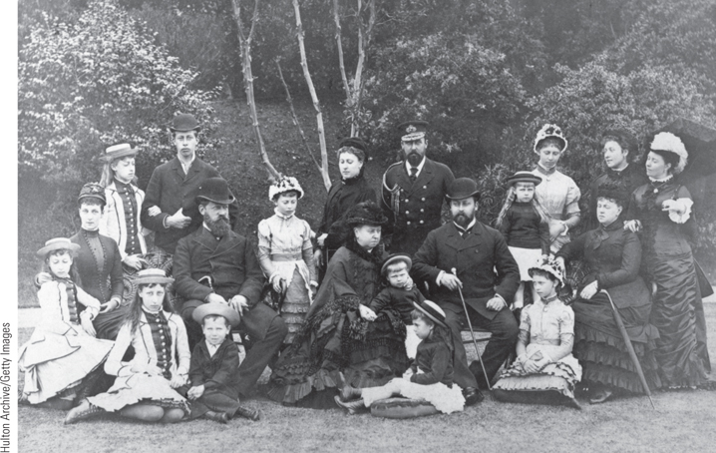
Queen Victoria and Her Family
Queen Victoria, who ruled Britain from 1837 to 1901, married her German first cousin, Prince Albert of Saxe-Coburg-Gotha, in 1840 and subsequently gave birth to four sons and five daughters, who married into a number of European royal families.
p669
Notes:
Queen Victoria and Her Family.
Queen Victoria, who ruled Britain from
1837 to 1901, married her German first
cousin, Prince Albert of Saxe-Coburg-Gotha,
in 1840 and subsequently gave birth to four
sons and five daughters, who married into a
number of European royal families. When
she died at age eighty-one, she had thirty-seven
great-grandchildren. Victoria is seated
at the center of this 1881 photograph,
surrounded by members of her family.

Slide 51
TABLE 22.1 Expansion of the British Electorate
Year | Number of Voters | Percentage of Total Population
1831 | 516,000 | 2.1
(Reform Act of 1832)
1833 | 812,000 | 3.4
1866 | 1,364,000 | 4.7
(Reform Act of 1867)
1868 | 2,418,000 | 8.4
1883 | 3,152,000 | 9.0
(Reform Act of 1884)
1885 | 5,669,000 | 16.3
Table 22.1 p670
Notes:
TABLE 22.1 Expansion of the British Electorate

Slide 52
Nation Building and Reform: The National State in Midcentury
The United States: Slavery and War
The issue of slavery: threat to national union
Differences between North and South
The cotton economy
Election of Abraham Lincoln and secession, 1860
The Civil War
Foreshadowing of total war
Lincoln’s Emancipation Proclamation, 1863
Northern advantages wear down the Confederacy
The Emergence of the Canadian Nation
The desire for more autonomy leads to rebellion, 1837
The Dominion of Canada, established 1867

Slide 53
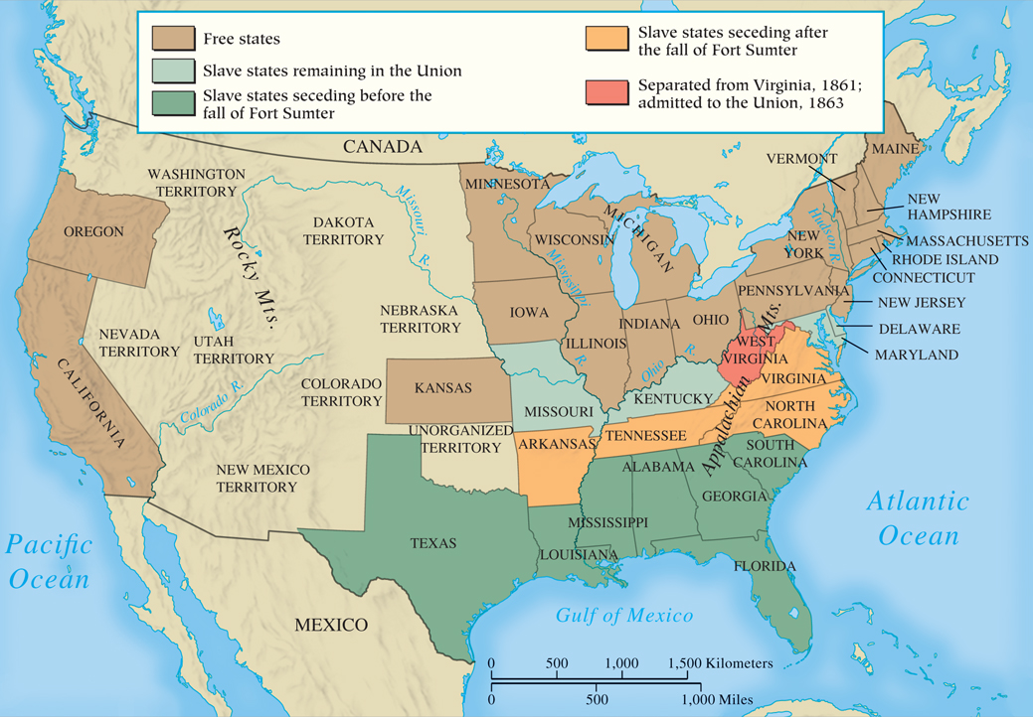
MAP 22.6 The United States: The West and the Civil War
Map 22.6 p671
Notes:
MAP 22.6 The United States: The West and the Civil War. By 1860, the North had developed
an economy based on industry and commerce, whereas the South had remained a primarily
agrarian economy based on black slave labor. The question of the continuance of slavery itself and
the expansion of slavery into western territories led to the Civil War, in which the South sought to
create an independent country.

Slide 54
CHRONOLOGY National States at Midcentury: France
Event | Dates
Louis Napoleon elected president | 1848
Coup d'état by Louis Napoleon | 1851
Creation of the Second Empire | 1852
Emperor Napoleon III | 1852–1870
“Authoritarian empire” | 1852–1860
Crimean War | 1854–1856
Treaty of Paris | 1856
“Liberal empire” | 1860–1870
p672
Notes:
CHRONOLOGY National States at Midcentury

Slide 55
CHRONOLOGY National States at Midcentury: Austrian Empire
Event | Dates
Establishment of imperial parliament | 1859
Ausgleich, Dual Monarchy | 1867

Slide 56
CHRONOLOGY National States at Midcentury: Russia
Event | Dates
Tsar Alexander II | 1855–1881
Emancipation edict | 1861 (March 3)
Creation of zemstvos and legal reforms | 1864

Slide 57
CHRONOLOGY National States at Midcentury: Great Britain
Event | Dates
Queen Victoria | 1837–1901
Ministry of Palmerston | 1855–1865
Reform Act | 1867
First Liberal ministry of William Gladstone | 1868–1874

Slide 58
CHRONOLOGY National States at Midcentury: United States
Event | Dates
Kansas-Nebraska Act | 1854
Election of Lincoln and secession of South Carolina | 1860
Outbreak of Civil War | 1861
Surrender of Lee | 1865 (April 9)

Slide 59
CHRONOLOGY National States at Midcentury: Canada
Event | Dates
Formation of Dominion of Canada | 1867

Slide 61
Industrialization and the Marxist Response
Industrialization on the Continent
Rapid expansion, fueled by railroads
Not many trade or labor unions until after 1870, and they were ineffective
Real change for the proletariat would come from socialist parties and socialist unions.

Slide 62
Industrialism and Marxism
Karl Marx (1818 – 1883) and Marxism
Born into a non-practicing Jewish family in Germany, and was a professed atheist.
Patron Friedrich Engels (1820 – 1895)
Son of wealthy cotton manufacturer
Ideas of The Communist Manifesto (1848)
History is the history of class struggle, culminating in a classless society
Saw France as proof that revolution could restructure society.
Influence of German philosopher George Hegel:
Everything evolves; all change is the result of conflict
Marx said history is determined by material forces.

Slide 63
Marxism
Medieval feudal system gave way to the bourgeoisie.
Bourgeoisie now control government and use it to serve only their interests.
Soon the bourgeoisie will give way to the proletariat through a fierce struggle.
Followed by a proletariat dictatorship, which would redistribute the means of production.
A classless society will emerge, and the state will fade away, since it was a tool of the bourgeoisie.
No more class struggle = greater wealth and progress for all.

Slide 64
Marxism
The aftermath of the failed 1848 revolutions
Das Kapital- never finished it.
Organizing the working class
International Working Men’s Association, 1864
The “First International”
Internal conflicts led to its collapse in 1872
Revived in 1889, but by then, socialism was in the hands of popular political parties.

Slide 65
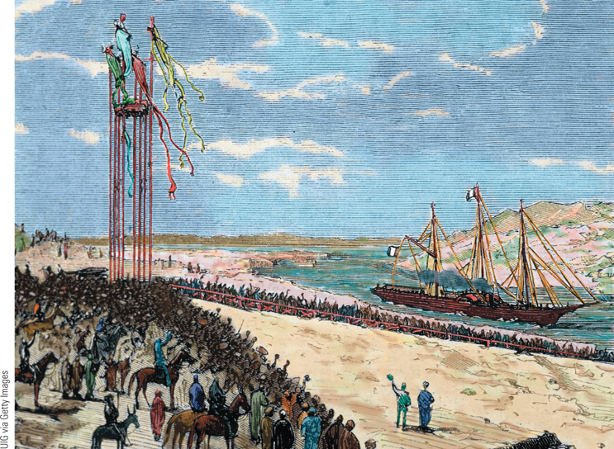
Opening of the Suez Canal
A French diplomat, Ferdinand de Lesseps was the guiding force behind the construction of the Suez Canal, which provided a link between the Mediterranean and Red Seas.
p673
Notes:
Opening of the Suez Canal. Between
1850 and 1871, Continental Europeans
built railways, bridges, and canals as
part of the ever-spreading process of
industrialization. A French diplomat,
Ferdinand de Lesseps (fer-DEE-nahn
duh le-SEPS), was the guiding force
behind the construction of the Suez
Canal, which provided a link between
the Mediterranean and Red Seas. Work
on the canal began in 1859 and was
completed ten years later. As seen here,
an elaborate ceremony marked the
opening of the canal. A French vessel
led the first convoy of ships through the
canal. The banks are lined with curious
local inhabitants.

Slide 66
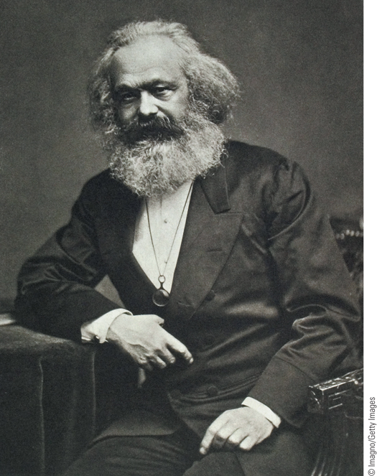
Karl Marx
Karl Marx was a radical journalist who joined with Friedrich Engels to write The Communist Manifesto, which proclaimed the ideas of a
revolutionary socialism.
p673
Notes:
Karl Marx. Karl Marx was a radical journalist who joined with Friedrich
Engels to write The Communist Manifesto, which proclaimed the ideas of a
revolutionary socialism. After the failure of the 1848 revolution in
Germany, Marx fled to Britain, where he continued to write and became
involved in the work of the first International Working Men’s
Association.

Slide 67
Science and Culture in an Age of Realism
A New Age of Science
Growth of interest in scientific research
New developments in physics, biology, and chemistry
Faith in science erodes religious faith
Increasing secularization of society
Growth in materialism: belief that everything mental, spiritual or ideal is the result of physical forces, and truth s found in concrete material existence, not in feeling or intuition.

Slide 68
Science and Culture in an Age of Realism
Charles Darwin (1809 – 1882) and the Theory of Organic Evolution
On the Origin of Species, 1859
All plants and animals evolved from earlier, simpler forms through adaptation (“survival of the fittest”)- this is organic evolution.
Based on Malthus’ economic theory of population: more individuals in a species are born than can survive, causing a struggle for existence.
Those that survive adapted to their environment and are the “fittest” due to genetic variations.

Slide 69
Charles Darwin
The Descent of Man, 1871: animal origins of humans too.
Humans are not an exception to the rule
Impact: controversy to gradual acceptance
Are humans not unique?
Is life really so bad?
Where do morals fit in?
Is there not a design/purpose for the universe?
Eventually scientists accepted Darwin’s findings and even applied them to society-
How do you think they will do that???

Slide 70
Science and Culture in an Age of Realism
A Revolution in Health Care
Louis Pasteur, Robert Koch, and Germs
Identifying bacteriological causation of diseases
New Surgical Practices
The antiseptic principle and anesthesia
New Public Health Measures
Bacteriology and preventive medicine.
Cleaner drinking water and public sanitation
New Medical Schools
Advances in training and professionalization
First in the U.S.: Johns Hopkins, 1893.

Slide 71
Science and Culture in an Age of Realism
Women and Medical Schools
Obstacles to education and professional recognition
First female doctor was American: Elizabeth Blackwell, 1849
London School of Medicine for Women, 1874.
Science and the Study of Society
August Comte- sociology
Theory of “positivism”: knowledge only grows.
Positive knowledge based on hierarchy of all sciences; reinforces Enlightenment’s optimistic view of science.

Slide 72
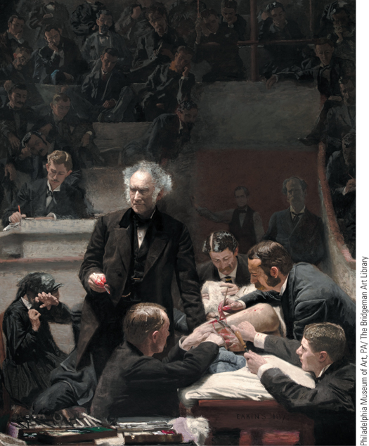
Thomas Eakins, The Gross Clinic
This painting, completed in 1875, shows Dr. Samuel Gross, one of the foremost surgeons in the United States, scalpel in hand, pausing midway in surgery on a young man’s leg to discuss the operation with his students in the amphitheater of the Jefferson Medical College.
p678
Notes:
Thomas Eakins, The Gross Clinic. This painting, completed in 1875,
shows Dr. Samuel Gross, one of the foremost surgeons in the United
States, scalpel in hand, pausing midway in surgery on a young man’s leg
to discuss the operation with his students in the amphitheater of the
Jefferson Medical College. Various tasks are performed by assistant
doctors, including the anesthetist, who holds his cloth over the youth’s
face. Eakins’s painting is a realistic portrayal of the new medical science
at work.

Slide 73
Science and Culture in an Age of Realism
Realism in Literature
Deliberation rejection of Romanticism
Emphasis on the ordinary and observation
Belief that the world should be viewed realistically
Realism and the Novel
Gustave Flaubert (1821 – 1880)
Madame Bovary, 1857
William Thackeray (1811 – 1863)
Vanity Fair, 1848
Charles Dickens (1812 – 1870)
Emphasis on exposing the troubles of Britain’s lower and middle classes
Emile Zola- wrote of alcoholism, prostitution, labor strife. Pointed out hypocrisy of “polite society”.

Slide 74
Science and Culture in an Age of Realism
Realism in Art
Gustave Courbet (1819 – 1877)
The Stonebreakers: Ordinary people and everyday life
Jean-Francois Millet (1814 – 1875)
The Gleaners: Scenes from rural life
Music: The Twilight of Romanticism
Franz Liszt (1811 – 1886)
Symphonic poems
Richard Wagner (1813 – 1883)
Nationalist subjects and themes
The Ring of the Nibelung

Slide 75
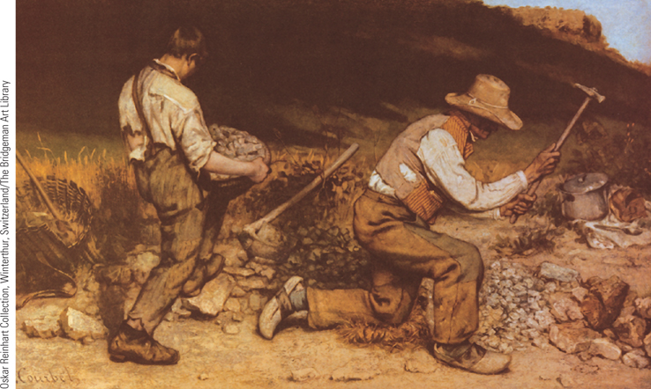
Gustave Courbet, The Stonebreakers
Realism, largely developed by French painters, aimed at a lifelike portrayal of the daily activities of ordinary people. Gustave Courbet was the most famous of the Realist artists. As is evident in The Stonebreakers, he sought to portray things as they really appear.
p680
Notes:
Gustave Courbet, The
Stonebreakers. Realism, largely
developed by French painters, aimed at
a lifelike portrayal of the daily activities
of ordinary people. Gustave Courbet
was the most famous of the Realist
artists. As is evident in The Stonebreakers,
he sought to portray things as they
really appear. He shows an old road
builder and his young assistant in their
tattered clothes, engrossed in their
dreary work of breaking stones to
construct a road. The use of browns and
grays helps communicate the drudgery
of their task.

Slide 76
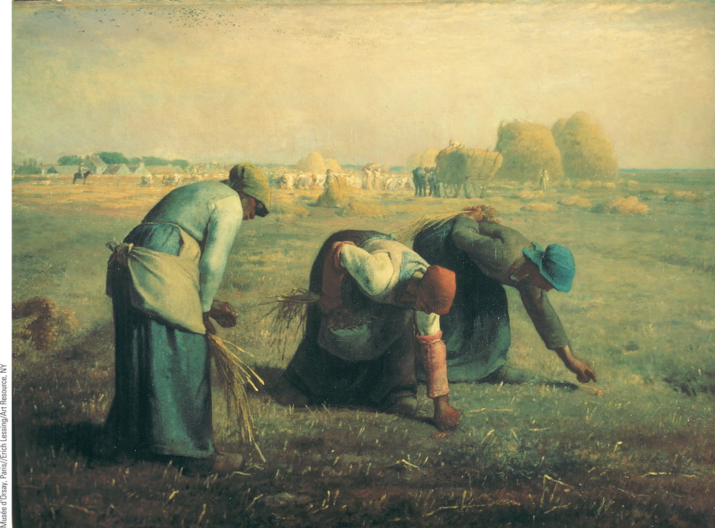
Jean-François Millet, The Gleaners
Jean-François Millet, another prominent French Realist painter, took a special interest in the daily activities of French peasants, although he tended to transform his peasants into heroic figures who dominated their environment.
p682
Notes:
Jean-François Millet, The Gleaners. Jean-François Millet, another prominent French Realist painter,
took a special interest in the daily activities of French peasants, although he tended to transform his peasants
into heroic figures who dominated their environment. In The Gleaners, for example, the three peasant
women engaged in the backbreaking work of gathering grain left after the harvest still appear as powerful
figures, symbolizing the union of humans with the earth.

Slide 77
Édouard Manet, A Bar at the Folies-Bergère, 1882.

Slide 78
Christian Krohg, Albertine at the Police Doctor’s Waiting Room, 1887. Oslo, Norway.

Slide 79
Edgar Degas, Two Laundresses, 1884.

Slide 80
Hubert von Herkomer, Hard Times, 1885.

Slide 81
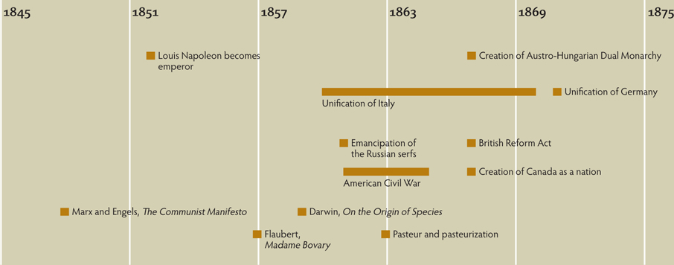
Chapter Timeline
p684

Slide 82
Discussion Questions
Trace the events that led to the Crimean War.
How did the Crimean War change the relationships of the European nations?
How did nationalism affect Germany, Italy, and Austria?
How did the issue of western expansion affect the situation of slavery in the United States?
What contributions of nineteenth-century advances in medicine have continuing significance today?
How important was the issue of German control of Alsace and Lorraine?

