Slide 1
An Age of Modernity Anxiety, and Imperialism, 1894–1914
Chapter 24

Slide 2
Focus Questions
​What developments in science, intellectual affairs, and the arts in the late nineteenth and early twentieth centuries “opened the way to a modern consciousness,” and how did this consciousness differ from earlier worldviews?
​What gains did women make in their movement for women’s rights? How did a new right-wing politics affect the Jews in different parts of Europe? What political problems did Great Britain, Italy, France, Germany, Austria-Hungary, and Russia face between 1894 and 1914, and how did they solve them?
​What were the causes of the new imperialism that took place after 1880, and what effects did European imperialism have on Africa and Asia?
​What was the Bismarckian system of alliances, and how successful was it at keeping the peace? What issues lay behind the international crises that Europe faced in the late nineteenth and early twentieth centuries?

Slide 3
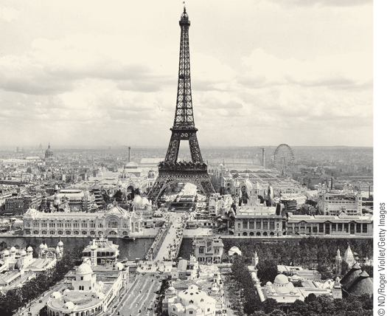
The Eiffel Tower at the World’s Fair of 1900 in Paris
Built in 1889 to commemorate the centennial of the French
Revolution and show off French industrial power.
p719
Notes:
The Eiffel Tower at the World’s Fair of 1900 in Paris
Made of wrought iron

Slide 4
The Modern Consciousness
Before 1914, Europeans believed in improvement through reason, logic, and science.
  Proven by better standard of living made possible by modern technology.
By end of 19th century, Europe had transformed its attitude about “reason” and knowledge.
  New view of physical universe
  Irrational, alternative views of human nature: no longer a “complete explanation” for the universe.
  New artistic expressions with a sense of confusion and anxiety
  Further secularization of Europe.

Slide 5
Toward the Modern Consciousness: Intellectual and Cultural Developments
Developments in the Sciences: the Emergence of a New Physics
  Challenging classical (Newtonian) physics
    Marie Curie (1867 – 1934) and Pierre Curie (1859 – 1906): radiation and atoms
      Subatomic particles: Are atoms mostly empty space???
    Max Planck (1858 – 1947): quantum theory
      How do atoms radiate energy?
  The work of Albert Einstein (1879 – 1955)
    Theory of relativity: E=mc₂
      Energy = mass x speed of light
    Four dimensional space-time continuum
    Energy of the atom

Slide 6
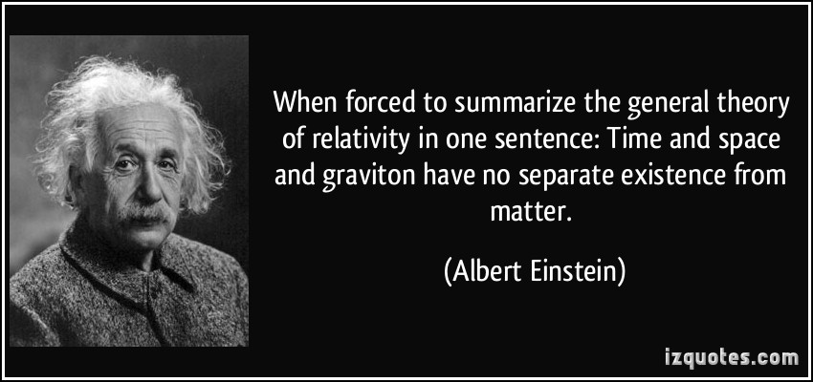
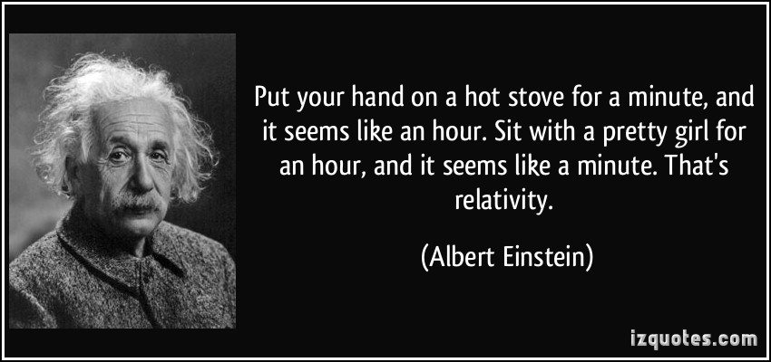

Slide 7
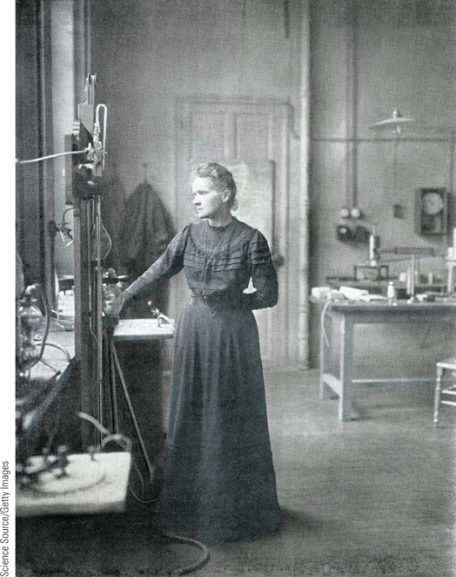
Marie Curie
Marie Curie was born in Warsaw, Poland, but studied at the University of Paris, where she received degrees in both physics and mathematics.
How would this picture be different if taken in her lab today??
p721
Notes:
Marie Curie. Marie Curie was born in Warsaw, Poland, but studied at
the University of Paris, where she received degrees in both physics and
mathematics. She was the first woman to win two Nobel Prizes, one in
1903 in physics and another in 1911 in chemistry. She is shown here in
her Paris laboratory in 1912. She died of leukemia, a result of her
laboratory work with radioactivity.

Slide 8
Toward a New Understanding of the Irrational
Friedrich Nietzsche (1844 – 1900)
  Glorification of the irrational; “dethrone reason” and question optimism and progress.
    Blame Christianity for decadence of Western society, making it incapable of cultural creativity.
    Humans are at the mercy of irrational forces, so we aren’t so reasonable anyway
    Blamed Christianity for “weakening” humans, as “Christianity is a religion of pity.”
    “God is dead”: Eliminate God and Christian morality to “liberate” us to create a higher being:
    Concept of the Superman: superior intellectuals, free of “ordinary thinking” of the masses.

Slide 9
Friedrich Nietzche
Very controversial and misunderstood philosopher
Questioned rational thinking, Christianity, democracy, nationalism, science, and progress.
  Are we trying to be too rational?
  Don’t ecstasy, instinct, and emotion play a positive role in humans too?
  In The Birth of Tragedy (1872), he argued the non-rational aspects of human nature are as noble as rational characteristics.
  Democracy and Christianity create masses of “sheep”. (Nietzche was atheist)

Slide 10
Friedrich Nietzche
Declared the “death of God” and birth of a “SuperMan”.
Critical of racism and anti-Semitism.
  However his ideas are found in Neo-Nazism: “super race”, anti-Christian, strength, weakness, etc.
Appealed to feelings and emotions in questioning rationalism.
Morals are man-made constructs. Therefore we can create new ones that glorify greatness, pride, assertiveness, strength.

Slide 11
Toward a New Understanding of the Irrational
Henri Bergson (1859 – 1941)
  Reality cannot be analyzed in separate parts.
Georges Sorel (1847 – 1922)
  French political theorist, combined Bergson and Nietzche’s ideas on rational thinking.
  Revolutionary socialism and the general strike to destroy capitalism.
    Violent action is only way to achieve socialist goals.
    The non-rational has political potential.
    A small group of ruling elite is needed to govern the masses.

Slide 12
Freud and Darwinism
Sigmund Freud (1856 – 1939) and Psychoanalysis
  Role of the unconscious
    Battle among id, ego, and superego for our “reality”: causes anxiety
      Repression and psychic conflict
      Interpretation of Dreams
      Psychosexual development
    Has been mostly debunked, but his impact was important in mental health: our experiences shape us.

Slide 13
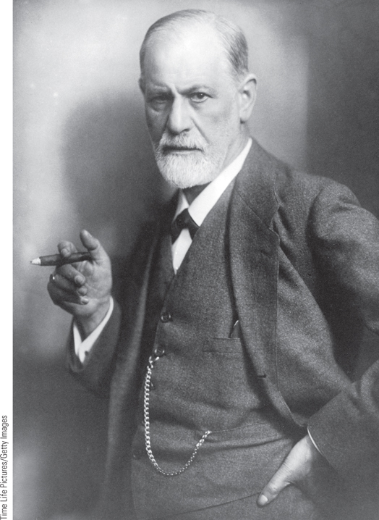
Sigmund Freud
Freud was one of the intellectual giants of the nineteenth and twentieth centuries. Born in Moravia, Freud began to study medicine at the University of Vienna in 1873.
p722
Notes:
Sigmund Freud. Freud was one of the intellectual giants of the
nineteenth and twentieth centuries. Born in Moravia, Freud began to
study medicine at the University of Vienna in 1873. After entering private
practice, he began to study patients suffering from psychosomatic
symptoms, which led him to believe that unconscious forces strongly
determine human behavior. Freud is seen here in a photograph taken in
1921. He was addicted to tobacco and smoked up to twenty cigars a day,
a habit that led to mouth cancer and a series of operations that were
ultimately unsuccessful.

Slide 14
Freud and Darwinism
The Impact of Darwin
  Social Darwinism: applied to the social order.
    Scientific principles wrongly applied to achieve other ends: this is also the age of imperialism.
    Herbert Spencer (1820 – 1903): “fit” societies
      In struggle for survival, the strong advance and the weak die out.
      The state should not intervene- the weakest links must die.

Slide 15
Social Darwinism
  Racism and Nationalism
    Nations also engaged in a struggle for survival
      Nationalist Association of Italy: “international struggle” is WAR
    Link of evolutionary ideas to national identity and struggles. In Germany, this was extremely dangerous.
      Volkish thought
      Friedrich von Bernhardi (1849 – 1930): war is a biological necessity
      Houston Stewart Chamberlain (1855 – 1927: Germans were “pure” successors of Aryan race, the “true creators of Western culture”.
        “Western culture is under attack by Jews, Negroes, and Asians” and must be saved and purified.

Slide 16
The Attack on Christianity
New Challenges: Science and Modernity
  State control of church courts, religious orders, and appointments results in anticlericalism
  Failed attempts at suppression of science
  The emergence of higher criticism
    Ernst Renan (1823 – 1892): Life of Jesus: portray Jesus as a regular man living by example
Response of the Churches
  Rejection of modern ideas and forms
    Pope Pius IX’s Syllabus of Errors (1864)
  Growth (and condemnation) of Modernism
    View Bible as book of progressive ideas
  Compromise
    Leo XIII’s De Rerum Novarum (1891) (“Of New Things”)

Slide 17
The Culture of Modernity: Literature
Naturalism
  Continuation of Realism but with a new pessimism about the future
    Example: Émile Zola (1840 – 1902)
  Golden age for Russian literature
    Leo Tolstoy (1828 – 1910) and Fyodor Dostoevsky (1821 – 1881)
    Clear descriptions, with each character meticulously psychoanalyzed.
    Profound insights into human nature
    Suffering and faith: how they purify the soul

Slide 18
The Culture of Modernity: Literature
Symbolism
  Reaction against Realism
    Objective knowledge of the world was impossible
    Mostly wrote poetry
    External world is not real; just a collection of symbols of one person’s reality
      Their poetry is difficult to understand because it is in the poet’s personal language.
      Art should function for its own sake- not to explain or reflect “reality” and social norms.

Slide 19
Modernism in the Arts
Impressionism
  Innovation, originality, and new subjects
  The origin of “modern art”: France 1870s
  Reject the studio/museum- go out in the world and paint what you see and feel.
  A lot of country and cityscapes, ordinary people.
  No “rules” in technique.
  It is only an “impression” of what you see, not a realistic imitation
  Very unpopular with critics, but the masses loved it.
    Camille Pissarro (1830 – 1903)
    Claude Monet (1840 – 1926)

Slide 20
Modernism in the Arts
Post-Impressionism
  Emphasis on light and color; new focus on structure and form
    Subjective reality: it shows what the artist’s own reality
      Not depicting the external world, but what is in the artist’s own imagination.
    Vincent van Gogh (1853 – 1890): the tragic artist
      Suffered from bipolar disorder and psychotic episodes
      Art was a spiritual experience for him
      His altered state made him create amazing and famous pieces, but he considered himself a failure.
    Paul Cezanne (1839-1906)
      Underlying geometric structure and form; used his brush to make “color cubes” into forms

Slide 21
Modernism in the Arts
The Search for Individual Expressionism
  Art no longer has to represent reality
    Because what is reality anyway?
  Invention of the camera: effects on artists
    Camera mirrors reality; artists create it.
  Cubism: Pablo Picasso (1881 – 1973)
    Use of geometric designs as visual stimuli
    Inspired by objects from European colonies, like African masks, tools, weapons, textiles.
  Abstract painting: Wassily Kandinsky (1866 – 1944): ulltimate “flight from reality”
    Art should “speak to the soul”
    Focus on color and emotion, not representation.

Slide 22
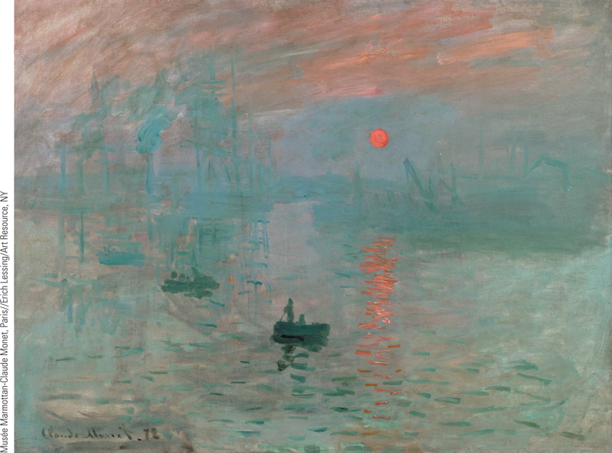
Claude Monet, Impression, Sunrise
Impressionists rejected ‘‘rules and principles’’ and sought to paint what they observed and felt in order ‘‘not to lose the first impression.’’
p727
Notes:
Claude Monet, Impression,
Sunrise. Impressionists rejected
‘‘rules and principles’’ and sought to
paint what they observed and felt in
order ‘‘not to lose the first
impression.’’ Monet entered this
painting, Impression, Sunrise, in the first
Impressionist show in 1874. He sought
to capture his impression of the
fleeting moments of sunrise through
the simple interplay of light, water,
and atmosphere.

Slide 23
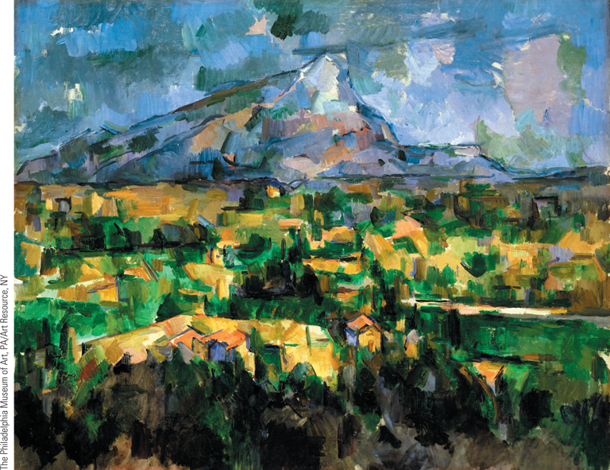
Paul Cezanne, Mont Sainte-Victoire
Post-Impressionists sought above all to express their inner feelings
and capture on canvas their own vision of reality.
p727
Notes:
Paul Cezanne, Mont Sainte-
Victoire. Post-Impressionists sought
above all to express their inner feelings
and capture on canvas their own
vision of reality. In Mont Sainte-Victoire,
depicting a mountain near his home
that he painted more than sixty times,
Cezanne challenged traditional
landscape painting by eliminating a
single perspective and replacing it with
subtle color that created the form of
the mountain.

Slide 24
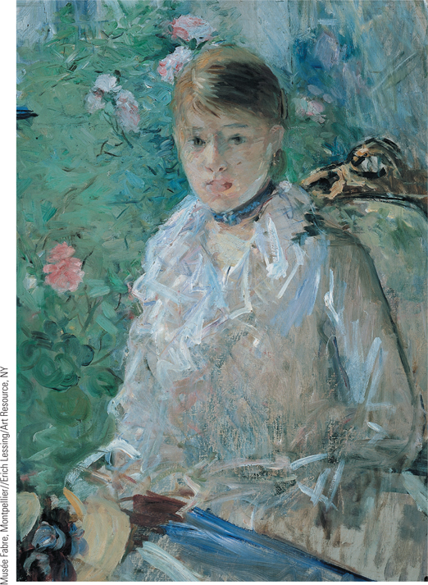
Global Perspectives:
Impressionist Painting: West and East (Slide 1 of 2)
Berthe Morisot, the first female painter to join the Impressionists, developed her own unique style. Her gentle colors and strong use of pastels are especially evident in Young Girl by the Window.
p728
Notes:
Berthe Morisot, Young Girl by the Window.
Berthe Morisot, the first female painter to join the
Impressionists, developed her own unique style. Her gentle
colors and strong use of pastels are especially evident in
Young Girl by the Window. Many of her
paintings focus on women and domestic scenes.

Slide 25
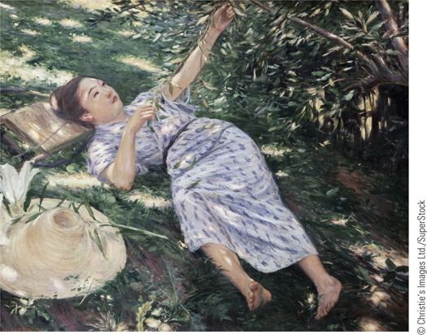
Global Perspectives:
Impressionist Painting: West and East (Slide 2 of 2)
Under the Trees, painted in 1898, an example of the fusion of contemporary French Impressionist painting with the Japanese tradition of courtesan prints.
p728
Notes:
Kuroda Seiki Under the Trees (p.728)
Under the Trees, painted in 1898, an example of the fusion of contemporary French
Impressionist painting with the Japanese tradition of courtesan prints.

Slide 26
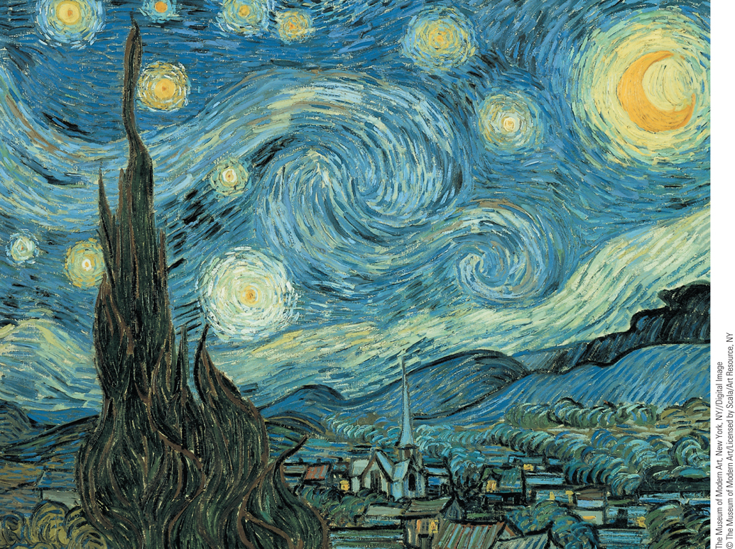
Vincent van Gogh, The Starry Night
The Dutch painter Vincent van Gogh was a major figure among the Post-Impressionists. His originality and power of expression made a strong impact on his artistic successors.
p729
Notes:
Vincent van Gogh, The Starry Night. The Dutch painter Vincent van Gogh was a major figure
among the Post-Impressionists. His originality and power of expression made a strong impact on his
artistic successors. In The Starry Night, painted in 1889, van Gogh’s subjective vision was given full play
as the dynamic swirling forms of the heavens above overwhelm the village below. The heavens seem
alive with a mysterious spiritual force. Van Gogh painted this work in an asylum one year before he
committed suicide.

Slide 27
Modernism in Music
New Styles and Emphases
  The influence of folk music and nationalism
    Edvard Grieg (1843 – 1907): Scandinavian composer, Norwegian folk music
    Claude Debussy (1862 – 1918): music set to poetry
      Prelude to The Afternoon of a Faun
      Clair de Lune
  Musical primitivism
    Igor Stravinsky (1882 – 1971)
      Important 20th century composer with the Russian ballet
    Sergei Diaghilev (1872 – 1929)
      Director of Russian ballet
      Firebird, Petrushka, and Rite of Spring were revolutionary in music; often overwhelmed audiences
    New understanding of irrational forces in music

Slide 28
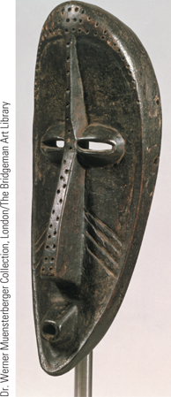
Pablo Picasso, Les Demoiselles d’Avignon (Slide 1 of 2)
Pablo Picasso, a major pioneer of modern art, experimented with a remarkable variety of styles.
p730
Notes:
Pablo Picasso, Les Demoiselles d’Avignon. Pablo
Picasso, a major pioneer of modern art, experimented with
a remarkable variety of styles. Les Demoiselles d’Avignon
(1907) was the first great example of Cubism, which one
art historian has called ‘‘the first style of [the twentieth]
century to break radically
with the past.’’ Geometric
shapes replace traditional
forms, forcing the viewer
to re-create reality in his
or her own mind. Picasso
said of this painting, ‘‘I
paint forms as I think
them, not as I see them.’’
Picasso’s attraction
to aspects of African art is evident from the
Congo mask pictured here.

Slide 29
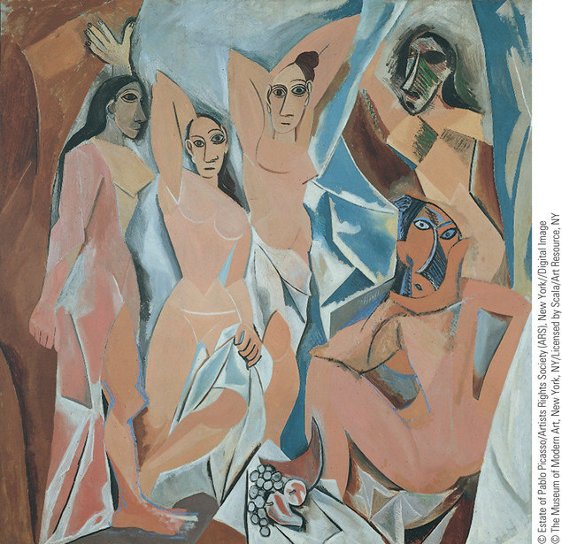
Pablo Picasso, Les Demoiselles d’Avignon (Slide 2 of 2)
Les Demoiselles d’Avignon (1907) was the first great example of Cubism, which one art historian has called ‘‘the first style of [the twentieth] century to break radically with the past.’’
p730
Notes:
Pablo Picasso, Les Demoiselles d’Avignon. Pablo
Picasso, a major pioneer of modern art, experimented with
a remarkable variety of styles. Les Demoiselles d’Avignon
(1907) was the first great example of Cubism, which one
art historian has called ‘‘the first style of [the twentieth]
century to break radically
with the past.’’ Geometric
shapes replace traditional
forms, forcing the viewer
to re-create reality in his
or her own mind. Picasso
said of this painting, ‘‘I
paint forms as I think
them, not as I see them.’’
The head at the upper
right of the painting
reflects Picasso’s attraction
to aspects of African art.

Slide 30
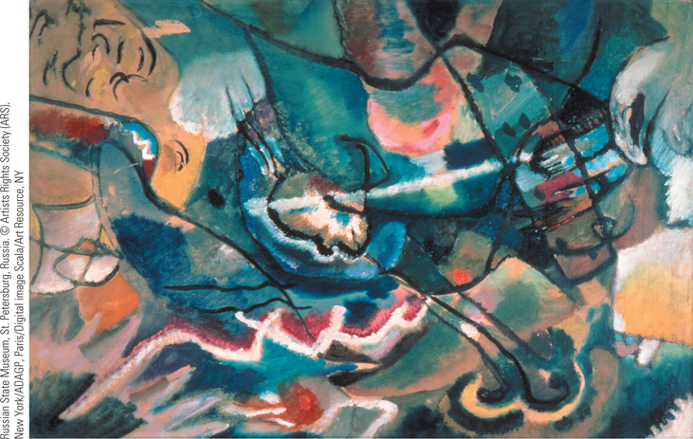
Wassily Kandinsky, Square with White Border
One of the originators of abstract painting was the Russian Wassily Kandinsky, who sought to eliminate representation altogether by focusing on color and avoiding any resemblance to visual reality.
p730
Notes:
Wassily Kandinsky, Square with White
Border. One of the originators of abstract
painting was the Russian Wassily Kandinsky,
who sought to eliminate representation
altogether by focusing on color and avoiding
any resemblance to visual reality. In Square
with White Border, Kandinsky used color ‘‘to
send light into the darkness of men’s hearts.’’
He believed that color, like music, could
fulfill a spiritual goal of appealing directly to
the human senses.

Slide 31
Politics: New Directions and New Uncertainties
The Movement for Women’s Rights
  Gains in divorce and property rights
  New professions
    The development of nursing
  The right to vote
    Growing demands, division over tactics
      Emmeline Pankhurst (1858 – 1928)
        Women’s Social and Political Union, 1903
  Efforts for peace
    Bertha von Suttner (1843 – 1914)
  The New Woman
    Maria Montessori (1870 – 1952)
      New roles and teaching materials

Slide 32
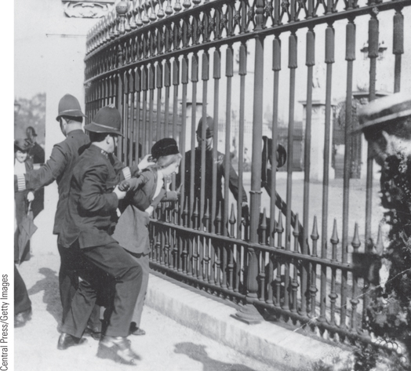
Images of Everyday Life:
The Struggle for the Right to Vote (Slide 1 of 3)
The photograph shows the arrest of a suffragist who had chained herself to the railings of Buckingham Palace in London.
p733
Notes:
The Struggle for the Right to Vote

Slide 33
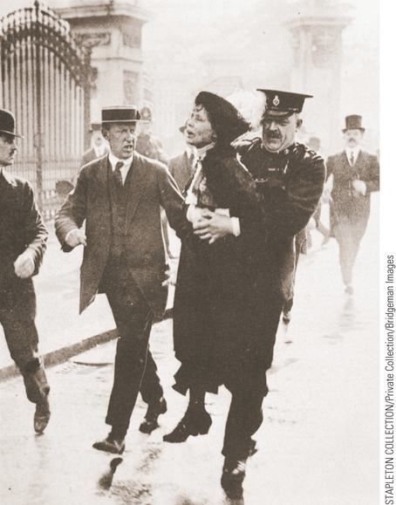
Images of Everyday Life:
The Struggle for the Right to Vote (Slide 2 of 3)
The illustration shows police arresting Emmeline Pankhurst outside Buckingham Palace in 1914.
p733
Notes:
(Emily Davison p.733) The Struggle for the Right to Vote

Slide 34
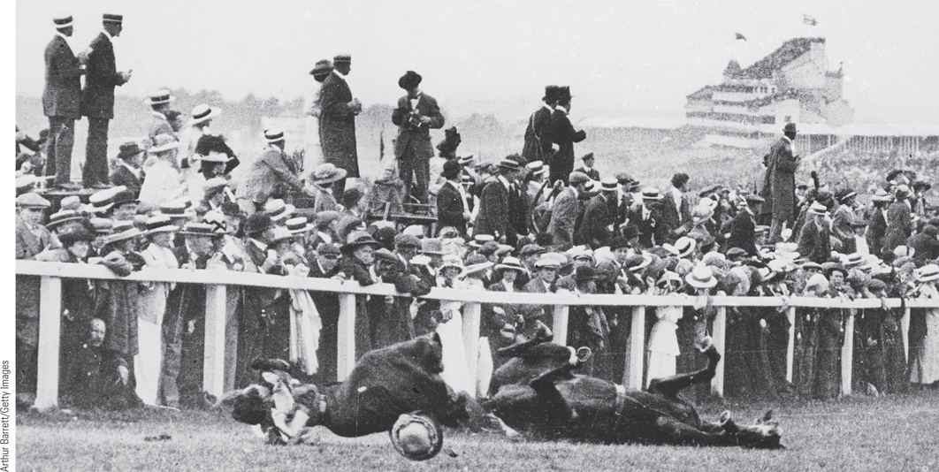
Images of Everyday Life:
The Struggle for the Right to Vote (Slide 3 of 3)
Pictured is Emily Davison sacrificing her life for the cause by throwing herself
under the king’s horse at the Epsom Derby horse race.
p733
Notes:
The Struggle for the Right to Vote

Slide 35

Film & History: Suffragette (2015)
The Struggle for the Right to Vote
p734
Notes:
The Struggle for the Right to Vote

Slide 36
Jews in the European Nation-State
Impact of Citizenship and Emancipation
Anti-Semitism in the Austrian Empire and Germany
  Fusing anti-Semitism, nationalism, and politics
Persecution of Jews in Eastern Europe
  Home to 72 percent of world Jewish population
  Limitations and pogroms fuel emigration
The Zionist Movement
  Theodor Herzl (1860 – 1904)
    The Jewish State, 1896

Slide 37
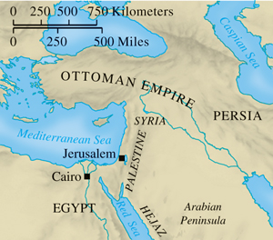
Palestine
p735
Notes:
Palestine

Slide 38
The Transformation of Liberalism
Great Britain
  Liberal reforms driven by trade unions and the Labour Party
    Trade union demands: “collective ownership”
    Fabian Socialists: advocating political activism
      Formation of Britain’s Labour Party
  David Lloyd George (1863 – 1945)
    Abandons laissez-faire, backs social reform measures
    National Insurance Act, 1911
      Beginnings of the welfare state
    The Irish problem: home rule and conflict
Italy
  Giovanni Giolitti’s use of trasformismo

Slide 39
France: Travails of the Third Republic
The Fragility of the Third Republic
  Anti-Semitism in the Dreyfus affair
    Impact at home and abroad
  Radicalism of government
    Purging of enemies
    Separation of church and state, 1905
  Quelling of political threats but little redress for worker discontent

Slide 40
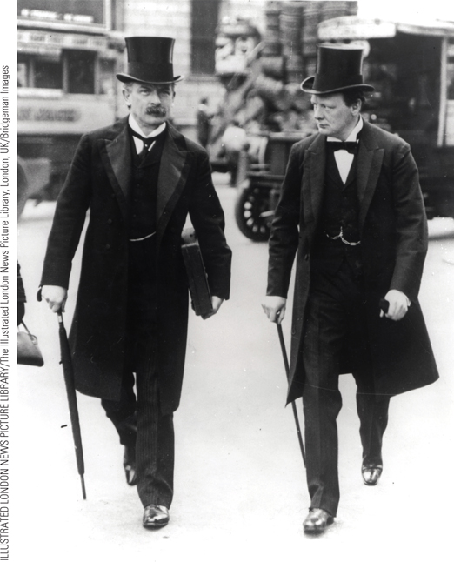
David Lloyd George
David Lloyd George (on the left), the Chancellor of the Exchequer, walking with Winston Churchill to the House of Commons on Budget Day in April 1910.
p737
Notes:
David Lloyd George (p.737)
David Lloyd George (on the left), the Chancellor of the Exchequer, walking with Winston Churchill to the House of Commons on Budget Day in April 1910. The ‘People’s Budget’ put forth by Lloyd George in 1908 led to a constitutional crisis and passage of the Parliament Act in 1911.

Slide 41
Growing Tensions
Germany
  William II (1888 – 1918)
    Military and industrial power
    Conflict of tradition and modernization
      Demands for more participation
      Strong nationalists and right-wing politics
Austria-Hungary: the Problem of Nationalities
  Lack of stability
    Growing agitation and nationalism
  Subjugation of nationalities
    Emperor Francis Joseph and Count István Tisza

Slide 42
Industrialization and Revolution in Imperial Russia
Surge of State-sponsored Industrialism
  Developing working class and socialist parties
    Marxist Social Democratic Party, Minsk, 1898
  Growing opposition to tsarist regime of Nicholas II (1894 – 1917)
The Revolution of 1905
  Defeat in the Russo-Japanese War, 1904-1905
  General strike, October 1905
    Granting of civil liberties and a legislative body, Duma
      Curtailment of power of the Duma, 1907
Failure of the Revolution

Slide 43
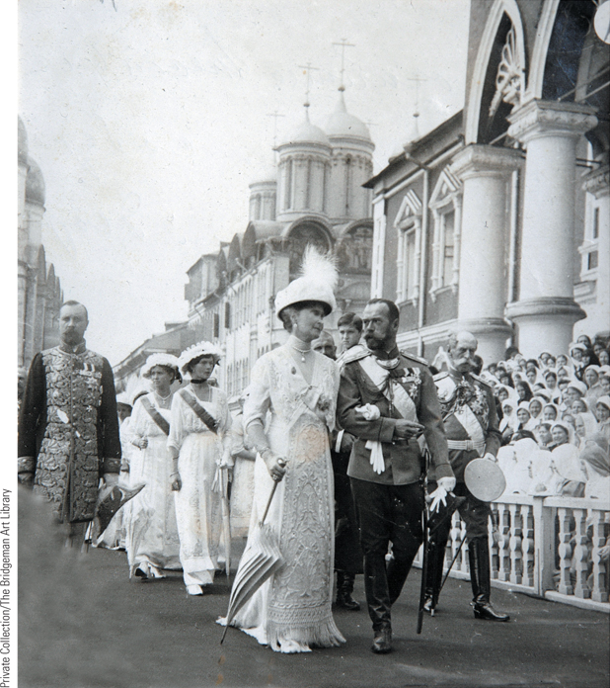
Nicholas II
The last tsar of Russia hoped to preserve the traditional autocratic ways of his predecessors. In this photograph, Nicholas II and his wife, Alexandra, are shown in 1913 with their family at the Kremlin.
p739
Notes:
Nicholas II. The last tsar of Russia hoped to preserve the traditional autocratic ways
of his predecessors. In this photograph, Nicholas II and his wife, Alexandra, are shown
in 1913 with their family at the Kremlin at the celebration of the three-hundredth
anniversary of the founding of the Romanov dynasty.

Slide 44
CHRONOLOGY Politics, 1894–1914
Event/Leader | Dates
Reign of Emperor William II | 1888–1918
Reign of Tsar Nicholas II | 1894–1917
Dreyfus affair in France | 1895–1899
Theodor Herzl, The Jewish State | 1896
Austrian Christian Socialists under Karl Lueger | 1897–1910
First congress of Social Democratic Party in Russia | 1898
Beginning of the Progressive Era in the United States | 1900
Formation of Labour Party in Britain | 1900
p741
Notes:
CHRONOLOGY Politics, 1894–1914

Slide 45
CHRONOLOGY Politics, 1894–1914
Event | Dates
Pankhursts establish Women’s Social and Political Union | 1903
Ministries of Giovanni Giolitti in Italy | 1903–1914
Russo-Japanese War | 1904–1905
Revolution in Russia | 1905
National Insurance Act in Britain | 1911
Universal male suffrage in Italy | 1912
Social Democratic Party becomes largest party in Germany | 1912

Slide 46
The United States and Canada
The Rise of the United States
  Shift to an industrial nation, 1860-1914
    American Federation of Labor
      Included only 8.4 percent of industrial labor force
      Urbanization; migration; immigration
      In 1860 20% lived in cities, 1900 40%
  Reform in the Progressive Era
  Woodrow Wilson, 1913-1921
    Income tax and Federal Reserve System
Growth of Canada
  Challenges to unity in the Dominion of Canada
    Distrust in divided Quebec
      William Laurier, First French Canadian prime minister 1896, and attempted reconciliation

Slide 47
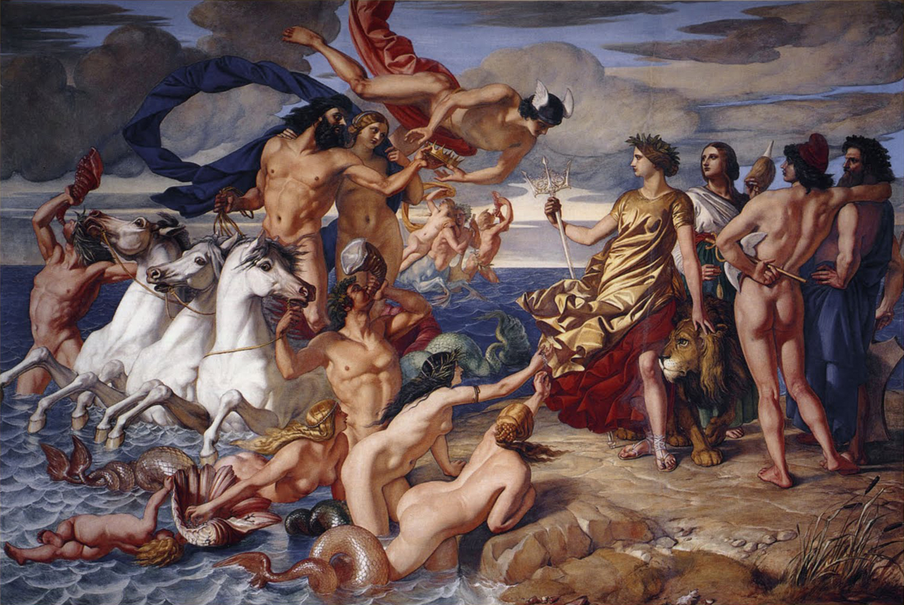
Neptune Resigning to Britain the Empire of the Sea (1847) by William Dyce

Slide 48
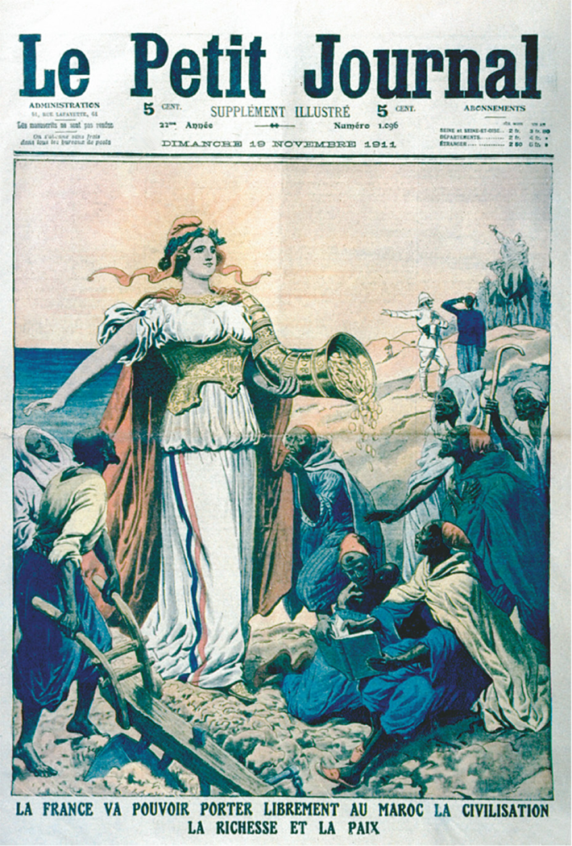
The French in Morocco

Slide 49
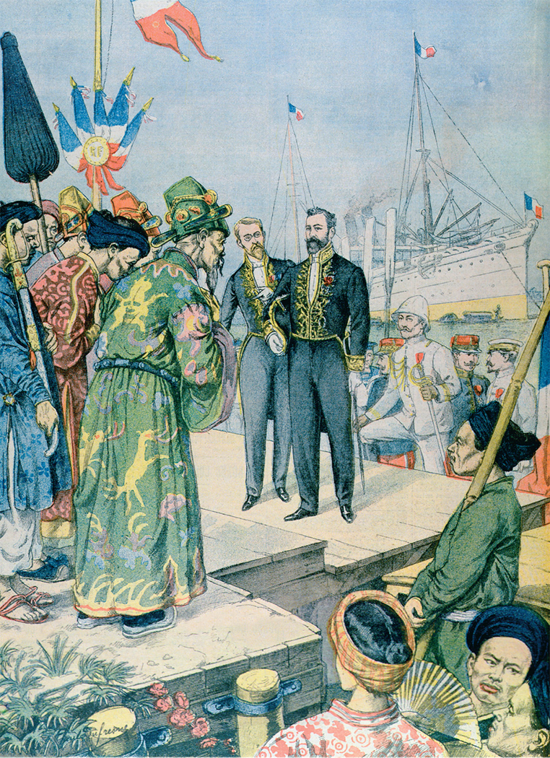
Arrival in Saigon of Paul Beau, Governor-General of Indo-China, 1902-1907

Slide 50
The New Imperialism
Causes of the New Imperialism
  Competition among European nations
  Economic resources and international prestige
  Nationalism and patriotic fervor
  Schools, newspapers, volunteer groups, theater
  The role of Social Darwinism and racism
  Religious motives
    Humanitarianism and the “white man’s burden”
  The economic motive
    Economic imperialism
    Not always profitable
    Marxist critique: V.I. Lenin, Imperialism, the Highest Stage of World Capitalism

Slide 51
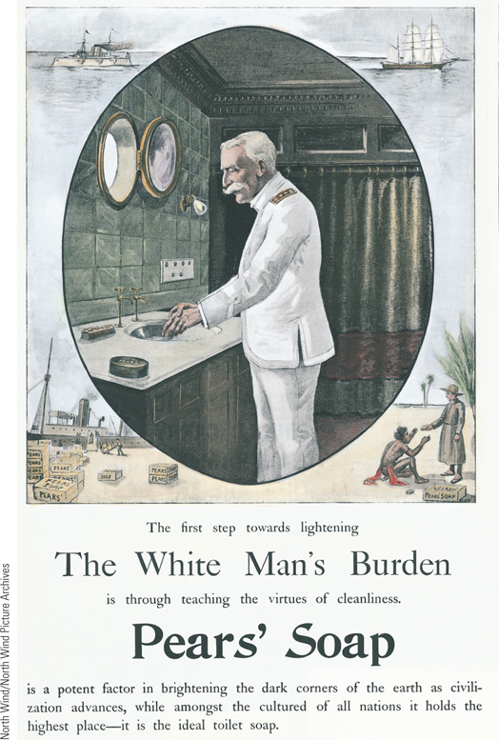
Soap and the White Man’s Burden
The concept of the ‘‘white man’s burden’’ included the belief that the superiority of their civilization obligated Europeans to impose their practices on supposedly primitive nonwhites.
p742
Notes:
Soap and the White Man’s Burden. The concept of the ‘‘white
man’s burden’’ included the belief that the superiority of their
civilization obligated Europeans to impose their practices on supposedly
primitive nonwhites. This advertisement for Pears’ Soap clearly
communicates the Europeans’ view of their responsibility toward other
peoples.

Slide 52
The Scramble for Africa (Slide 1 of 2)
South Africa
  Britain’s Cape Colony
    Tensions with the Boers (Afrikaners)
  Great Trek, 1835
    Region between Orange Free State and the Vaal River (Transvaal)
  Cecil Rhodes (1853 – 1902)
    Diamond and gold companies
    Seizure of the Transvaal
    Attempts to overthrow the neighboring Boer Government
The Boer War, 1899-1902
  Lessons on the costliness of modern warfare
  Union of South Africa, 1910

Slide 53
The Boer War and Apartheid
Boer War: 1899
  Boers- guerilla warfare
  British response: Placed Boer women and children in concentration camps, where many died.
1910: British join all South Africa into a confederation and establish a constitution with Apartheid laws:
  Apartheid: “Separateness”- South Africa became a segregated state, in which a white minority ruled over a black majority.

Slide 54
Apartheid
Black South Africans forbidden to vote, own property, hold office, or participate in any way in white society.
  Black South Africans needed “passports” to leave their “townships”.
Apartheid remained a legal institution in South Africa until 1994.
South Africa continues to struggle with racial tension and economic injustice (black poverty still very prevalent).
  AIDS epidemic has ravaged the country.

Slide 55
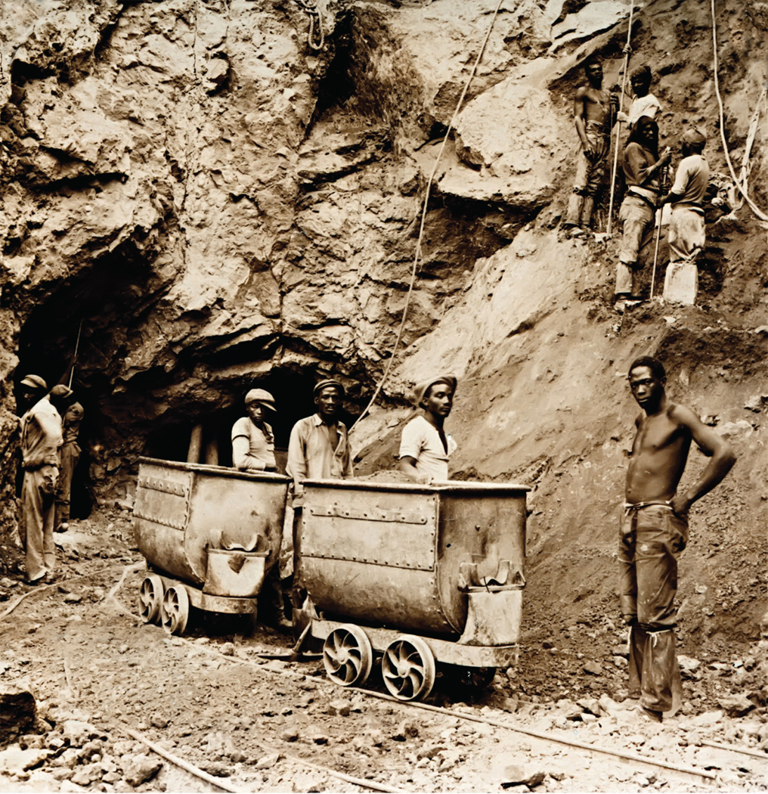
Diamond mining in Kimberly, South Africa, 1900. These men are mining for De Beers Diamond Co, started by Cecil Rhodes, and even today one of the biggest purchasers of “blood diamonds” or “conflict diamonds”

Slide 56
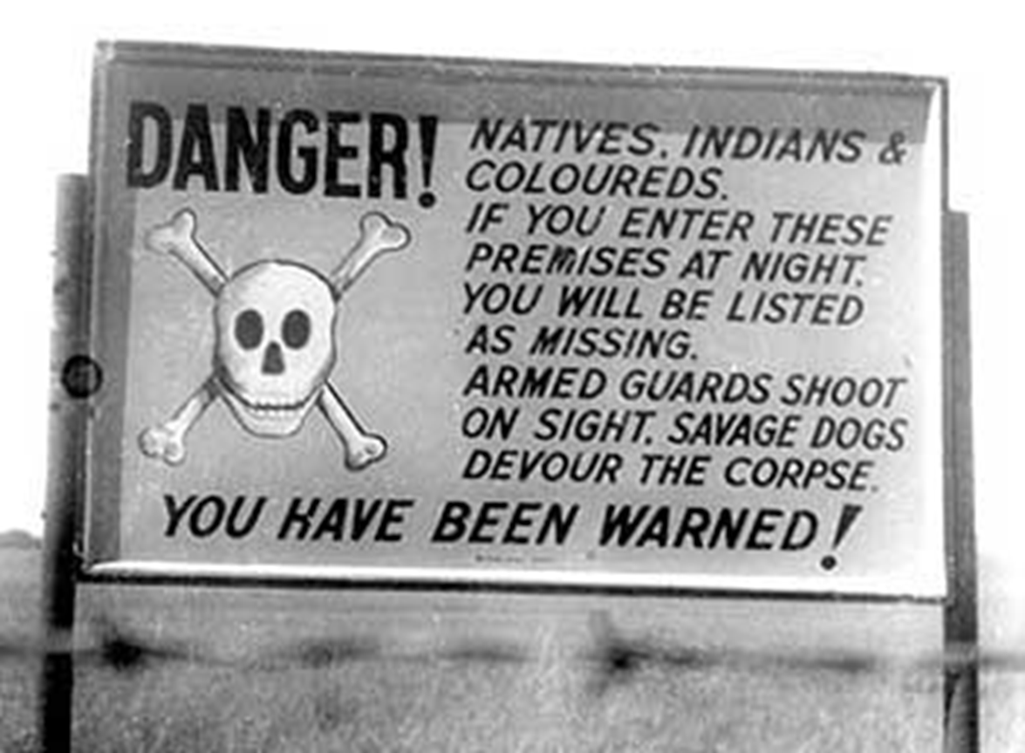
These signs were typical in Apartheid South Africa

Slide 57
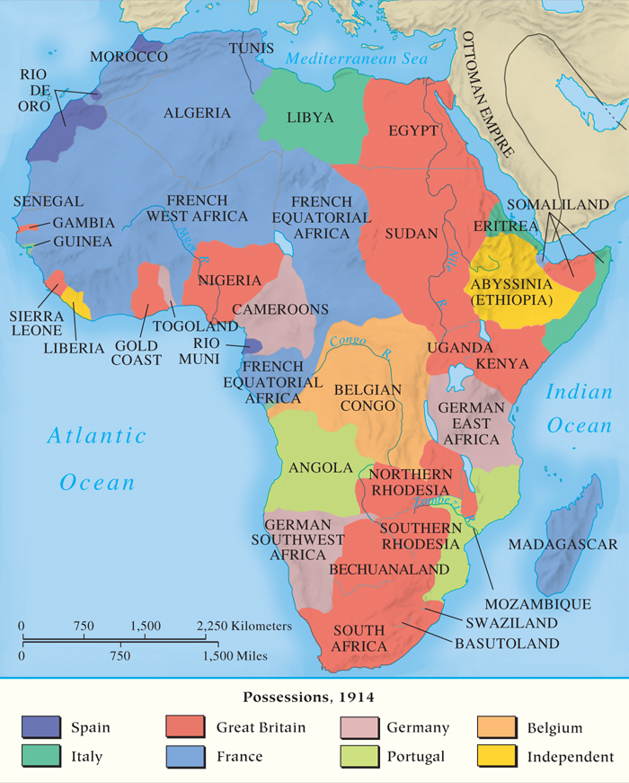
MAP 24.1 Africa in 1914
Map 24.1 p744
Notes:
MAP 24.1 Africa in 1914. The major European powers’ rush to acquire colonies was
motivated by a combination of factors: the need for ports and fueling stations for navies,
enhancement of international prestige, outlets for nationalist feelings, expression of social
Darwinism, and a desire to ‘‘civilize’’ non-Europeans.

Slide 58
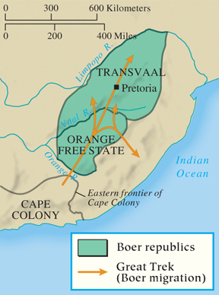
The Struggle for South Africa
p745
Notes:
The Struggle for South Africa

Slide 59
The Scramble for Africa (Slide 2 of 2)
Portuguese and French Possessions
  Portugal’s hold on Mozambique and Angola
  French expansion: Algeria, West Africa, Tunisia, and Morocco
Other British Possessions
  From Egypt and the Suez Canal to the Sudan
Belgium and Central Africa
  Leopold II (1865 – 1909) and the Congo
German Possessions
  Imperialism in South West Africa, Cameroon, Togoland, and East Africa
Impact on Africa

Slide 60
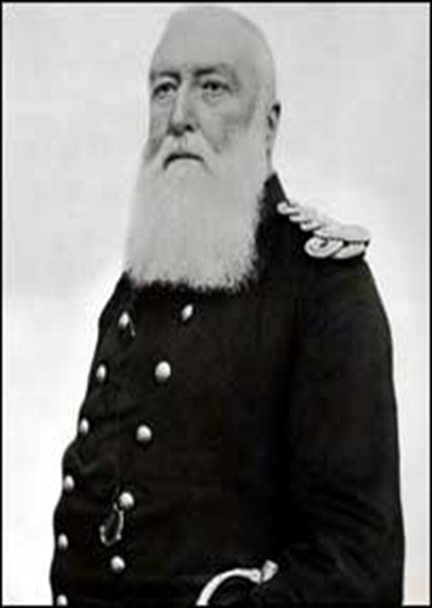
King Leopold II of Belgium

Slide 61
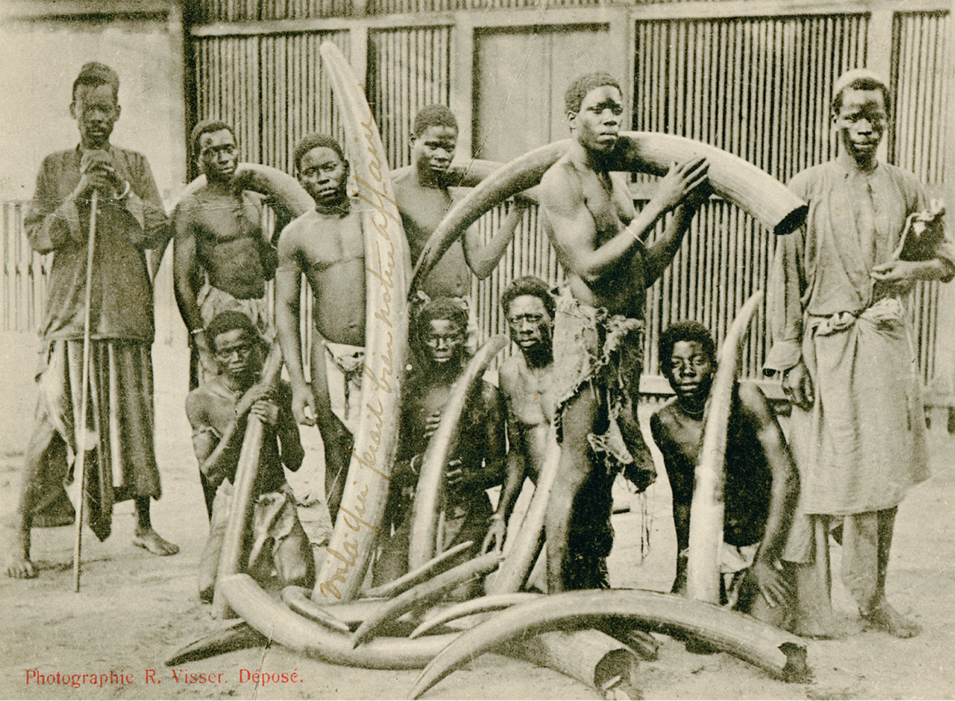

Slide 62
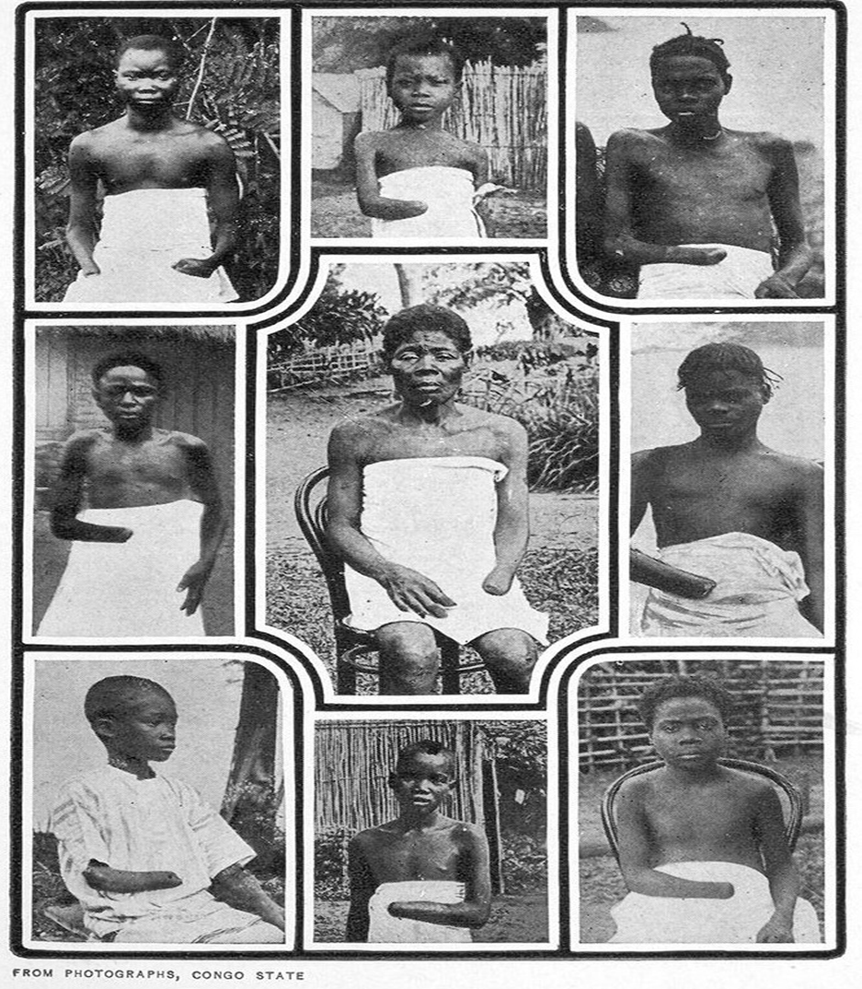

Slide 63
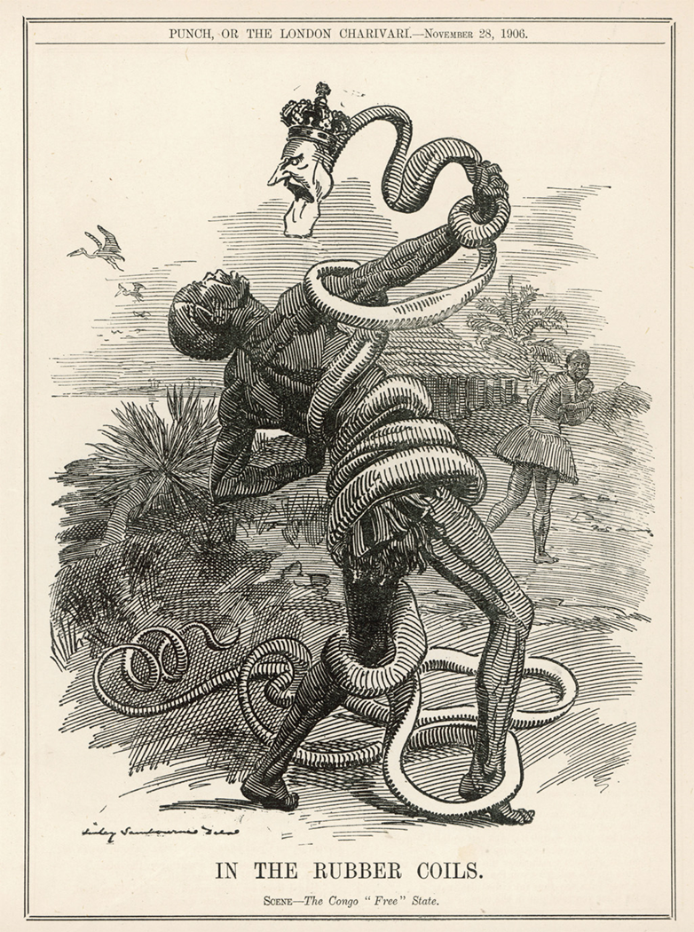

Slide 64
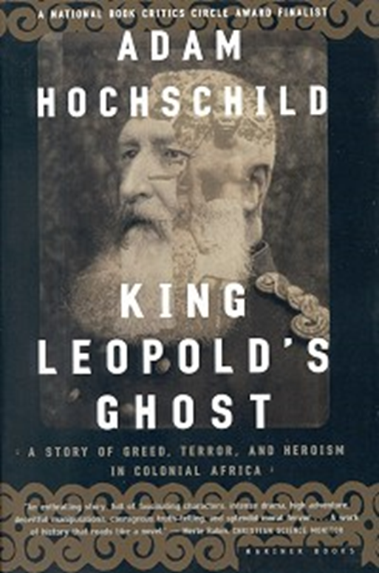


Slide 65
German Empire in Africa
Not much enthusiasm for imperialism; main motive was to compete against France and Britain.
In 1884 and 1885, Germany established protectorates over South-West Africa (today Namibia), Togoland, the Cameroons, and Tanganyika.
German imperialism was short-lived, involved few Germans, and produced no significant economic returns.
Genocide in South-West Africa
  1904 Genocide against the Herero people of South-West Africa: 80% of the pop. dead.

Slide 66
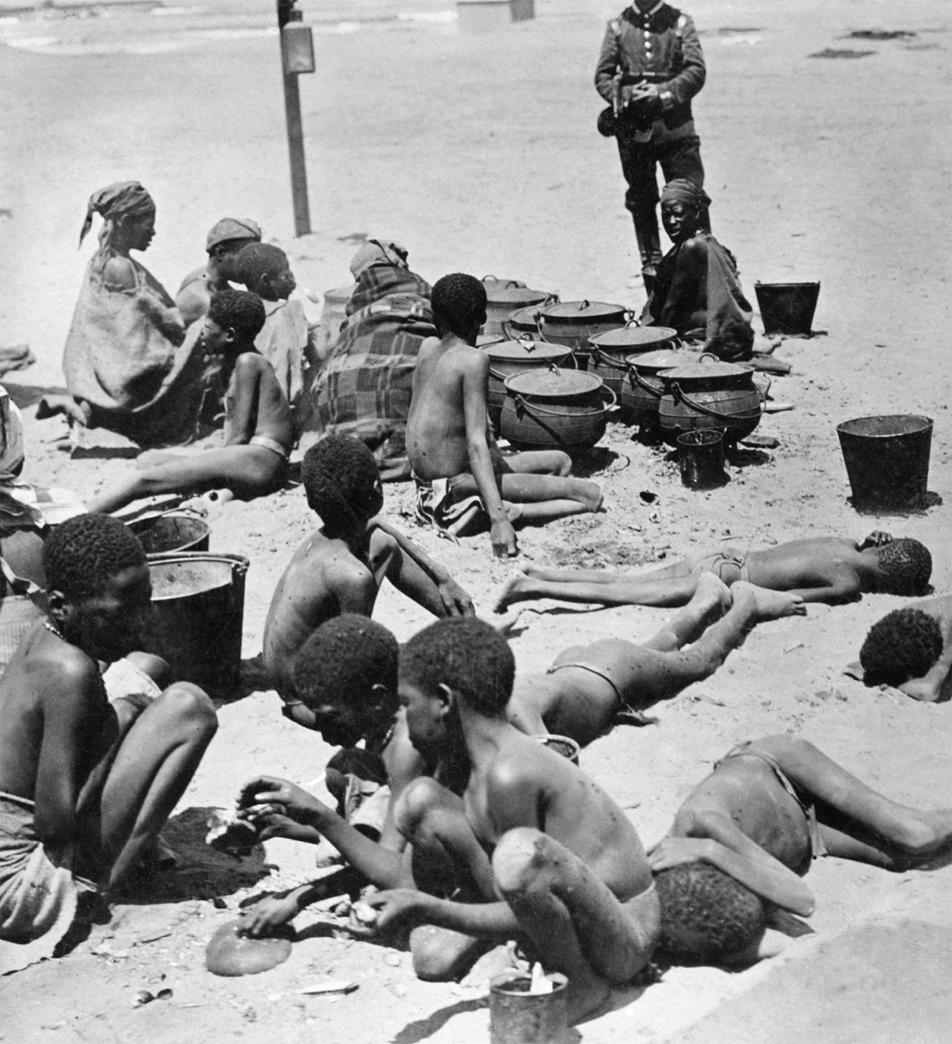
A German guards Herero women and children in German South-West Africa, 1906, in a prison camp.

Slide 67
CHRONOLOGY The New Imperialism: Africa
Event | Dates
Great Trek of the Boers | 1835
Opening of the Suez Canal | 1869
Leopold of Belgium establishes settlements in the Congo | 1876
British seizure of Transvaal | 1877
French conquest of Algeria | 1879
British expeditionary force in Egypt | 1882
Ethiopians defeat the Italians | 1896
Battle of Omdurman in the Sudan | 1898
Boer War | 1899–1902
Union of South Africa | 1910
Italians seize Tripoli | 1911
French protectorate over Morocco | 1912
p747
Notes:
CHRONOLOGY The New Imperialism: Africa

Slide 68
Imperialism in Asia
The British in Asia
  From private to imperial control in India, 1876
The Russians in Asia
  A product of Russia’s traditional expansionism
    Steady growth at the expense of the Ottoman Empire
    Temporary halt after defeat against Japan, 1905
China
  The Opium Wars- 1839
  Treaty of Nanjing (1842): British acquisition of Hong Kong
  Creation of Western spheres of influence

Slide 69
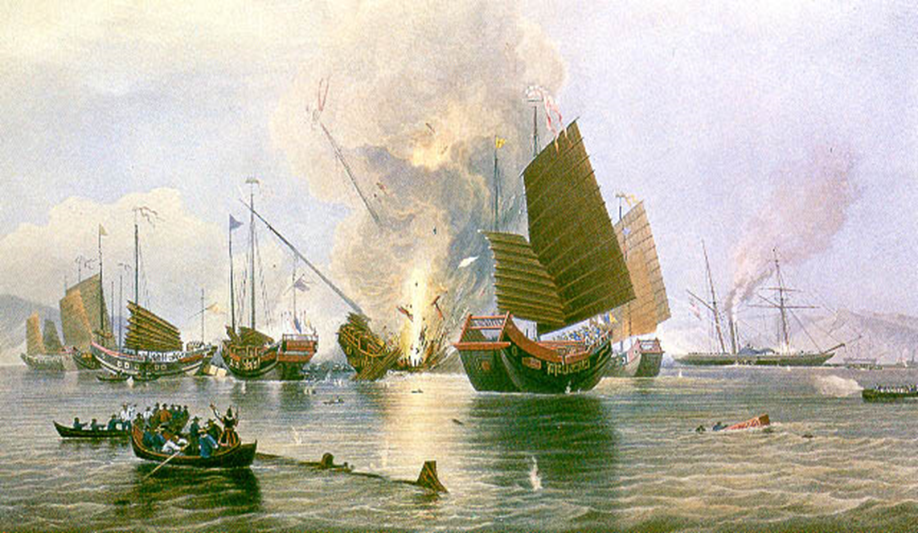
The Opium Wars, 1939

Slide 70
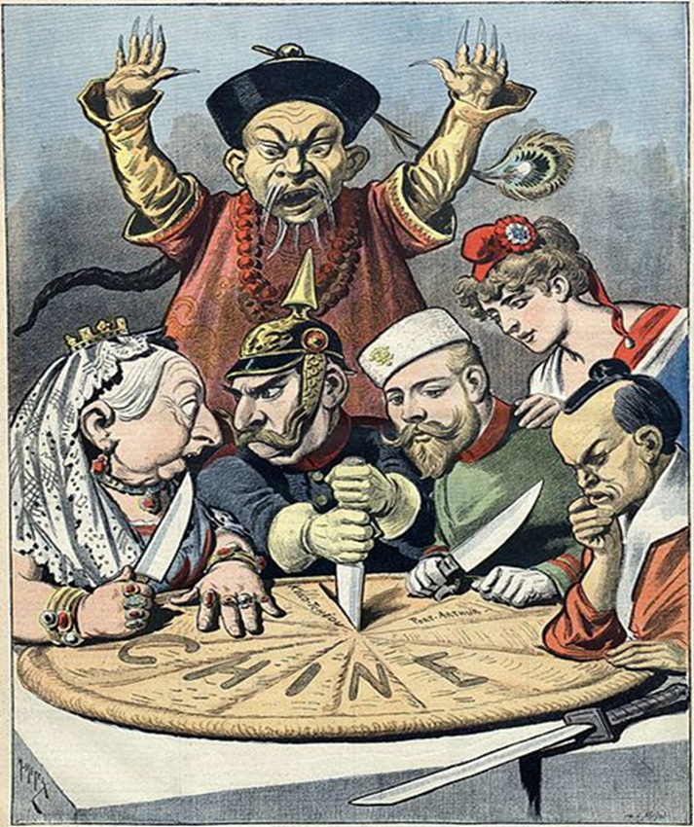
Imperial rivalry over China

Slide 71
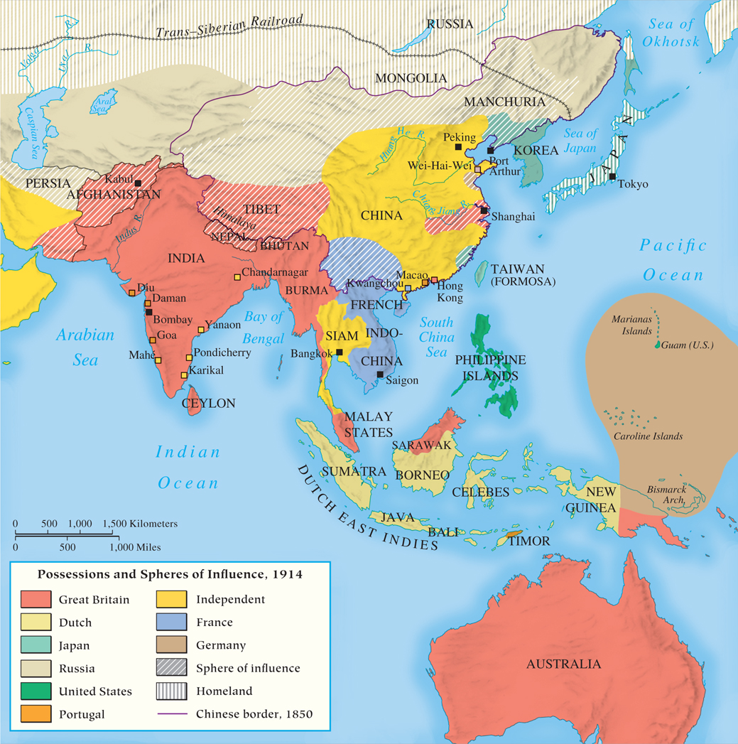
MAP 24.2 Asia in 1914
Map 24.2 p748
Notes:
MAP 24.2 Asia in 1914. Asia became an important arena of international competition in the
nineteenth and early twentieth centuries. Beset by economic stagnation and an inability to modernize,
a weak China was unable to withstand the demands of the United States, the European powers, and a
Westernizing Japan. Britain, France, Russia, Japan, and the United States had direct or indirect control
of nearly all of Asia by 1914.

Slide 72
Imperialism in Asia
Japan and Korea
  New contacts: Matthew Perry (USA)opens Japan, 1853-1854
    “If you can’t beat ‘em, join ‘em!”
  Japan’s emergence as a power allows for domination of Korea
Southeast Asia
  British and French control and rivalry
    French Indochina: Vietnam
American Imperialism
  The Spanish-American War, 1898
    The Philippines and Cuba

Slide 73
CHRONOLOGY The New Imperialism: Asia (Slide 1 of 2)
Event | Dates
Britain obtains Hong Kong and trading rights from Chinese government | 1842
Australian colonies receive self-government | 1850
Mission of Commodore Perry to Japan | 1853–1854
Rebellion of sepoys in India | 1857–1858
French occupy Saigon | 1858
Overthrow of the shogun in Japan | 1867
Emperor Mutsuhito and the Meiji Restoration | 1867–1912
Queen Victoria is made Empress of India | 1876
Russians in Central Asia (trans-Caspian area) | 1881
Formation of Indian National Congress | 1883
p749
Notes:
CHRONOLOGY The New Imperialism: Asia

Slide 74
CHRONOLOGY The New Imperialism: Asia (Slide 2 of 2)
Event | Dates
Japanese defeat of China | 1894–1895
Spanish-American War; United States annexes Philippines | 1898
“Open door” policy in China | 1899
Boxer Rebellion in China | 1900–1901
Commonwealth of Australia | 1901
Commonwealth of New Zealand | 1907
Russian-British agreement over Afghanistan and Persia | 1907
Japan annexes Korea | 1910
Overthrow of Manchu dynasty in China | 1912

Slide 75
Responses to Imperialism (Slide 1 of 2)
Africa
  New class of educated African leaders
  Resentment of foreigners for many exploited by imperial practices
    Complaints of the middle-class Africans
  Intellectual hatred of colonial rule
    Political parties and movements
China
  Antiforeign revolt: the failed Boxer Rebellion, 1900-1901
  Sun Yat-sen (1866 – 1925) and the fall of the Manchu dynasty, 1912
    Establishment of the Republic of China

Slide 76
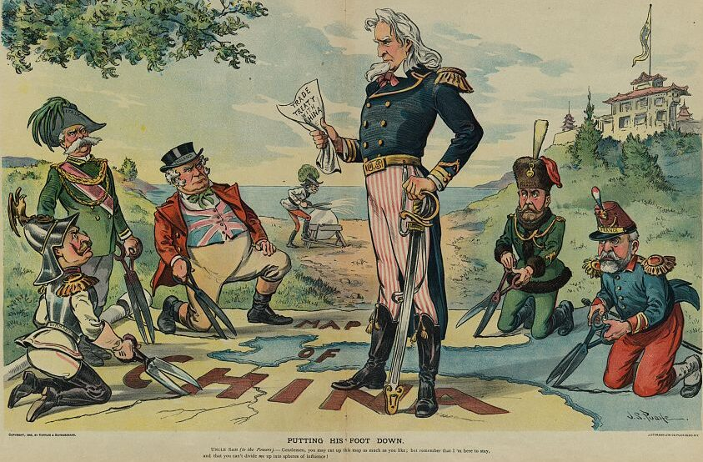
The U.S. Open Door Policy:
Did it help or hurt China?

Slide 77
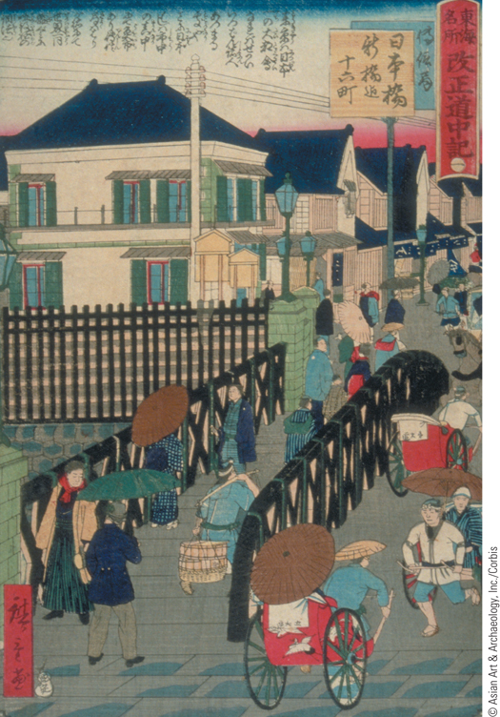
The West and Japan
In their attempt to modernize, the Japanese absorbed and adopted Western methods.
p750
Notes:
The West and Japan. In their attempt to modernize, the Japanese
absorbed and adopted Western methods. They were also influenced
by Western culture as Western fashions became the rage in elite circles.
Baseball was even imported from the United States. This painting
shows Western-style stone houses in Tokyo and streets filled with people
dressed in a variety of styles.

Slide 78
Responses to Imperialism (Slide 2 of 2)
Japan
  Mutsuhito, 1867 – 1912
    Meiji Era (Enlightened Government)
    Westernization of military and industry
India: “The Jewel in the Crown”
  Sepoy Rebellion leads to official colonization
  British control brings peace, honest government, Western technology, and Western education
  The price of British rule
    Extreme poverty
  Indian National Congress, 1883: Growth of Indian nationalism

Slide 79
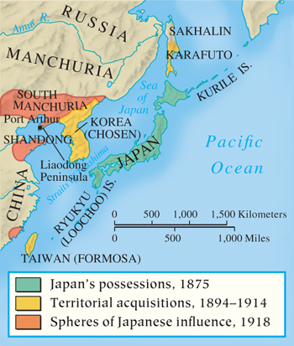
Japanese Expansion
p750
Notes:
Japanese Expansion

Slide 80
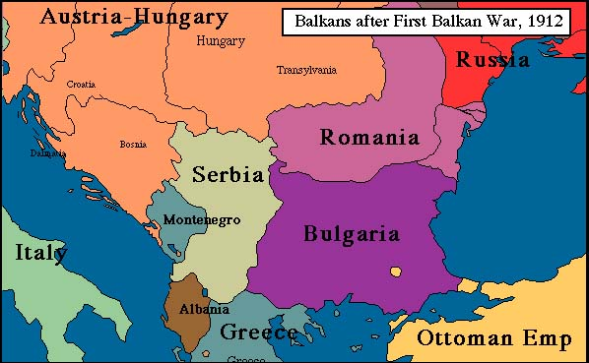

Slide 81
International Rivalry and the Coming of War
War could have broken out well before 1914, but it didn’t- because of Bismarck’s careful manipulation.
  **Bismarck was fired in 1890 by Emperor Wilhelm II.
Bismarck knew he had upset the balance of power in Europe, and that France was vengeful.
Made alliance with Russia and Austria-Hungary
  But it fell apart because Russia and Austria-Hungary were in conflict over the Balkans, and Bismarck had to restrain the two from going to war with each other!
Decline of the Ottoman Empire : “Sick man of Europe”
    It only survived as long as it did, because European nations distrusted each other with its remains. So long as it remained in tact, no one could technically “claim it”.

Slide 82
International Rivalry and the Coming of War
The Bismarckian System
  1876 Balkan Crisis: Bosnia and Montenegro attack the Ottoman Empire; Russia attacks the Ottomans as well
    Austria actually approves of this!
    Treaty of San Staefano 1878
    Creates Bulgaria, as a large Satellite state of Russia.
    Other European powers feel threatened, so they call:
      The Congress of Berlin, 1878:
      Dominated by Bismarck
      Treaty of San Stefano is trashed, Russia humiliated
      Bulgaria is established as a smaller state, while Serbia, Montenegro, and Romania are independent states (previously under Ottoman control)
      Bosnia and Herzegovina are placed under Austrian control
        A sort of balance of power is kept in place.

Slide 83
International Rivalry and the Coming of War
New Alliances
  Russia is angry at Germany
  Bismarck allies with Austria
  Italy secretly joins their alliance because they are angry at France over losing some North African colonies.
    → Triple Alliance, 1882: Germany, Austria, and Italy
    ALSO KNOWN AS THE CENTRAL POWERS
  Reinsurance Treaty between Russia and Germany, 1887: Bismarck tries to remain friendly with Russia, because he doesn’t want Russia to ally with France!
    But Bismarck is fired in 1890, and Wilhelm puts an end to that treaty so it doesn’t insult his BFF, Austria.

Slide 84
International Rivalry and the Coming of War
New Directions and New Crises
  Wilhelm wants Germany’s “place in the sun”
      Translation: He wants Germany to rule Europe.
    Russia is alienated, and allies with France in 1894.
      France is eager, since France HATES Germany
    Wilhelm tries to instigate a revolution in Morocco, a French colony.
    Britain does not like anyone messing with African colonies and inciting revolution, so they ally with France in solidarity.
    →Triple Entente, 1907: Britain, France, Russia
    ALSO KNOWN AS “THE ALLIES”

Slide 85
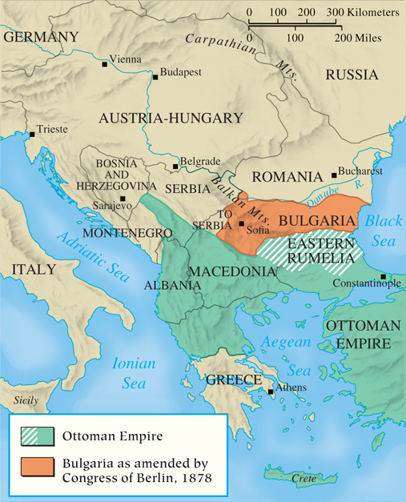
The Balkans in 1878
p752
Notes:
The Balkans in 1878

Slide 86
Crisis in the Balkans, 1908-1913
Setting the Stage for World War I
  Austrian annexation of Bosnia and Herzegovina, 1908: They weren’t supposed to do that!
    Serbian protest and Russian support of Serbia
    Austria does not wat a large Slavic state- it would threaten their empire.
    Kaiser Wilhelm intervenes and tells Russia to step back, or else.
      Russia complies, because they just got humiliated by Japan in the Russo-Japanese War.
  First Balkan War, 1912
    Balkan League (Serbia, Bulgaria, Montenegro, Greece) defeats the Ottomans
    Can’t figure out how to divide newly conquered, former Ottoman Macedonia and Albania

Slide 87
Crisis in the Balkans 1908-1913
Second Balkan War, 1913
  Greece, Serbia, Romania, and the Ottoman Empire attacked and defeated Bulgaria, because Bulgaria tried to take Macedonia and Albania itself.
  Serbia’s ambitions: they want Albanian port to the Adriatic Sea
  London Conference: Austria blocks this by making Albania independent.
    Germany applauds the move
    Serbia boils with rage at Austria
    Russia supports “Pan-Slavism”: the movement for a large independent Slavic state.
“Peace remains at the mercy of an accident.”

Slide 88
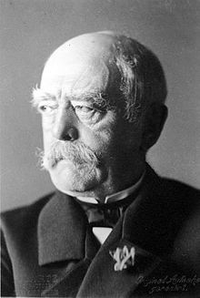
“One day, the great European war will come out of some damned foolish thing in the Balkans.”
- Otto von Bismarck,
1888

Slide 89
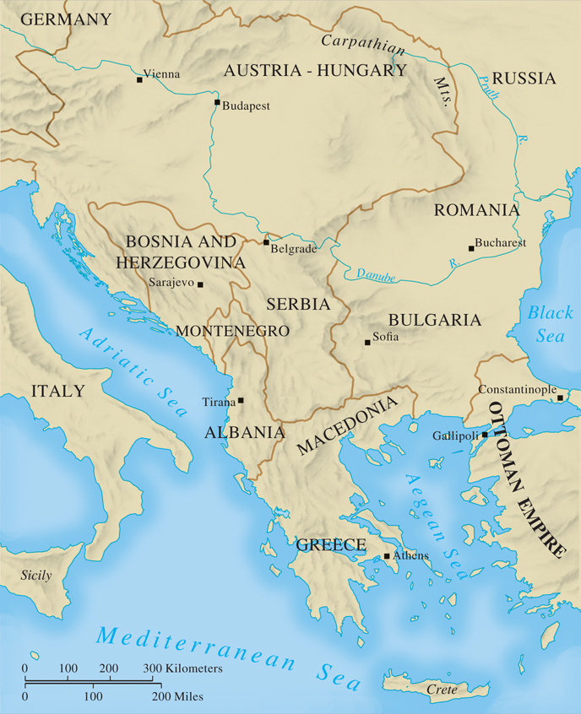
MAP 24.3 The Balkans in 1913
Map 24.3 p753
Notes:
MAP 24.3 The Balkans in 1913. The
First Balkan War (1912) liberated most of
the region from Ottoman control; the
Second Balkan War (1913) increased the
size of Greece and Serbia at Bulgaria’s
expense. Russia supported the ambitions
of its fellow Slavs in Serbia, who sought
to create a large Slavic kingdom in the
Balkans. Austria and its ally Germany
opposed Serbia’s ambitions.

Slide 90
CHRONOLOGY European Diplomacy
Event | Dates
Three Emperors’ League | 1873
Serbia and Montenegro attack the Ottoman Empire | 1876
Treaty San Stefano | 1878
Congress of Berlin | 1878
Defensive alliance: Germany and Austria | 1879
Triple Alliance: Germany, Austria, and Italy | 1882
Reinsurance Treaty: Germany and Russia | 1887
Military alliance: Russia and France | 1894
Triple Entente: France, Britain, and Russia | 1907
First Balkan War | 1912
Second Balkan War | 1913
p753
Notes:
CHRONOLOGY European Diplomacy

Slide 91
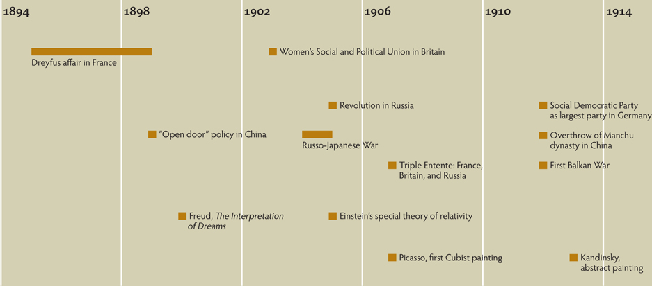
Chapter Timeline
p754

Slide 92
Discussion Questions
How did the “new view” of science change thinking about the universe?
What radical changes in concepts about human behavior followed as a result of Sigmund Freud’s work?
What was the new racism? How were Darwin’s ideas of natural selection transformed to apply to civilization?
Support or refute: Imperialism was beneficial to the nations in which it occurred.
Why would the European nations worry about the rise of a militaristic Germany?

