Slide 1
The Beginning of the Twentieth-Century Crisis: War and Revolution
Chapter 25

Slide 2
Focus Questions
​What were the long-range and immediate causes of World War I?
​What did the belligerents expect at the beginning of World War I, and why did the course of the war turn out to be so different from their expectations? How did World War I affect the belligerents’ governmental and political institutions, economic affairs, and social life?
​What were the causes of the Russian Revolution of 1917, and why did the Bolsheviks prevail in the civil war and gain control of Russia?
​What were the objectives of the chief participants at the Paris Peace Conference of 1919, and how closely did the final settlement reflect these objectives?

Slide 3
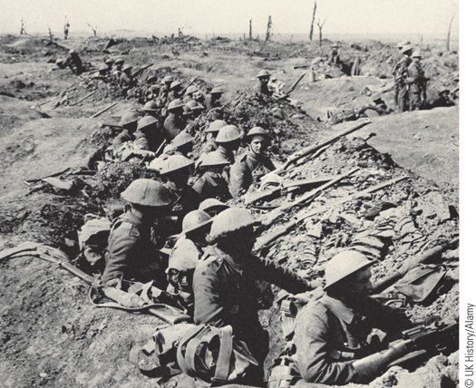
British infantrymen prepare to advance during the Battle of the Somme
p757
Notes:
British infantrymen prepare to advance during the Battle of the Somme

Slide 4
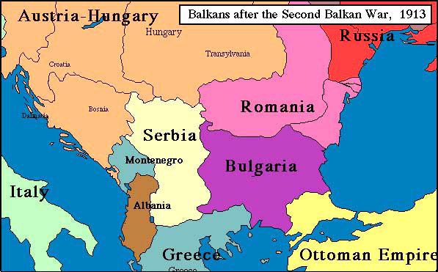
“One day, the great European war will come out of some damned foolish thing in the Balkans.”
- Otto von Bismarck, 1888.

Slide 5
The Road to World War I
Nationalism
System of emerging nation-states led to competition instead of cooperation
The dangers of the diplomacy of brinksmanship
French resentment over Alsace and Lorraine
Russian support of Pan-Slavism
Internal Dissent
Challenges from dissatisfied minorities and labor movements
Militarism
Mass armies and the practice of conscription
Growing influence of military leaders
Lack of flexibility in military plans

Slide 6
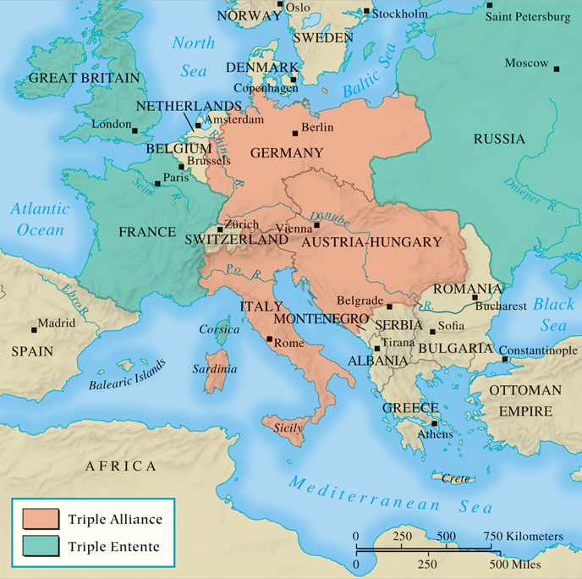
MAP 25.1 Europe in 1914
Map 25.1 p759
Notes:
MAP 25.1 Europe in 1914. By 1914,
two alliances dominated Europe: the Triple
Entente of Britain, France, and Russia and
the Triple Alliance of Germany, Austria-
Hungary, and Italy. Russia sought to bolster
its fellow Slavs in Serbia, whereas Austria-
Hungary was intent on increasing its power
in the Balkans and thwarting Serbia’s
ambitions. Thus, the Balkans became the
flash point for World War I.

Slide 7
The Road to World War I
The Outbreak of War: the Summer of 1914
Another crisis in the Balkans
Preexisting tensions and rivalries
Backdrop of mutual distrust and hatred for competing powers (Russia, Austria-Hungary, and Serbia)
The Assassination of Archduke Francis Ferdinand and wife Sophia: June 28, 1914
German pledge of “full support” to Austria
Historians Debate: The Assassination of Francis Ferdinand: A Blank Check?
Declarations of War
Mobilization and ultimatums
Involving western powers: the Schlieffen Plan

Slide 8
The Chain of Events
June 28, 1914: Assassination of Archduke Franz Ferdinand in Sarajevo, Bosnia, by Gavrilo Princip- a member of “The Black Hand”.
Also known as “Unity or Death” by the Slavs
Austria issues ridiculous ultimatum
Serbia rejects most of it, to preserve its autonomy
Germany offers Austria a “blank check” (?)
July 28, 1914: Austria declares war on Serbia
July 29: Czar Nicholas II order mobilization of military
August 1: Germany declares war on Russia

Slide 9
The Chain of Events
August 3: Germany declares war on France
The Schlieffen Plan (1894) created just for this purpose: Germany knew it would find itself in a two-front war.
Minimal troop deployment against Russia, because Russia would be slow
Quickly invade France, surround Paris by surprise via an invasion of Belgium.
Then crush Paris and swing to the east to defeat Russia.
Flawless plan; we’ll all be home by Christmas

Slide 10
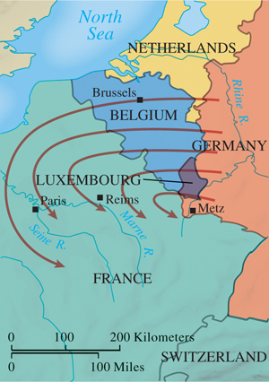
The Schlieffen Plan
p764
Notes:
The Schlieffen Plan

Slide 11
The Chain of Events: completed
Belgium is neutral, and had promised neutrality in 1839 in exchange for independence.
Britain had sworn to protect it.
August 4: Britain declares war on Germany
Did Britain have other motives for entering the war??
What if Germany and Austria had won, and Britain had remained neutral? What would become of Britain, without friends?

Slide 12
CHRONOLOGY The Road to World War I
Event | 1914
Assassination of Archduke Francis Ferdinand | June 28
The “blank check” | July 5
Austria’s ultimatum to Serbia | July 23
Austria declares war on Serbia | July 28
Russia mobilizes | July 29
Germany’s ultimatum to Russia | July 31
Germany declares war on Russia | August 1
Germany declares war on France | August 3
German troops invade Belgium | August 4
Great Britain declares war on Germany | August 4
p760
Notes:
CHRONOLOGY The Road to World War I

Slide 13
The War 1914-195: Illusions & Stalemate
Attitudes toward the Outbreak of War
Excitement and belief in quick victory
War in the West
Failure of the Schlieffen Plan
First Battle of the Marne, September 6-10, 1914
War in the East
Russian failures
Battle of Tannenberg, August 30, 1914
Battle of Masurian Lakes, September 15, 1914
Austria: initial failures followed by success
Galicia and Serbia

Slide 14
Trenches of the Western Front

Slide 16
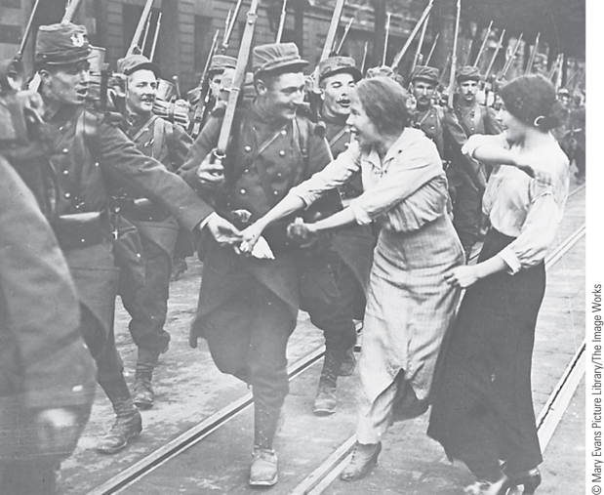
The Excitement of War (Slide 1 of 2)
World War I was greeted with incredible enthusiasm. Each of the major belligerents was convinced of the rightness of its cause.
p762
Notes:
The Excitement of War. World War I was greeted with incredible enthusiasm.
Each of the major belligerents was convinced of the rightness of its cause. The photograph shows a group of German soldiers marching off to battle with
civilian support. The belief that the soldiers would be home by Christmas proved to
be a pathetic illusion.

Slide 17
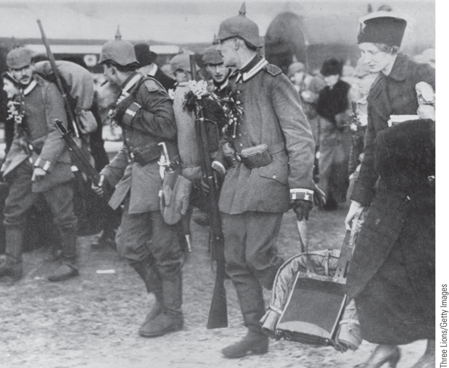
The Excitement of War (Slide 2 of 2)
Everywhere in Europe, jubilant civilians sent their troops off to war with joyous fervor as is evident in the photograph, showing French troops marching off to war.
p762
Notes:
The Excitement of War. World War I was greeted with incredible enthusiasm.
Each of the major belligerents was convinced of the rightness of its cause. Everywhere
in Europe, jubilant civilians sent their troops off to war with joyous fervor as is
evident in the photograph showing French troops marching off to war.

Slide 18
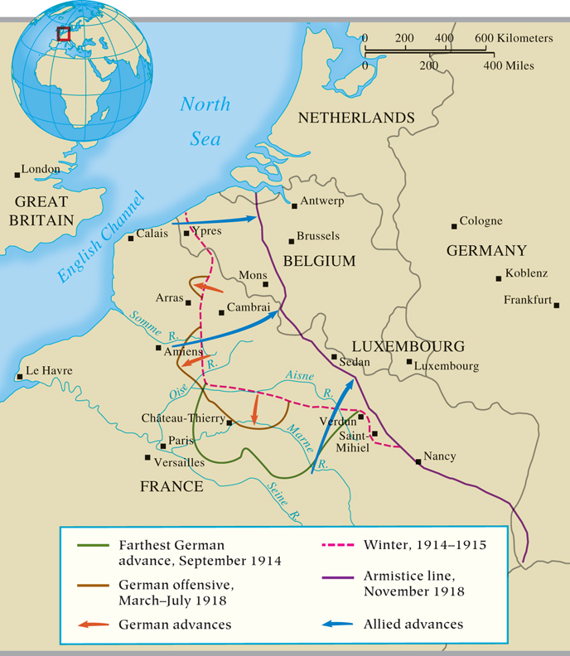
MAP 25.2 The Western Front, 1914–1918
Map 25.2 p764
Notes:
MAP 25.2 The Western Front, 1914–
1918. The Western Front was the site of
massive carnage: millions of soldiers died in
offensives and counteroffensives as they
moved battle lines only a few miles at a
time in France and Belgium from 1914 to
1917. Soldiers in the trenches were often
surrounded by the rotting bodies of dead
comrades.

Slide 19
The War 1916-1917: The Great Slaughter
“No-Man’s Land”
Strategy for breaking the stalemate
“Softening up” the enemy with artillery, followed by an attempt to go “over the top”
Battle of Verdun: 700,000 lost
Symbolic of the senseless of trench warfare
Daily Life in the Trenches
Horrors of sights, sounds and smells
Intervals of boredom and terror
The “live and let live” system
Comradeship

Slide 20
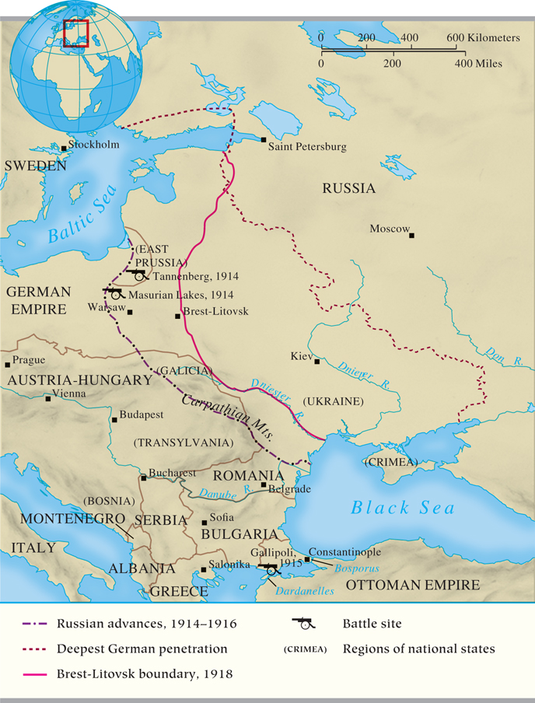
MAP 25.3 The Eastern Front, 1914-1918
Map 25.3 p765
Notes:
MAP 25.3 The Eastern Front, 1914–
1918. Russia made early gains but then
was pushed far back into its own territory
by the German army. After the Bolsheviks
seized power, they negotiated the Treaty
of Brest-Litovsk, which extracted Russia
from the war at the cost of substantial
Russian territory (see Map 25.4).

Slide 21
The Widening of the War
New Antagonists
Entry of Ottoman Empire, Italy, and Bulgaria into the war, 1914-1915
A Global Conflict
Middle East
Lawrence of Arabia (1888 – 1935)
War in Africa and impact on Africans
Entry of the United States
Undoing U.S. neutrality
Sinking of the Lusitania: May 7, 1915
Unrestricted submarine warfare resumes: January 1917
United States enters the war, April 6, 1917

Slide 22
A New Kind of Warfare
New Technology
Airplanes
Machine Guns
Zeppelins
Tanks

Slide 23
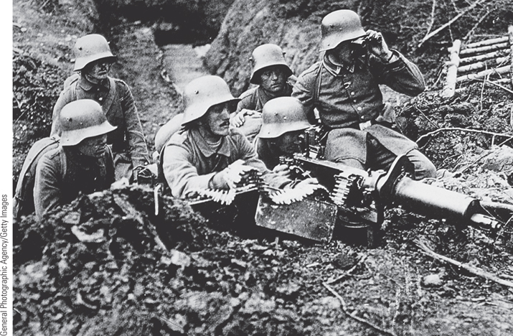
Impact of the Machine Gun
Trench warfare on the Western Front stymied military leaders, who had expected to fight a war based on movement and maneuver.
p766
Notes:
Impact of the Machine Gun. Trench
warfare on the Western Front stymied
military leaders, who had expected to fight a
war based on movement and maneuver.
Their efforts to effect a breakthrough by
sending masses of men against enemy lines
were the height of folly in view of the brutal
efficiency of the machine gun. This
photograph shows a group of German
soldiers in their machine-gun nest.

Slide 24
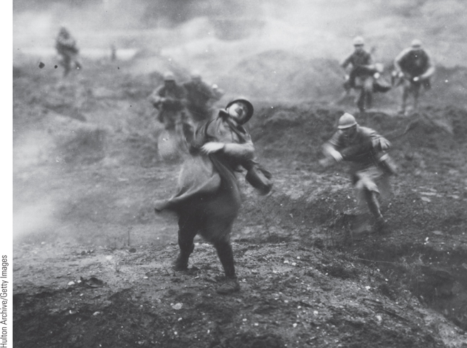
Victims of the Machine Gun
Masses of men weighed down with equipment and advancing slowly
across open land made magnificent targets for opponents armed with machine guns.
p766
Notes:
Victims of the Machine Gun. Masses of men
weighed down with equipment and advancing slowly
across open land made magnificent targets for
opponents armed with machine guns. This
photograph shows French soldiers moving across a
rocky terrain, all open targets for their enemies
manning the new weapons.

Slide 25
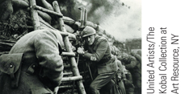
Film & History: Paths of Glory (1957)
Colonel Dax (Kirk Douglas) begins to lead his men out of the trenches to attack Ant Hill.
p768
Notes:
Colonel Dax (Kirk Douglas) begins to lead his men out of the trenches to attack
Ant Hill.

Slide 26
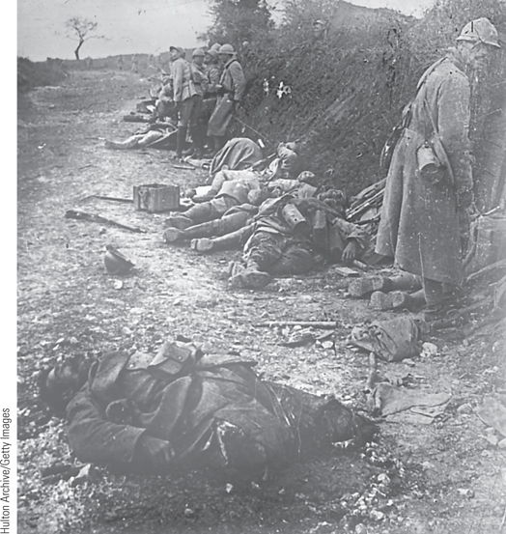
Images of Everyday Life: Life in the Trenches (Slide 1 of 3)
For the sake of survival, many soldiers learned to harden themselves against the stench of decomposing bodies and the sight of bodies horribly dismembered by artillery barrages.
p769
Notes:
Life in the Trenches

Slide 27
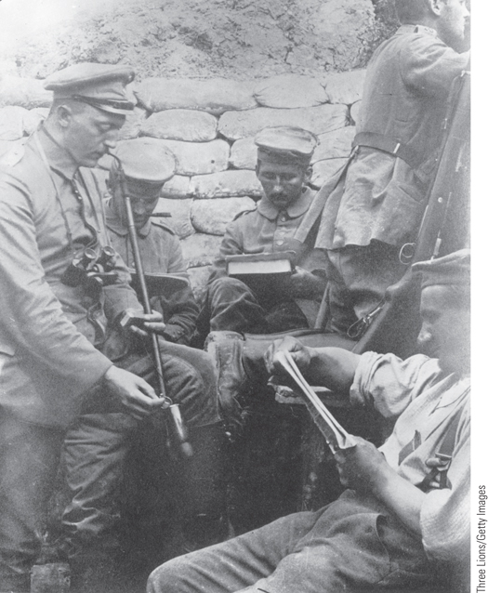
Images of Everyday Life: Life in the Trenches (Slide 2 of 3)
Life in the trenches could also be boring, and soldiers whiled away the time as best they could when they were not fighting.
p769
Notes:
Life in the Trenches

Slide 28
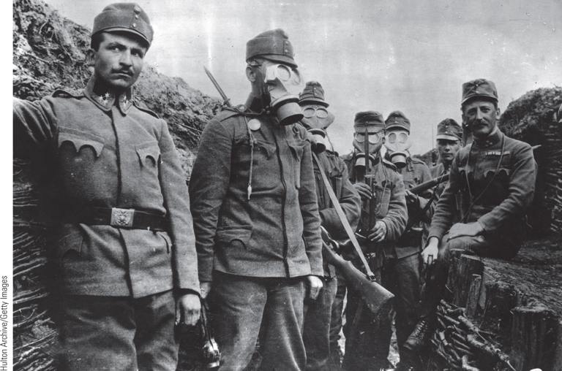
Images of Everyday Life: Life in the Trenches (Slide 3 of 3)
The introduction of poison gas in 1915 led quickly to the use of protective gas masks.
p769
Notes:
Life in the Trenches

Slide 29
The Home Front: The Impact of Total War
Total War: Political Centralization and Economic Regimentation
Conscription
Effects on economics
Impact of nationalization
Uneven success among the European states in shifting to total war
Germany’s planned economy
Dramatic increases in power of central governments in Britain and France
Limited successes in Russia, Austria-Hungary, and Italy

Slide 30
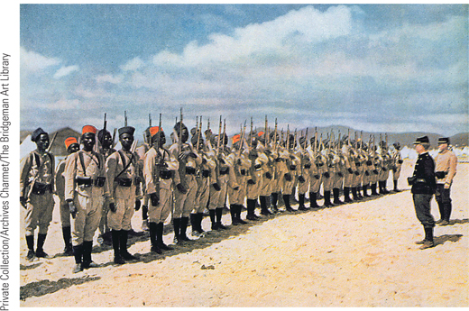
Global Perspectives: Soldiers from Around the World (Slide 1 of 2)
The French drafted more than 170,000 troops to fight in Europe. Shown in the photograph are French Senegalese troops as they arrived in France in 1915.
p771
Notes:
French African Troops.
The French drafted more than 170,000 troops to fight in Europe. Shown in the photograph are French Senegalese troops as they arrived in France in 1915. They would later fight in the Marne campaign on the western front. About 80,000 Africans were killed or injured in Europe.

Slide 31
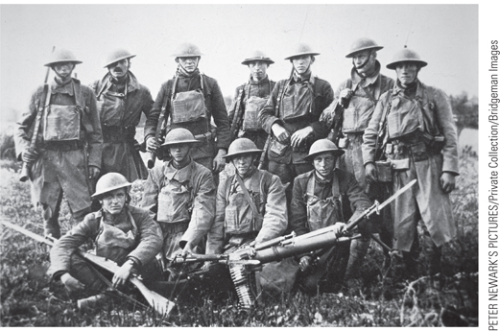
Global Perspectives: Soldiers from Around the World (Slide 2 of 2)
The photo shows a group of American soldiers with a German machine captured during an offensive in 1918.
p771
Notes:
American Soldiers (p.771)
The photo shows a group of American soldiers with a German machine captured during an offensive in 1918.

Slide 32
The Home Front: The Impact of Total War (Slide 1 of 2)
Public Order and Public Opinion
Dealing with unrest
Strikes and revolutionary upheavals
Opposition to the war from liberals and socialists
Expansion of police powers
Defense of the Real Act in Britain
Propaganda
Growing need to revive flagging enthusiasm for the war

Slide 33
The Home Front: The Impact of Total War (Slide 2 of 2)
The Social Impact of Total War
Labor benefits
End of unemployment
Power of the trade unions
New roles for women
Women’s demand for equal pay
Gains achieved but not equality
Post-war removal of women from workforce
Impact on women’s movement for social and political emancipation
Right to vote: Britain, Germany, Austria, and the U.S.
War both leveled and exacerbated social hierarchies

Slide 34
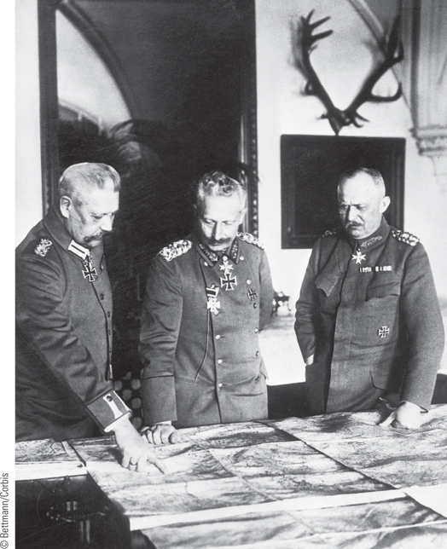
The Wartime Leaders of Germany
Over the course of the war, the power of central governments was greatly enlarged in order to meet the demands of total war. In Germany, the two military heroes of the war, Paul von Hindenburg (left) and Erich Ludendorff (right), became virtual military dictators by 1916.
p773
Notes:
The Wartime Leaders of Germany. Over the course of the war, the
power of central governments was greatly enlarged in order to meet the
demands of total war. In Germany, the two military heroes of the war,
Paul von Hindenburg (left) and Erich Ludendorff (right), became virtual
military dictators by 1916. The two are shown here with Emperor
William II (center), whose power declined as the war dragged on.

Slide 35
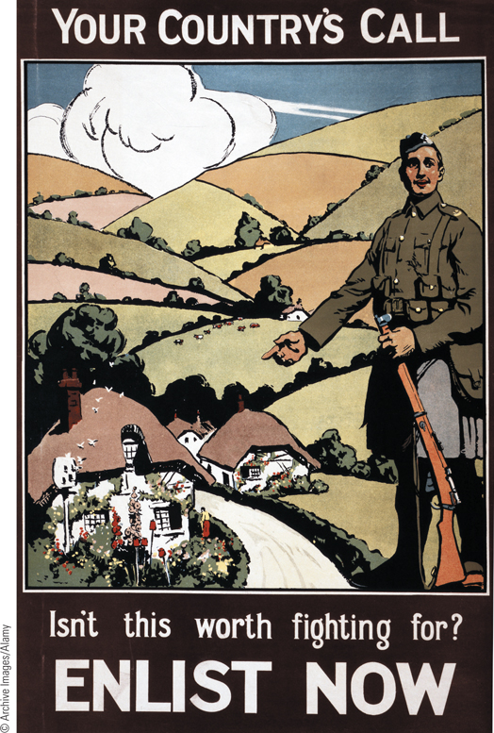
British Recruiting Poster
As the conflict persisted month after month, governments resorted to active propaganda campaigns to generate enthusiasm for the war.
p774
Notes:
British Recruiting Poster. As the conflict persisted month after
month, governments resorted to active propaganda campaigns to
generate enthusiasm for the war. In this British recruiting poster, the
government encourages men to ‘‘enlist now’’ to preserve their country.
By 1916, the British were forced to adopt compulsory military service.

Slide 36
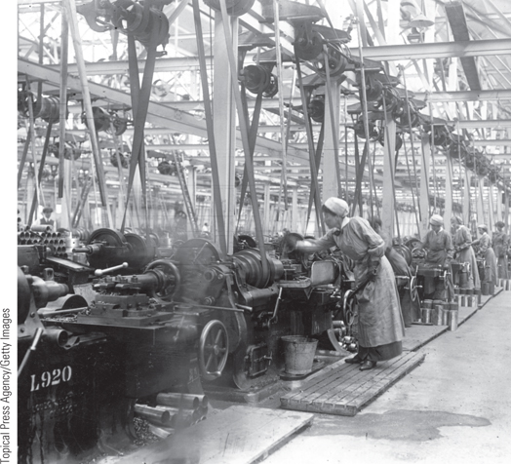
Women Munition Workers in a British Factory (Slide 1 of 2)
World War I created new opportunities for women. They were now employed in jobs that had earlier been considered beyond their capacity.
p776
Notes:
Women Munition Workers in a British Factory. World War I
created new opportunities for women. They were now employed in jobs
that had earlier been considered beyond their capacity. As seen in the
picture, British women, dressed in caps and smocks, are
making munitions in an armaments factory.

Slide 37
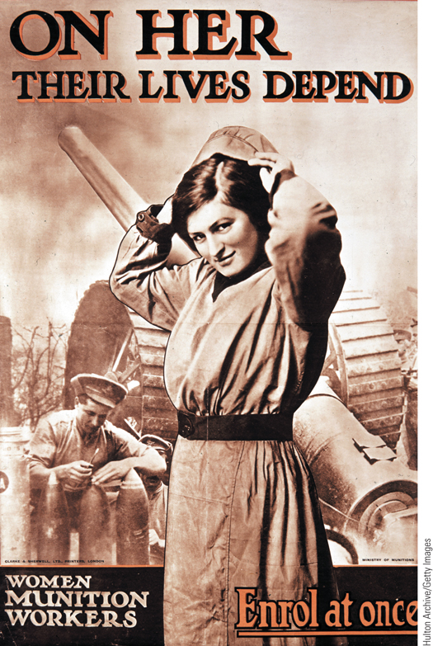
Women Munition Workers in a British Factory (Slide 2 of 2)
The recruitment poster shows that the British government encouraged women to work in the munitions factories to aid the war effort.
p776
Notes:
Women Munition Workers in a British Factory. The recruitment poster shows that the British government encouraged women to work in
the munitions factories to aid the war effort. Women working in these
factories were often nicknamed ‘‘munitionettes.’’

Slide 38
War and the Russian Revolution
The coming of complete collapse, 1917
Autocratic rule under Nicholas II
1905 Revolution had not accomplished much- the Duma was powerless, discontent continued.
Middle class and liberal aristocrats were angry
Russian industry was limited, and conditions were awful.
Nicholas relied on army and secret police (the Okrana) to uphold his authority.
Exposure of Russia’s ill-preparedness for war
2 million dead in 1914-1916, 4-6 million wounded
Government distrusted its own people
Influence of Rasputin over Alexandra
Even conservatives were angry
Prince Felix Yusopov, the czar’s nephew, murdered Rasputin in December 1916.

Slide 39
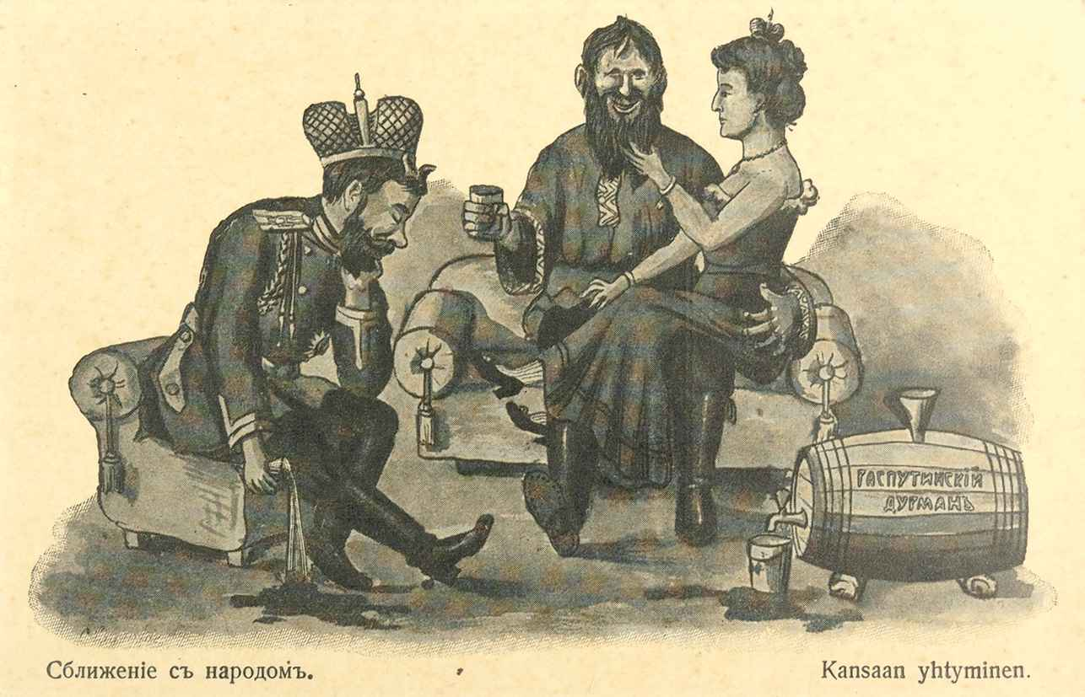
Anti-Romanov propaganda

Slide 40
The Russian Revolution
The March Revolution
Problems in Petrograd
Czar Nicholas was away at the front.
Bread riots →March of the women, March 8, 1917
Calls for a general strike
Soldiers ordered to stop the riots actually join the marchers
Nicholas is forced to abdicate: March 15, 1917
Provisional Government takes control- led by Alexander Kerensky, a liberal in the Duma
The Provisional Gov decides to stay in the war- a very unpopular move.

Slide 41
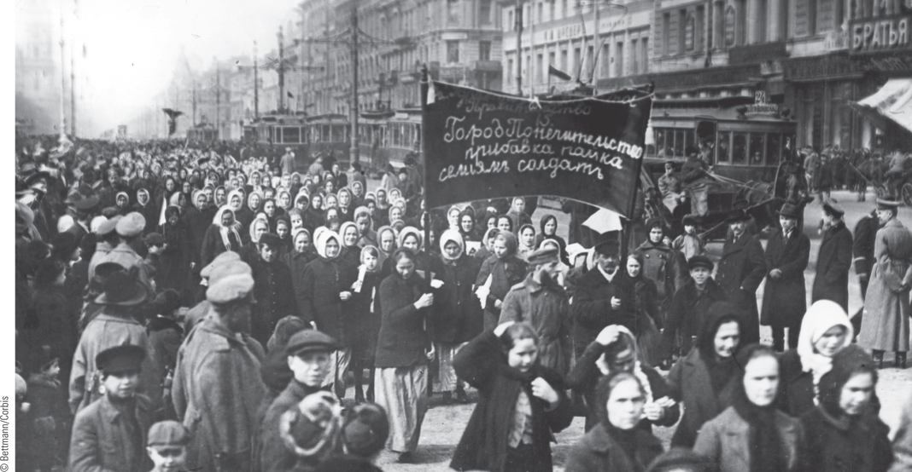
The Women’s March in Petrograd
After the imposition of bread rationing in Petrograd, 10,000 women engaged in mass demonstrations and demanded ‘‘Peace and bread’’ for the families of soldiers.
p778
Notes:
The Women’s March in Petrograd. After the imposition of bread rationing in Petrograd, 10,000
women engaged in mass demonstrations and demanded ‘‘Peace and bread’’ for the families of soldiers.
This photograph shows the women marching through the streets of Petrograd on March 8, 1917.

Slide 42
The Russian Revolution
Emergence of the soviets- councils of workers and soldiers
Represent interests of radical working class
The local authorities that took control of various cities.
Bolsheviks- Led by V.I. Lenin
Small, very radical faction of Russian Social Democrats
Mensheviks- more moderate, larger faction of Social Democrats, wanted to be a mass electoral party like in Western Europe.
The expulsion and return of V. I. Lenin (1870 – 1924)

Slide 43
How did Lenin modify Marx’s ideas?
Marx
Capitalism is a dictatorship of the rich over the workers (proletariat).
Three factors of capitalism that will promote a class struggle: unequal wealth, private ownership of capital, and exploitation of workers.
Lenin
Emphasized Marx’s revolutionary theory and not his economic views.
The working class will never rise up and seize power, because they are too easily satisfied by small wage raises or other small changes.

Slide 44
How did Lenin modify Marx’s ideas?
Marx:
3. When the time is right, revolution would occur SPONTANEOUSLY.
4. Expected revolution to occur in Germany or England because it was advanced economically and had a large proletariat.
Lenin:
3. Violent seizure of political power is the only way to socialism (his nickname was “Robespierre”)
4. Power must be seized at the first opportunity- regardless of economic condition or the proletariat’s population.

Slide 45
How did Lenin modify Marx’s ideas?
Marx:
5. Never believed that a small group should lead the revolution in the name of the people.
Bottom line: Violence/revolution would occur naturally when capitalist conditions got bad enough.
Lenin:
5. The proletariat must be guided to revolution, directed by a small, tightly organized group to smash capitalism through violence.
Bottom line: Revolution will be direct, violent, and led by a small organized group and create a new world order.

Slide 46
Russian Revolution
The Bolshevik Revolution
Lenin arrives in Russia, April 3, with help from German High Command
April 20: April Theses
Bolshevik control
Creating a new Soviet government
“All Power to the Soviets!”
“Peace, Land, and Bread!”
“Worker control of production”
Won control of Moscow and Petrograd Soviets
Provisional Government lost control; soldiers on the front abandoned post and went home to participate in peasant land seizures.
New social and economic policies
Peace: Treaty of Brest-Litovsk

Slide 47
The Russian Revolution
Civil war: 1917-1921
Bolshevik (Red) Army versus Anti-Bolshevik (White) Army
Leon Trotsky led Red Army with brutal discipline
Red Terror by the Cheka
Differences within the White Army
Red Army had to fight on many fronts, deflected attempts of several “white” armies to take over.
Royal family was murdered in 1918
By 1921, Communists took over independent governments in Georgia, Azerbaijan, and Armenia.
“war communism”: Lenin’s brutal policy of nationalizing industries, municipalities, and taking peasant’s grain and land during the war.
Forced kulaks to submit or be executed.

Slide 48
The Russian Revolution
Terror: both sides committed atrocities and terrorist acts
Cheka claimed to only kill bourgeois, but in reality killed more proletariat and anyone who opposed the Reds. (sound familiar?)
Invasion of allied troops
Actually helped the Red Army stir up patriotism for their cause.
1921: Communist control of Russia
Came at enormous cost of life and destruction
Russia, or the Soviet Union, was a bureaucratically centralized state, dominated by a single party.
Made possible by WWI, and impacted the course of the war as well.

Slide 49
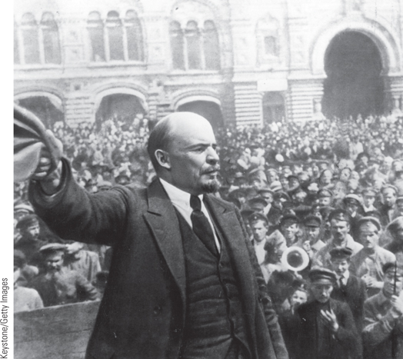
Lenin and Trotsky (Slide 1 of 2)
Lenin is seen addressing a rally in Moscow in 1917.
p780
Notes:
Lenin and Trotsky. V. I. Lenin and Leon Trotsky were important
figures in the Bolsheviks’ successful seizure of power in Russia. Lenin is seen addressing a rally in Moscow in 1917.

Slide 50
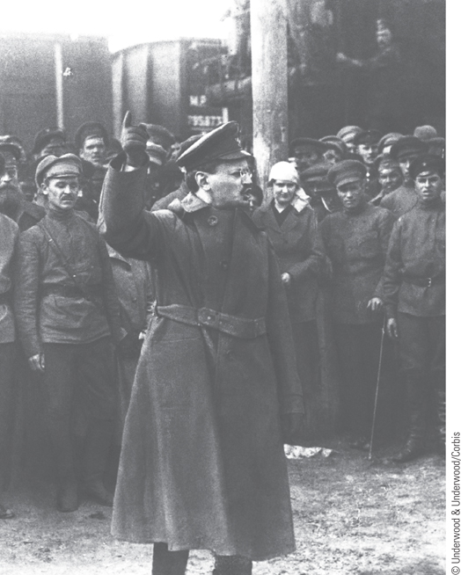
Lenin and Trotsky (Slide 2 of 2)
Trotsky, who became commissar of war in the new regime, is shown haranguing the troops of the Red Guard in 1918.
p780
Notes:
Lenin and Trotsky. V. I. Lenin and Leon Trotsky were important
figures in the Bolsheviks’ successful seizure of power in Russia.
Trotsky, who became commissar of war in the new regime, is shown
haranguing the troops of the Red Guard in 1918.

Slide 51
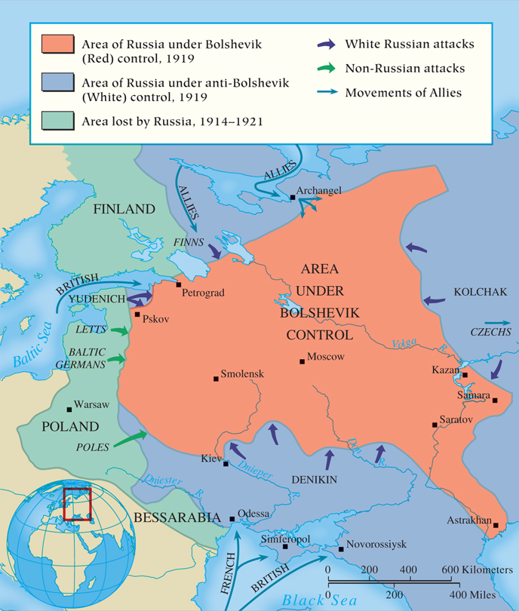
MAP 25.4 The Russian Revolution and Civil War
Map 25.4 p782
Notes:
MAP 25.4 The Russian Revolution and Civil War. The Russian Civil War lasted from 1918 to
1921. A variety of disparate groups, including victorious powers from World War I, sought to
either overthrow the Bolsheviks or seize Russian territory. Lack of cohesion among their
enemies helped the Bolsheviks triumph, but at the cost of much hardship and bloodshed.

Slide 52
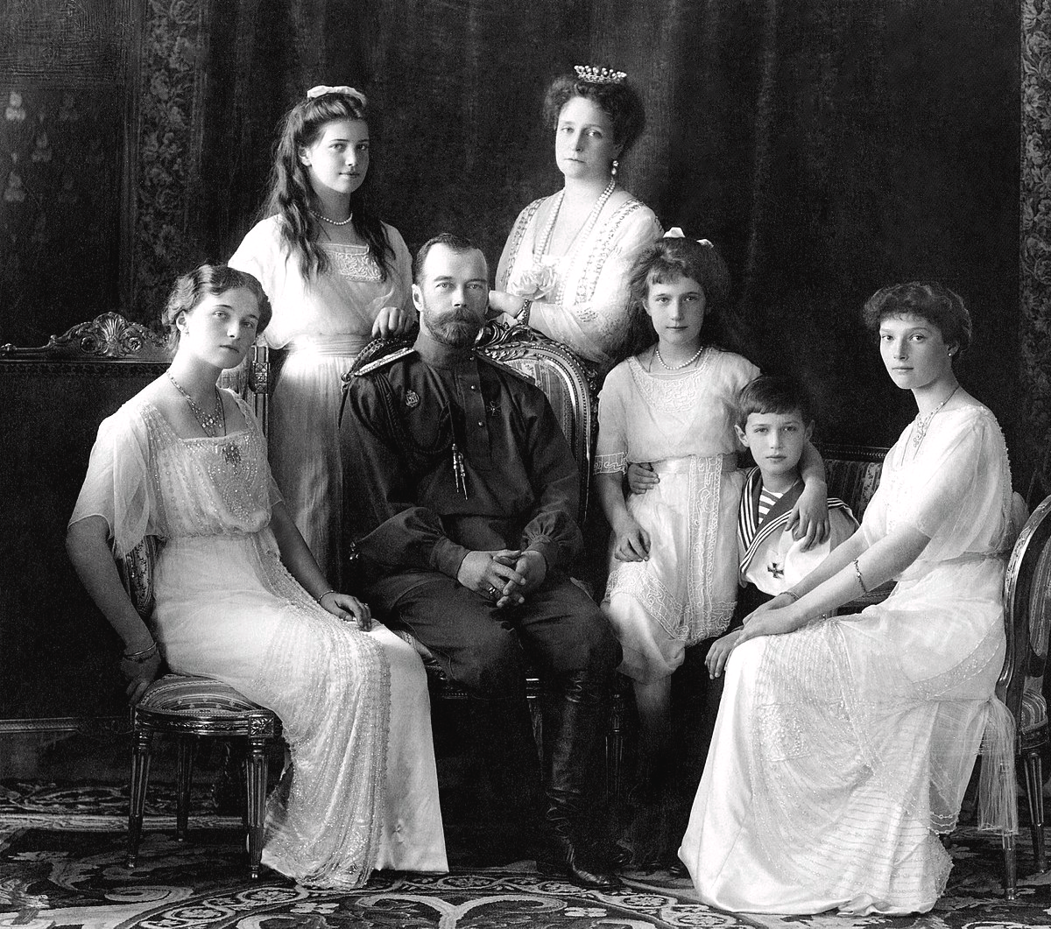
The Last Romanovs

Slide 53
CHRONOLOGY The Russian Revolution
Event | Dates
March of women in Petrograd | 1917 (March 8)
General strike in Petrograd | 1917 (March 10)
Establishment of provisional government | 1917 (March 15)
Tsar abdicates | 1917 (March 15)
Formation of Petrograd soviet | 1917 (March)
Lenin arrives in Russia | 1917 (April 3)
Lenin’s “April Theses” | 1917 (April 20)
Bolsheviks gain majority in Petrograd soviet | 1917 (October)
Bolsheviks overthrow provisional government | 1917 (November 6–7)
Lenin disbands Constituent Assembly | 1918 (January)
Treaty of Brest-Litovsk | 1918 (March 3)
Civil war | 1918–1921
p783
Notes:
CHRONOLOGY The Russian Revolution

Slide 54
The Last Year of the War
Germany’s Final Gamble
Last German offensive, March-July, 1918
Allied counterattack
Second Battle of the Marne, July 18, 1918
American soldiers helped push Germans back
Generals Hindenberg and Ludendorff try to sue for peace, realizing the war is lost.
Abdication of William II, November 9, 1918
Allies would not negotiate with the Kaiser
Republic is established in Germany- led by socialists under Friedrich Ebert.
Armistice, November 11, 1918
Myth of the “stab in the back”

Slide 55
The Last Year of the War
The Casualties of the War
The human cost: soldiers and civilians
8-9 million soldiers died
22 million wounded/mutilated
A “lost generation” of veterans, who would later turn to extreme right-wing nationalism for identity and vindication.
1915- Armenian genocide by the Ottoman Turks, as punishment for rebellion and supporting Russia.
One million Armenians were systematically murdered

Slide 56
CHRONOLOGY World War I (Slide 1 of 2)
Event | Dates
Battle of Tannenberg | 1914 (August 26–30)
First Battle of the Marne | 1914 (September 6–10)
Battle of Masurian Lakes | 1914 (September 15)
Russia, Britain, and France declare war on Ottoman Empire | 1914 (November)
Battle of Gallipoli begins | 1915 (April 25)
Italy declares war on Austria-Hungary | 1915 (May 23)
Entry of Bulgaria into the war | 1915 (September)
Battle of Verdun | 1916 (February 21–December 18)
Battle of Jutland | 1916 (May 31)
Somme offensive | 1916 (July 1–November 19)
p784
Notes:
CHRONOLOGY World War I

Slide 57
CHRONOLOGY World War I (Slide 2 of 2)
Event | Dates
Germany resumes unrestricted submarine warfare | 1917 (January)
United States enters the war | 1917 (April 6)
Champagne offensive | 1917 (April 16–29)
Last German offensive | 1918 (March 21–July 18)
Second Battle of the Marne | 1918 (July 18)
Allied counteroffensive | 1918 (July 18–November 10)
Armistice between Allies and Germany | 1918 (November 11)
Paris Peace Conference begins | 1919 (January 18)
Peace of Versailles | 1919 (June 28)

Slide 58
Revolutionary Upheavals in Germany and Austria-Hungary
Defeat and Political Revolution
Germany’s November Revolution and aftermath
Socialist divisions: Social Democrats and German Communist Party
Failed Communist revolutions in Berlin and Munich
Moderate socialists needed help from the regular army (conservatives) to crush attempted Communist coup.
Enduring fear of Communism among German middle class

Slide 59
Revolutionary Upheavals
Nationalism and the end of Austria-Hungary
Agitation from ethnic minorities for national independence
War exhaustion
The Allies supported self-determination for new nations:
Austria
Hungary
Czechoslovakia
Yugoslavia (new South Slavic kingdom- fell apart in 1992)
Some regions joined Italy, Romania, Poland.
These regions would be plagued by nationalist rivalries, political boundary disputes, and Communist influence for the next 80 years (until the year 2000!)

Slide 60
The Peace Settlement
Peace Aims
Divisions of interest at the Paris Peace Conference
Woodrow Wilson’s idealistic “Fourteen Points”
Tried to portray WWI as a “war against absolutism and militarism” to try to justify it for a greater moral cause.
No secret treaties, reduction of militaries, self-determination for peoples (except colonies), create a League of Nations.
His 14 Points were heard by colonial peoples too.
Pragmatism of other states
Lloyd George’s determination to make Germany pay
Georges Clemenceau of France concerned with his nation’s security and wanted revenge against Germany
Fear of Bolshevik revolution- led Allies to strengthen and enlarge Poland, Czechoslovakia, and Romania

Slide 61
The Paris Peace Conference
27 nations represented, but it was dominated by the Big Three:
Britain, France, USA (and Italy had a small role)
Some states were represented, but could not participate in decisions (the losers)
Some weren’t even represented at all, but had played a role in the war- like Ireland and Vietnam.
Compromise:
League of Nations is established
Germany is punished by militarizing the Rhineland, France and Britain have an alliance, and Germany reduces its military.

Slide 62
The Treaty of Versailles (Slide 1 of 3)
Signed on June 9, 1919
Provisions
Article 231: War Guilt Clause
Admission of responsibility and payment of reparations
Reduction of military: army of 100,000
Loss of Alsace and Lorraine (back to France)
Loss of colonies in Africa and the Pacific
Sections of Prussia to the new Polish state
Demilitarized zone (west and east of Rhine)
German unhappiness: charges of a “dictated peace” orchestrated by “Marxist Jews”

Slide 63
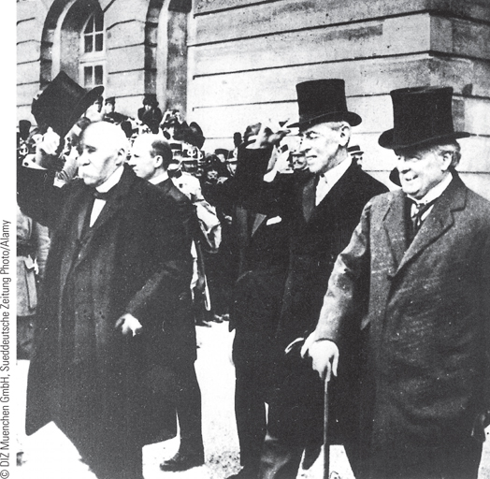
The Treaty of Versailles (Slide 2 of 3)
Shown above are the three most important decision makers at the Paris Peace Conference, Georges Clemenceau, Woodrow Wilson, and David Lloyd George, shortly after the signing of the Treaty of Versailles.
p788
Notes:
The Treaty of Versailles. Shown above are the three most important
decision makers at the Paris Peace Conference, Georges Clemenceau,
Woodrow Wilson, and David Lloyd George, shortly after the signing of
the Treaty of Versailles.

Slide 64
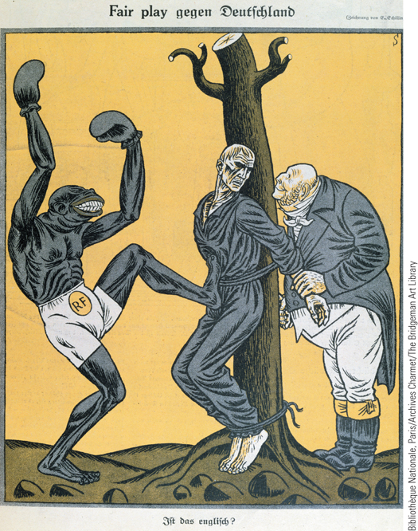
The Treaty of Versailles (Slide 3 of 3)
The Germans’ reaction to what they considered a harsh and unfair peace treaty is captured on the cover of Simplicissimus, a German satirical magazine published in Munich. A black man representing France is seen beating a German tied to a tree trunk while an Englishman looks on with a grin on his face.
p788
Notes:
The Treaty of Versailles. The Germans’ reaction to what they considered
a harsh and unfair peace treaty is captured on the cover of Simplicissimus,
a German satirical magazine published in Munich. A black man
representing France is seen beating a German tied to a tree trunk while
an Englishman looks on with a grin on his face.

Slide 65
The Other Peace Treaties
Redrawing the Map of Eastern Europe
Territorial changes
German and Russian losses, Romanian gains
New nation-states: Finland, Latvia, Estonia, Lithuania, Poland, Czechoslovakia, Austria, Hungary, and Yugoslavia
Minorities in every eastern European state
Ottoman Empire dismembered
Promises of independence in the Middle East
Mandates:
France – Lebanon and Syria
Britain – Iraq and Palestine
Attacks on the settlement and consequences
Difficult to enforce
The United States never ratified the Versailles Treaty

Slide 66
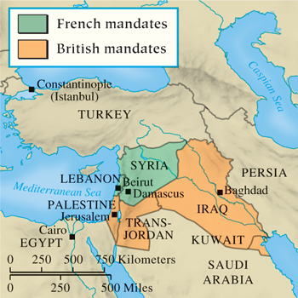
The Middle East in 1919
p788
Notes:
The Middle East in 1919

Slide 67
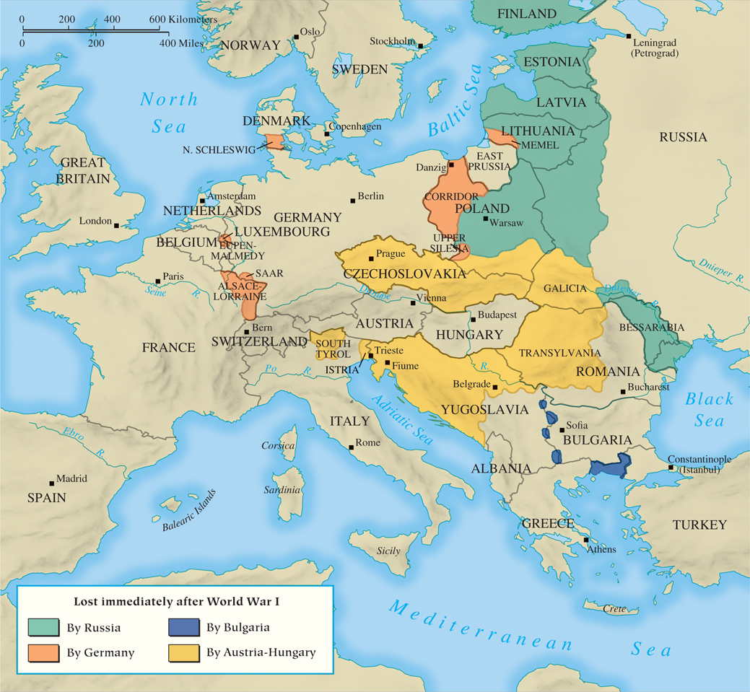
MAP 25.5 Europe in 1919
Map 25.5 p789
Notes:
MAP 25.5 Europe in 1919. The victorious allies met to determine the shape and nature of postwar
Europe. At the urging of the American president Woodrow Wilson, the peace conference created
several new countries from the prewar territory of Austria-Hungary, Germany, and Russia in an effort to
satisfy the nationalist aspirations of many former imperial subjects.

Slide 68
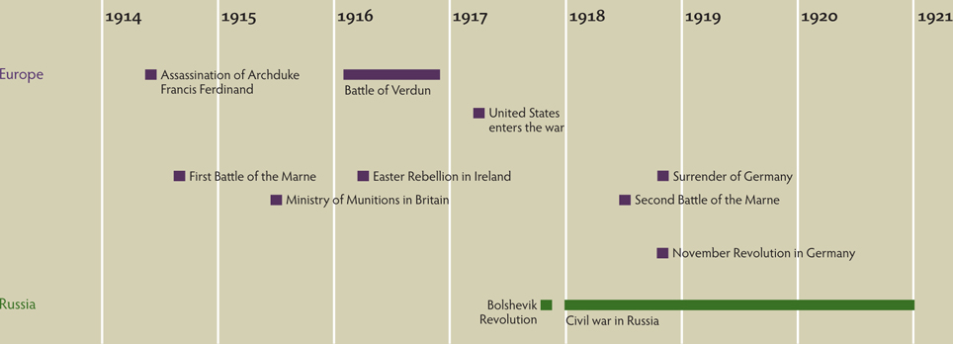
Chapter Timeline
p790

Slide 69
Discussion Questions
Describe the impact of the Industrial Revolution on the fighting in World War I.
How did the Industrial Revolution help to create the trench warfare?
Define the concept of total war, and discuss its relevance for World War I.
What influenced Russia to exit the war in the east?
What were the changes on the map of Europe as a result of World War I?
To what degree did the peace settlement successfully address the issues that sparked the conflict?

