Slide 1
The Futile Search for a New Stability: Europe Between the Wars, 1919–1939
Chapter 26

Slide 2
Focus Questions
​What was the impact of World War I, and what problems did European countries face in the 1920s?
​How did France, Great Britain, and the United States respond to the various crises, including the Great Depression, that they faced in the interwar years? How did World War I affect Europe’s colonies in Asia and Africa?
​Why did many European states experience a retreat from democracy in the interwar years? What are the characteristics of so-called totalitarian states, and to what degree were these characteristics present in Fascist Italy, Nazi Germany, and Stalinist Russia?
​What new dimensions in mass culture and mass leisure emerged during the interwar years, and what role did these activities play in Italy, Germany, and the Soviet Union?
​What were the main cultural and intellectual trends in the interwar years?

Slide 3
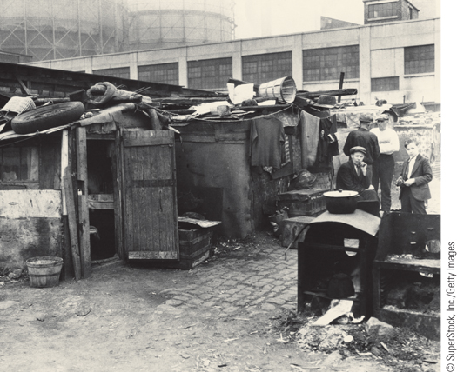
A ‘‘Hooverville’’ on the streets of the United States
p792
Notes:
A ‘‘Hooverville’’ on the streets of the United States

Slide 4
An Uncertain Peace (Slide 1 of 2)
The Impact of World War I
The Search for Security
Weaknesses of the League of Nations
French policy of coercion (1919-1924)
Desire for strict enforcement the Treaty of Versailles
Reparations (set at $33 billion) and crisis
German inability to pay in 1922 leads to French occupation of the Ruhr Valley
Collapse of the German mark and political unrest

Slide 5
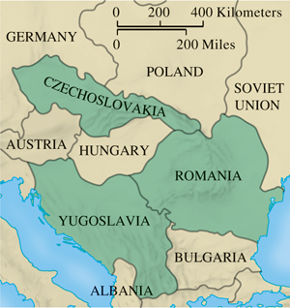
The Little Entente
p794
Notes:
The Little Entente

Slide 6
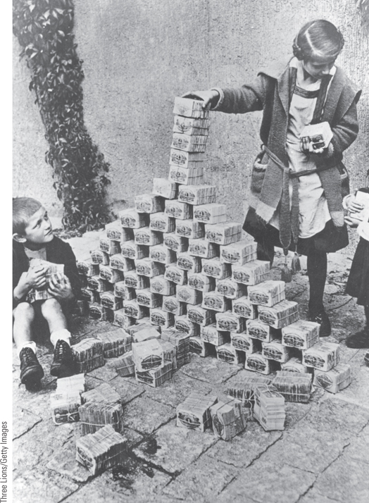
The Effects of Inflation
By the early 1920s, the value of the German mark had fallen precipitously. This photograph shows German children using bundles of worthless money as building blocks.
p795
Notes:
The Effects of Inflation. The inflationary pressures that had begun in
Germany at the end of World War I intensified during the French
occupation of the Ruhr. By the early 1920s, the value of the German
mark had fallen precipitously. This photograph shows German children
using bundles of worthless money as building blocks. The wads of
money were cheaper than toys.

Slide 7
An Uncertain Peace (Slide 2 of 2)
The Hopeful Years (1924-1929)
New conciliatory approaches
The spirit of Locarno
Treaty (1925): new cooperation
Coexistence with Soviet Russia
The Great Depression
Causes
Domestic downturn coupled with international crisis
Unemployment
Social and Political Repercussions
Powerlessness of governments

Slide 8
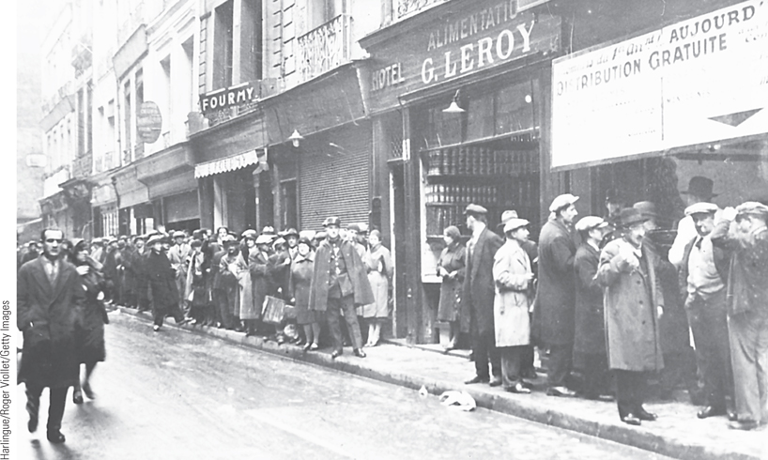
The Great Depression: Bread Lines in Paris
The Great Depression devastated the European economy and had serious political repercussions.
p796
Notes:
The Great Depression:
Bread Lines in Paris. The
Great Depression devastated
the European economy and
had serious political
repercussions. Because of its
more balanced economy,
France did not feel the effects
of the depression as quickly as
other European countries. By
1931, however, even France
was experiencing lines of
unemployed people at free food
centers.

Slide 9
The Democratic States in the West (Slide 1 of 2)
Great Britain
The challenge of the Labour Party
Failure to solve economic problems
Coalition claimed credit for recovery
The push for state intervention: John Maynard Keynes (1883 – 1946)
France
Consequences of economic instability
The rise of extremists
The Popular Front and the French New Deal

Slide 10
The Democratic States in the West (Slide 2 of 2)
The Scandinavian States
Socialist governments
Expansion of social services
High taxes and large bureaucracies
The United States
Franklin D. Roosevelt (1933-1945) and active government intervention in the economy
The New Deal: relief, recovery, and reform
Public works
Slow recovery: continuing crises of unemployment

Slide 11
CHRONOLOGY The Democratic States: Great Britain
Event | Dates
First Labour Party government | 1924
Conservative Party government | 1924–1929
General strike | 1926
Second Labour Party government | 1929–1931
Beginning of National Government coalition | 1931
p799
Notes:
CHRONOLOGY The Democratic States

Slide 12
CHRONOLOGY The Democratic States: France
Event | Dates
Formation of the Popular Front | 1936

Slide 13
CHRONOLOGY The Democratic States: United States
Event | Dates
Election of Franklin D. Roosevelt | 1932
Beginning of the New Deal | 1933
Second New Deal | 1935

Slide 14
European States and the World: The Colonial Empires (Slide 1 of 2)
The Middle East
New modernizing regimes
1932: Independent government in Saudi Arabia
Mustafa Kemal/Atatürk (1881 – 1938) and a new Westernized Turkey
India
Gandhi (1869 – 1948)
1919: Amritsar Massacre
Civil disobedience
1935: British grant India limited internal self-government

Slide 15
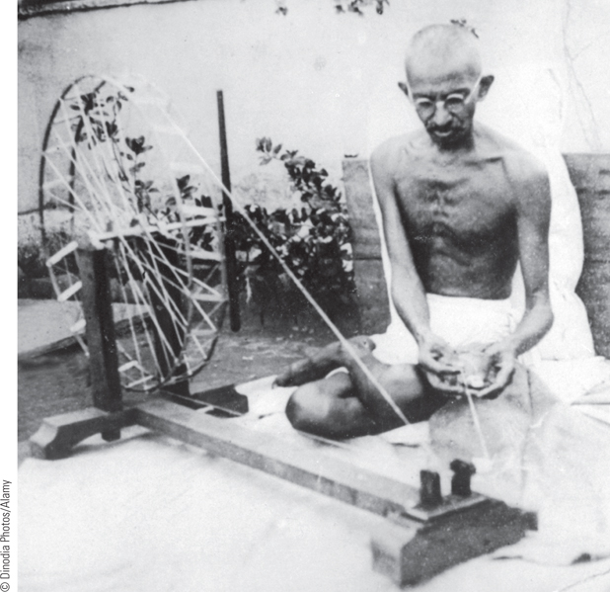
Gandhi
Mahatma Gandhi, India’s ‘‘Great Soul,’’ became the spiritual leader of
India’s struggle for independence from British colonial rule.
p800
Notes:
Gandhi. Mahatma Gandhi, India’s ‘‘Great Soul,’’ became the spiritual leader of
India’s struggle for independence from British colonial rule. Unlike many other
nationalist leaders, Gandhi rejected the materialistic culture of the West and urged his
followers to return to the native traditions of the Indian village. To illustrate his point,
as seen in this illustration, Gandhi dressed in the simple Indian dhoti rather than in the
Western fashion favored by many of his colleagues. He is also using a manual
spinning wheel to make cotton thread to protest imports of British textiles.

Slide 16
European States and the World: The Colonial Empires (Slide 2 of 2)
Africa
Disappointed hopes following WWI
Post-war activism and protest
Trade unions in Nigeria and South Africa
1929: Nigerian women killed at protest
African leaders and calls for independence
Pan-Africanism
W. E. B. Du Bois (1868 – 1963)
Marcus Garvey (1887 – 1940)
Jomo Kenyatta (1894 – 1978)
Facing Mount Kenya

Slide 17
The Authoritarian and Totalitarian States
Historians Debate: The Retreat from Democracy: Did Europe Have Totalitarian States?
New mass electorate and the movement toward radicalized politics
Class and gender divisions
The modern totalitarian state
Characteristics: single leader and single party with active commitment of citizens
Mass propaganda techniques and high speed communication
Domination of all aspects of life
The term totalitarian

Slide 18
Fascist Italy
Impact of World War I
Inability of government to deal with problems
The Birth of Fascism
Benito Mussolini (1883-1945)
Formation of the Fascio di Combattimento, 1919
Combining anticommunism, antistrike activity, nationalist rhetoric, and brute force
Squadristi, armed Fascists
Resulting parliamentary gains
March on Rome, 1922
Mussolini appointed prime minister, October 29, 1922

Slide 19
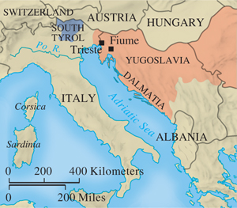
Territory Gained by Italy
p802
Notes:
Territory Gained by Italy

Slide 20
Mussolini and the Italian Fascist State
Fascist Government
Fascist dictatorship established, 1926
New policies: press laws, police laws, and a political monopoly
Mussolini’s view of a Fascist state: totalitarian
Molding Italians into a single community
Young Fascists
Attitudes toward women
Family as the pillar of the state
Never achieves the degree of control achieved in Germany or Soviet Union
Compromise with traditional institutions: Lateran Accords, February 1929

Slide 21
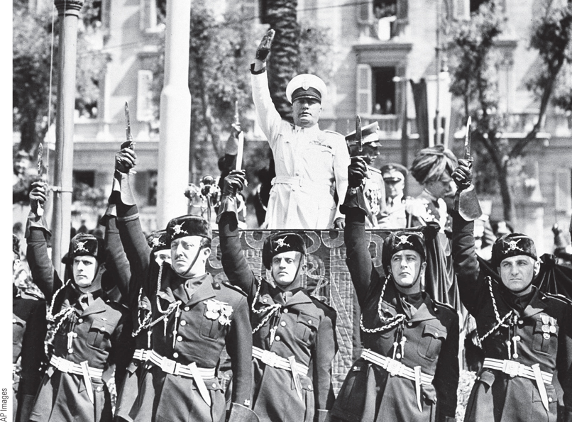
Mussolini, the Iron Duce
One of Mussolini’s favorite images of himself was that of the Iron Duce—the strong leader who is always right.
p803
Notes:
Mussolini, the Iron Duce.
One of Mussolini’s favorite
images of himself was that of the
Iron Duce—the strong leader
who is always right.
Consequently, he was often seen
in military-style uniforms and
military poses. This photograph
shows Mussolini in one of his
numerous uniforms with his
Blackshirt bodyguards giving the
Fascist salute.

Slide 22
CHRONOLOGY Fascist Italy
Event | Dates
Creation of Fascio di Combattimento | 1919
Squadristi violence | 1920–1921
Fascists win thirty-five seats in Parliament | 1921
Mussolini is made prime minister | 1922
Electoral victory for Fascists | 1924
Establishment of Fascist dictatorship | 1925–1926
Lateran Accords with Catholic Church | 1929
p805
Notes:
CHRONOLOGY Fascist Italy

Slide 23
Hitler and Nazi Germany (Slide 1 of 2)
Weimar Germany
Unresolved political and economic problems
The Emergence of Adolf Hitler (1889 – 1945)
Formation of ideologies of racism, nationalism, and struggle
The Rise of the Nazis
National Socialist German Workers’ Party (Nazi), 1921
Sturmabteilung (SA): Storm Troops
The Failed Munich Beer Hall Putsch, 1923
Hitler imprisoned: Mein Kampf

Slide 24
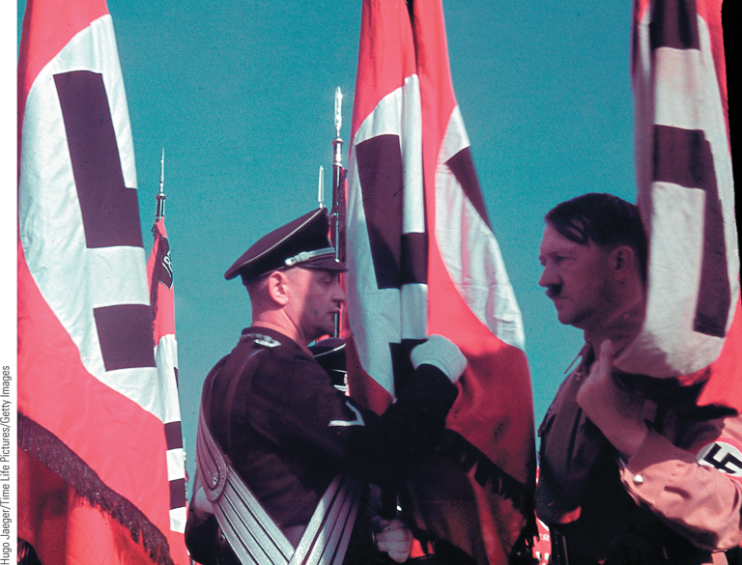
Hitler and the Blood Flag Ritual
In developing his mass political movement, Adolf Hitler used
ritualistic ceremonies as a means of binding party members to his own person.
p807
Notes:
Hitler and the Blood Flag Ritual.
In developing his mass political
movement, Adolf Hitler used
ritualistic ceremonies as a means of
binding party members to his own
person. Here Hitler is shown
touching the ‘‘blood flag,’’ which had
supposedly been stained with the
blood of Nazis killed during the Beer
Hall Putsch, to an SS banner while
the SS standard-bearer makes a
‘‘blood oath’’ of allegiance: ‘‘I vow to
remain true to my Fu¨hrer, Adolf
Hitler. I bind myself to carry out all
orders conscientiously and without
reluctance. Standards and flags shall
be sacred to me.’’ The SS originated
as Hitler’s personal bodyguard and
later became a secret police force and
instrument of terror in the Nazi state.

Slide 25
Hitler and Nazi Germany (Slide 2 of 2)
Hitler’s New Tactics
Need for a lawful takeover of power
Organization: Führeprinzip
Nazi success in the Reichstag with 1932 election
Support of middle-class voters
The Nazi Seizure of Power
Political maneuvering
Innovative electioneering techniques
Hermann Göring (1893 – 1946): legal Nazi terror
Enabling Act, March 1933
Gleichschaltung, coordination of all institutions under Nazi control
The final stages: eliminating threats from the SA and the death of Hindenburg

Slide 26
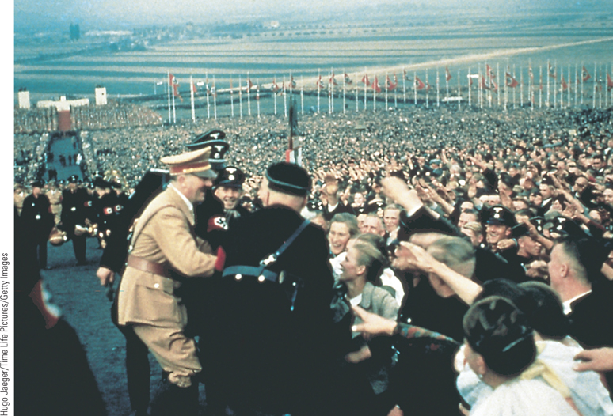
The Nazi Mass Spectacle
Hitler and the Nazis made clever use of mass spectacles to rally the German people behind the Nazi regime.
p810
Notes:
The Nazi Mass Spectacle.
Hitler and the Nazis made clever
use of mass spectacles to rally the
German people behind the Nazi
regime. These mass demonstrations
evoked intense enthusiasm, as is
evident in this photograph of Hitler
arriving at the Bu¨ckeberg near
Hamelin for the Harvest Festival in
1937. Almost one million people
were present for the celebration.

Slide 27
CHRONOLOGY Nazi Germany
Event | Dates
Hitler as Munich politician | 1919–1923
Beer Hall Putsch | 1923
Nazis win 107 seats in Reichstag | 1930 (September)
Hitler is made chancellor | 1933 (January 30)
Reichstag fire | 1933 (February 27)
Enabling Act | 1933 (March 23)
Purge of the SA | 1934 (June 30)
Hindenburg dies; Hitler as sole ruler | 1934 (August 2)
Nuremberg laws | 1935
Kristallnacht | 1938 (November 9–10)
p811
Notes:
CHRONOLOGY Nazi Germany

Slide 28
The Nazi State (1933-1939)
Developing the “Total State”
Creation of a unified Aryan racial state
Mass demonstrations and spectacles
Constant rivalry gives Hitler power
Economic control and the drop in unemployment
Heinrich Himmler and the Schutzstaffeln (SS)
Churches and education brought under Nazi control
Hitler Jugend (Hitler Youth) and Bund Deutscher Mädel (German Girls Association)
Influence of Nazi ideas on working women
Strong anti-Semitism
Nuremberg laws, September 1935
Kristallnacht: November 9-10, 1938
Restrictions on Jews

Slide 29
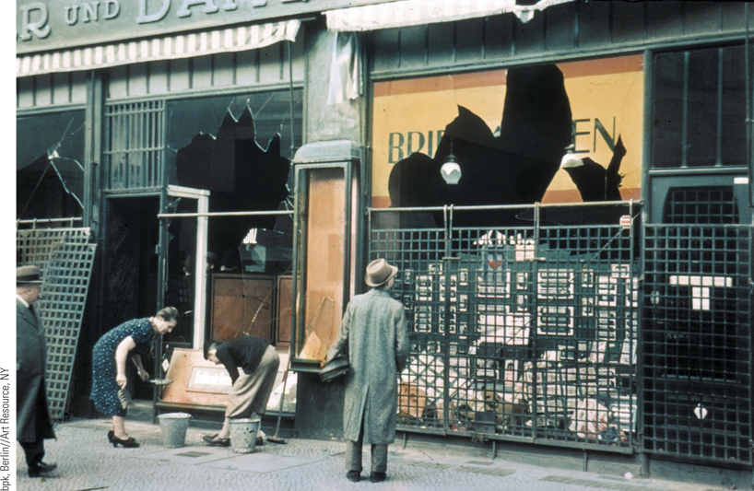
Anti-Semitism in Nazi Germany
Soon after seizing power, Hitler and the Nazis began to translate their anti-Semitic ideas into anti-Semitic policies.
p811
Notes:
Anti-Semitism in Nazi
Germany. Soon after seizing
power, Hitler and the Nazis
began to translate their anti-
Semitic ideas into anti-Semitic
policies. This photograph
shows one example of Nazi
action against the Jews as
Germans are seen passing by
the broken windows of a
Jewish shop in Berlin the
morning after Kristallnacht,
the Night of Shattered Glass,
when thousands of Jewish
businesses were destroyed.

Slide 30
The Soviet Union
Communists won Civil War
Use of terror and “war communism”
Gov requisition of food causes fierce peasant resistance and leads to famine (5 million dead)
Industrial collapse as Russia is exhausted.
New Economic Policy
Lenin’s plan to save the USSR
Modified capitalism! Allowed some private selling and trading of small farms and businesses.
Union of Socialist Republics established, 1922
Revived economy; intended to be temporary
Created wealthy class of kulaks again (remember that Lenin had previously persecuted them).
Created bigger government and powerful state government (is that what Marx intended?)

Slide 31
The Soviet Union
The Struggle for Power
Lenin suffers strokes, dies in 1924.
He had been a one-man ruler, so what now?
Division of the Politburo
Leon Trotsky and the Left- want to end the NEP, industrialize rapidly, and world-wide communist revolution.
Right- focus on strengthening the USSR, continue the NEP, against rapid industrialization.
Joseph Stalin (1879 – 1953)
From general party secretary to Communist Party control
Supported strengthening the USSR “socialism in one country”.
Had Trotsky expelled, then killed.
Expels the Old Bolsheviks in 1929; starts new dictatorship

Slide 32
The Stalinist Era (1929-1939)
Sweeping Economic, Social, and Political Revolution
First Five-Year Plan, 1928
Emphasis on industry
Real wages declined
Use of propaganda and the “Stakhanov cult”
Rapid collectivization of agriculture
Famine of 1932-1933; 10 million peasants died
Political control
Stalin dictatorship established, 1929
Political purge, 1936-1938; 8 million arrested
Impact on citizens’ lives
Reduced women’s rights, emphasis on family, birthrate.
Higher education for all, especially for engineering

Slide 33
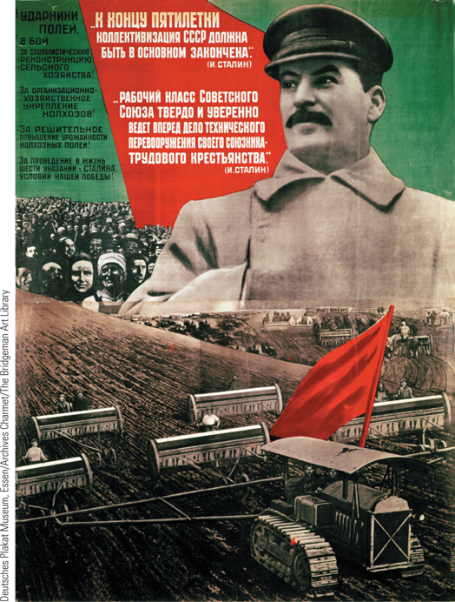
Stalin and the First Five-Year Plan
After establishing his dictatorship, Stalin sought to achieve the rapid industrialization of the Soviet Union as well as the collectivization of agriculture by his first five-year plan.
p813
Notes:
Stalin and the First Five-Year Plan. After establishing his
dictatorship, Stalin sought to achieve the rapid industrialization
of the Soviet Union as well as the collectivization of agriculture
by his first five-year plan. This poster, published in 1932 with
a photograph of Stalin, celebrates the achievements of that plan.
It reads, ‘‘At the end of the Plan, the basis of collectivization must
be completed.’’

Slide 34
CHRONOLOGY The Soviet Union
Event | Dates
New Economic Policy begins | 1921
Death of Lenin | 1924
Trotsky is expelled from the Communist Party | 1927
First five-year plan begins | 1928
Stalin’s dictatorship is established | 1929
Height of Stalin’s purges | 1936–1938
p813
Notes:
CHRONOLOGY The Soviet Union

Slide 35
Authoritarianism in Eastern Europe
Post-War Changes
From political democracy to authoritarian regimes
Problems
Little or no tradition of liberalism and parliamentary politics
No substantial middle class
Rural and agrarian states
Ethnic conflicts
Fear of upheaval creates quest for order and control

Slide 36
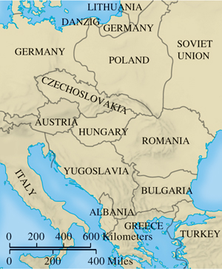
Eastern Europe After World War I
p815
Notes:
Eastern Europe After World War I

Slide 37
Dictatorship in the Iberian Peninsula
The Formation of a Spanish Republic
Instability and political turmoil
Military revolt led by Francisco Franco (1892 – 1975)
The Spanish Civil War, 1936-1939
The split between Republicans and Nationalists
Foreign intervention and its consequences
The Franco Regime
Dictatorship favoring tradition
Portugal
Strongman Antonio Salazar (1889 – 1970)

Slide 38
CHRONOLOGY The Authoritarian States: Eastern Europe
Event | Dates
Pilsudski creates military dictatorship in Poland | 1926
Alexander I creates royal dictatorship in Yugoslavia | 1929
Gömbös is made prime minister in Hungary | 1932
Dictatorship of General Metaxas in Greece | 1936
Carol II crushes Iron Guard and imposes authoritarian rule in Romania | 1938
p816
Notes:
CHRONOLOGY The Authoritarian States

Slide 39
CHRONOLOGY The Authoritarian States: Eastern Europe: Spain
Event | Dates
Dictatorship of Primo de Rivera | 1923–1930
Creation of Spanish Republic | 1931
Spanish Civil War | 1936–1939
Dictatorship of Franco | 1939–1975

Slide 40
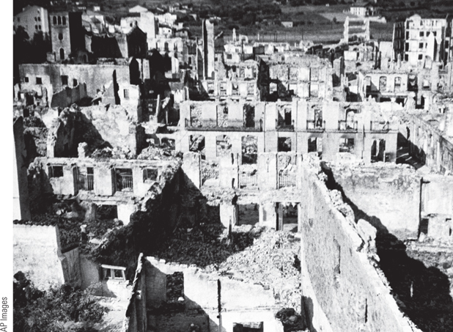
The Destruction of Guernica (Slide 1 of 2)
On April 26, 1937, the German Condor Legion dropped 100,000 tons of explosives in three hours on the small Basque town of Guernica, killing 1,654 people and wounding 889.
p817
Notes:
The Destruction of Guernica. On April 26, 1937, the
German Condor Legion dropped 100,000 tons of explosives
in three hours on the small Basque town of Guernica,
killing 1,654 people and wounding 889. The illustration
shows the ruins of Guernica after the German attack.

Slide 41
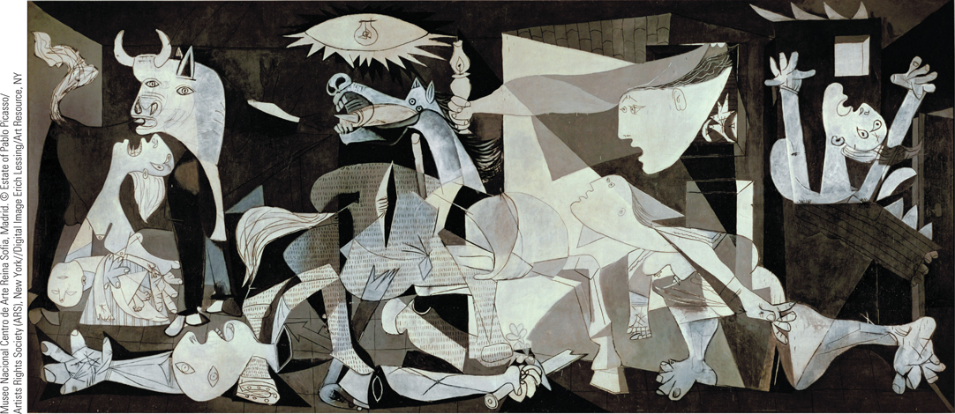
The Destruction of Guernica (Slide 2 of 2)
The scene was captured in Pablo Picasso’s Guernica (1937), a large (11 by 25 feet) Cubist piece that portrays the horror and human destruction caused by mass bombings.
p817
Notes:
The Destruction of Guernica. On April 26, 1937, the
German Condor Legion dropped 100,000 tons of explosives
in three hours on the small Basque town of Guernica,
killing 1,654 people and wounding 889. The
scene was captured in Pablo Picasso’s Guernica (1937),
a large (11 by 25 feet) Cubist piece that portrays the horror
and human destruction caused by mass bombings. The
fragmented bodies include a woman holding her dead
child, dismembered limbs, and terrified horses.

Slide 42
Expansion of Mass Culture and Mass Leisure
The Roaring Twenties
Exuberant popular culture of dancing and music
Jazz Age
Radio and Movies
New broadcasting facilities, radio production, and mass audiences
The popularity of movies
Immediate shared experiences
Used for political purposes
Triumph of the Will, 1934

Slide 43
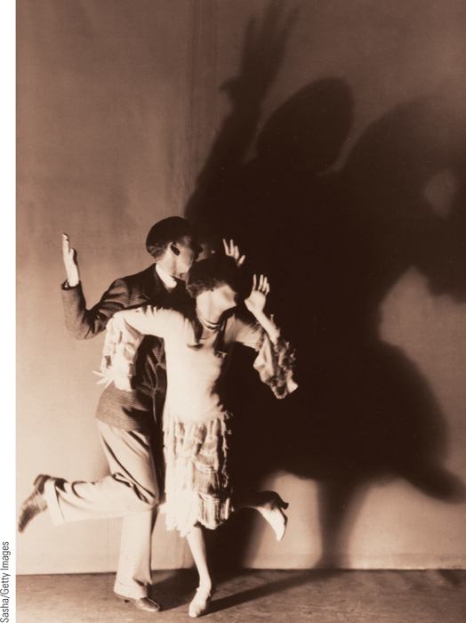
The Charleston
Dancing became the rage during the Roaring Twenties, and the Charleston was the most popular and enduring dance of the decade.
p818
Notes:
The Charleston. Dancing became the rage during the Roaring
Twenties, and the Charleston was the most popular and enduring dance
of the decade. This photograph shows a couple dancing the Charleston
in a scene from the London musical Just a Kiss in 1926.

Slide 44
Mass Leisure
Sports
Tourism
Commercial air service
Organized Mass Leisure in Italy and Germany
National recreation agencies
Kraft durch Freude in Germany
Increase in the homogeneity of national populations

Slide 45
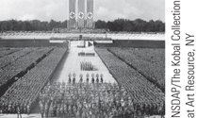
Film & History: Triumph of the Will (1934)
A scene from Triumph of the Will showing one of the many mass rallies at Nuremberg.
p819
Notes:
A scene from Triumph of the Will showing one of the many mass rallies at Nuremberg.

Slide 46
Cultural and Intellectual Trends in the Interwar Years
The Impact of World War I
Greater acceptance of prewar avant-garde ideas, previously considered shocking.
Belief that humans are violent and irrational is validated by the war
Enhanced by Great Depression and rise of fascism and totalitarianism, anxiety and uncertainty.
War broke down traditional attitudes, especially about women.
Changes in fashion and attitudes about sex
New definition of “feminine”; no more corsets!

Slide 47
Cultural and Intellectual Trends
Nightmares and New Visions: Art and Music
German Expressionists
The horrors of war-
Kathe Kollwitz, George Grosz, Otto Dix
The Dada Movement
“Anti-art” meant to shock and disturb viewers
Tries to represent purposelessness of life.
Tristan Tzara (1896 – 1945)
Surrealism
Seeks reality beyond the material, sensible world
Made of unconscious, fantasies, dreams, nightmares
Disturbing, evocative images; makes the irrational tangible. Forces us to question reality.
Salvador Dali (1904 – 1989)

Slide 48
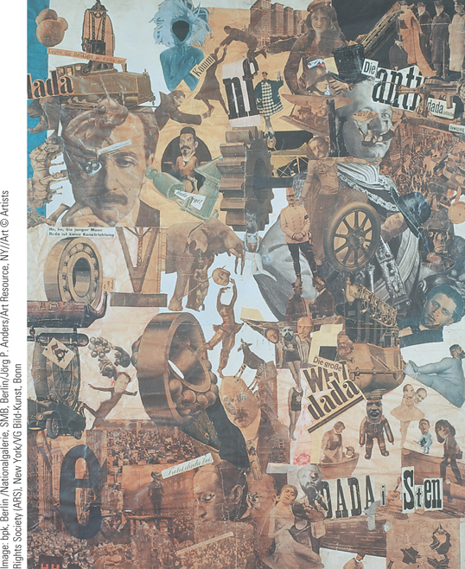
Hannah Hoch, Cut with the Kitchen Knife Dada Through the Last Weimar Beer Belly Cultural Epoch of Germany
Hannah Hoch, a prominent figure in the postwar Dada movement, used photomontage to create images that reflected on women’s issues.
p821
Notes:
Hannah Hoch, Cut with the Kitchen Knife Dada Through the
Last Weimar Beer Belly Cultural Epoch of Germany. Hannah
Hoch, a prominent figure in the postwar Dada movement, used
photomontage to create images that reflected on women’s issues. In Cut
with the Kitchen Knife (1919), she combined pictures of German political
leaders with sports stars, Dada artists, and scenes from urban life. One
major theme emerged: the confrontation between the anti-Dada world
of German political leaders and the Dada world of revolutionary ideals.
Hoch associated women with Dada and the new world.

Slide 49
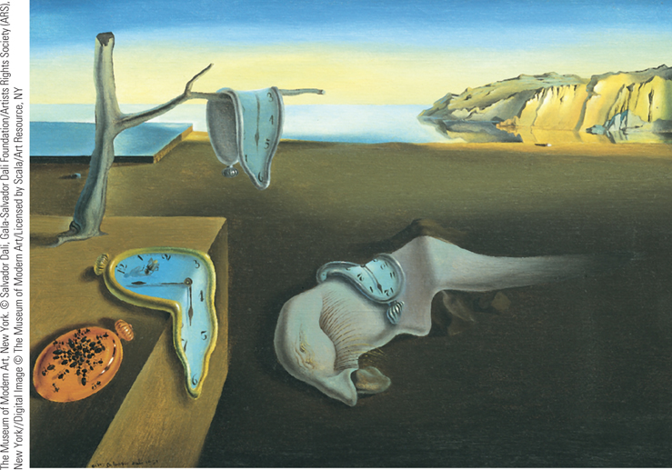
Salvador Dali, The Persistence of Memory
Surrealism was another important artistic movement between the
wars. Influenced by the theories of Freudian psychology, Surrealists sought to reveal the world of the unconscious, or the ‘‘greater reality’’ that they believed existed beyond the world of physical appearances.
p821
Notes:
Salvador Dali, The Persistence of
Memory. Surrealism was another
important artistic movement between the
wars. Influenced by the theories of
Freudian psychology, Surrealists sought to
reveal the world of the unconscious, or
the ‘‘greater reality’’ that they believed
existed beyond the world of physical
appearances. As is evident in this 1931
painting, Salvador Dalı´ sought to portray
the world of dreams by painting
recognizable objects in unrecognizable
relationships.

Slide 50
Cultural and Intellectual Trends in the Interwar Years
Functionalism in Modern Architecture
Buildings should be functional, with less adornment.
Unify art and engineering
The Chicago School in the U.S. : Louis H. Sullivan and Frank Lloyd Wright
Bauhaus School in Germany- est. 1919
A Popular Audience
Involvement of artists in new mass culture
Put studios in working-class neighborhoods; idea that art can help society
Some denounced modern art as “degenerate”

Slide 51
Cultural and Intellectual Trends
Culture of Nazism
Nazis hated modern art and music
Artists and writers were under the control of the state- art had to glorify the state.
Ernst Jünger: The Storm of Steel
Rejection of “degenerate” or “Jewish” art
Confiscated and destroyed thousands of paintings, even by Van Gogh and Picasso
Brought back Romanticism style of the 19th century- glorifying every day simple life and patriotic history.
A New Style in Music
Arnold Schönberg (1874 – 1951)

Slide 52
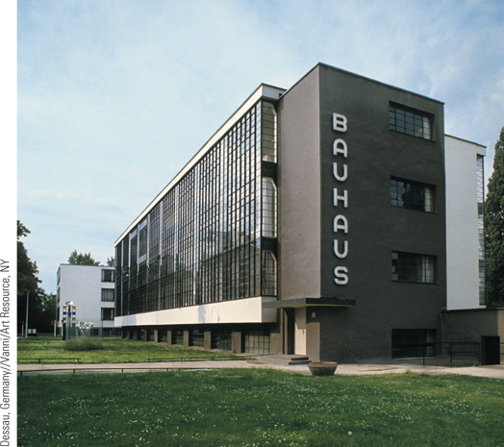
Walter Gropius, The Bauhaus
Walter Gropius was one of Europe’s pioneers in modern architecture. When the Bauhaus moved to Dessau in 1925, Gropius designed a building for its activities.
p822
Notes:
Walter Gropius, The Bauhaus. Walter Gropius was one of Europe’s
pioneers in modern architecture. When the Bauhaus moved to Dessau in
1925, Gropius designed a building for its activities. His straightforward
use of steel, reinforced concrete, and rows of windows reflects the move
to functionalism in modern architecture.

Slide 53
The Search for the Unconscious
Literature
“Stream-of-consciousness”
The Great Gatsby and Catcher in the Rye
James Joyce (1882 – 1941)
Ulysses
Hermann Hesse (1877 – 1962)
Psychology: Carl Jung (1856 – 1961)
Continuing impact of Freud
Goal: a higher state of consciousness
The “personal unconscious” and the “collective unconscious”

Slide 54
The “Heroic Age of Physics”
Continuation of the Prewar Revolution
Ernest Rutherford (1871 – 1937)
Splitting the atom
Werner Heisenberg (1901 – 1976)
The “uncertainty principle”

Slide 55
Chapter Timeline
p824

Slide 56
Discussion Questions
What were the causes of the Great Depression?
What did France feel it needed for security after the Great War? How did this affect Germany?
What were the characteristics of Nazi Germany?
What were the characteristics of Stalin’s Soviet Union?
Describe the art trends of this period. What were the lasting effects of these trends?
How did totalitarian governments manipulate art?

