Slide 1
After the Fall: The Western World in a Global Age (Since 1985)
Chapter 30

Slide 2
Focus Questions
​What reforms did Gorbachev institute in the Soviet Union, and what role did he play in the demise of the Soviet Union? What are the major political developments in Eastern Europe, Western Europe, and North America since 1985?
​How and why did the Cold War end? What are the main issues in the struggle with terrorism?
​What are the major developments in the women’s movement since 1985, and what problems have immigrants created for European society?
​What major Western cultural trends have emerged since 1985?
​What is globalization, and what are some of its important aspects in the twenty-first century?

Slide 3
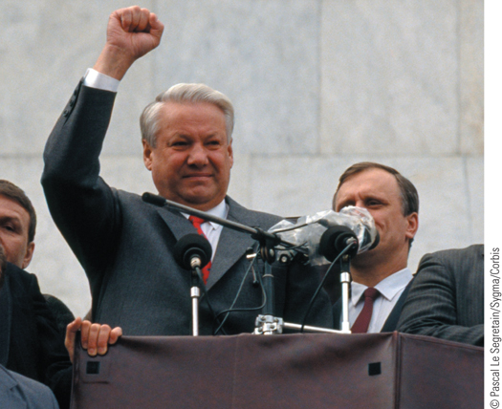
With clenched fist, Boris Yeltsin speaks out against an attempted right-wing coup
p920
Notes:
With clenched fist, Boris Yeltsin speaks out against an attempted right-wing
coup.

Slide 4
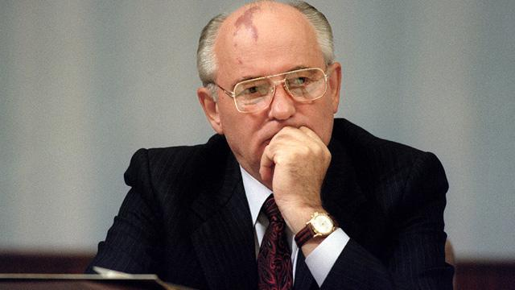
Mikhail Gorbachev, 1931-

Slide 5
Toward a New Western Order
The Revolutionary Era in the Soviet Union
The Gorbachev Era
The policies of Mikhail Gorbachev, 1985-1991
Young reformer: “We cannot go on like this.”
Product of the Khruschev years
Low standard of living in the USSR, lack of high tech, like computers
Economic reforms: perestroika and glasnost
Perestroika: restructured economy, politics, society
Limited free enterprise, some private property
Beginning of a free market economy

Slide 6
Revolutionary Era in the USSR
Glasnost: “Openness”
Freedom to openly discuss problems of the USSR without fear
Even the Pravda reported on corruption and factory conditions.
Political reforms: separation of state and party
Democratization: 1988-1989- creation of new Soviet parliament.
1990:Legalized other political parties, struck out Article 6, which guaranteed leading role of the Communist Party
Established state presidency, separating the Party from the government.
1990: Gorbachev become first Soviet President
1988-1990 Emergence of ethnic nationalist movements within the Union of Soviet Socialist Republics

Slide 7
Revolutionary Era in the USSR
The End of the Soviet Union
Gorbachev couldn’t deal with problems unleashed by glasnost and perestroika.
Conservative reaction
August 1991: Gorbi is arrested by conservative communists in attempted coup, but Boris Yeltsin (president of Russia), along with protestors in Moscow, holds them off.
Independence of the Soviet republics, 1991
One by one, Soviet republics began to declare independence
The creation of the Commonwealth of Independent States
Resignation of Gorbachev, December 25, 1991
Leadership passes to Boris Yeltsin, president of Russia, 1991-1999

Slide 8
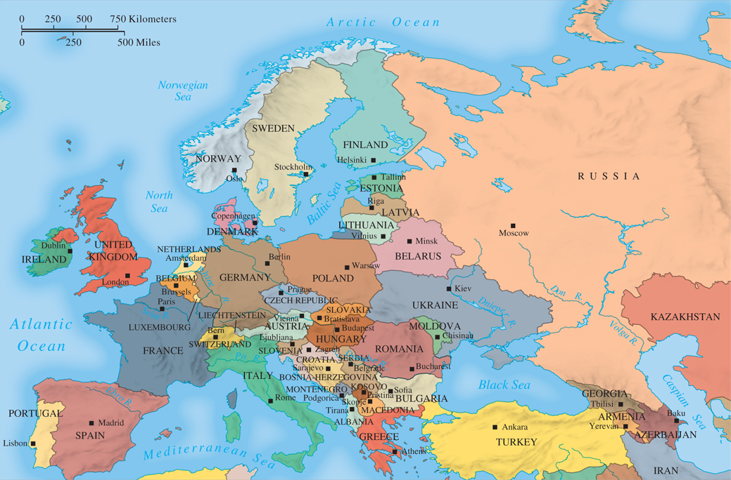
MAP 30.1 The New Europe
Map 30.1 p922
Notes:
MAP 30.1 The New Europe. The combination of an inefficient economy and high military spending
had led to stagnation in the Soviet Union by the early 1980s. Mikhail Gorbachev came to power in
1985, unleashing political, economic, and nationalist forces that led to independence for the former
Soviet republics and also for Eastern Europe.

Slide 9
The Revolutionary Era in the Soviet Union
Historians Debate: Why Did the Soviet Union Collapse?
Some Americans think Reagan gets the credit
Economic considerations- inefficient economy
Lack of innovation and consumer goods, lack of investment in new technology
Multiethnic character of the republics, wanting independence from white-dominated Moscow
The New Russia
The emergence of a power struggle
Yeltsin’s attempts to create a pluralistic political system and market economy

Slide 10
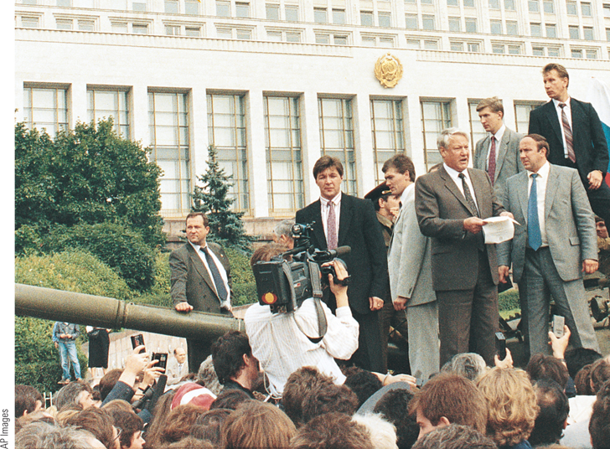
Yeltsin Resists a Right-Wing Coup
In August 1991, the attempt of right-wing plotters to overthrow Mikhail Gorbachev and seize power in the Soviet Union was
thwarted by the efforts of Boris Yeltsin, president of the Russian Republic, and his supporters.
p924
Notes:
Yeltsin Resists a Right-Wing Coup.
In August 1991, the attempt of right-wing
plotters to overthrow Mikhail Gorbachev
and seize power in the Soviet Union was
thwarted by the efforts of Boris Yeltsin,
president of the Russian Republic, and
his supporters. Yeltsin (holding papers)
is shown here atop a tank in front of the
Russian parliament building in Moscow,
urging the Russian people to resist the
conspirators.

Slide 11
The Revolutionary Era in the Soviet Union
Yeltsin’s New Russia plagued by corruption and economic inequality.
Russians were shook- was the old way better?
The Putin Era: Vladimir Putin
Former KGB agent
Strengthening central government
Silencing critics
Assertive foreign policy (Chechnya)
2013: Conflict with Ukraine
2014: Russia occupies the Crimea to prevent Ukraine rom aligning with the European Union
Diplomatic and economic sanctions from the West

Slide 12
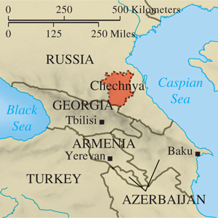
Chechnya
p924
Notes:
Chechyna

Slide 13
Eastern Europe: The Revolutions of 1989 and the Collapse of the Communist Order
The Fall
Peaceful transitions in Poland, Hungary, and Czechoslovakia
Poland
Solidarity is revived and Lech Wałesa becomes president
Czechoslovakia
Václav Havel
Romania’s violent path
Growing discontent sparks demonstrations and the executions of the Ceauşescus

Slide 14
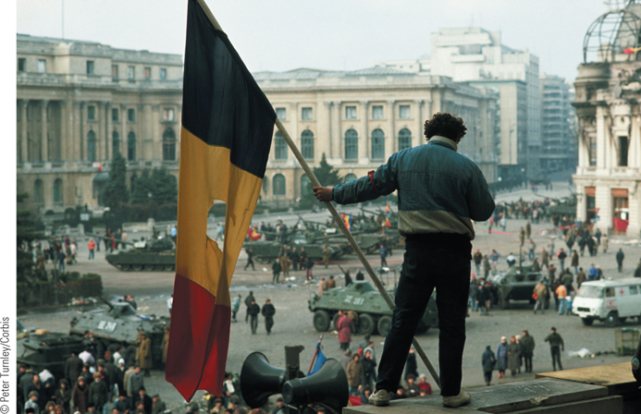
A Romanian Revolutionary
The revolt against Communist rule in Eastern Europe in 1989 came last to Romania.
p925
Notes:
A Romanian Revolutionary. The revolt against Communist rule in Eastern Europe in 1989
came last to Romania. It was also more violent as the government at first tried to stem the revolt
by massacring demonstrators. This picture shows a young Romanian rebel waving the national
flag with the Communist emblem cut out of the center. He is on a balcony overlooking the
tanks, soldiers, and citizens filling Palace Square in Bucharest.

Slide 15
Eastern Europe
After the Fall
The difficult road to democracy and free market systems
Little or no experience with democracy
Ethnic divisions
Rapid move to capitalism, without innovation or new technology led to “shock therapy austerity” and mass economic suffering.
Signs of revival: joining NATO and the EU
Impact of the 2008 financial crisis in Eastern Europe
Conflicts over European integration- will prosperous nations have to support struggling ones? Take in low-wage workers from other countries?

Slide 16
The Reunification of Germany
June 1989: Hungarians dismantle electric fence on Austro-Hungarian border.
→ East German “tourists” went to Hungary, then escaped to Austria from there.
→Sets off chain of events as more people start flooding out of East Germany through Hungary and Czechoslovakia.
Protests bring down the wall and open the border
German Communist government gives in to protesters.
East Germany’s first free elections, March 1990
Political reunification, October 3, 1990
Had seemed impossible at the beginning of 1989.

Slide 17
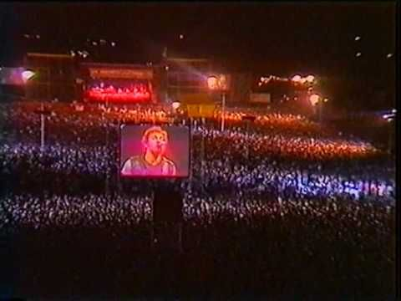
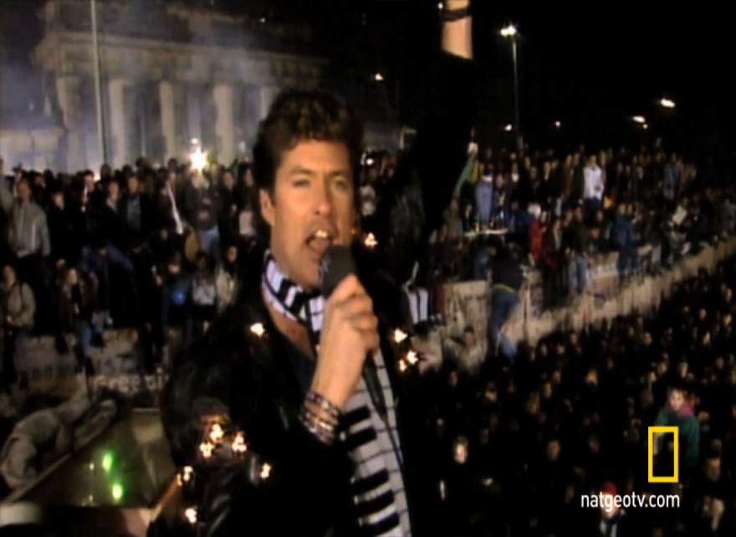
Concerts at the Wall
David Bowie singing “Heroes”
June 6, 1987
Bruce Springsteen in EAST
Berlin, July 1988. Many believe he
“put a crack in the wall”.
David Hasselhoff, Dec. 1989
Singing “Looking for Freedom”

Slide 18
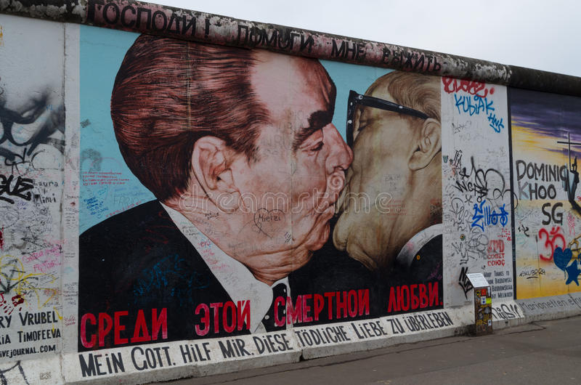
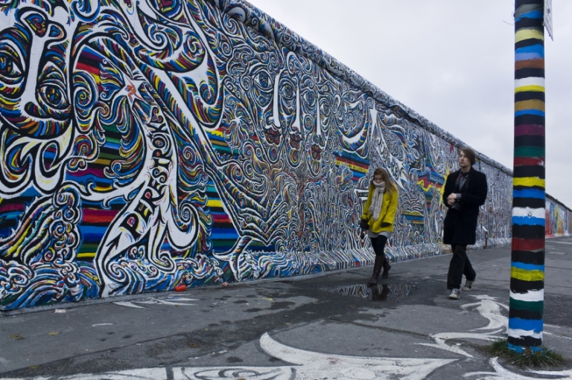
Graffiti on the Berlin Wall

Slide 19
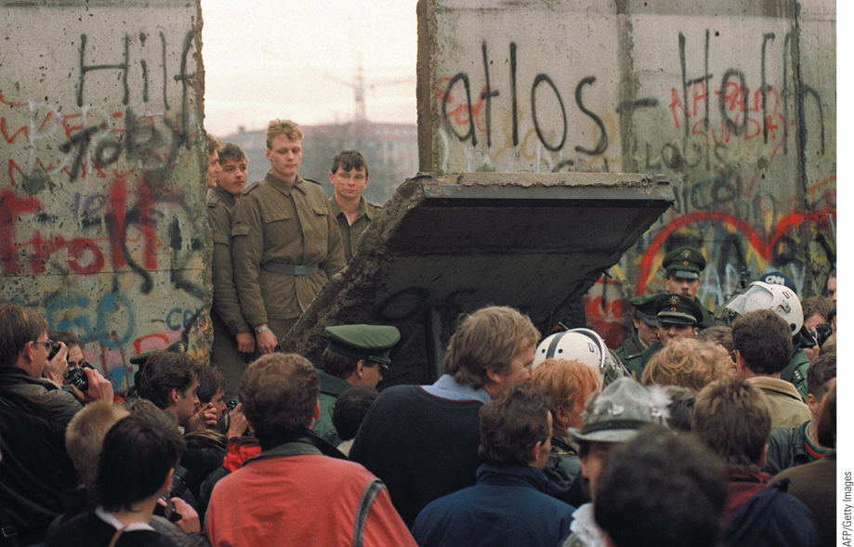
And the Wall Came Tumbling Down
The Berlin Wall, long a symbol of Europe’s Cold War divisions, became the site of massive celebrations after the East German government opened its border with the West.
p927
Notes:
And the Wall Came Tumbling Down. The Berlin Wall, long a symbol of Europe’s Cold War divisions,
became the site of massive celebrations after the East German government opened its border with the
West. On November 11, East German border guards demolished a section of the wall to create a new
crossing point. As seen in this photograph, West Germans celebrated the opening of the new crossing point.

Slide 20
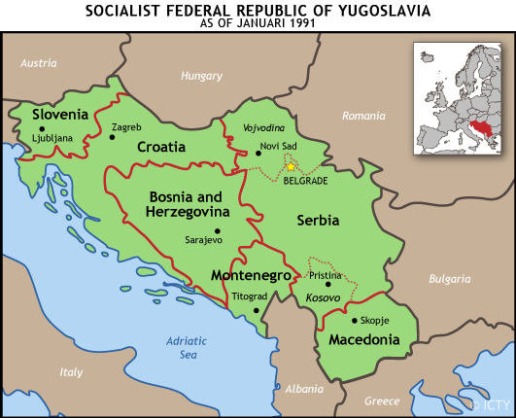
Eastern Europe
The Disintegration of Yugoslavia
The artificiality of Yugoslavia as a state
Serbia and the rejection of separatism
Slobodan Milošević and Serbian nationalism
Failed negotiations and bloodshed
Slovenia and Croatia declared independence, June ‘91.
Milosevic sends in Yugoslavian army, which was really just becoming Serbian.

Slide 21
Yugoslavia
War in Bosnia (same year as the genocide in Rwanda)
Europe and the U.S. recognized these nations as independent, but Serbia attacked Bosnia anyway.
Genocide, or ethnic cleansing of Bosniaks- Bosnian Muslims.
Massacre of 8,000 men and boys at Srebrenica
250,000 Bosnians were killed, and European nations took little decisive action against Serbia.
U.S. and NATO airstrikes, led by Bill Clinton, on Bosnia.
Peace, with NATO oversight, 1995
Bosnia was split: Bosnia-Herzegovina

Slide 22
Yugoslavia
War in Kosovo- 1999
Disputed territory in Yugoslavia, made independent.
Ethnic Albanians who kept their own language and a Serbian minority, who considered Kosovo sacred.
Milosevic, a Serbian nationalist, outlaws Albanian language.
Albanians establish Kosovo Liberation Army (KLA), and Serbs retaliate by murdering ethnic Albanians.
The U.S. and NATO intervened, found concentration camps and sites of mass graves. Most victims were Albanians, but the KLA committed war crimes too.
kidnappings, rape, hostages, organ theft, summary executions.
The Aftermath
Bosnia and Kosovo: an uncertain fate
Kosovo is still disputed; only presence of NATO and UN keeps the peace.

Slide 23
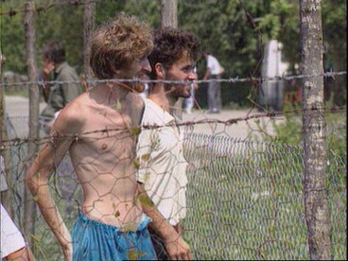
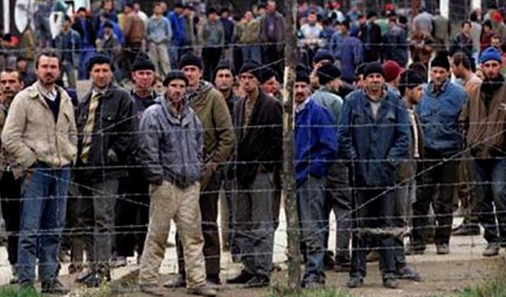
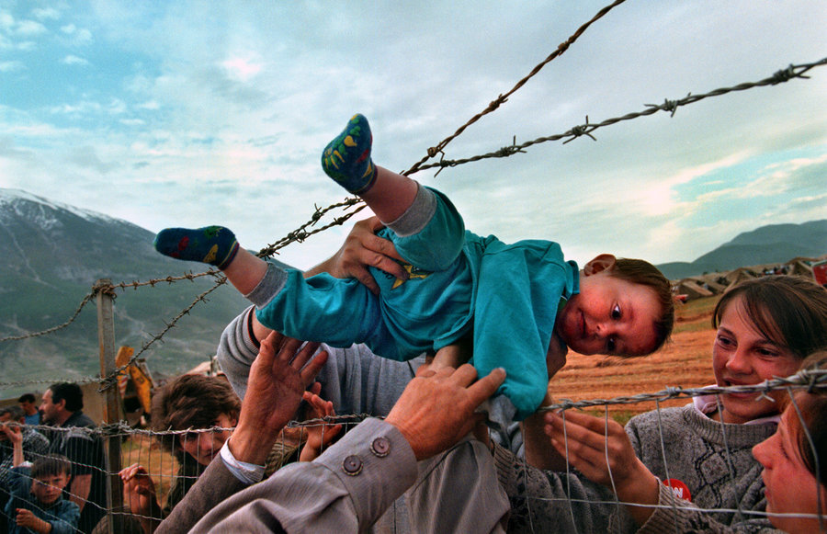

Slide 24
Slobodan Milosevic
Died in 2006 in his prison cell in The Hague, the
Netherlands, during his trial. Cause of death was a
heart attack.

Slide 25
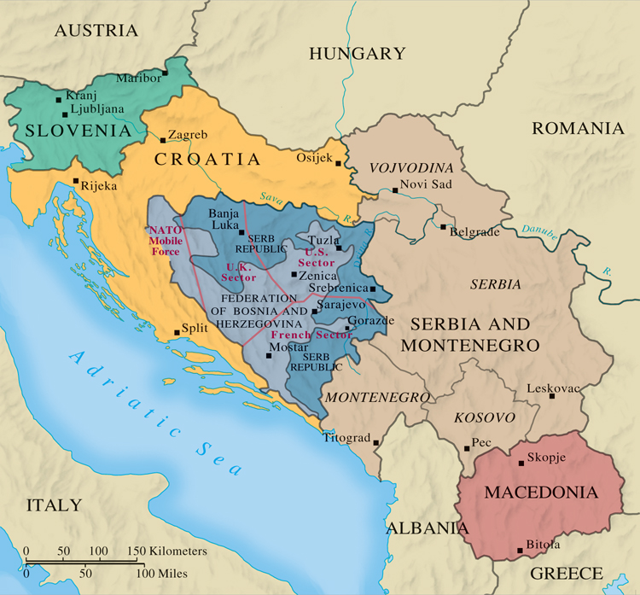
MAP 30.2 The Lands of the Former Yugoslavia, 1995
Map 30.2 p930
Notes:
MAP 30.2 The Lands of the
Former Yugoslavia, 1995. By
1991, resurgent nationalism and
the wave of independence
sweeping across Europe overcame
the forces that held Yugoslavia
together. Declarations of
independence by Slovenia,
Croatia, and Bosnia-Herzegovina
led to war with the Serbian dominated
rump Yugoslavia of
Slobodan Milosevic

Slide 26
CHRONOLOGY The Fall of the Soviet Bloc (Slide 1 of 2)
Event | Dates
Collapse of Communist government in Czechoslovakia | 1989 (December)
Collapse of East German government | 1989 (December)
Execution of Ceauşescu in Romania | 1989 (December 25)
Lithuania declares independence | 1990 (March 11)
East German elections—victory of Christian Democrats | 1990 (March 18)
Reunification of Germany | 1990 (October 3)
Lech Wałęsa becomes president of Poland | 1990 (December)
p928
Notes:
CHRONOLOGY The Fall of the Soviet Bloc

Slide 27
CHRONOLOGY The Fall of the Soviet Bloc (Slide 2 of 2)
Event | Dates
Yeltsin becomes president of Russia | 1991 (June)
Slovenia and Croatia declare independence | 1991 (June)
Right-wing coup in the Soviet Union | 1991 (August 19)
Dissolution of the Soviet Union | 1991 (December)

Slide 28
Western Europe and the Search for Unity
Germany Restored
Helmut Kohl and the Christian Democrats
Economic and political challenges
Stasi files
Post-1998 shifts in power: Gerhard Schröeder and Angela Merkel
Role in European debt crisis
Refugee crisis
Post-Thatcher Britain
The rise of the Labour Party
From John Major to Tony Blair, Gordon Brown
David Cameron (2010)

Slide 29
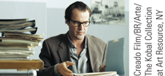
Film & History: The Lives of Others (2006)
Georg Dreyman (Sebastian Koch) examines his Stasi files.
p930
Notes:
Georg Dreyman (Sebastian Koch) examines his Stasi files.

Slide 30
Western Europe and the Search for Unity
France: Right and Left
The conservative policies of Jacques Chirac
Anti-foreign sentiment and its backlash
2005 Muslim riots
From right to left
Nicolas Sarkozy and François Hollande
2015 Paris terrorist attacks
Corruption in Italy
The domination of Silvio Berlusconi
Mario Monti’s unpopular reforms lead to resignation, 2012
2014 Matteo Renzi; economic reforms

Slide 31
CHRONOLOGY Western Europe Since 1985
Event | Dates
First all-German federal election | 1990
Victory of Conservative Party under John Major in Britain | 1992
Conservative victory in France | 1993
Creation of European Union | 1994
Jacques Chirac becomes president of France | 1995
Election of Tony Blair in Britain | 1997
Gerhard Schrӧder becomes chancellor of Germany | 1998
Angela Merkel becomes chancellor of Germany | 2005
Romano Prodi becomes prime minister of Italy | 2006
Election of Nicolas Sarkozy in France | 2007
David Cameron becomes prime minister of Britain | 2010
Mario Monti becomes prime minister of Italy | 2011
Election of Franҫois Hollande in France | 2012
Matteo Renzi becomes prime minister of Italy | 2014
p932
Notes:
CHRONOLOGY Western Europe Since 1985

Slide 32
The Unification of Europe
The Coming of European Union
Treaty on European Union
EU established 1994
Single market and currency (the euro)
Goals
Common economic policies
Emerging political structure
Problems
Toward a United Europe
Goal of incorporation of states of eastern and southeastern Europe

Slide 33
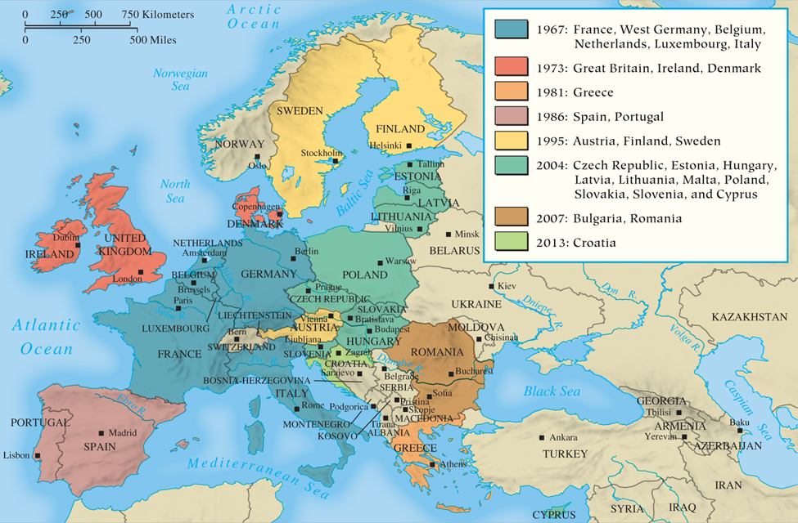
MAP 30.3 European Union, 2013
Map 30.3 p933
Notes:
MAP 30.3 European Union, 2013. Beginning in 1967 as the European Economic Community, also
known as the Common Market, the union of European states seeking to integrate their economies has
gradually grown from six members to twenty-eight in 2013. By 2002, the European Union had
achieved two major goals—the creation of a single internal market and a common currency—although
it has been less successful at working toward common political and foreign policy goals.

Slide 34
The United States: Move to the Center
“New Democrat” Bill Clinton, 1992-2000
Period of economic revival
2nd term impeachment
George W. Bush, 2000-2008
Growing disapproval
War in Iraq and its discontents
Bush tax cuts for the wealthy
Barack Obama, 2008-2016
Facing economic recession
Agenda: health care reform, combatting global warming and gun violence, education
Black Lives Matter movement

Slide 35
Contemporary Canada
Challenges and Change
The unpopular policies of Brian Mulroney, 1984-1993
Free trade agreement with the U.S.
Liberal Jean Chrétien, 1993-2006
Conservative Stephen Harper, 2006
The crisis of Quebec
René Lévesque and the Parti Québécois
Continued uncertainty of the province’s future

Slide 36
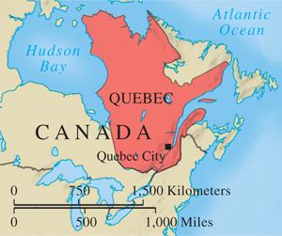
Quebec
p934
Notes:
Quebec

Slide 37
After the Cold War: New World Order or Age of Terrorism?
The End of the Cold War
Mikhail Gorbachev and “New Thinking”
The INF Treaty
Overthrow of Communist regimes
The Persian Gulf War
A minor role for the Soviets, followed by Soviet collapse
The end of superpower rivalry
Optimism for a ‘‘new world order’’ fades in the wake of new and old conflicts

Slide 38
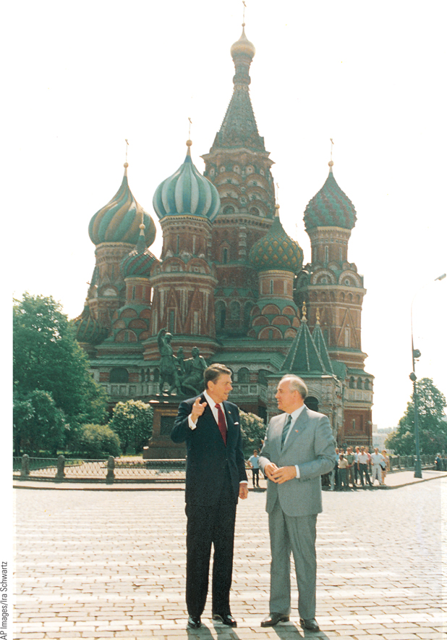
Reagan and Gorbachev
The willingness of Mikhail Gorbachev and Ronald Reagan to dampen the arms race was a significant factor in ending the Cold War confrontation between the United States and the Soviet Union.
p935
Notes:
Reagan and Gorbachev. The willingness of Mikhail Gorbachev and Ronald
Reagan to dampen the arms race was a significant factor in ending the Cold
War confrontation between the United States and the Soviet Union. Reagan
and Gorbachev are shown here standing before Saint Basil’s Cathedral during
Reagan’s visit to Moscow in 1988.

Slide 39
An Age of Terrorism?
“The Enemy of Our Generation”
Drawing attention to demands through acts of terror
Munich Olympic Games
Proliferation of motives and organizations
Left- and right-wing groups
Militant nationalists
The continuing threat of international terrorism
Acts of Palestinian terrorists
Sponsorship by military governments

Slide 40
Terrorist Attack on the United States
September 11, 2001
Hijackers attack the World Trade Center and the Pentagon
Coordination by Osama bin Laden and al-Qaeda
War in Afghanistan
Ouster of the Taliban, 2001
New multiethnic government faced problems of renewed Taliban activity
War in Iraq
U.S. attack on Saddam Hussein’s regime followed by instability and withdrawal

Slide 41
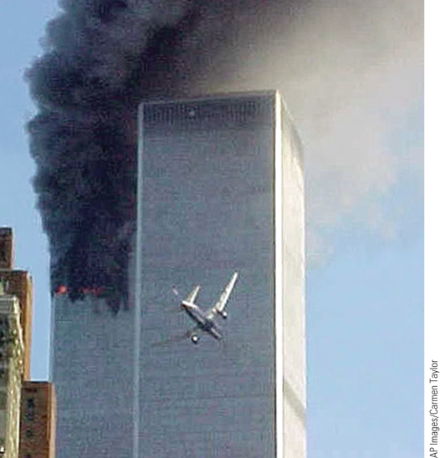
Terrorist Attack on the World Trade Center in New York City
On September 11, 2001, hijackers flew two commercial jetliners into the
twin towers of the World Trade Center.
p936
Notes:
Terrorist Attack on the World Trade Center in New York City.
On September 11, 2001, hijackers flew two commercial jetliners into the
twin towers of the World Trade Center. The photograph shows the
second of the two jetliners about to hit one of the towers while smoke
billows from the site of the first attack.

Slide 42
The West and Islam
Sources Anti-Western Sentiment in the Muslim World
Ongoing Israeli-Palestinian conflict
Revolution in Iran, 1979; Ayatollah Khomeini
Consequences of the Persian Gulf War; Resentment against the attack on Iraq in 2003
U.S. forces in the Middle East considered an affront to Islam by anti-Western Islamic groups
Terrorism as Global War
ISIS/ISIL (Islamic State)
Fighters from at least 90 countries
Jihad
November 2015 Paris Terrorist Attacks

Slide 43
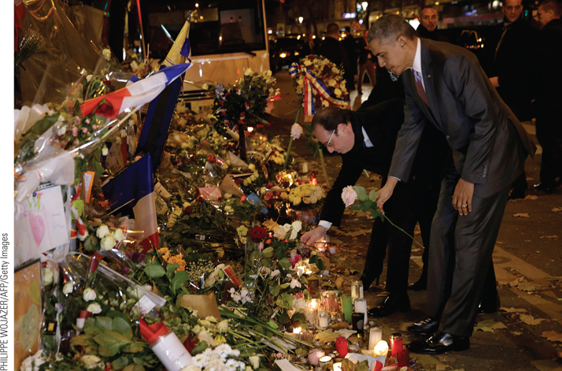
Paris Terrorist Attacks
United States president Barack Obama (right) pays tribute to the victims of the Paris attacks with French president François Hollande on November 30, 2015, outside the Bataclan music theatre, scene of terrorist attacks there on November 13, 2015.
p939
Notes:
Paris Terrorist Attacks. P. 939
United States president Barack Obama (right) pays tribute to the victims of the Paris attacks with French president François Hollande on November 30, 2015, outside the Bataclan music theatre, scene of terrorist attacks there on November 13, 2015.

Slide 44
New Directions in Western Society (Slide 1 of 2)
Transformation in Women’s Lives
Work and family
Falling birthrates
Woman in workforce on the rise
New employment areas, continuing inequalities
The Women’s Movement
Activism for control over reproduction and varied political and social causes
Cooperation through international conferences

Slide 45
New Directions in Western Society (Slide 2 of 2)
Guest Workers and Immigrants
Economic, political, and cultural tensions promote varied policies
The Migration Crisis
2015: Rise of migrants fleeing wars in Middle East
Angela Merkel and role of Germany
Resistance and conflict among EU states
Rise in anti-immigration sentiment and racist incidents
The New Urban Environment
Return to urban areas; By 2010 majority of Europeans and Americans live in cities

Slide 46
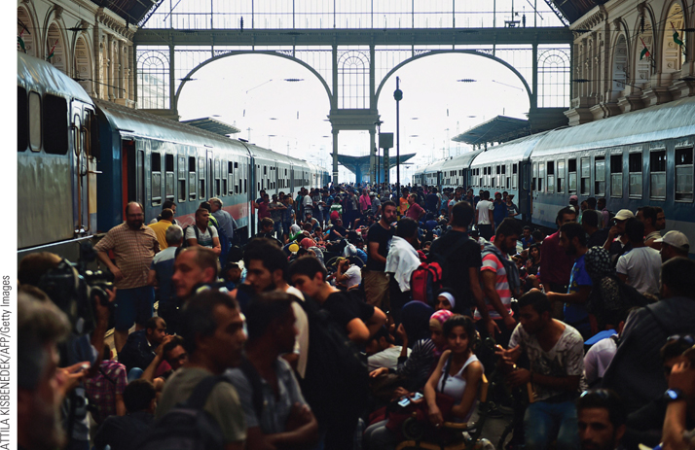
Migrant Crisis in Europe
In Budapest’s main railway station, thousands of refugees who had come through Serbia are seen attempting to board trains in Budapest before authorities closed the railway station.
p941
Notes:
Migrant Crisis in Europe. (p.941)
In Budapest’s main railway station, thousands of refugees who had come through Serbia are seen attempting to board trains in Budapest before authorities closed the railway station. Families were torn apart and refugees struggled to find provisions.

Slide 47
Western Culture Today
Varieties of Religious Life
Growth of both secularism and fundamentalism
The growth of Islam
The Catholic Church
Pope John Paul II (1978) and Pope Francis (2013)
Social justice and a new global nature
The Digital Age
The Technological World
The Internet and its capabilities
New forms of communication
Cell phones and smart phones
The iPod and iPad
Social Media

Slide 48
Western Culture Today
Art in the Contemporary World
Transformed by technology and finance
New role for museums; Biennials
Contemporary Trends in the Visual Arts
Neo-Expressionism (e.g. Anslem Kiefer)
Identity politics (e.g. Shirin Neshat)
Multiculturalism (e.g. Yinka Shonibare )
Time-based new media (e.g. Christian Marclay)
Music since 1985
Grunge, rap, and hip hop
ITunes and streaming services

Slide 49
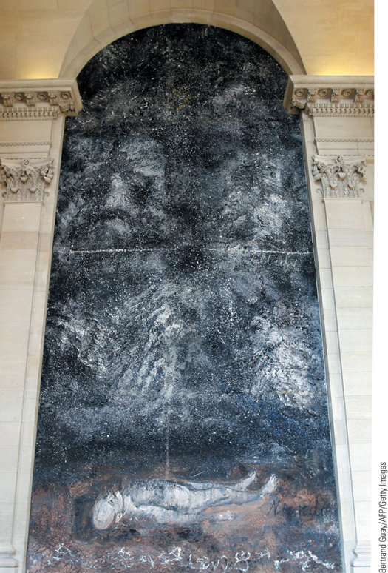
Anselm Kiefer, Athanor
In 2007, Kiefer painted a monumental work (30 feet by 15 feet) on the wall of a stairwell in the Louvre Museum in Paris.
p943
Notes:
Anselm Kiefer, Athanor. In 2007, Kiefer painted a monumental
work (30 feet by 15 feet) on the wall of a stairwell in the Louvre
Museum in Paris. This textured painting is named after the athanor,
a furnace that alchemists used in their efforts to transform base
metals into gold. The painting shows a nude man on his back
connected by a beam of light extending from his stomach to the
heavens above. According to Kiefer, the man is not dead, but ‘‘in the
universe.’’ At the bottom of the painting Kiefer poured liquid lead
onto a layer of soil from the area where he lives in southern France;
higher up in the painting are silver and then gold, symbolizing the
stages of the alchemical process.

Slide 50
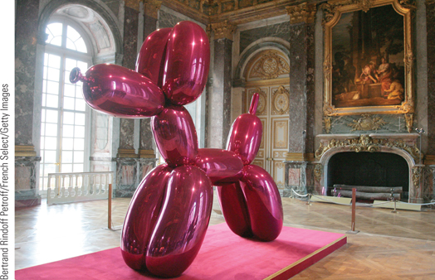
Jeff Koons, Balloon Dog (1994–2006) on exhibition at the Palace of Versailles, France
In 2008, Jeff Koons became the first contemporary artist to have an exhibition at Versailles, the former Palace of Louis XIV. While some criticized his work as banal, others found the materialism and self-aggrandizement of Koons’s artistic practice commensurate to that of the Sun King.
p944
Notes:
Jeff Koons, Balloon Dog (1994–2006) on exhibition at the Palace of Versailles, France. (p.944)
In 2008, Jeff Koons became the first contemporary artist to have an exhibition at Versailles, the former Palace of Louis XIV. While some criticized his work as banal, others found the materialism and self-aggrandizement of Koons’s artistic practice commensurate to that of the Sun King. The artist carefully selected which sculptures would be displayed in each room, as Koons sought a dialogue between his popular contemporary forms and the Baroque environment of the palace. The stainless steel Balloon Dog stands ten feet tall and weighs one ton, playfully altering the characteristics of its original reference.

Slide 51
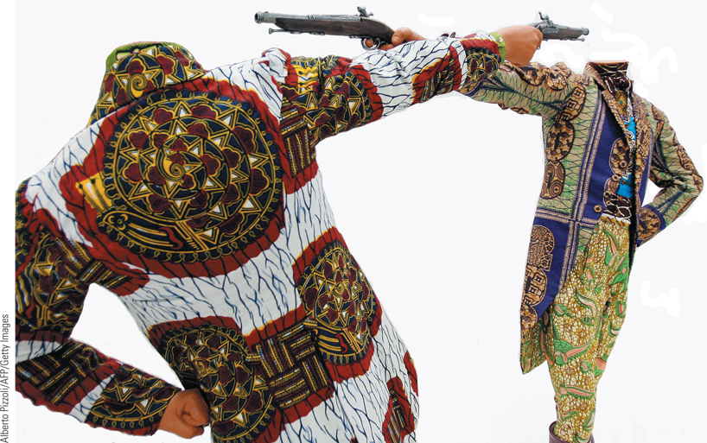
Yinka Shonibare, How to Blow Up Two Heads at Once (Gentlemen)
In this work, Yinka Shonibare humorously re-creates a nineteenth-century European duel in which two headless figures wearing Victorian costumes are simultaneously aiming guns at each other’s heads.
p944
Notes:
Yinka Shonibare, How
to Blow Up Two Heads
at Once (Gentlemen).
In this work, Yinka Shonibare
humorously re-creates a
nineteenth-century European
duel in which two headless
figures wearing Victorian
costumes are simultaneously
aiming guns at each other’s
heads. His choice of Victorian
figures and costumes reflect
his interest in the history of
Britain’s colonial endeavors.
The Dutch wax cloth used
for the costumes symbolizes
the complexity of modern
African identity in Europe.
The cloth was produced in
the Netherlands and Britain
and then sold in West Africa
during the nineteenth century.

Slide 52
Toward a Global Civilization: New Challenges and Hopes
Globalization
The Global Economy
New structures and agreements
World Bank and the International Monetary Fund
Transnational corporations
General Agreement on Tariffs and Trade
World Trade Organization
The End of Excess
Troubles in the U.S. housing market
The impact of globalization: the spread of distress
The Greek crisis
Troubled recovery

Slide 53
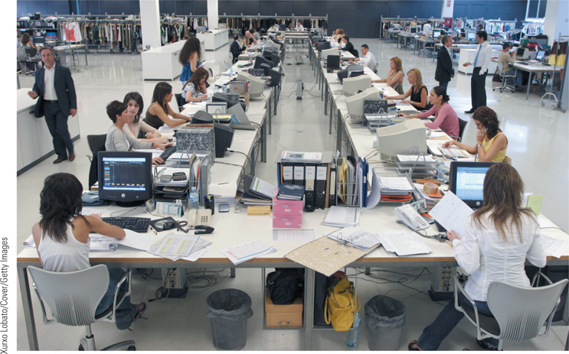
Global Perspectives: The New Global Economy: Fast Fashion (Slide 1 of 3)
Shown is the design area in the Zara factory in La Coruja, Spain, where a number of designers are working together.
p946
Notes:
The New Global Economy: Fast Fashion

Slide 54
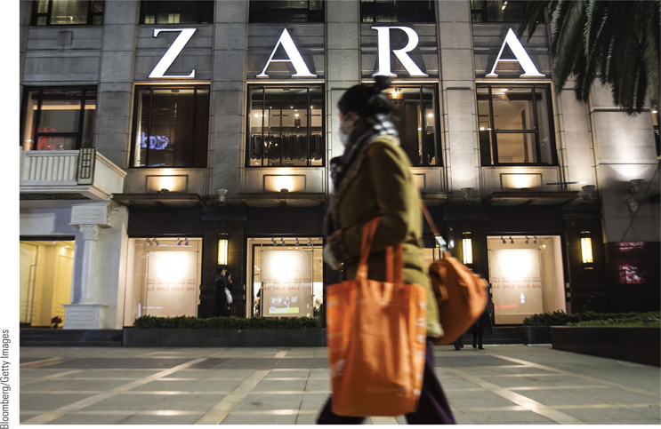
Global Perspectives: The New Global Economy: Fast Fashion (Slide 2 of 3)
A shopper walks outside of a store in Beijing, China in 2015.
p946
Notes:
The New Global Economy: Fast Fashion

Slide 55
Toward a Global Civilization
Globalization and the Environmental Crisis
Problems of population growth and consumption
Global warming and greenhouse gases
The Social Challenges of Globalization
The impact of migration
Developed and developing nations
New Global Movements and New Hopes
‘‘Think globally, act locally’’
Nongovernmental organizations (NGOs)

Slide 56
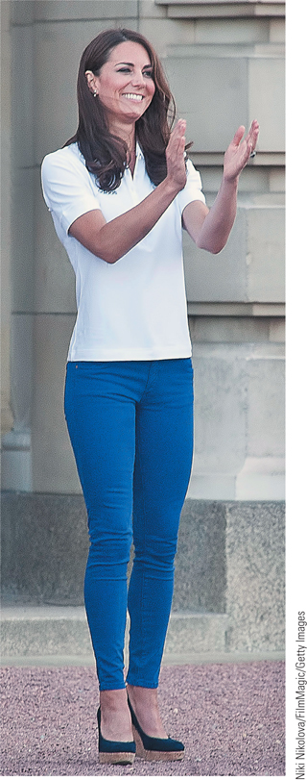
Global Perspectives: The New Global Economy: Fast Fashion (Slide 3 of 3)
Kate, the duchess of Cambridge, photographed in Zara clothing, is emblematic of Zara’s appeal.
p946
Notes:
The New Global Economy: Fast Fashion

Slide 57
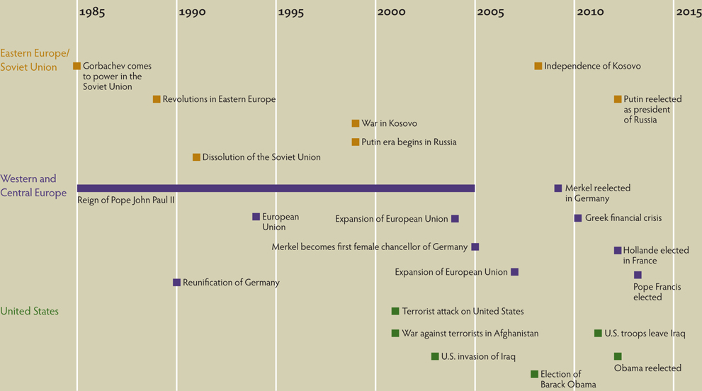
Chapter Timeline
p951

Slide 58
Discussion Questions
What was the impact of Mikhail Gorbachev’s reforms on the Soviet Union? Was he its savior or its destroyer?
How did Reagan’s push for weapons development contribute to the Soviet economic collapse?
What were the chief obstacles in the reunification of Germany? How were these obstacles resolved?
How has terrorism changed over the last two decades? What forces brought about these changes?
What unresolved challenges from the past still face Western civilization in the new global age?

