Slide 1
Document Based Question: Writer’s Workshop
AP European History: Printing Press DBQ
Sourcing: Videos/DBQ/And Rubric from Tom Richey (www.TomRichey.net)

Slide 2
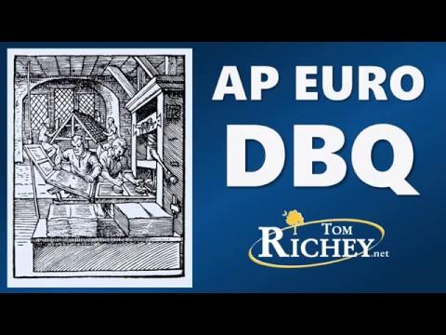
The DBQ in General

Slide 3
The Prompt
Evaluate the extent to which the invention of the printing press altered the lives of Europeans.
Step one should ALWAYS be analyzing the prompt and understanding what it is asking you to do.
What does it mean to “evaluate”
What are we evaluating?
To do a good job answering this question, what time frames do we need to talk about?

Slide 4
What should we do next?
-Why do we need to HIPP the documents first?
- Let’s do this and then talk them out together
HIPP THE DOCUMENTS!
H- Historical Situation/Context
I- Intended Audience
P- Purpose of the Document
P- Point of View

Slide 5
Time to think about a thesis:

Slide 6
Let’s Practice
1st- Remember the THREEsis. What three items can you find to become your supporting points?
2nd- Let’s Review the Complex/Split Thesis Model
3rd- Write your thesis
3rd- Before we move on, let’s sort our documents
Which documents line-up with which items in your supporting points?

Slide 7
Create the following chart on your paper
Supporting Topic 1 | Supporting Topic 2 | Supporting Topic 3
Obviously, don’t write “supporting topic 1”. Put your supporting argument there instead
Sort your documents. Strive for a 2/2/3 split

Slide 8
Contextualization

Slide 9
Did you catch that???
You could get a 2, which is the average on the Euro DBQ just by doing an excellent job on the intro paragraph.

Slide 10
Contextualization
Brainstorm with your table what items you could/should use in your contextualization
Make sure that they connect to the prompt!
What SPECIFIC details/evidence could you include in here?

Slide 11
Organization
Intro paragraph-
Contextualization
Thesis Statement
Body Paragraphs
Topic Sentence! Each paragraph should really be covering one of the supporting details from your thesis!
At the end of the body paragraph, you should tie the topic back to HOW it answers the thesis question!

Slide 12
Using the Documents-

Slide 13
Don’t do a drive by description!
This was a HUGE issue. You need to show that you understand the document. My telling you to allude to the document didn’t mean to ignore the document completely! I simply meant to not quote the document.
The reader knows what the document says. They want to make sure you do.

Slide 14
So what does this look like?
Notice… he says this is done in a SINGLE SENTENCE

Slide 15
Let’s Practice
Look at your first supporting detail
Identify and re-read one of the documents that work with this ideal
Write a “describing” sentence that you could use in your essay about that document
Exchange with each other and provide feedback
“Describing” Point

Slide 16
Using the documents to Support your argument

Slide 17
Let’s Practice
“Supporting” Point
Watch the Clip
Let’s write the paragraph topic sentences
Look at the “describing” sentence that you wrote in the previous section
Write a second sentence that now supports the thesis point you are emphasizing in this paragraph (should be your topic sentence
Exchange with each other and provide feedback

Slide 18
Using the documents to explain

Slide 19
Let’s Practice
Look at the “describing and supporting” sentences that you wrote in the previous section
Write a Third sentence that now explains one of the HIPP points
Exchange with each other and provide feedback
“Explaining” Point

Slide 20
The Last Two Points: Outside Evidence

Slide 21
The Last Point: Complex Understanding
This is the hardest point to get.
I will never tell you to not do a part of the rubric
But….
If you are short on time (only during timed writing) this is what you should cut because it’s the one you are going to have the hardest time doing

