Slide 1
Inter-War Years Art
Modern Art

Slide 2
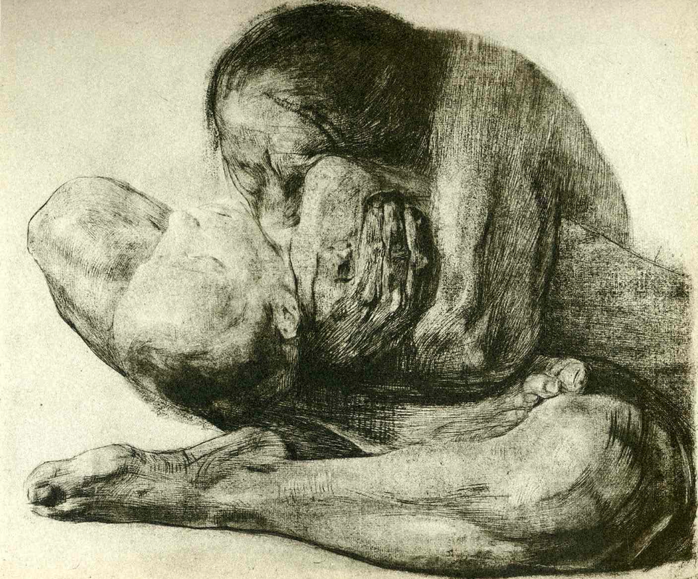
Kathe Kollwitz: Mother with Dead Child, 1903.
National Gallery of Art, Washington D.C.
Though this was painted before World War I, her work became more popular in the inter-war years.

Slide 3
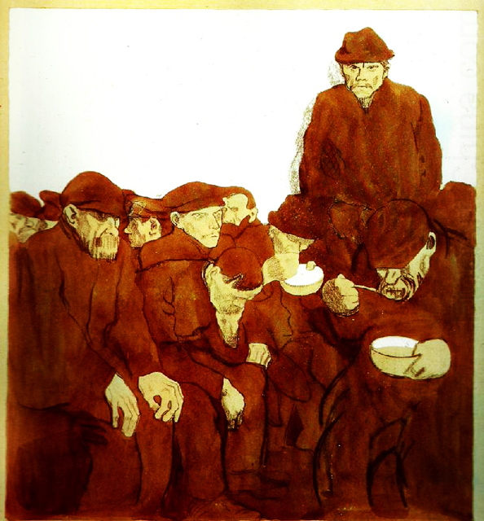
Kathe Kollwitz, The Lunch Hour, 1909. Private collection.

Slide 4
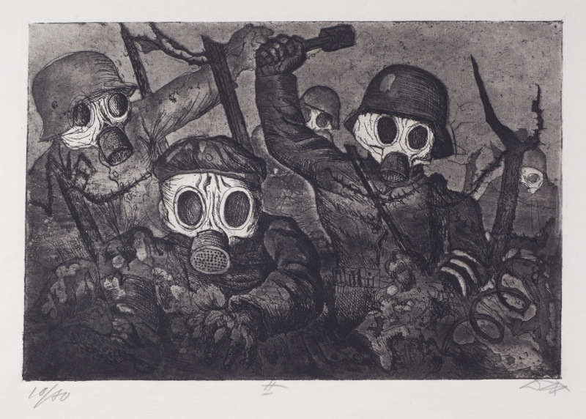
Otto Dix, Storm Troopers Advancing Under Gas, 1924.

Slide 5
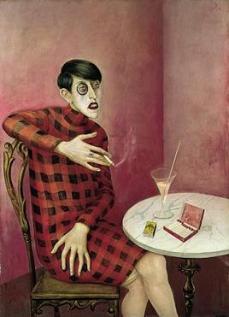
Otto Dix, Portrait of the Journalist Sylvia von Harden, 1926. Centre Georges Pompidou, Paris.

Slide 6
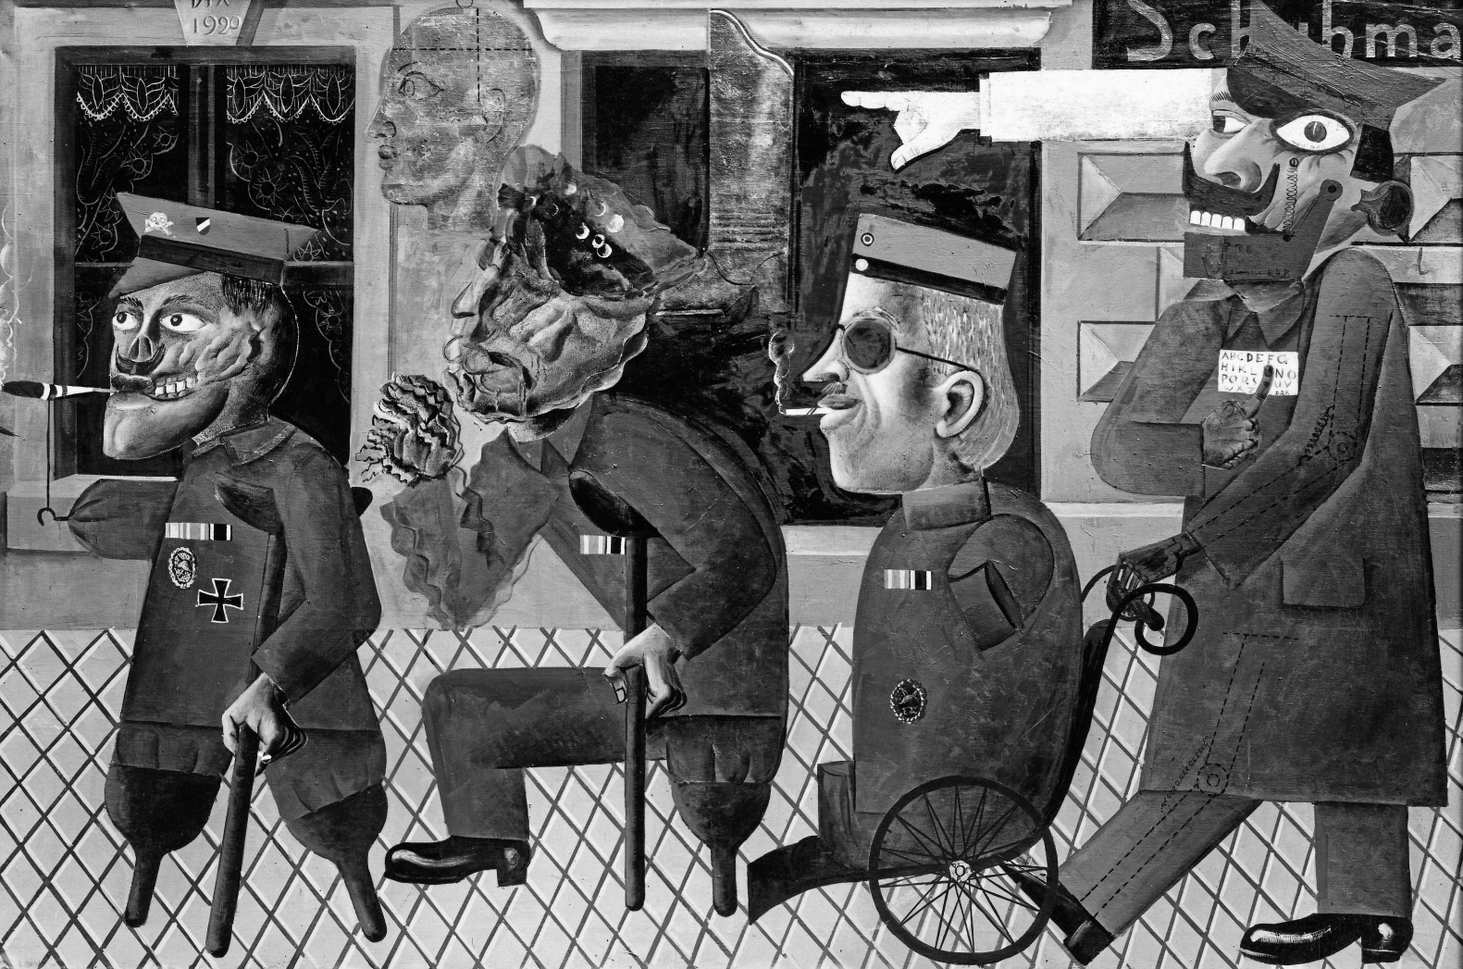
Otto Dix, The War Cripples, 1920.
Nazis displayed it as degenerate art labelled “Slander Against our German War Heroes” and presumably this painting was destroyed.

Slide 7
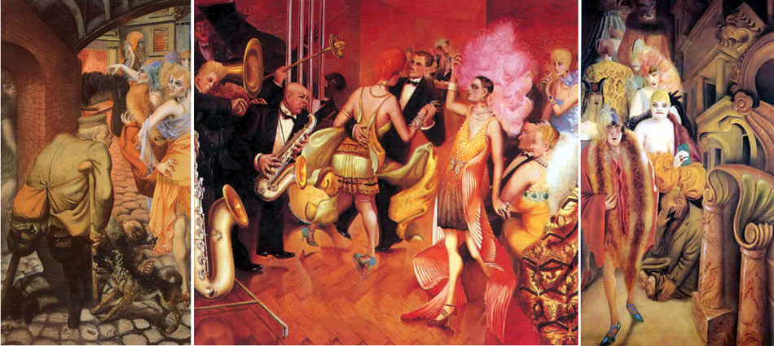
Otto Dix, Metropolis. 1928. Kunstmuseum Stuttgart, Germany.

Slide 8
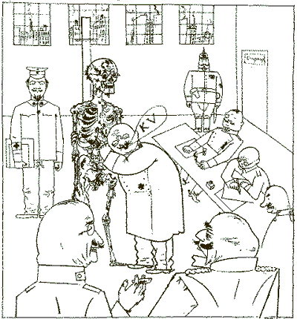
George Grosz, Fit for Active Service (or The Faith Healers), 1918.

Slide 9
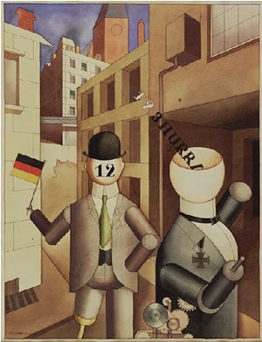
George Grosz, Republican Automatons. 1920.
Museum of Modern Art, New York City.

Slide 10
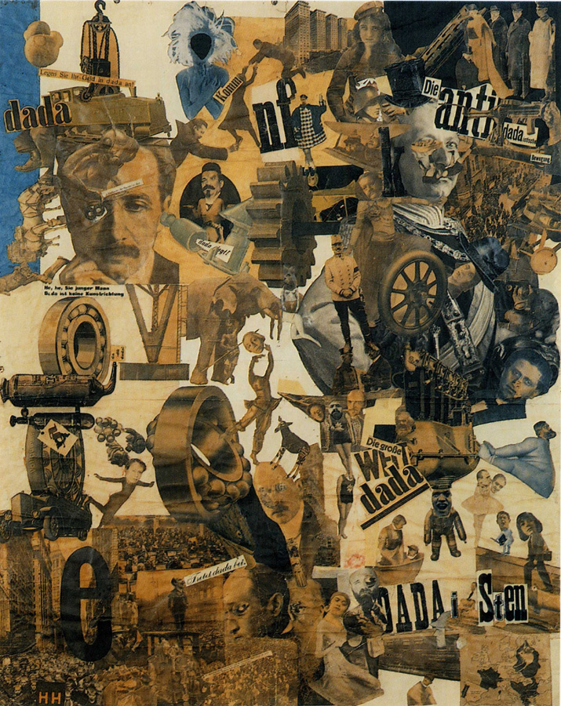
Hannah Hoch, Cut With the Kitchen Knife Dada Through the Last Weimar Beer Belly Cultural Epoch of Germany, 1919.
Nationalgalerie, Staatliche Museen zu Berlin. Collage of pasted papers.

Slide 11
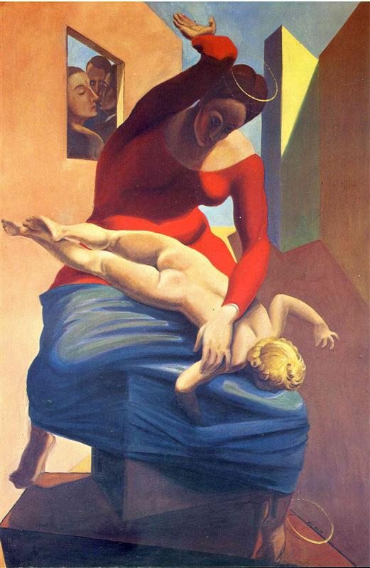
Max Ernst, The Virgin Spanking the Christ Child Before Three Witnesses: Andre Breton, Paul Eluard, and the Artist, 1926. Museum Ludwig, Cologne, Germany.

Slide 12
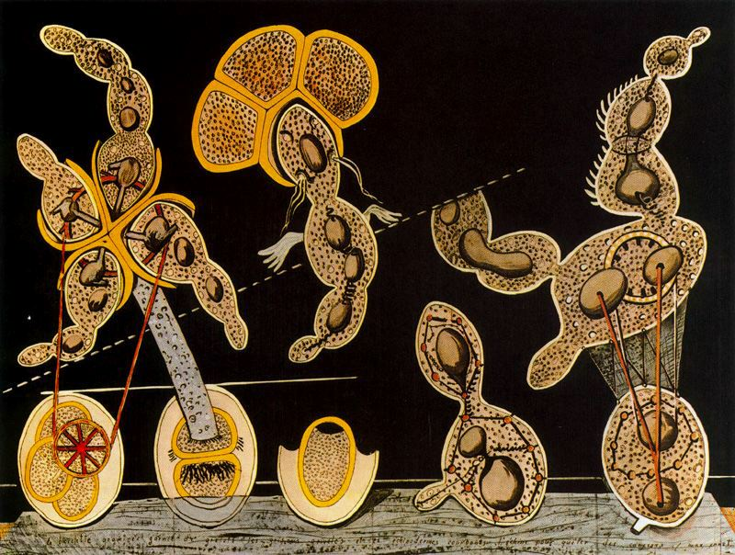
Max Ernst, The Gramineous Bicycle Garnished with Bells the Dappled Fire Damps and the Echinoderms Bending the Spine to Look for Caresses, 1920. Museum of Modern Art, New York City.

Slide 13
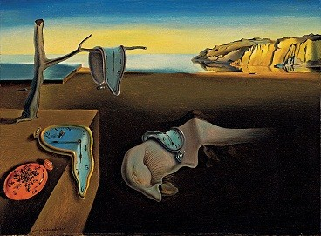
Salvador Dali, The Persistence of Memory, 1931.
Museum of Modern Art, New York City.

Slide 14
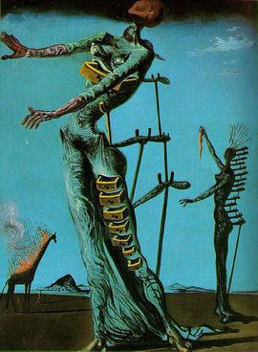
Salvador Dali, The Burning Giraffe, 1937.
Kunstmuseum Basel, Switzerland.

Slide 15
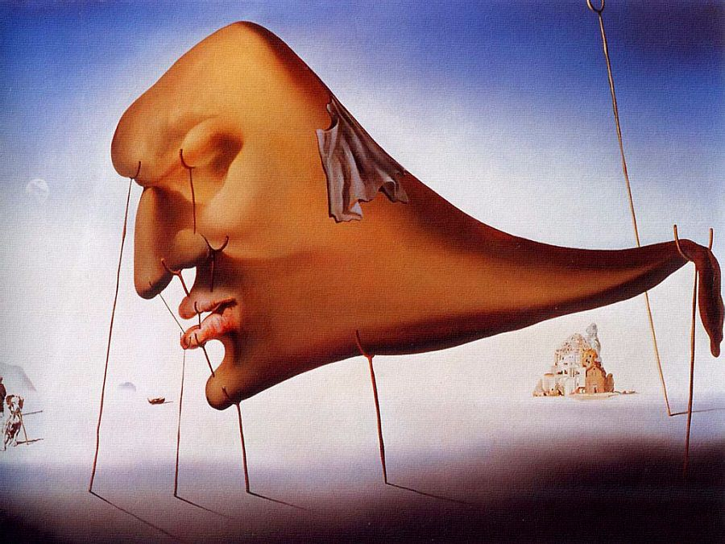
Salvador Dali, Le Sommeil (Sleep), 1937.

Slide 16

Frank Lloyd Wright, Fallingwater (Edgar J. Kaufmann House), 1935-1938. Bear Run, Pennsylvania.

Slide 17
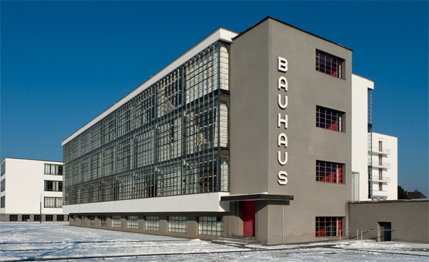
Bauhaus Building, Walter Gropius, 1926. Dessau, Germany.

