Slide 1
Images of Religious Wars
Europe in the 1600’s

Slide 2
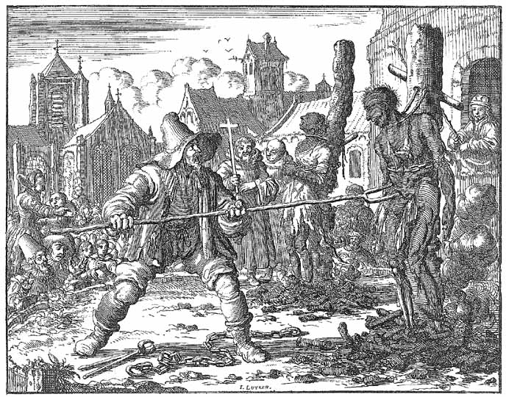
Execution of the Mennonites: The Netherlands

Slide 3
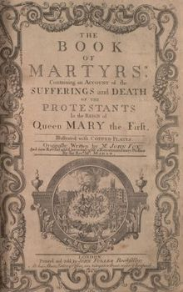
John Foxe’s The Book of Martyrs

Slide 4
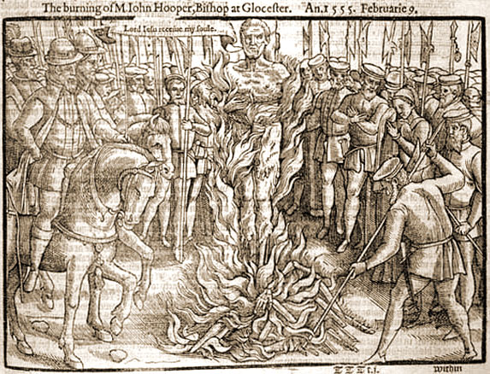
Burning of John Hooper in Scotland by Queen Mary

Slide 5
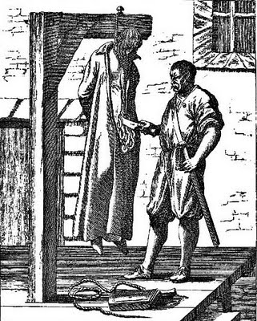
“A Jesuit Disemboweled” John Ogilvie’s death in Scotland, 1615

Slide 6
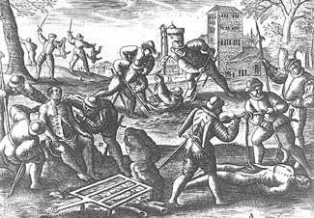
Persecution of the Catholics by Huguenots

Slide 7
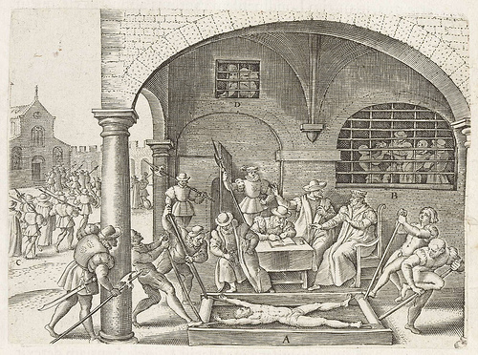
Persecution of Catholics by Huguenots

