Slide 1
Impressionism and Post-Impressionism
Chapter 16: Modern European Thought

Slide 2
Impressionism
Began mainly in Paris.
Depiction of modern life itself (rather than religious, mythological, or historical themes).
  Especially social life and leisure of urban middle and lower classes.
Fascination with light, color, and momentary, unfocused visual experience.
Fleeting and brief word of a first impression based on light and the sudden moment.
Short, choppy, light brushstrokes and en plein aire (outdoors).
Vibrant, light, with little detail.

Slide 3
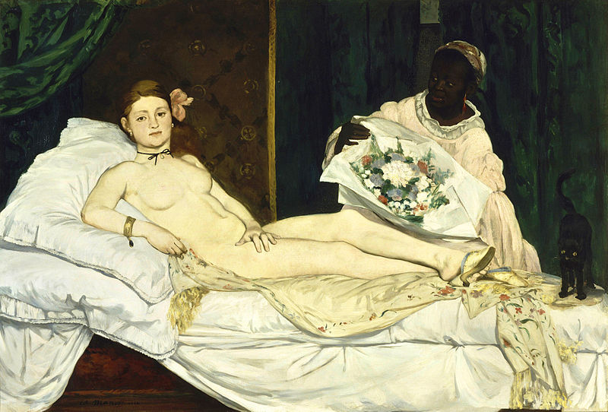
Edouard Manet, Olympia, 1863. Oil on canvas.
“When our artists give us Venuses, they correct nature, they lie. Edouard Manet asked himself why lie, why not tell
The trurh; he introduced us to Olympia, the fille [girl] of our time, whom you meet on the sidewalks.” – Emile Zola

Slide 4
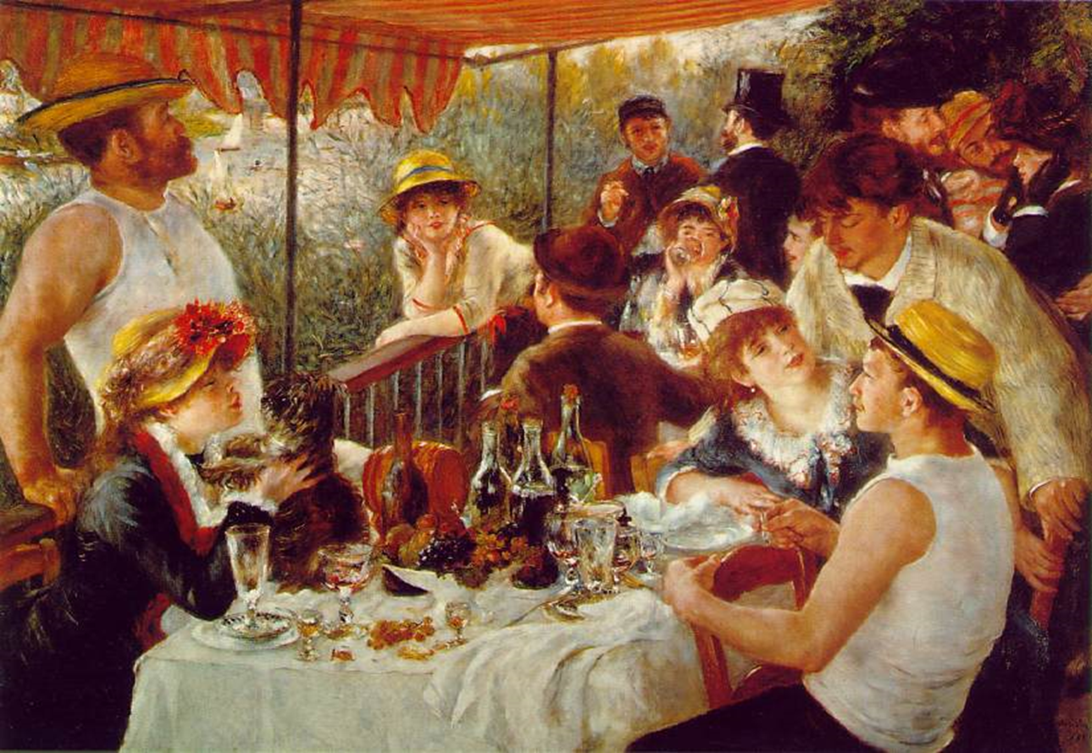
Pierre-August Renoir, The Luncheon of the Boating Party, 1881. Oil on canvas.

Slide 5
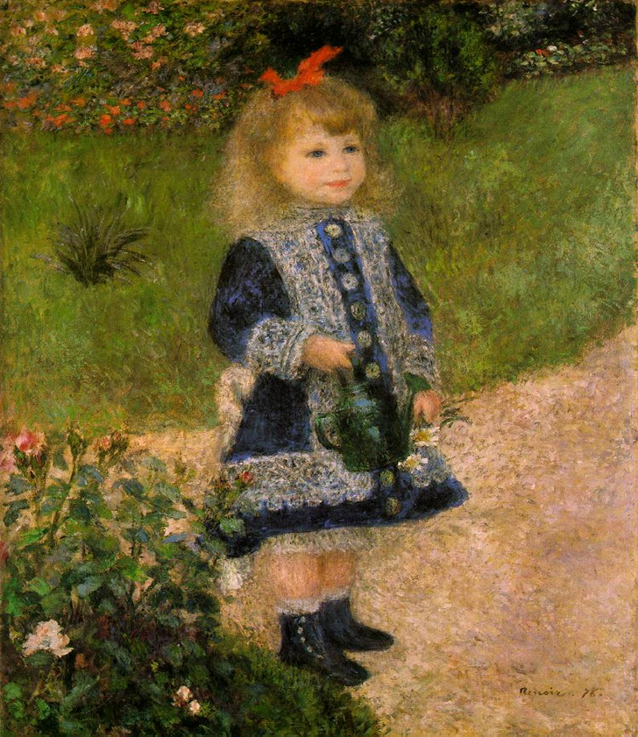
Pierre-August Renoir, Girl with a Watering Can, 1876.

Slide 6
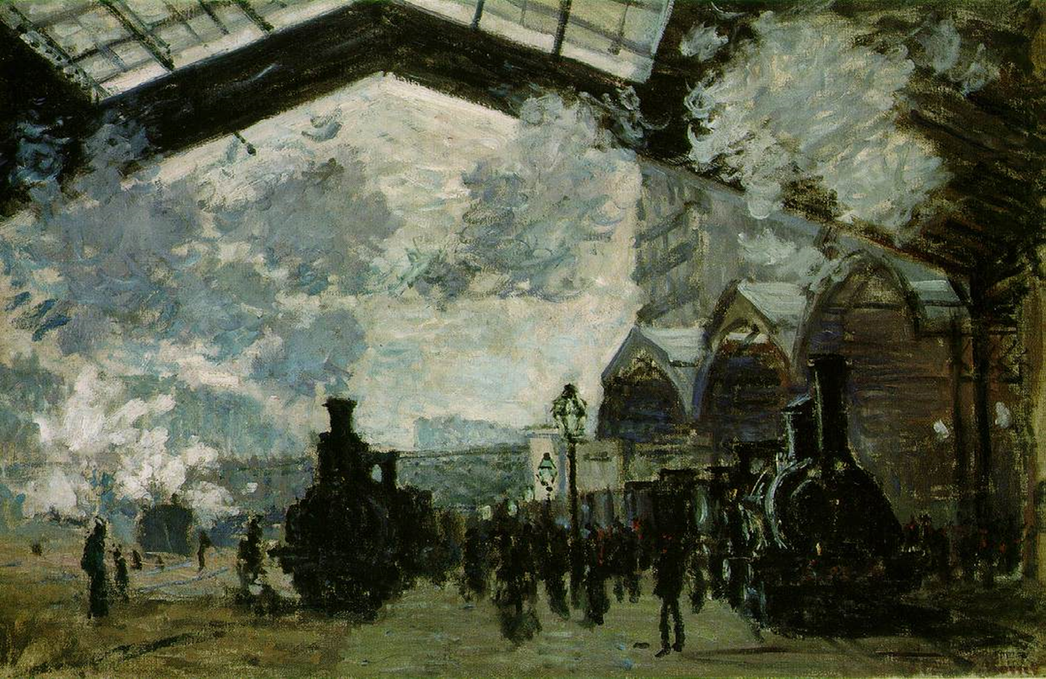
Claude Monet, The Saint-Lazare Station, 1877.

Slide 7
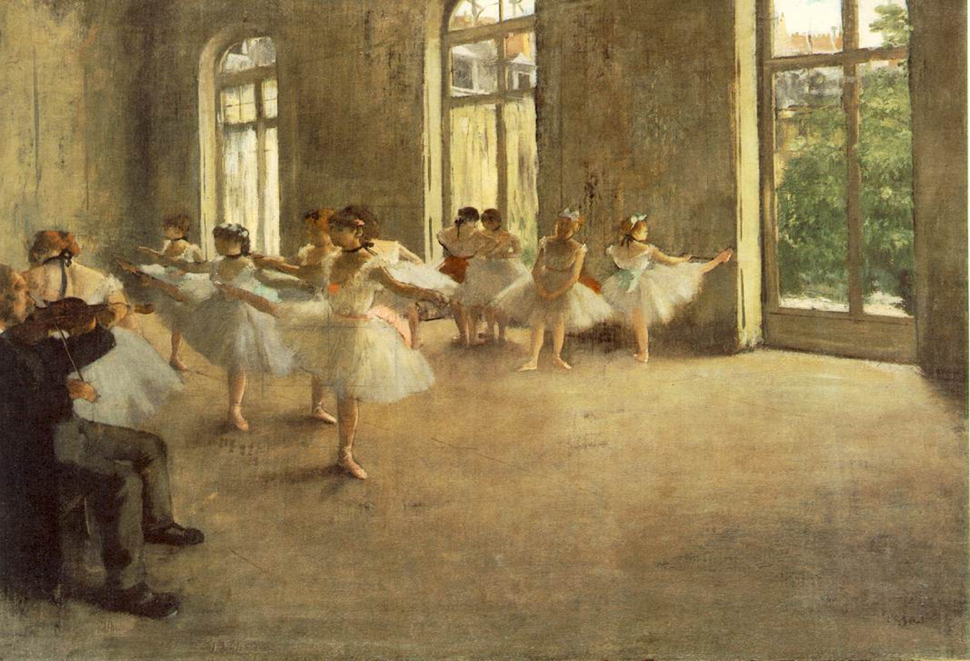
Edgar Degas, The Rehearsal, 1878.

Slide 8
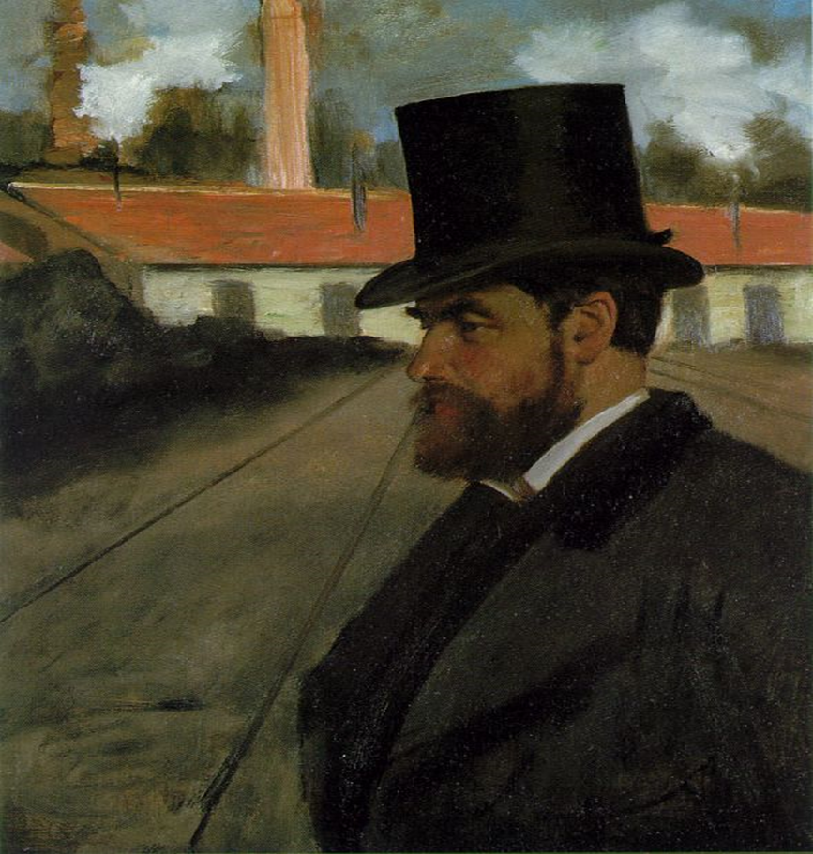
Edgar Degas, Henri Rouart in Front of His Factory, 1875.

Slide 9
Post-Impressionism
Impressionism left a huge impact by the 1880s.
Younger artists drew on methods and ideas of impressionists.
Form and structure were more important than the effort to record the impression.
Represented impressionism, but rejected its limitations.
Studies depth, sometimes more detailed than impressionism
More depth, structure, and some use of pointillism

Slide 10
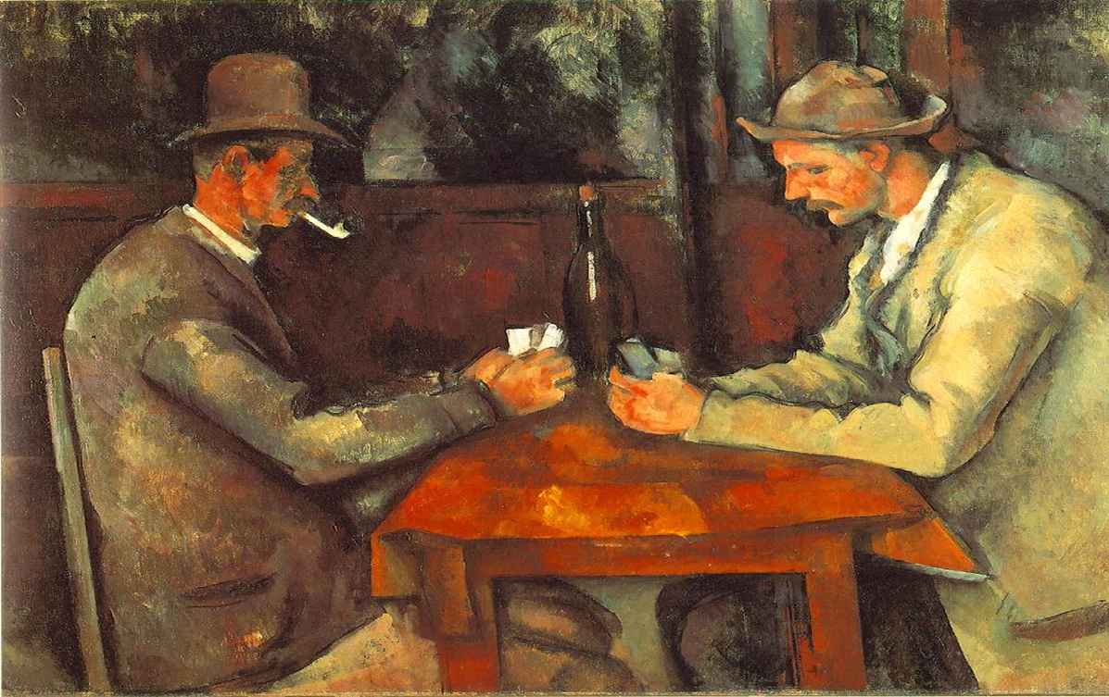
Paul Cezanne, The Card Players, 1895.

Slide 11
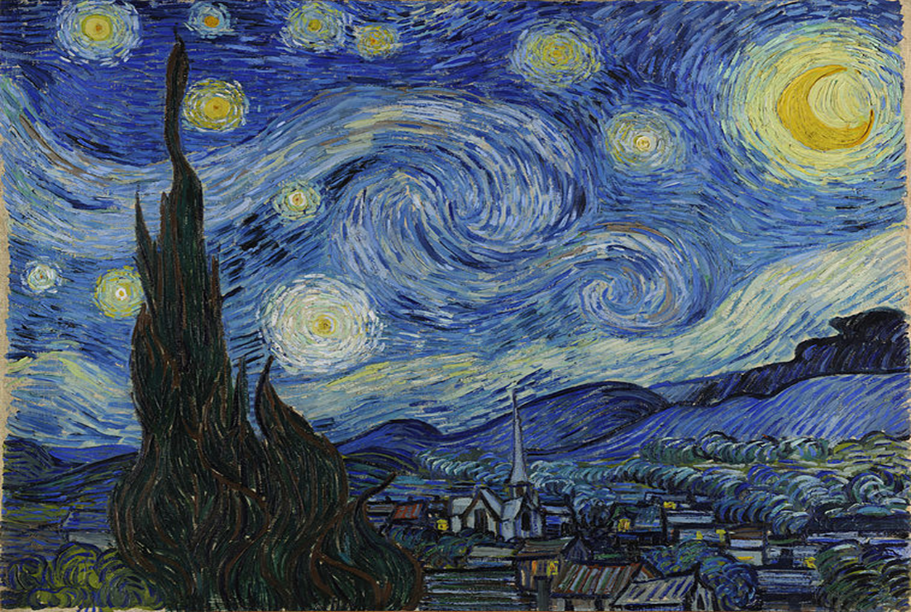
Vincent Can Gogh, The Starry Night, 1889.

Slide 12
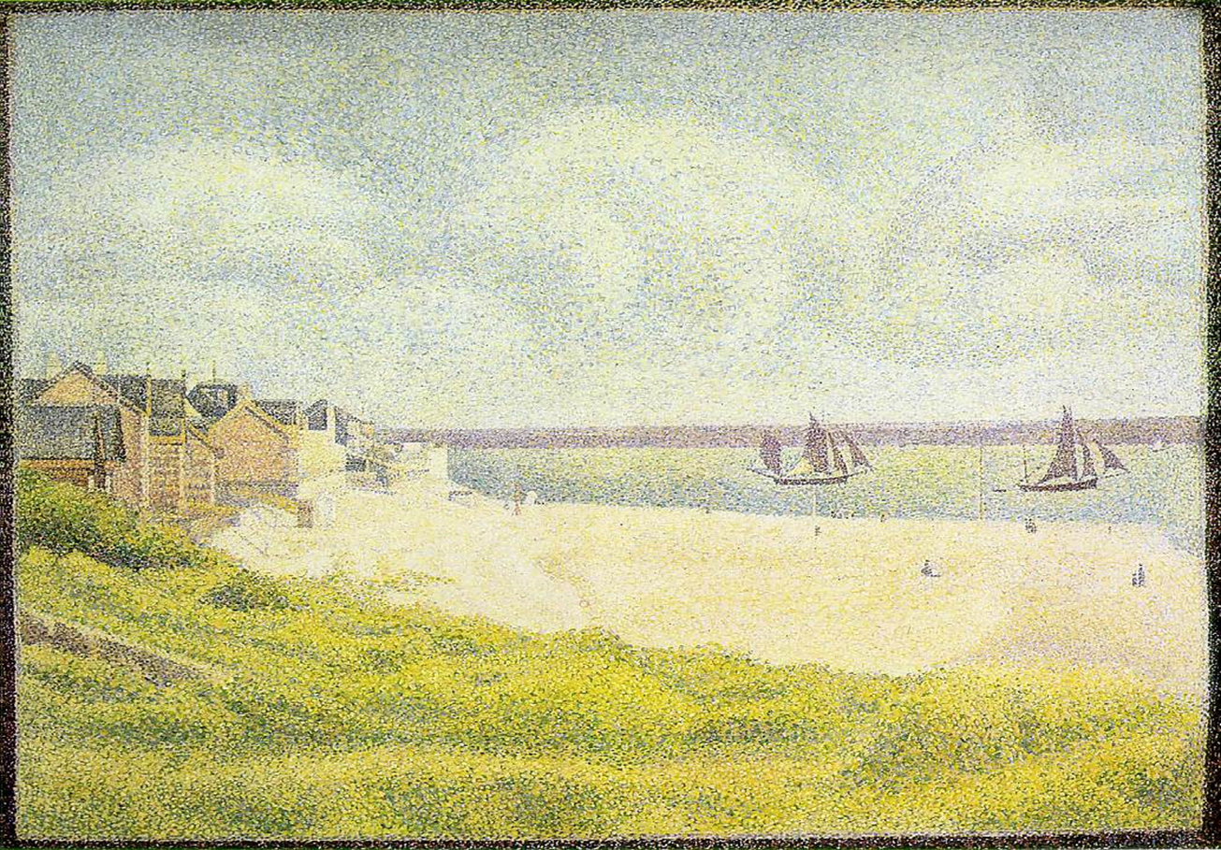
Georges Seurat, View of Le Cretoy, 1889.

