Slide 1
Roman, Jewish, and Christian Influences on Government
[Your Name]
[Your Teacher’s Name]
[Your School]
[Your Grade]

Slide 2
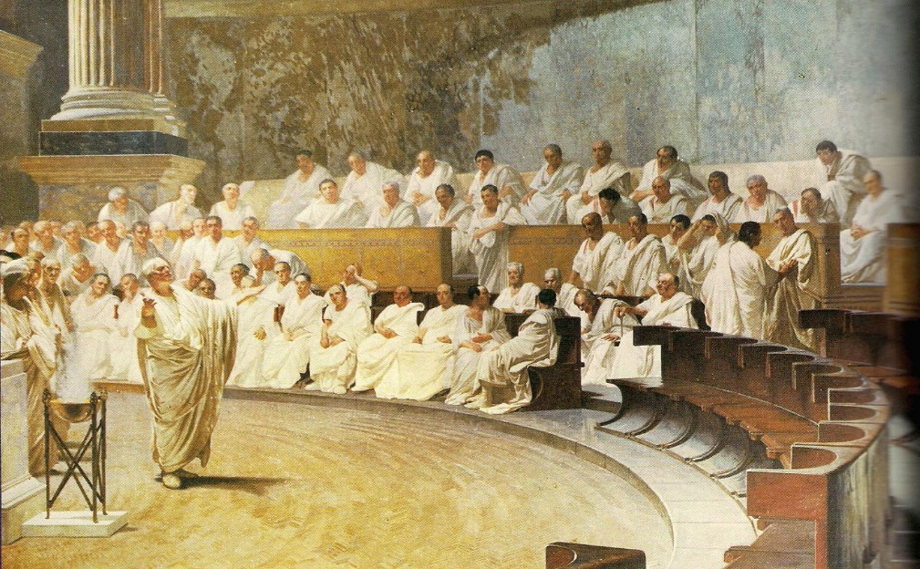
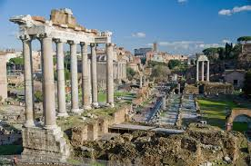
I. Establishing a Republic
“Republic”: Re= “of, or pertaining to”
Public= “the people”
Made of two consuls and a Senate of 300 members.
A dictator was elected in times of war to serve for 6 months at a time- why?

Slide 3
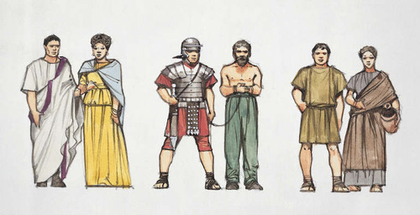
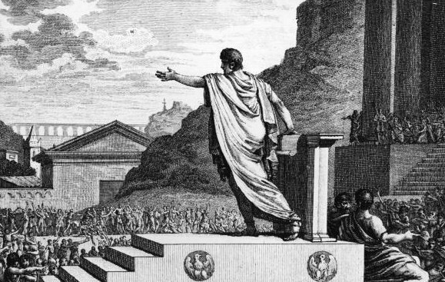
I. Establishing a Republic
The Roman Population
Plebeians: The common people
They made up most of the population, but had no representation in government!
How did they get representation in government?

Slide 4
Plebeian representation
Tribunes: officials of the common people, who represent them in the Senate.
Veto- The ability to block a law. Tribunes could veto a law if it was harmful to the people.
Twelve Tables- Laws of Rome inscribed on 12 stone tablets- for people to know their rights.
Gaius Gracchus
addressing the
people of Rome.
Their lasting legacy was that they gained access to power and guarded their rights.

Slide 6
Roman Law
Two systems of law:
Civil Laws
Apply to every day lives of citizens
Law of nations
Based on laws of nature and the human ability to use reason (common sense)
Inspired the principle of Natural Rights- the idea that we are all born with rights to life, liberty, and property.
Common Principles:
Innocent until proven guilty
The accused can face their accuser in court
Guilt to be established “clearer than daylight”
Judges interpret laws and make decisions.

Slide 7
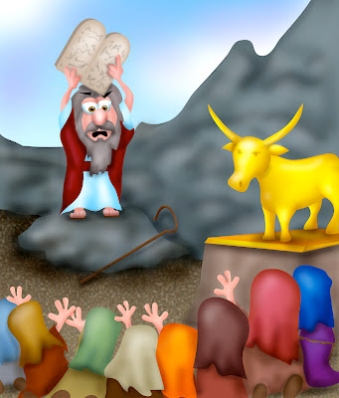
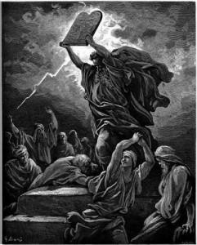
Judaism
Teachings on Law and Morality
Moses is the “law-giver” to the Jews.
The Ten Commandments stress religious duties of the individual toward God, such as keeping the Sabbath, and for respecting others.
They apply to all Jews.

Slide 8
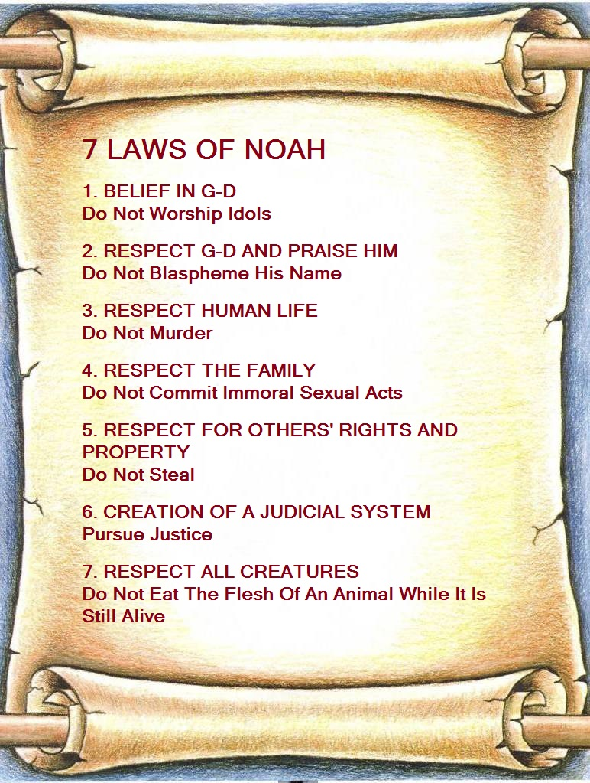
Judaism
Seven Universal Laws
These apply to all people, not just Jews.
Establish laws against murder, robbery, etc., and to establish a court system and laws.

Slide 9
Judaism
An ethical worldview
Disobeying God will bring God’s punishment.
One must have ethics: moral standards of behavior.
Jews believe “God created man in His own image”, therefore all men are created equal.
Jews make their leaders obey God as well, because in their belief leaders are men, and no man is superior to God.

Slide 10
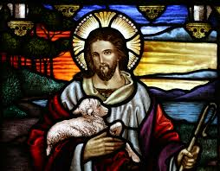
Christianity
Jesus of Nazareth
Main message: There is one God; all must accept the Ten Commandments and accept Him as the son of God, which will bring spiritual salvation.
He emphasized love, justice, morality, and charity.
Jesus believed a person’s main responsibilities were to love the Lord, love your neighbors, and love yourself.

Slide 11
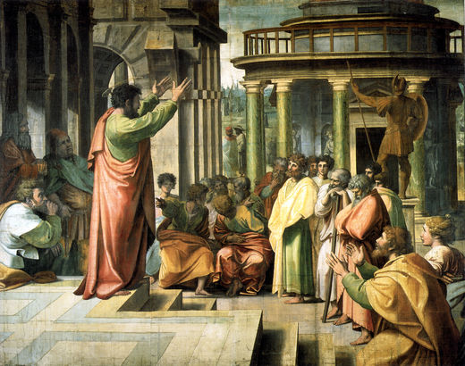
Christianity
Spread of Christianity
Paul spread the Gospel, or teachings of Jesus
The New Testament were Christian writings about Jesus. It was added to the Jewish Old Testament, and these two became known as the Bible.

Slide 12
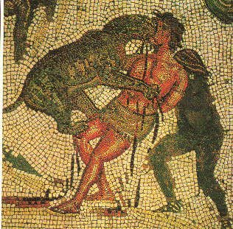
Christianity
Christians were persecuted because they did not worship the Emperor of Rome or the Roman gods. They refused to make sacrifices to them.
Christianity mostly appealed to the
poor and weak, because of its comforting message of love and forgiveness.
Persecution ends in A.D. 313, when the Emperor Constantine issued the Edict of Milan, which made Christianity the official religion of Rome.

Slide 13
Christianity in the Roman Empire

