Slide 1
The Eighteenth Century: An Age of Enlightenment
Chapter 17

Slide 2
Focus Questions
​What intellectual developments led to the emergence of the Enlightenment? Who were the leading figures of the Enlightenment, and what were their main contributions? In what type of social environment did the philosophes thrive, and what role did women play in that environment?
​What innovations in art, music, and literature occurred in the eighteenth century? How did popular culture differ from high culture in the eighteenth century?
​How did popular religion differ from institutional religion in the eighteenth century?

Slide 3
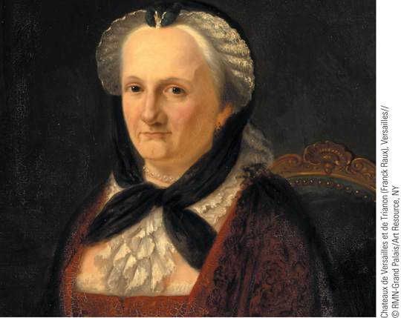
Portrait of Madame Geoffrin
Marie-Thérèse de Geoffrin, the wife of a wealthy merchant, held sway
over gatherings that became the talk of France and even Europe.
p499
Notes:
Portrait of Madame Geoffrin

Slide 4
The Enlightenment
The Paths to Enlightenment
“Dare to know”: Immanuel Kant (1724 – 1804)
The popularization of science
Bernard de Fontenelle (1657-1757), Plurality of Worlds
A new skepticism
Pierre Bayle (1647 – 1706)
Skepticism about religion and growing secularization
The impact of travel literature
Captain James Cook
The “noble savage” and cultural relativism
The Legacy of Locke and Newton
Locke’s Essay Concerning Human Understanding

Slide 5
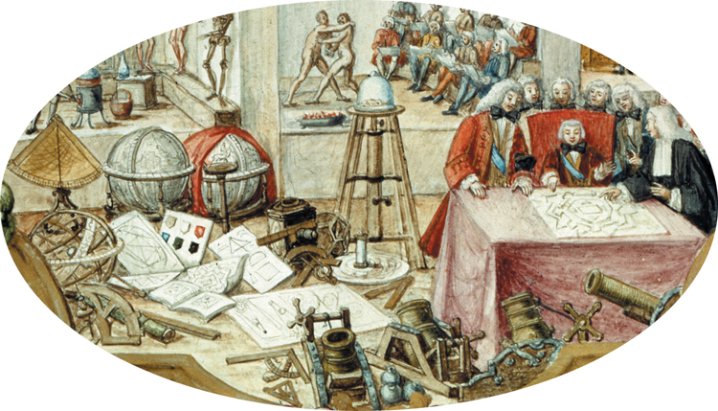
The Popularization of Science in the Age of the Enlightenment
During the Enlightenment, the ideas of the Scientific Revolution were spread and popularized in a variety of ways.
p501
Notes:
The Popularization of Science
in the Age of the
Enlightenment. During the
Enlightenment, the ideas of the
Scientific Revolution were spread
and popularized in a variety of ways.
Scientific societies funded by royal
and princely patrons were especially
valuable in providing outlets for the
spread of new scientific ideas. This
illustration shows the German prince
Frederick Christian visiting his
Academy of Sciences in 1739. Note
the many instruments of the new
science around the rooms—human
skeletons, globes, microscopes,
telescopes, and orreries (mechanical
models of the solar system).

Slide 6
The Enlightenment
The Legacy of Locke and Newton: Provided main intellectual inspiration for the Enlightenment
Newton’s rules of reasoning= natural laws that governed social world
John Locke: Essay Concerning Human Understanding
Denied innate ideas; all born with a “tabula rasa”
Knowledge comes from environment and reason, not from heredity or faith
People molded by the environment and experience both of which can be changed by creating new society

Slide 7
The Philosophes and Their Ideas
The Philosophes
Diverse backgrounds, common bonds
Desire to change the world
Freedom of expression and a spirit of rational criticism
Baron de Montesquieu (1689 – 1755), and Political Thought
Persian Letters, 1721
Attacks on traditional religion and slavery, advocacy of religious toleration and reason
The Spirit of the Laws, 1748
“Separation of powers”

Slide 8
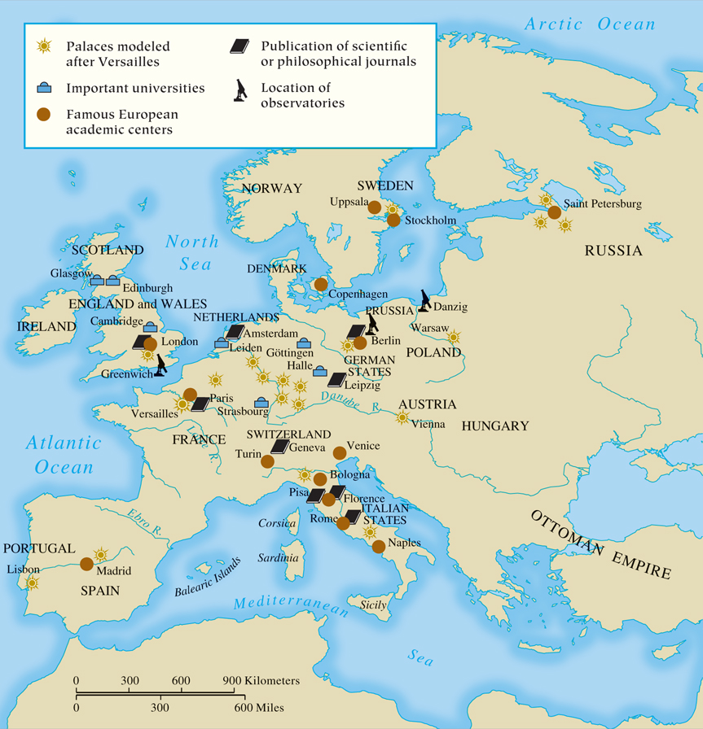
MAP 17.1 The Enlightenment in Europe
Map 17.1 p503
Notes:
MAP 17.1 The Enlightenment in Europe. ‘‘Have the courage to use your own intelligence!’’ Kant’s
words epitomize the role of the individual in using reason to understand all aspects of life—the
natural world and the sphere of human nature, behavior, and institutions.

Slide 9
The Philosophes and Their Ideas
Voltaire (1694 – 1778) and the Enlightenment
Born of middle class; became very wealthy
Middle class was very dissatisfied with Frech church and monarchy
Popular among the elite because of his razor sharp wit and humor
Philosophic Letters on the English (1733)
Indictment of French absolutism
Admired English government, freedom, and religious toleration
Views of women were very progressive
Wrote book on Newton’s philosophy with help of his mistress Emilie du Chatelet, a mathematician.
Criticism of traditional religion and intolerance
The Calas affair
Treatise on Toleration, 1763

Slide 10
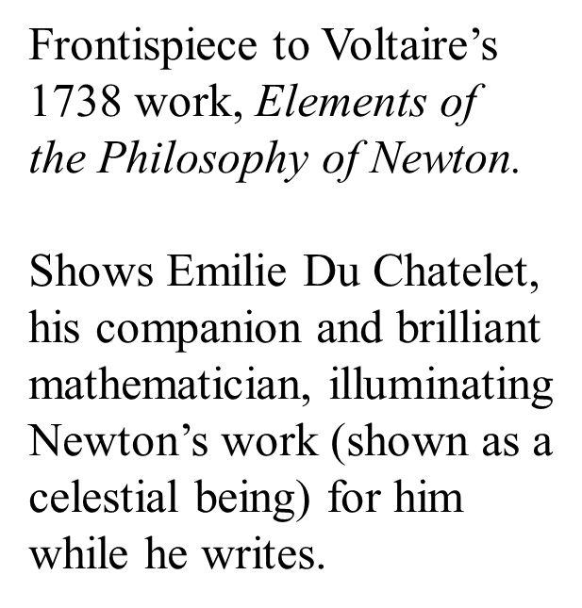

Slide 11
Voltaire and Religion
Criticism of traditional religion and intolerance
The Calas affair
Treatise on Toleration, 1763
“Whatever you do, crush the infamous thing [superstition and hypocrisy]! And love those who love you.”
Deism- belief in God as a creator of the “machine” universe, who set it to work, then allowed it to work according to its own natural laws, without interference or favor from Him.
God doesn’t work miracles or answer prayers.
Jesus is a good guy, but not divine. His teachings are important.
Not atheist.

Slide 12
Voltaire and his satires
Candide, or L’Optimisme (1759)
Is this “the best of all possible worlds”?
What is the point in improving it then?
Is everything God’s will? Who usually says so?
We can improve this wretched world by “cultivating our own garden”
We can still have hope without “blind optimism”
Satire and humor are used to call attention to important issues.
He was not the first satirist- Jonathan Swift of Ireland wrote A Modest Proposal in Dublin 30 years earlier (1729) about starving homeless orphans.

Slide 13
Leonard Bernstein’s Candide on Broadway

Slide 14
Stanton Wood’s play: Candide Americana

Slide 15
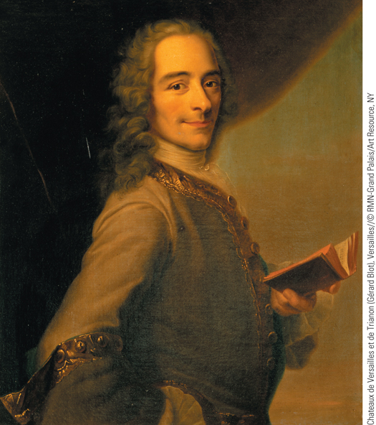
Voltaire
François-Marie Arouet, better known as Voltaire, achieved his first success as a playwright.
p504
Notes:
Voltaire. François-Marie Arouet, better known as Voltaire, achieved his
first success as a playwright. A philosophe, Voltaire was well known for
his criticism of traditional religion and his support of religious toleration.
Maurice-Quentin de La Tour painted this portrait of Voltaire holding one
of his books in 1736.

Slide 16
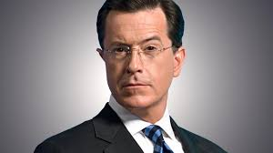

Slide 17
The Philosophes and Their Ideas
Denis Diderot (1713 – 1784) and the Encyclopedia
Goal: “change the general way of thinking”
Contributors to 28-volume collection expressed major concerns
Attacks on religious superstitions
Advanced a program for social, legal, and political improvements
Lowered price helped spread Enlightenment ideas

Slide 18
The Philosophes and Their Ideas
The New “Science of Man”
David Hume (1711 – 1776)
Observation of human nature
Natural Laws and Economics
François Quesnay (1694 – 1774)
Leader of the Physiocrats: natural economic laws
Primacy of agriculture
Rejection of mercantilism in favor of supply and demand

Slide 19
The Philosophes and Their Ideas
Adam Smith (1723 – 1790) and laissez-faire economics
The Wealth of Nations, 1776
People should exploit their own “greed” and ambition in order to expand the economy and wealth
“Enlightened self-interest”
Promotion of free trade
Government has only three basic functions
Protect society from invasion
Defend individuals from injustice and oppression
Keep up public works

Slide 20
 | Mercantilism | Physiocrats- Francois Quesnay | Adam Smith- Laissez-faire
What is wealth? | Gold, silver “Buillon” | Land (Agriculture) | Labor
Tariffs (taxes on imports) | Yes! We must protect our colonial trade. | Eh. Domestic economy is more important, but if you must import, you must. | No! Free trade is win-win!
Who controls the economy? | The monarch and nobility (the government) | The natural law of supply and demand. | The natural law of supply and demand.
Who benefits? | Tis all for the glory of the king and state: Absolutism | Landowners, and wealth will “trickle down” to the farmers. | Allegedly everyone- if you’re up for some competition.

Slide 21
The Philosophes and Their Ideas
The Later Enlightenment
Baron Paul d’Holbach (1723 – 1789)
A doctrine of atheism and materialism
Only reason necessary for life in this world
Marie-Jean de Condorcet (1743 – 1794)
The Progress of the Human Mind and the nine stages of history

Slide 22
The Philosophes and Their Ideas
Jean-Jacques Rousseau (1712 – 1778) and the Social Contract
Discourse on the Origins of the Inequality of Mankind
Preservation of private property enslaved people
Social Contract (1762)
Attempt to harmonize individual liberty with governmental authority
Governance by the general will
Émile (1762), precursor of Romanticism
Treatise advocating balance of sentiment and reason
Arguments about the natural inferiority of women

Slide 23
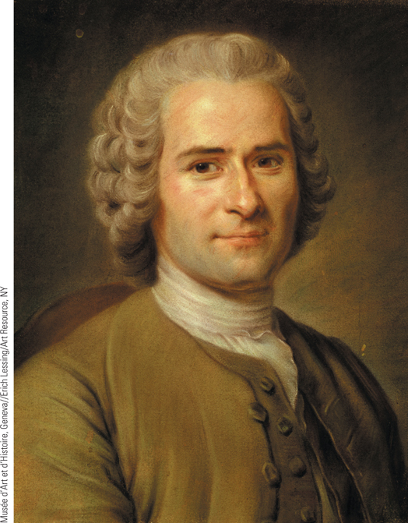
Jean-Jacques Rousseau
By the late 1760s, a new generation of philosophes arose who began to move beyond and even to question the beliefs of their predecessors. Of the philosophes of the late Enlightenment, Rousseau was perhaps the most critical of his predecessors.
p508
Notes:
Jean-Jacques Rousseau. By the late 1760s, a new generation of
philosophes arose who began to move beyond and even to question
the beliefs of their predecessors. Of the philosophes of the late
Enlightenment, Rousseau was perhaps the most critical of his
predecessors. Shown here is a portrait of Rousseau by Maurice-Quentin
de La Tour.

Slide 24
The Philosophes and Their Ideas
The “Woman’s Question” in the Enlightenment
General agreement among male writers that the nature of women made them inferior
More positive views offered by Diderot and Voltaire
Mary Astell (1666 – 1731)
A Serious Proposal to the Ladies (1697)
Better education and equality in marriage
Mary Wollstonecraft (1759 – 1797)
Founder of modern feminism
Vindication of the Rights of Woman (1792)
Subjection of women by men wrong

Slide 25
The Social Environment of the Philosophes
The Spread of Enlightenment Ideas
Appeal to aristocracy and upper middle classes
Common people little affected by the Enlightenment
The importance of publications and salons
The influence of women
Marie-Thérèse de Geoffrin (1699 – 1777)
Marquise du Deffand (1697 – 1780)
Other gathering places: coffeehouses, cafés, reading clubs, and public lending libraries

Slide 26
CHRONOLOGY Works of the Philosophes (Slide 1 of 2)
Work | Dates
Montesquieu, Persian Letters | 1721
Voltaire, Philosophic Letters on the English | 1733
Hume, Treatise on Human Nature | 1739–1740
Montesquieu, The Spirit of the Laws | 1748
Voltaire, The Age of Louis XIV | 1751
Diderot, Encyclopedia | 1751–1765
Rousseau, The Social Contract; Émile | 1762
Voltaire, Treatise on Toleration | 1763
Beccaria, On Crimes and Punishments | 1764
p510
Notes:
CHRONOLOGY Works of the Philosophes

Slide 27
CHRONOLOGY Works of the Philosophes (Slide 2 of 2)
Work | Dates
Holbach, System of Nature | 1770
Smith, The Wealth of Nations | 1776
Gibbon, The Decline and Fall of the Roman Empire | 1776–1788
Wollstonecraft, Vindication of the Rights of Woman | 1792
Condorcet, The Progress of the Human Mind | 1794

Slide 28
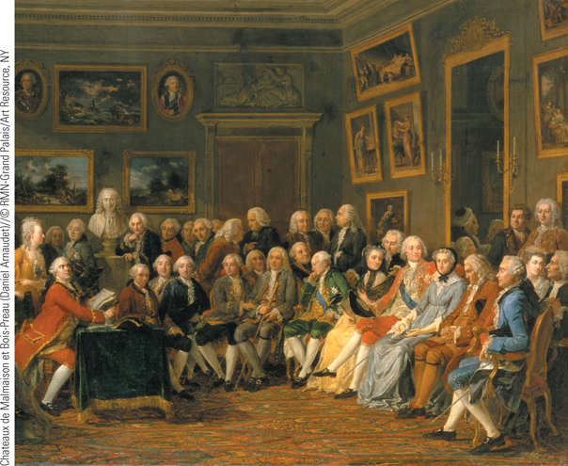
Images of Everyday Life: Women and the Enlightenment Salon
Madame Geoffrin is seen (third on the right) in her salon surrounded by philosophes in her home on the rue Saint-Honore.
p512
Notes:
Women and the Enlightenment Salon

Slide 29
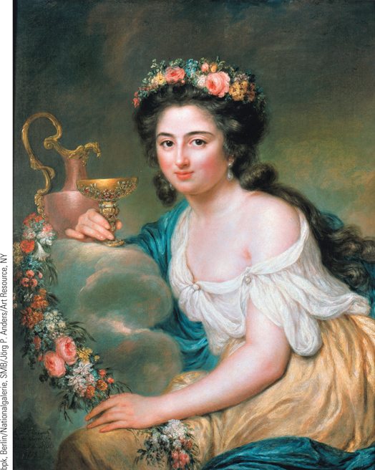
Images of Everyday Life: Women and the Enlightenment Salon
Henriette Herz’s father was the first Jewish physician to
practice in Berlin. Herz was one of many notable wealthy women
from Jewish families who sponsored salons in Berlin and Vienna.
p512
Notes:
Women and the Enlightenment Salon

Slide 30
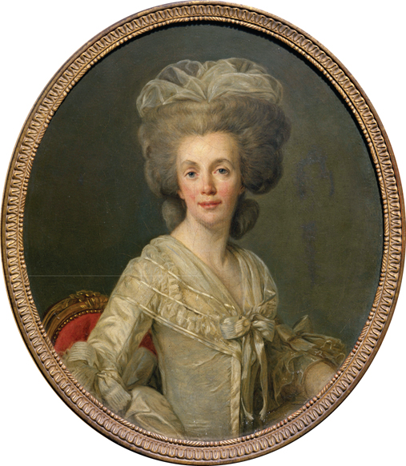
Images of Everyday Life: Women and the Enlightenment Salon
Suzanne Necker was the wife of financier Jacques Necker and spent her days preparing for the evening discussions by reading and writing in her journal.
p512
Notes:
Women and the Enlightenment Salon

Slide 31
Culture and Society in the Enlightenment
Innovations in Art, Music, and Literature
Rococo
Popularized by the Bourbons
Emphasized grace and gentle action
Subject: pursuit of pleasure, happiness, love
Unlike Baroque, which was large, heavy, and majestic (and for kings), Rococo was light, charming, depicted life of leisure- it was the nobility.
Often paired with Baroque architecture
Antoine Watteau (1684 – 1721)
Lyrical view of aristocratic life
Fragility and transitory nature of pleasure, love, and life

Slide 32
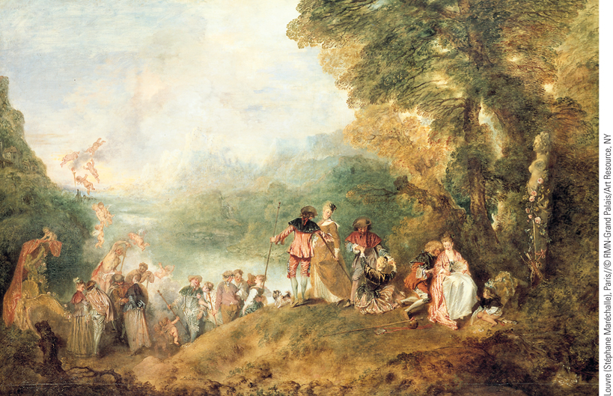
Antoine Watteau, Return from Cythera
Antoine Watteau was one of the most gifted painters in eighteenth-century France. His portrayal of aristocratic life reveals a world of elegance, wealth, and pleasure.
p513
Notes:
Antoine Watteau, Return from Cythera. Antoine Watteau was one of the most gifted painters in
eighteenth-century France. His portrayal of aristocratic life reveals a world of elegance, wealth, and pleasure.
In this painting, which is considered his masterpiece, Watteau depicts a group of aristocratic lovers about to
depart from the island of Cythera, where they have paid homage to Venus, the goddess of love. Luxuriously
dressed, they move from the woodlands to a golden barge that is waiting to take them from the island.

Slide 33
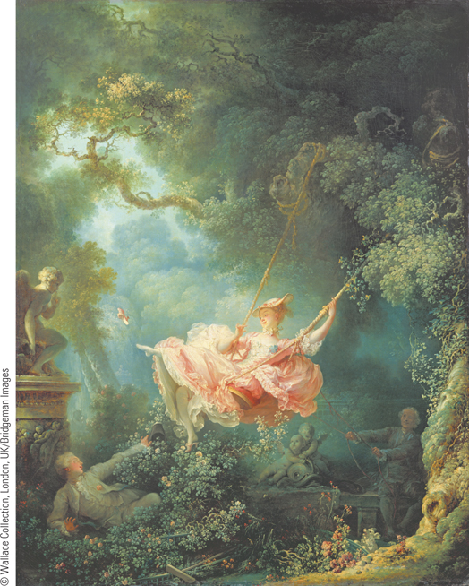
The Swing: Jean-Honoré Fragonard
Fragonard captured the frivolity and decadence of France’s aristocracy. In this painting, Fragonard portrays a young lady being pushed on a swing as her suitor sits below her.
p514
Notes:
Jean-Honoré Fragonard, The Swing. (p.514)
Fragonard captured the frivolity and decadence of France’s aristocracy. In this painting, Fragonard portrays a young lady being pushed on a swing as her suitor sits below her. The lush environs and curvilinear landscape epitomize Rococo’s love of nature, while the delicate light and color of the lady’s dress highlight the playful moment of her kicking off her shoe

Slide 34
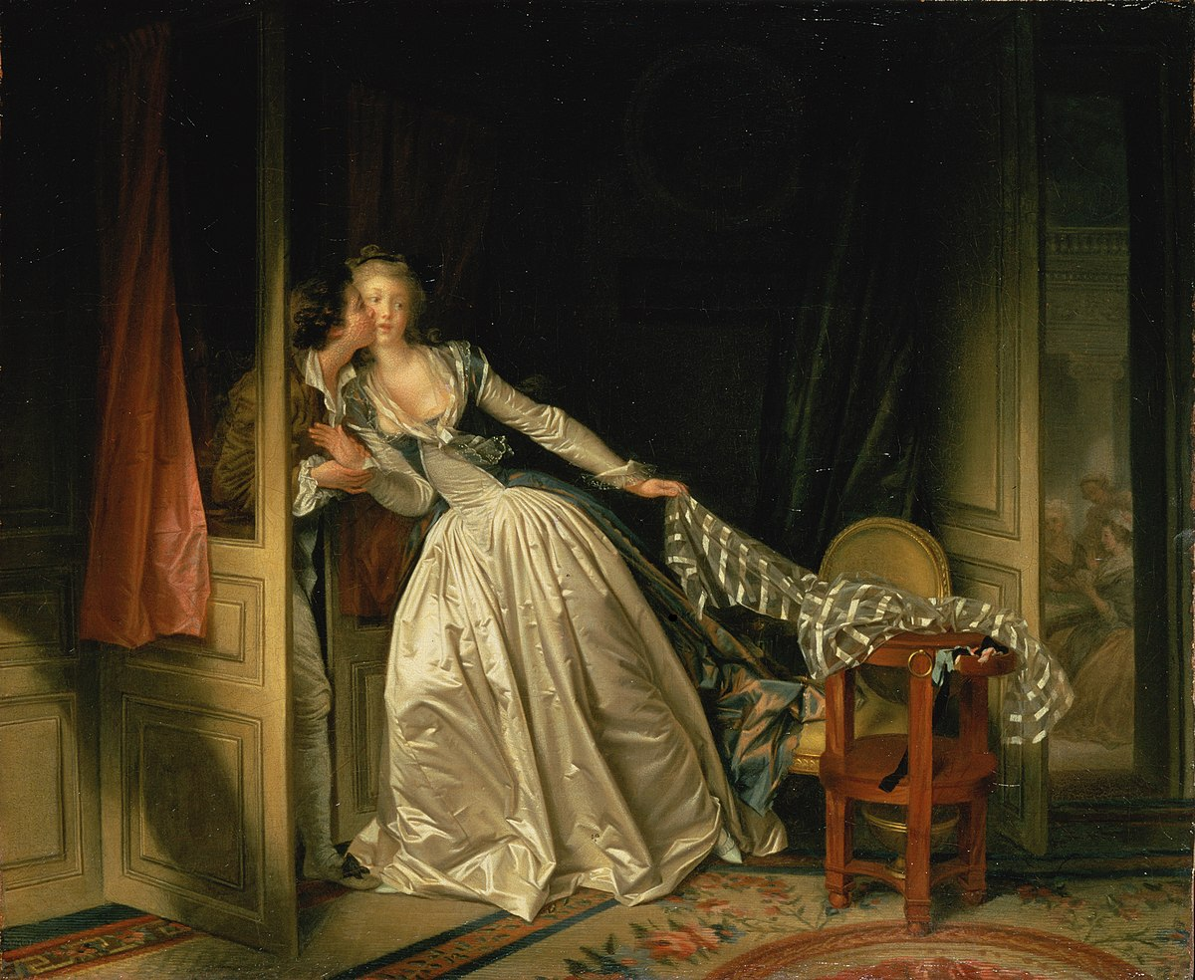
The Stolen Kiss: Jean-Honoré Fragonard

Slide 35
Diana Returning from the Hunt: Francois Boucher (1729)

Slide 36
St. Peter Attempting to Walk on Water: Francois Boucher (1766)

Slide 37
Dreaming Shepherdess: Francois Boucher (1763)

Slide 38
Portrait of Madame du Pompadour: Francois Boucher (1756)

Slide 39
Culture and Art
Baroque-Rococo architectural style
Balthasar Neumann (1687 – 1753)
Secular and spiritual interchangeable
Continuing appeal of Neoclassicism
Rejection of Baroque and Rococo; return to simplicity and “clean lines” of the classics
Inspired by recent excavation of Pompeii.
Glorified the Roman republic and patriotic duty
The Roman Republic was seen as ideal “republic of reason”, hence the popularity of “new” or “Neo” classicism.
Jacques-Louis David (1748 – 1825)

Slide 40
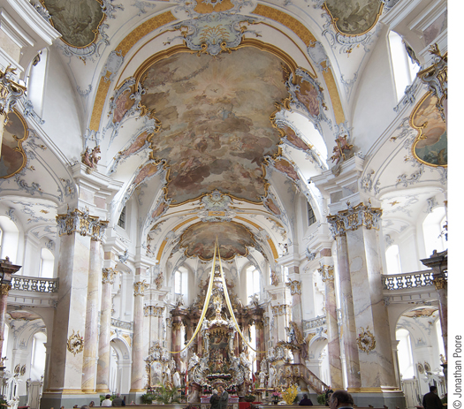
Vierzehnheiligen, Interior View
Pictured here is the interior of the Vierzehnheiligen, the pilgrimage church designed by Balthasar Neumann.
p514
Notes:
Vierzehnheiligen, Interior View. (p.514)
Pictured here is the interior of the Vierzehnheiligen, the pilgrimage church designed by Balthasar Neumann. Elaborate detail, blazing light, rich colors, and opulent decoration blend together to create a work of stunning beauty. The pilgrim in search of holiness is struck by an incredible richness of detail. Persuaded by joy rather than fear, the believer is lifted toward heaven on a cloud of rapture.

Slide 41
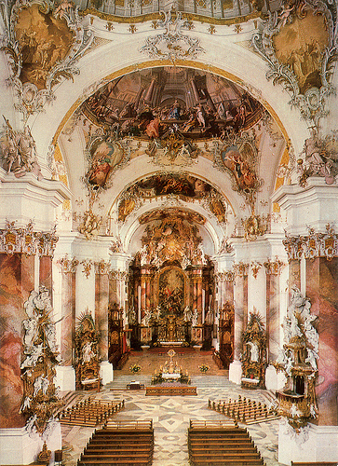
Basilica of Ottobeuren, Bavaria Germany

Slide 42
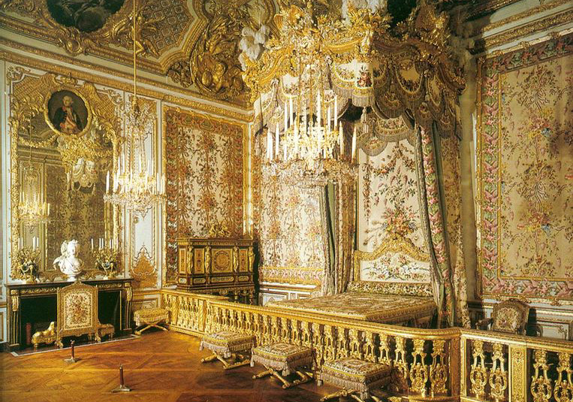
The Queen’s Bedroom at Versailles

Slide 43
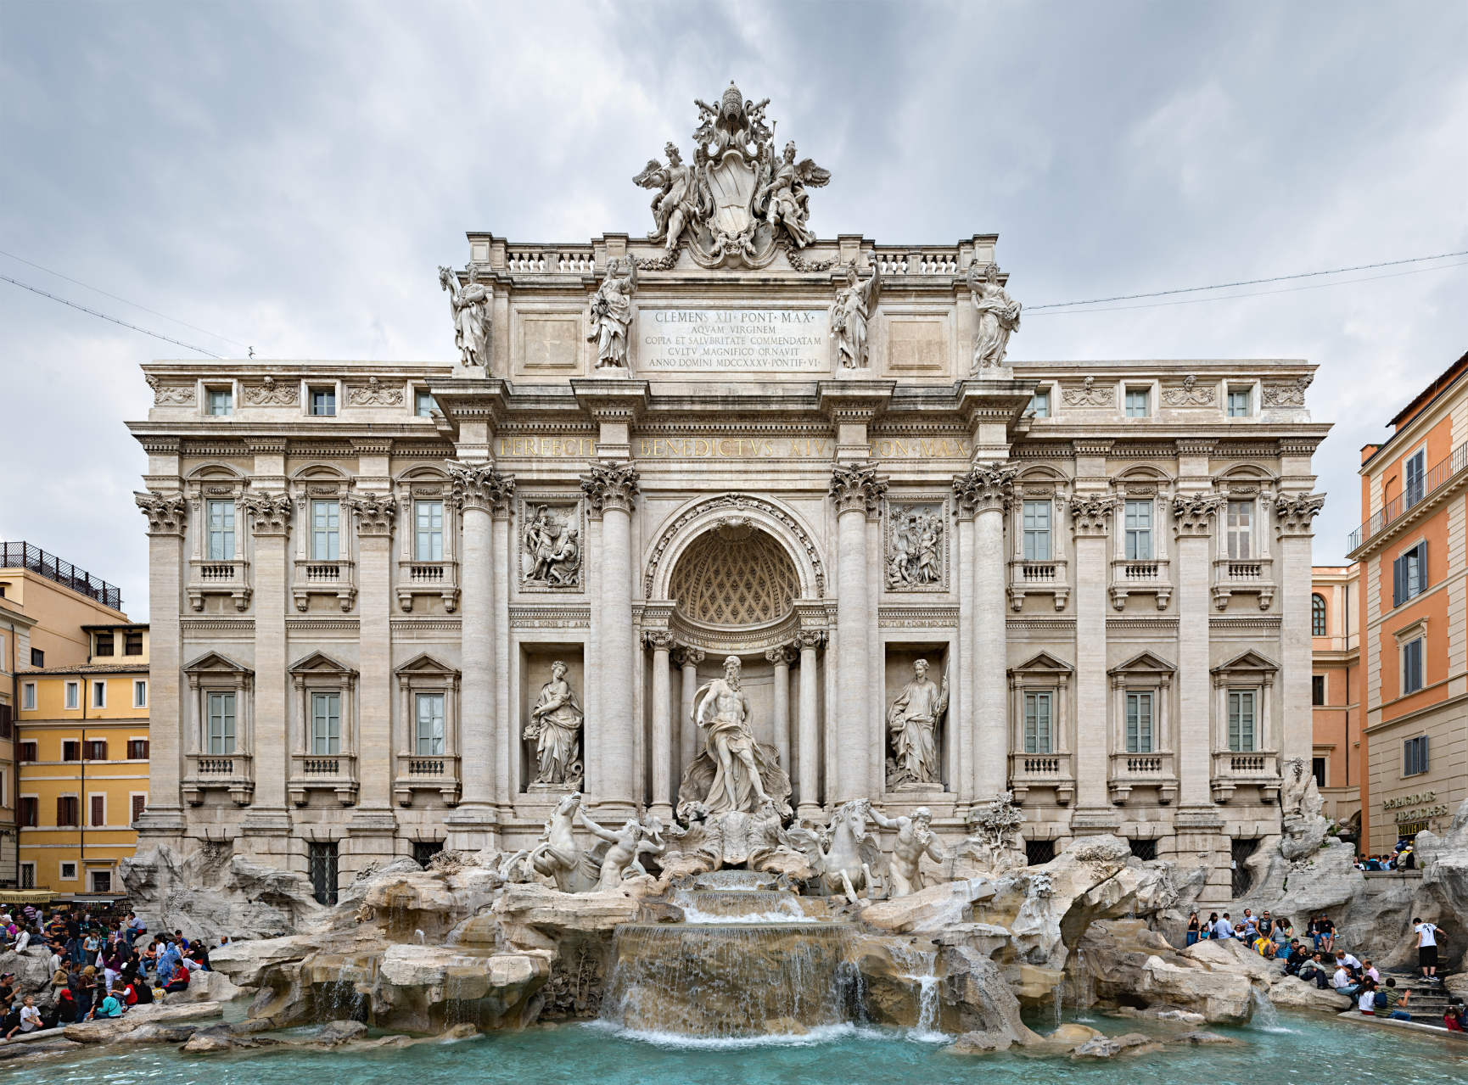
The Trevi Fountain, Rome, Italy

Slide 44
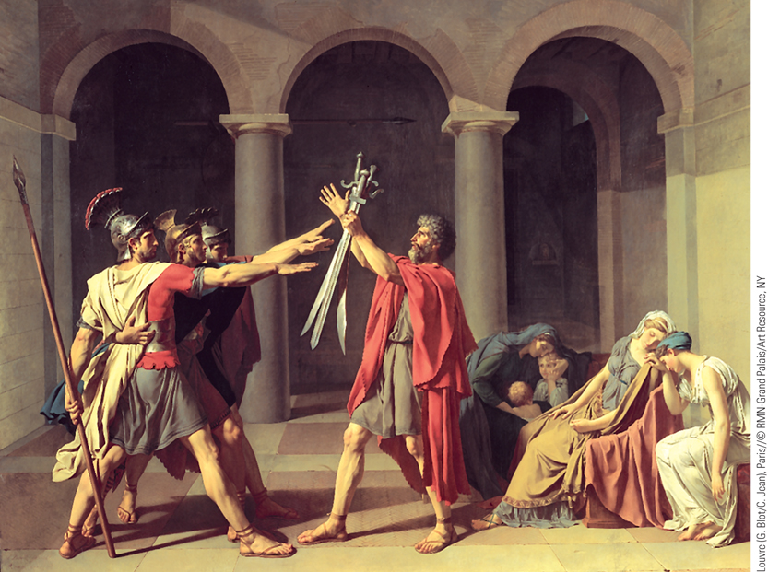
Jacques-Louis David, Oath of the Horatii
The Frenchman Jacques-Louis David was one of the most
famous Neoclassical artists of the late eighteenth century.
p515
Notes:
Jacques-Louis David, Oath of the Horatii. The Frenchman Jacques-Louis David was one of the most
famous Neoclassical artists of the late eighteenth century. To immerse himself in the world of Classical
antiquity, he painted the Oath of the Horatii in Rome. Thanks to its emphasis on patriotic duty, the work
became an instant hit in both Paris and Rome.

Slide 45
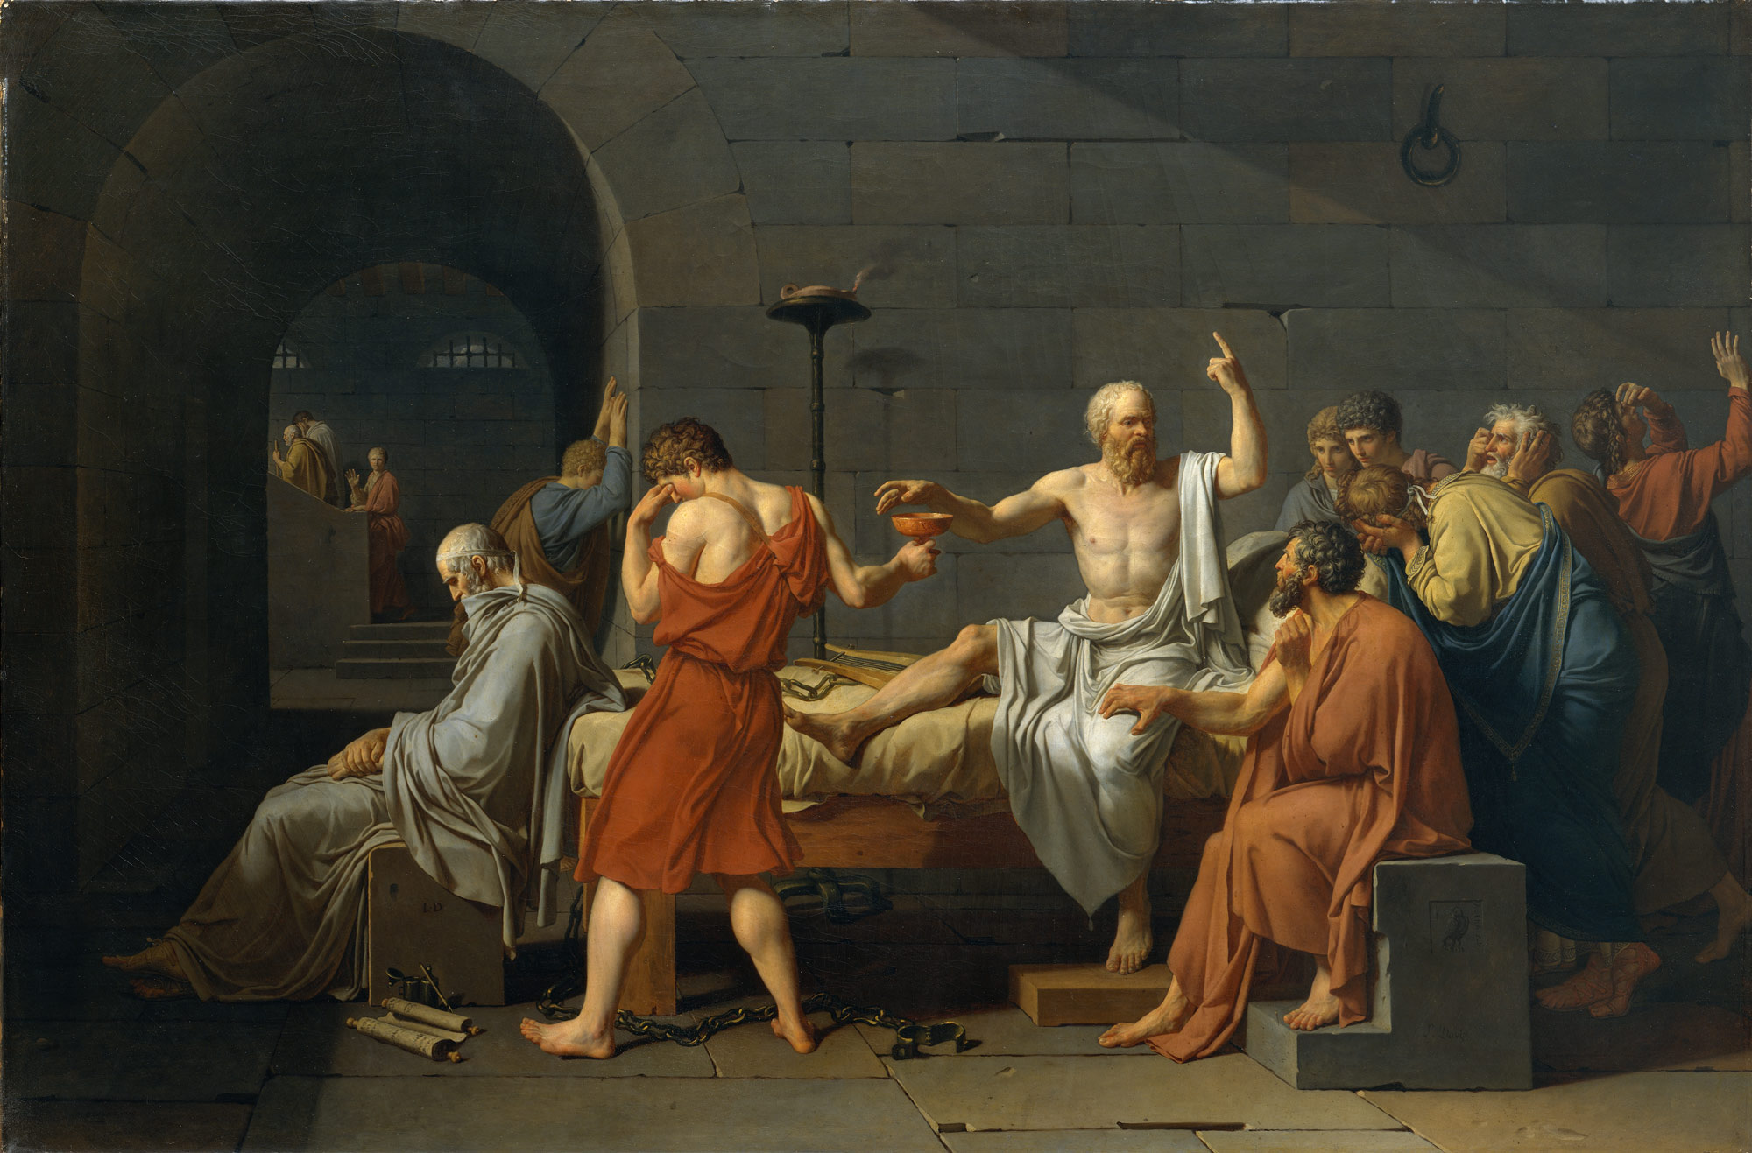
Jacques-Louis David; The Death of Socrates (1787)

Slide 46
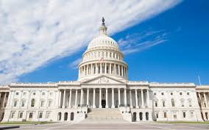
Neoclassical Architecture
The White House and U.S.
Capitol Buildings- started
construction in 1792.

Slide 47
Innovations in Art, Music, and Literature
The Development of Music
Domination of Baroque style (1600 – 1750)
Johann Sebastian Bach (1685 – 1750)
George Frederick Handel (1685 – 1759)
The classical era (1750 – 1830)
Franz Joseph Haydn (1756 – 1809)
Wolfgang Amadeus Mozart (1756 – 1791)

Slide 48
Innovations in Art, Music, and Literature
The Development of the Novel
The emergence of the modern novel
Literary experimentation
Samuel Richardson (1689 – 1761)
Virtue Rewarded
Henry Fielding (1707 – 1754)
The History of Tom Jones
The Writing of History
Broadening the scope of history
Voltaire’s Age of Louis XIV
Edward Gibbon (1737 – 1794)
Decline and Fall of the Roman Empire

Slide 49
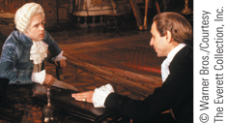
Film & History: Amadeus
Mozart (Tom Hulce) meets with Salieri (F. Murray Abraham).
p515
Notes:
Mozart (Tom Hulce) meets with Salieri (F. Murray Abraham).

Slide 50
The High Culture of the Eighteenth Century
Characteristics
Increased readership and publishing
Development of magazines and newspapers for the general public
Joseph Addison and Richard Steele’s Spectator
Female Spectator
Daily newspapers
Coffeehouses
Education and Universities
Perpetuated class hierarchy of Europe
Concentration on the classics
New middle class education

Slide 51
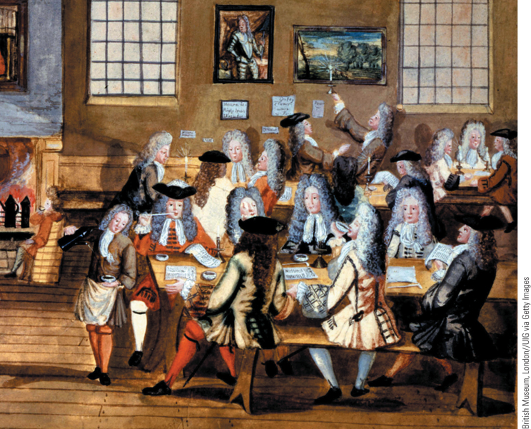
A London Coffeehouse
Coffeehouses first appeared in Venice and Constantinople but quickly spread throughout Europe by the beginning of the eighteenth century.
p517
Notes:
A London Coffeehouse. Coffeehouses first appeared in Venice and Constantinople but quickly spread
throughout Europe by the beginning of the eighteenth century. In addition to drinking coffee, patrons of
coffeehouses could read magazines and newspapers, exchange ideas, play chess, smoke, and engage in
business transactions. In this scene from a London coffeehouse of 1705, well-attired gentlemen make bids
on commodities.

Slide 52
Crime and Punishment
Punishment in the Early Eighteenth Century
Emphasis on torture and public spectacle
The Enlightenment Approach to Justice
Cesare Beccaria (1738 – 1794), On Crimes and Punishments
Punishment should serve only as deterrent
Punishment moved away from spectacle towards rehabilitation
Decline in both corporal and capital punishment by end of the century
The emergence of the prison

Slide 53
The World of Medicine
Practitioners and Their Hierarchy
Importance of education for physicians
University of Leiden: introduction of clinical experience
England’s Royal College of Physicians
Barber-surgeons: division
Apothecaries, midwives, and faith healers
Service to commoners
Hospital conditions
Appeals for reform ineffectual

Slide 54
Popular Culture
Characteristics: Collective and Public in Nature
Carnival
Time of indulgence, sexual license, and aggression
Taverns and Alcohol
Drinking habits differed between rich and poor
Literacy and Primary Education
Spread of literacy
State-supported primary schools
Connections between religion and education

Slide 55
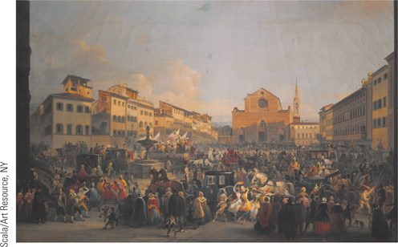
Global Perspectives: Popular Culture in the West and East
At the top is a scene from the celebration of Carnival on the Piazza Sante Croce in Florence, Italy.
p520
Notes:
(p.520) At the top is a scene from the celebration of Carnival on the Piazza Sante Croce in Florence, Italy.

Slide 56
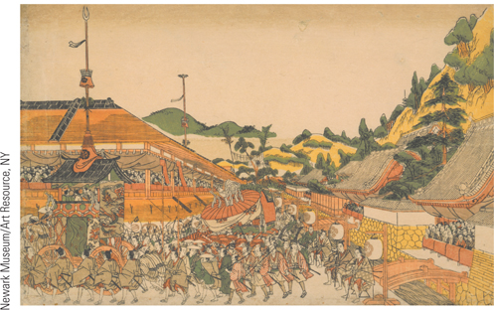
Global Perspectives: Popular Culture in the West and East
Above is a festival scene from the pleasure district of Kyoto known as the Gion. Spectators on a balcony are enjoying a colorful parade of floats and costumed performers.
p520
Notes:
(p.520) Above is a festival scene from the pleasure district of Kyoto known as the Gion. Spectators on a balcony are enjoying a colorful parade of floats and costumed performers.

Slide 57
Religion and the Churches
The Institutional Church
Conservatism of Catholic and Protestant Churches
Church-State Relations
The growth of state control
The end of the Jesuits
Toleration and Religious Minorities
Last burning of a heretic in 1781
Joseph II of Austria and Toleration Patent of 1781
Dutch Republic: Union of Utrecht of 1579; Declaration of Human Rights 1796

Slide 58
Religion and the Churches
Toleration and the Jews
Ashkenazic Jews: Primarily Eastern Europe
Faced many restrictions
Pogroms
Sephardic Jews: Expelled from Spain in 15th century
Settled in cities in Western and central Europe
Some very successful; “court Jews”
Some Enlightenment thinkers favored acceptance of the Jews
Joseph II: limited reforms toward the Jews

Slide 59
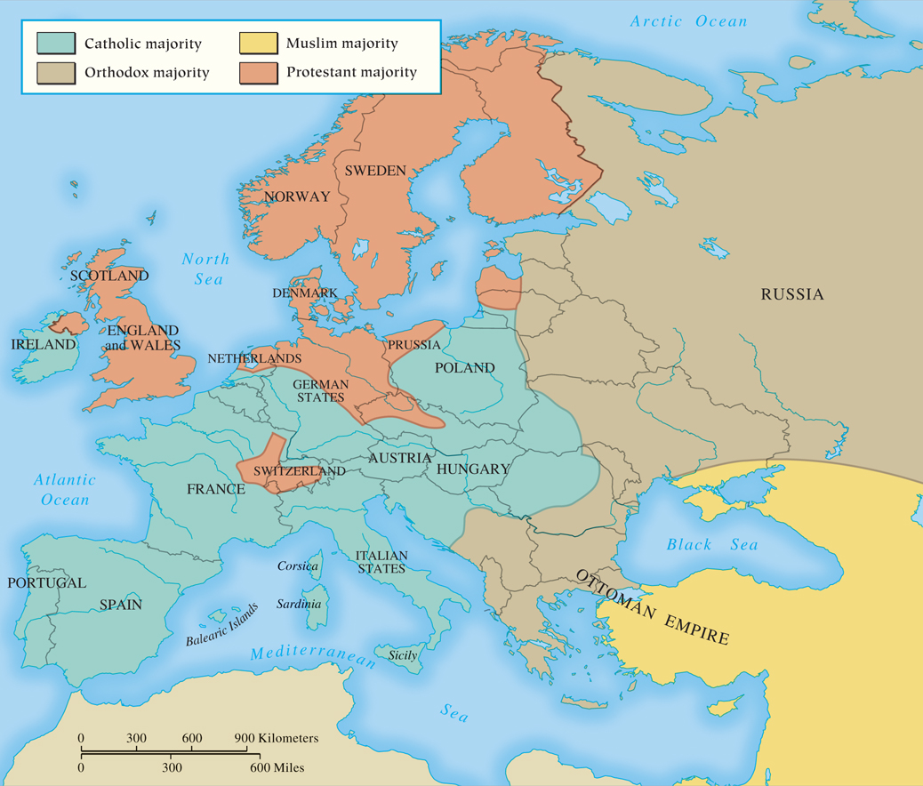
MAP 17.2 Religious Populations of Eighteenth-Century Europe
Map 17.2 p522
Notes:
MAP 17.2 Religious Populations of Eighteenth-Century Europe. Christianity was still a dominant
force in eighteenth-century Europe—even many of the philosophes remained Christians while attacking
the authority and power of the established Catholic and Protestant churches. By the end of the century,
however, most monarchs had increased royal power at the expense of religious institutions.

Slide 60
Popular Religion in the Eighteenth Century
Catholic Piety
Highly selective in nature
Popular devotion: the appeal of traditional ideas and practices
Protestant Revivalism: Pietism
Count Nikolaus von Zinzendorf (1700 – 1760)
John Wesley (1703 – 1791) and Methodism
The power of emotional mysticism
Brought the Gospel to the people
Methodist societies and the split from the Anglican Church

Slide 61
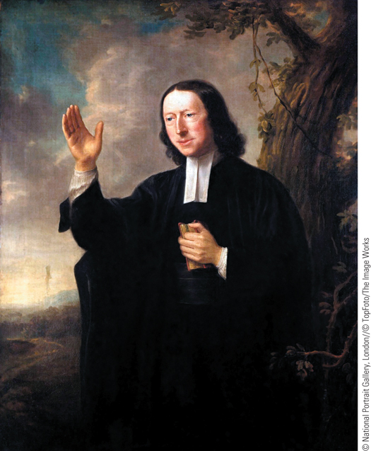
John Wesley
In leading a deep spiritual revival in Britain, John Wesley
founded a religious movement that came to be known as Methodism.
p523
Notes:
John Wesley. In leading a deep spiritual revival in Britain, John Wesley
founded a religious movement that came to be known as Methodism. He
loved to preach to the masses, and this 1766 portrait by Nathaniel Hone
shows him as he might have appeared before a crowd of people.

Slide 62
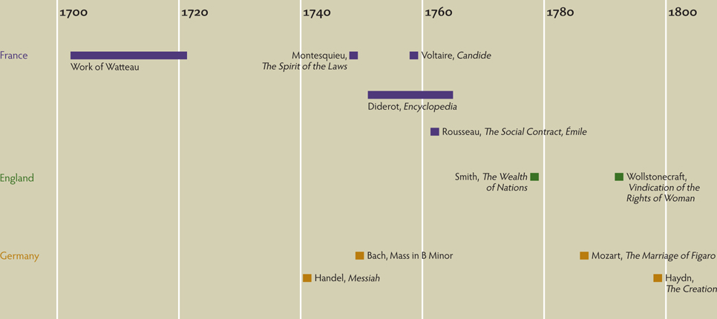
Chapter Timeline
p525

Slide 63
Discussion Questions
What do you see as a possible reason the Enlightenment was centered in France?
Why and when did it emerge?
Was there a connection between the Enlightenment and changes in gender relations throughout Western Europe?
How did the Enlightenment affect the idea of crime and punishment?

