Slide 1
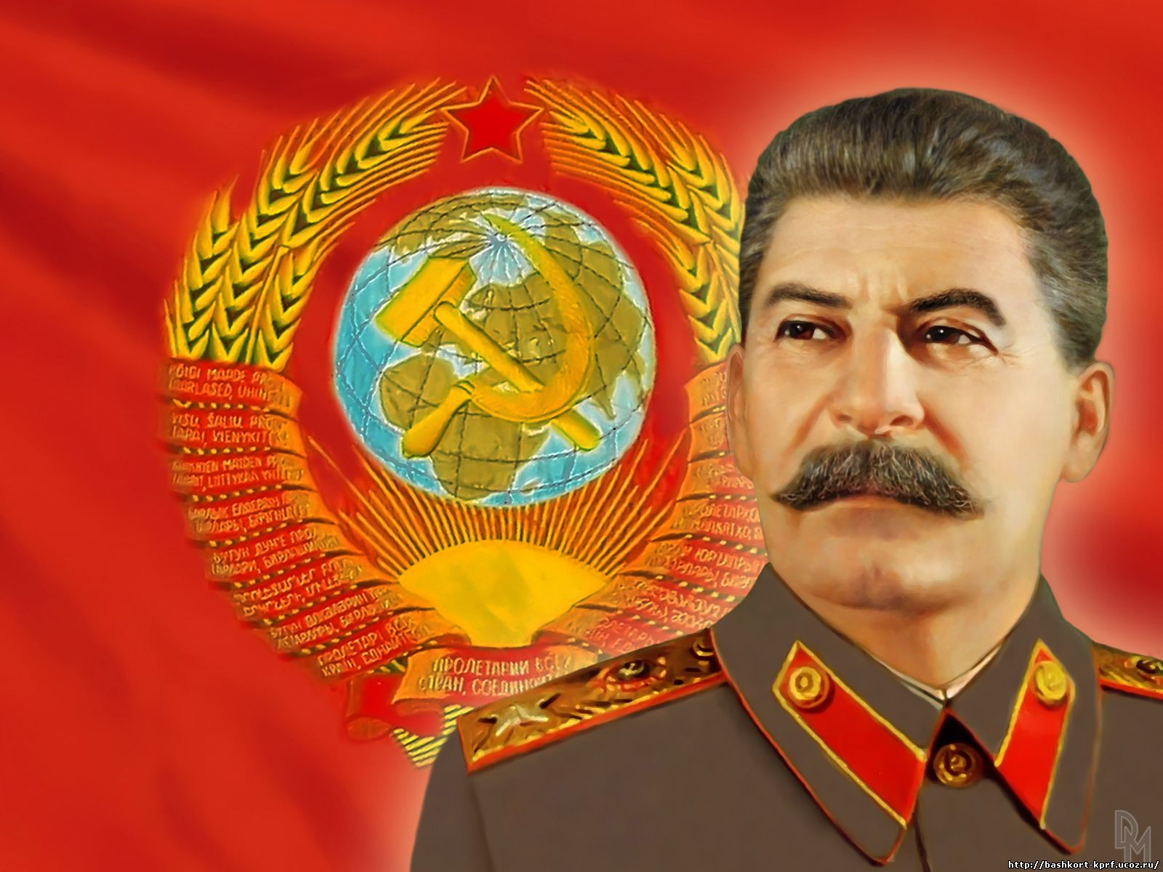
Stalin’s USSR
He will kill you!!!

Slide 2
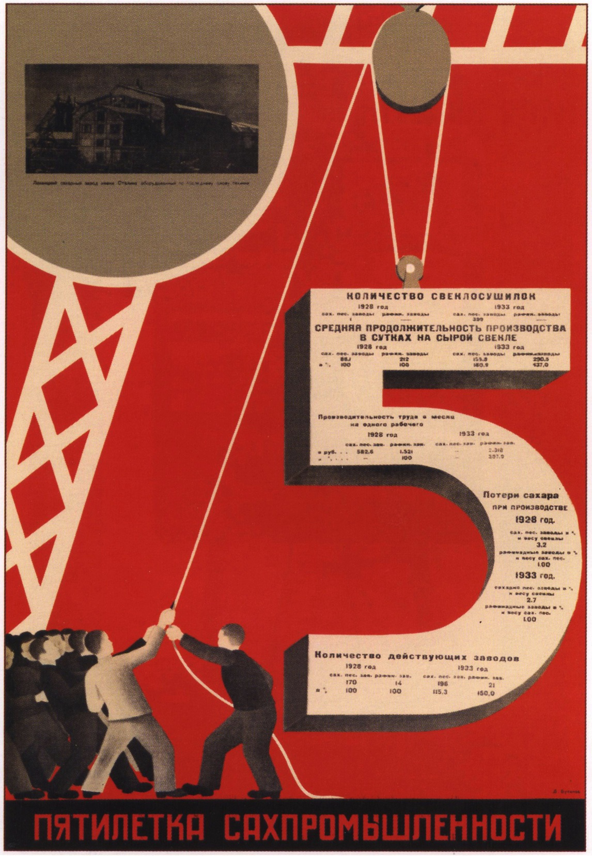
FIVE YEAR PLANS

Slide 3
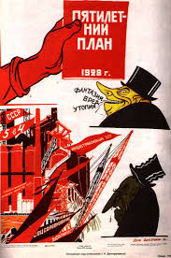
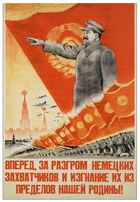
“We are 50 to 100 years behind the advanced countries. We must cover this distance in 10 years.” - Stalin

Slide 4
COLLECTIVE FARMS

Slide 5
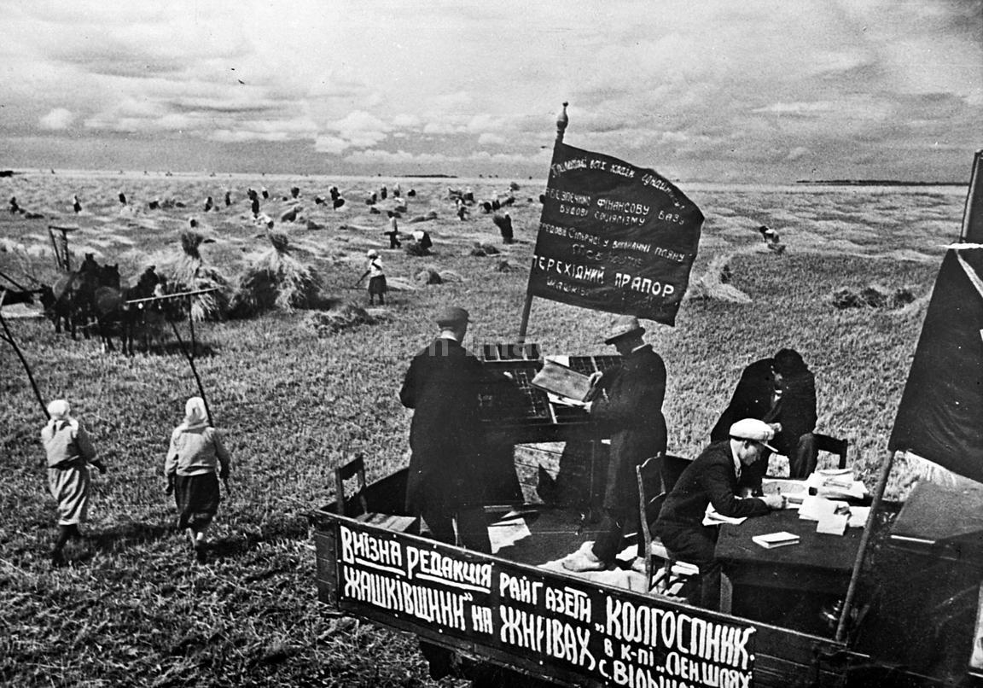
COLLECTIVE FARMS

Slide 6
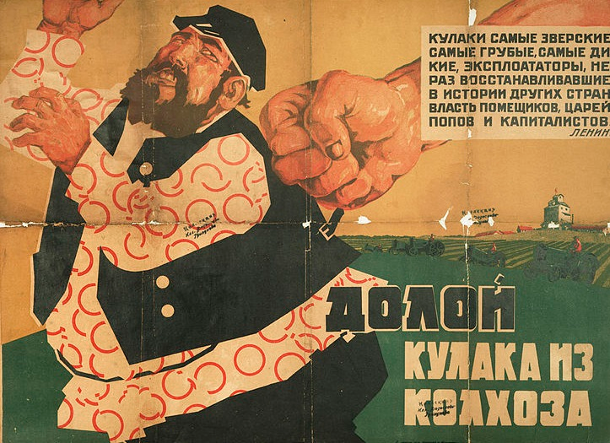
Propaganda for De-Kulakization

Slide 7
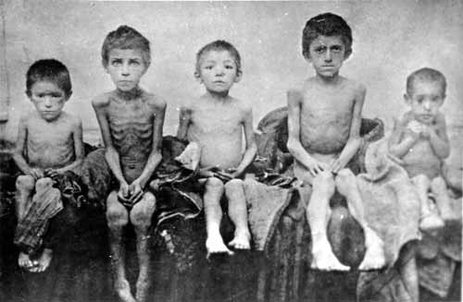
Ruthless policies against the kulaks in Ukraine. 1933.

Slide 8
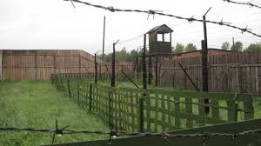
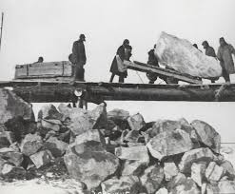
Terrorist tactics: The Gulag

Slide 9
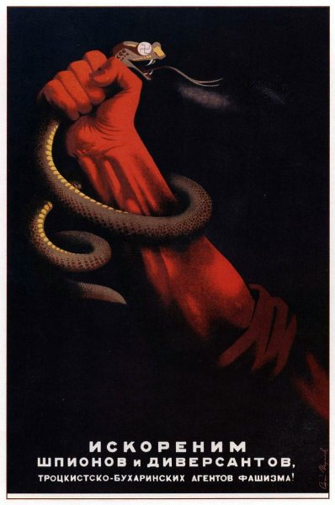
Terrorist tactics: Show trials and “The Great Purge”

Slide 10
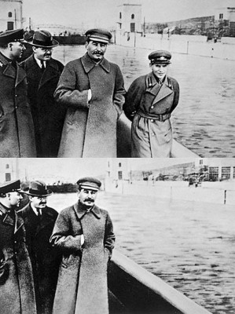
The Great Purge

Slide 11
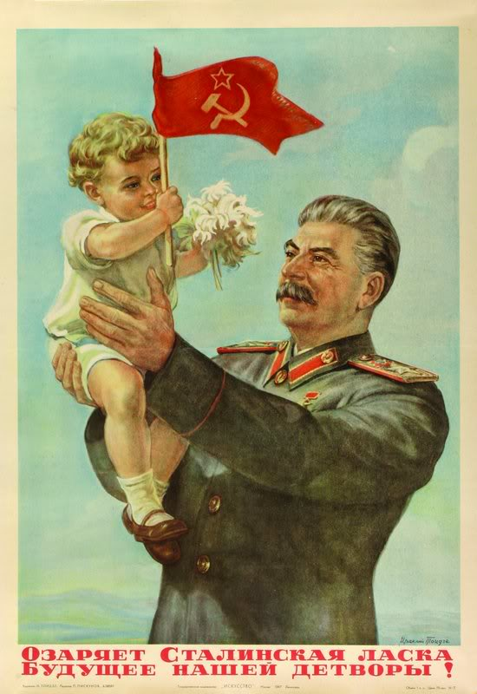
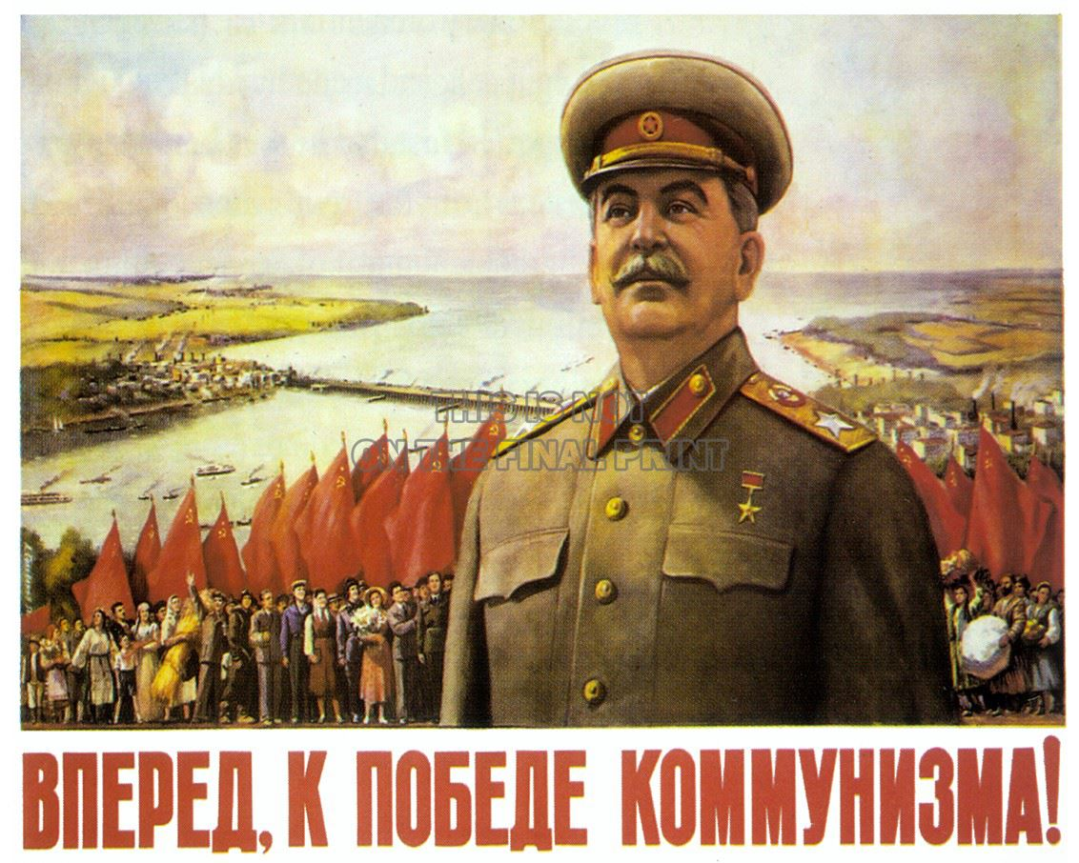
Propaganda: Socialist Realism

Slide 12
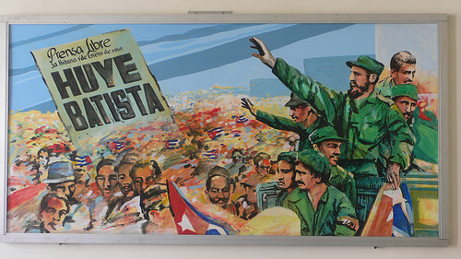
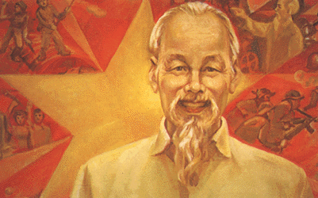
Socialist Realism
Cuba
North Korea
Vietnam
China

Slide 13
The Soviet Union

Slide 14
Peoples of the Soviet Union

